Slide 2
VESTIGE MARKETING PLAN
4 Fold Bonus Marketing Plan
• Cumulative Plan
• Only promotions, no demotions
• Never reaches zero
• No re-qualification
(One time achievement)
• Director Bonus compresses downward
• Leadership bonus roll-up
• No Renewal
• Engineered to make you wealthy

Slide 3
4 FOLD BONUS MARKETING PLAN
How do you start earning this income?
No registration fee is charged. Just buy products of your choice and do personal business of 350 BV within 30 days to complete the registration process and become a valid Vestige Distributor.
Return Policy
Customers can return products for full refund within 30 days from the date of purchase. 10% of the DP would be deducted as service charges.

Slide 4
ENRICHMENT PLAN
7 WAYS OF INCOME
Retail Profit 10 - 20%
Performance Bonus 5 – 20%
Director Bonus 14%
Leadership Overriding Bonus 15%
Car Fund 5%
House Fund 3%
Travel Fund 3%

Slide 5
1.RETAIL PROFIT
Distributor Price + Retail Profit = MRP
Rs. 250 + Rs. 50 = Rs. 300

Slide 6
2.VESTIGE PERFORMANCE BONUS
PERFORMANCE BONUS LEVEL | ACCUMULATIVE PV |  | ACCUMULATIVE BV |  | % ACHIEVEMENT
 | MIN | MAX | MIN | MAX
Distributor | 1 | 500 | 16 | 8,000 | 5%
Distributor | 501 | 2,000 | 8,016 | 32,000 | 8%
Distributor | 2,001 | 4,500 | 32,016 | 72,000 | 11%
Senior Distributor | 4,501 | 7,500 | 72,016 | 1,20,000 | 14%
Asst. Director | 7,501 | 10,000 | 1,20,016 | 1,60,000 | 17%
Director | 10.001+ |  | 1,60,016+ |  | 20%
ADDITIONAL ADVANTAGE
EXAMPLE OF HOW CUMULATION WORKS
Single Month | Fast Start
4500 BV | 8 %
1,20,016 BV | 20 %
Month | BV | Acc BV | % | EARNINGS
1 | 40,000 | 40,000 | 11 % | Rs. 4,400
2 | 40,000 | 80,000 | 14 % | Rs. 5,600
3 | 41,000 | 1,21,000 | 17 % | Rs. 6,970
4 | 40,000 | 1,61,000 | 20 % | Rs.8,000

Slide 7
3.VESTIGE DIRECTOR BONUS
DIRECTOR BONUS - 14%
Status | Director Groups | Qualifying Conditions | QUALIFIED DIRECTOR LEVEL IN %
 |  |  | You | 1 | 2 | 3 | 4 | 5 | 6 | 7 | 8 | 9
Director | - | PS: 600 BV PGS : 2,001 PV | 6
Silver Director | 1 | PS: 600 BV PGS : 1801 PV | 6 | 5 | 4
Gold Director | 2 | PS: 600 BV PGS : 1501 PV | 6 | 5 | 4 | 3
Star Director | 3 | PS: 600 BV PGS : 1001 PV | 6 | 5 | 4 | 3 | 2
Diamond Director | 4 | PS: 600 BV PGS : 501 PV | 6 | 5 | 4 | 3 | 2 | 1
Crown Director | 6 | PS: 600 BV | 6 | 5 | 4 | 3 | 2 | 1 | .5
Universal Crown Director | 8 | PS: 600 BV | 6 | 5 | 4 | 3 | 2 | 1 | .5 | .5
Double Crown Director | 12 | PS: 600 BV | 6 | 5 | 4 | 3 | 2 | 1 | .5 | .5 | .5
Double Universal Crown Director | 16 | PS: 600 BV | 6 | 5 | 4 | 3 | 2 | 1 | .5 | .5 | .5 | .5

Slide 8
3.VESTIGE DIRECTOR BONUS
You
24,016 BV
6%
28,816 BV
5%
28,816 BV
5%
Dynamic Compression - BV of non-qualified Directors
is compressed till qualified
DIRECTORS TO DETERMINE LEVELS!
32,016 BV
4%
28,816 BV
4%
32,016 BV
3%
14% of company monthly BV
Total No. of DB Points
Director Bonus =
= Point Value

Slide 9
4.VESTIGE LEADERSHIP BONUS
LEADERSHIP OVERRIDING BONUS – 15%
28,816 BV
Status | Director Groups | Qualifying Conditions | SD | GD | Star | DD | CD | UCD | DCD | DUCD
Silver Director | 1 | GBV 90,000 | 5
Gold Director | 2 | GBV 90,000 | 5 | 5
Star Director | 3 | GBV 90,000 | 5 | 5 | 5
Diamond Director | 4 | GBV 90,000 | 5 | 5 | 5 | 4
Crown Director | 6 | GBV 90,000 | 5 | 5 | 5 | 4 | 3
Universal Crown Director | 8 | GBV 90,000 | 5 | 5 | 5 | 4 | 3 | 2
Double Crown Director | 12 | GBV 90,000 | 5 | 5 | 5 | 4 | 3 | 2 | 1
Double Universal Crown Director | >=16 | GBV 90,000 | 5 | 5 | 5 | 4 | 3 | 2 | 1 | .5
You
32,016 BV
28,816 BV
48,016 BV
ROLL UP TO ENSURE INCOME
15% of company monthly BV
Total No. of LOB Points
Leadership Bonus =
= Point Value

Slide 10
5.VESTIGE TRAVEL FUND

Slide 11
5.VESTIGE TRAVEL FUND
TRAVEL FUND – 3%
You
28,816 BV
32,016 BV
3% of company monthly BV
Total No. of TF Points
Travel Fund =
= Point Value

Slide 12
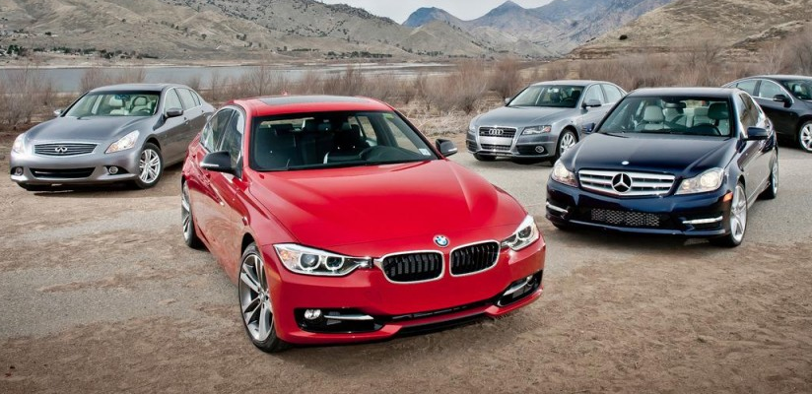
6.VESTIGE CAR FUND

Slide 13
6.VESTIGE CAR FUND
STAR DIRECTOR
CAR FUND – 5%
16,016 BV
You
CONTINUOUSLY MAINTAIN FOR
3 MONTHS & QUALIFIED FOR LIFE
32,016 BV
32,016 BV
32,016 BV
5% of company monthly BV
Total No. of CF Points
Car Fund =
= Point Value

Slide 14
7.VESTIGE HOUSE FUND

Slide 15
7.VESTIGE HOUSE FUND
CROWN DIRECTOR
HOUSE FUND – 3%
CONTINUOUSLY MAINTAIN FOR
3 MONTHS & QUALIFIED FOR LIFE
You
32,016 BV
32,016 BV
32,016 BV
32,016 BV
32,016 BV
32,016 BV
3% of company monthly BV
Total No. of HF Points
House Fund =
= Point Value

