Slide 1


Frequently Asked Questions

Slide 2
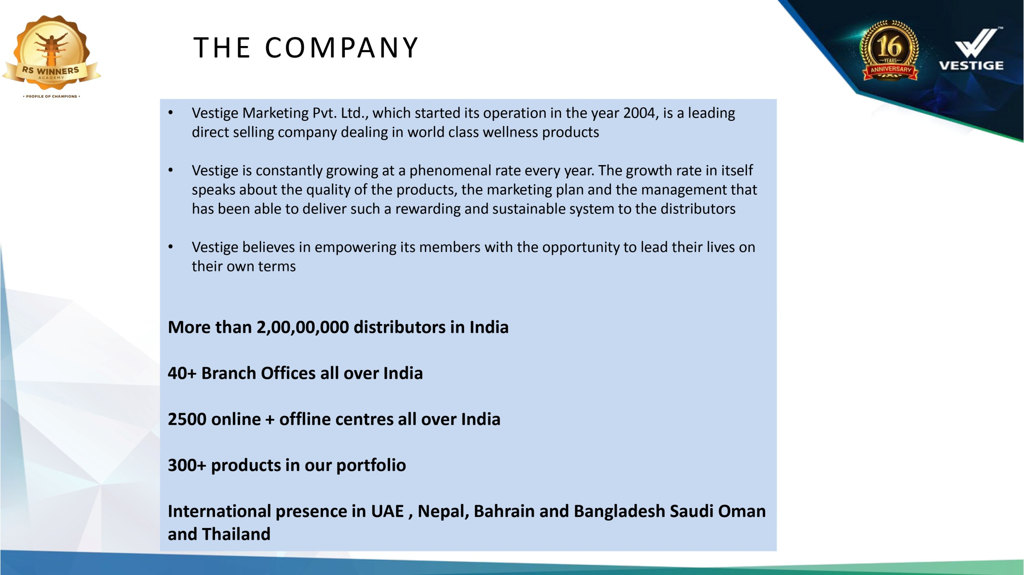
About Vestige ?

Slide 3
How to join Vestige and what is joining procedure?
Anyone above 18 years can join Vestige. There is no joining fee or renewals. A first purchase of 30PV is mandatory to activate your lifetime distributor ID.
After registration, a unique distributor ID will be issued to you along with the password, which can be used on the official website of Vestige to check your business related information such as Profile, Points, Downlines, Bonus, Updated News, Training, Branches, etc.

Slide 4
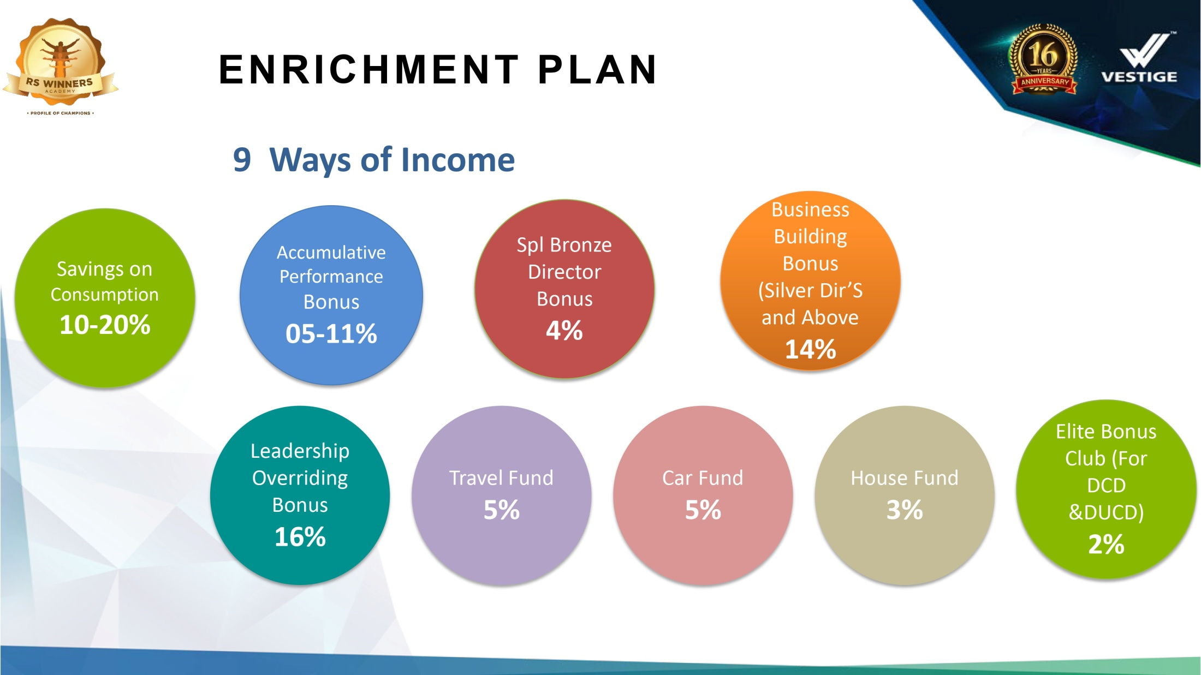
What are the type of income available in Vestige ?

Slide 5
What are the level in Vestige ?
Level | Director Group
Bronze Director
Silver Director | 1
Gold Director | 2
Star Director | 3
Diamond Director | 4
Crown Director | 6
Universal Crown Director | 8
Double Crown Director | 12
Double Universal Crown Director | 16

Slide 6
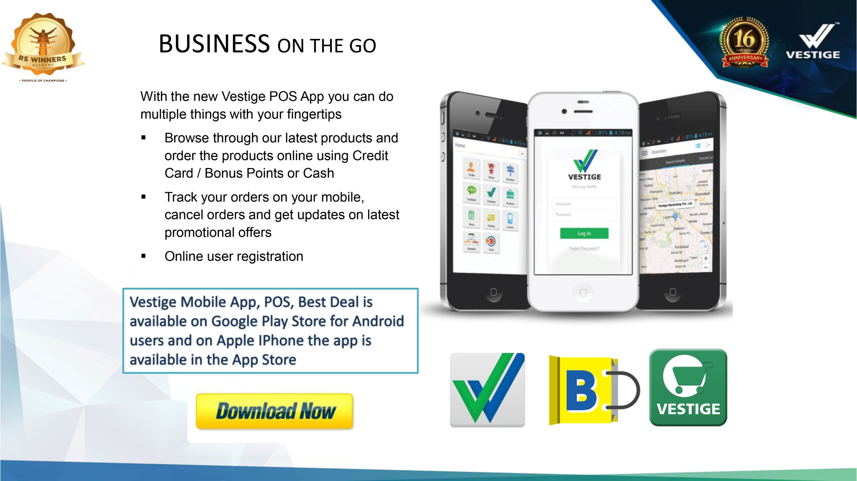
Do we have Mobile app for Vestige ?

Slide 7



What are the Mobile app that I need to install for Vestige?
1. Vestige Online Shopping App
https://play.google.com/store/apps/details?id=com.vestigeshopping&hl=en
2. Vestige POS
https://play.google.com/store/apps/details?id=com.vestige.ui.webandroidpos&hl=en
3. Vestige Best Deal
https://play.google.com/store/apps/details?id=com.myvestige.vestigedeal&hl=en
4. You can place online Order and Online Joining, Update DAF and KYC through
https://shop.myvestige.com/
You can login using your Distributor ID and Password

Slide 8
Do I have to renew the Distributorship ?
No. There is no renewal, It is a life time ID.

Slide 9
Can I use my distributor ID for other countries?
Yes, Vestige distributor ID is an International ID, which can be used to do business in all countries wherever Vestige offices are available.

Slide 10
What is DAF ?
DAF = Distributor Application Form, which needs to be signed by the distributor and submitted offline and now you can submit it online too.

Slide 11
Which documents are required for KYC ?
As per Government of India guidelines, if you are joining as a Consumer/Distributor, you will have to submit clear attested copies of the following to activate your ID.
Address Proof
Aadhar Card / Driving License / Voter ID / Passport [which has your address mentioned in it]
PAN Card and bank account linking [To receive your bonus in your account]-
PAN Card,
Bank passbook or cancelled cheque [IFSC, Account Number and Name should be printed on it]

Slide 12
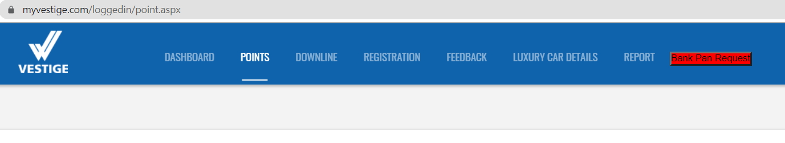
How do I receive my monthly bonus ?
You can update your bank details with Vestige, then every month 10th you will receive you bonus in your bank account.
We required PAN and bank passbook or cheque leaf, to update your Bank and PAN details with Vestige.
You can directly upload and update your bank and PAN details when you login to www.myvestige.com

Slide 13
Is there any minimum PV required to receive my monthly bonus?
Yes,
From 5% to 10% you need to maintain minimum 20 PV as SPV (Self PV)
From 11% above ( Bronze Director ) you need to maintain minimum 40 PV as SPV
What happens to my bonus amount if I’m not able to maintain this minimum PV ?
Your performance bonus will be added in your Vestige account, and the same will be transferred you, when you maintain your Self PV in the coming months.

Slide 14
What is PV/BV Ratio in India? Is it same for other countries also?
PV = Point Value
BV = Business Volume
PV : BV ratio in India 1 : 18
PV : BV ratio in Dubai, Bahrain, Saudi Arabia, Oman 1 : 28
The PV : BV ratio may be different in other countries, Bonus Payout in all countries will be calculated based on their respective PV : BV

Slide 15
How to I get products and marketing plan knowledge?
We conduct regular meetings and trainings once you become Distributor with our team. You can fix the One to One meeting or join our team meeting to know more about Vestige opportunity.
Watch our CNT Presentation Video to know more about Vestige.
https://www.youtube.com/watch?v=wlgBiCoYOhw

Slide 16
How to find new prospects & how to start Vestige business?
Write the names in a list which should include your friends and relatives, and start the business.
Approach your upline or the super upline of your sponsorship line.
Your Uplines are always ready to support you and guide you to know how to develop the Business.
Watch our NDO Video ( New Distributor Orientation ) to know how to start Vestige Business.

Slide 17
How can I register new distributor in my team ?
Collect the following details from new member to join with Vestige.
Name:
Date of Birth:
Address:
City:
State:
Pin Code:
Mobile Number:
Email ID:
ID Proof:
You can register new Distributor using Vestige Mobile app or http://shop.myvestige.com/

Slide 18
How to update DAF and KYC of my downline?
DAF – Distributor Application form
KYC - Know your customer
You can Update using Vestige Mobile app or http://shop.myvestige.com/

Slide 19
Is courier service free?
For joining new members courier is free all over the India, for repurchase if the order amount less then Rs. 4000/- then Rs. 65/- will apply for courier charge. When the order amount is more than Rs. 4000/- courier is free all over the India.

Slide 20
What is Vestige System ?
Vestige System is very simple & most essential for success in Vestige. It has 7 steps which needs to be followed daily.
Consume the Products
Share the Products
Make a List
Invite the People
Share the Opportunity
Team Work
Follow Up

Slide 21
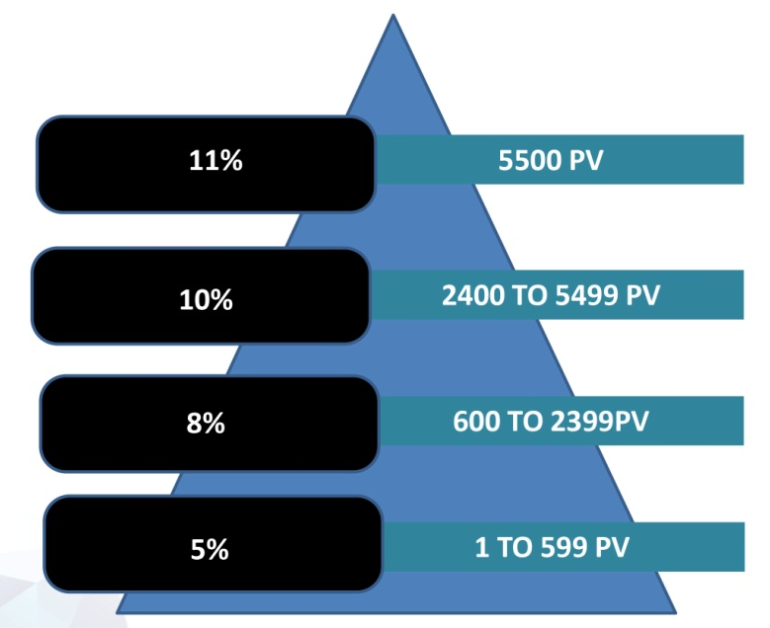
What is Fast Start 8% ?
Normal procedure to reach 8% level is 600 PV. When a distributor does GPV of 282 PV in single month before reaching 8% level, he/she is qualified as Fast Start 8% also he /she will get Rs. 800/- worth of gift products from Company.
If a qualifying distributor has a down line also qualifying for fast start 8% then Upline has to maintain personal 282 PV or from other lines.

Slide 22

What is Fast Start Bronze Director?
The normal procedure to reach Bronze Director Level 5500 PV Required, If any one achieve 4500 PV in single business month they will qualify for fast start Bronze Director.

Slide 23
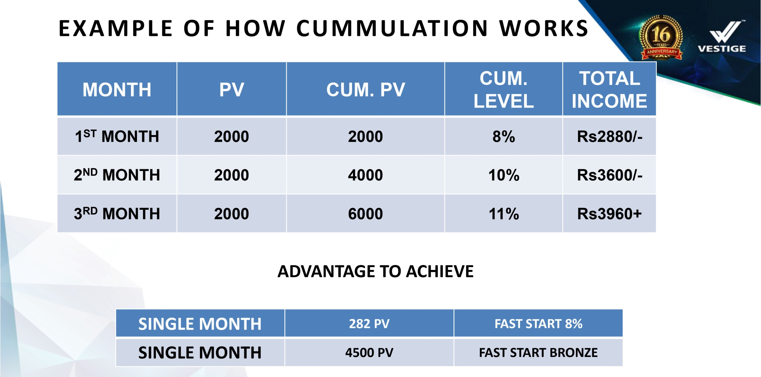
What is Accumulation PV ?
Vestige provides accumulated PV feature in its business plan which means your points will not reset to zero, it will carry forward every month and you will move forward towards your next levels based on your team performance.

Slide 24
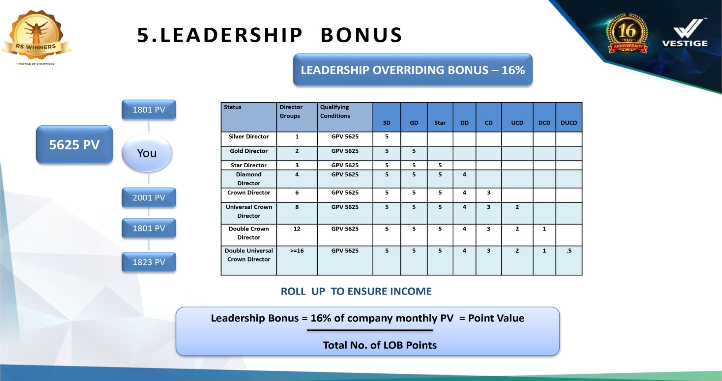
What is LOB and who is eligible for LOB?
LOB = Leadership Overriding Bonus
LOB is payable to Silver Director and above, to qualify LOB you should have personal purchase 40 PV and 5,625 PV from single downline group.

Slide 25
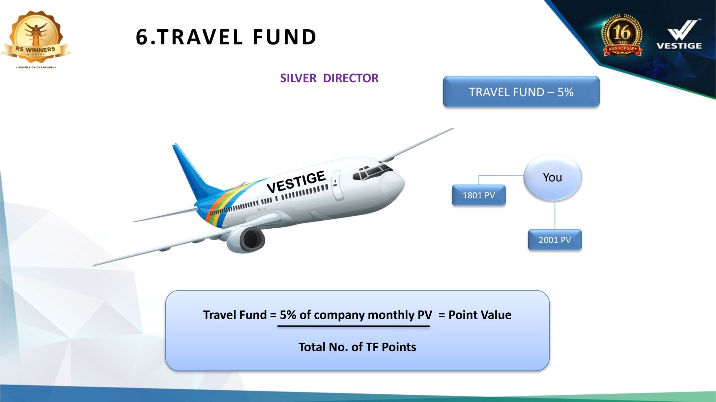
What is Travel Fund?
Vestige provides Travel fund to Silver Director and above, you can use this amount for foreign trips.

Slide 26
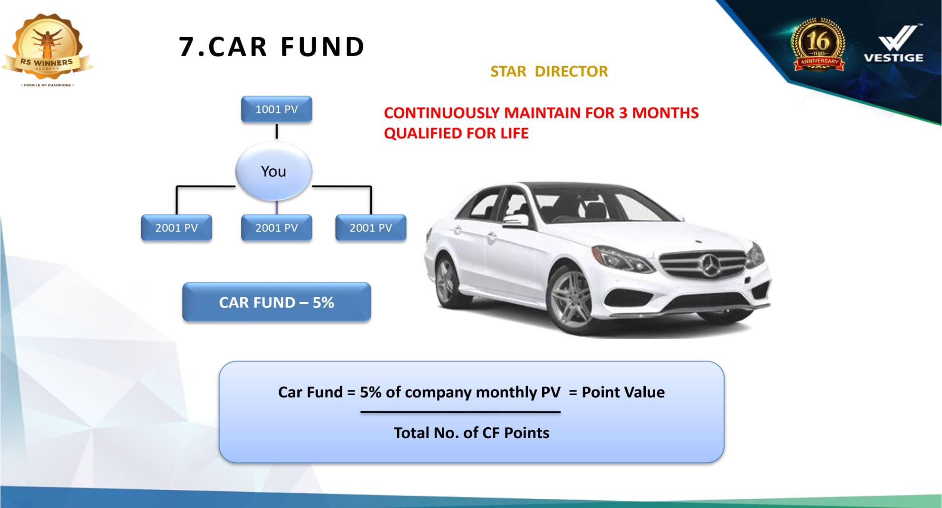
What is Car Fund? Will Vestige provide me the car ?
To Qualify Car Fund, you should reach Star Director Level and Maintain Star Director level for 3 Months Continuously. Then you will be getting the car fund for your life time, until you maintain your Silver Director level.

Slide 27
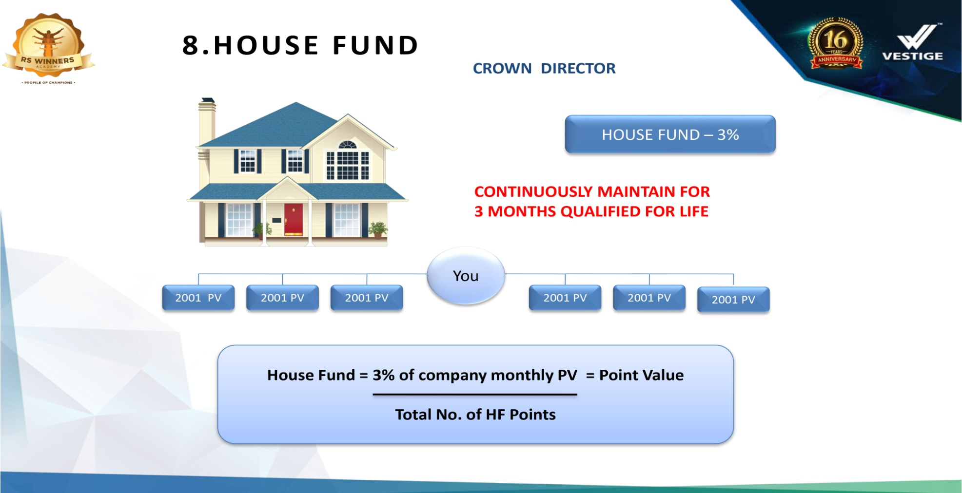
What is House Fund? Will Vestige provide me the house?
To Qualify House Fund, you should reach Crown Director Level and Maintain Crown Director level for 3 Months Continuously. Then you will be getting the House fund for your life time, Until you maintain your Silver Director level.

Slide 28
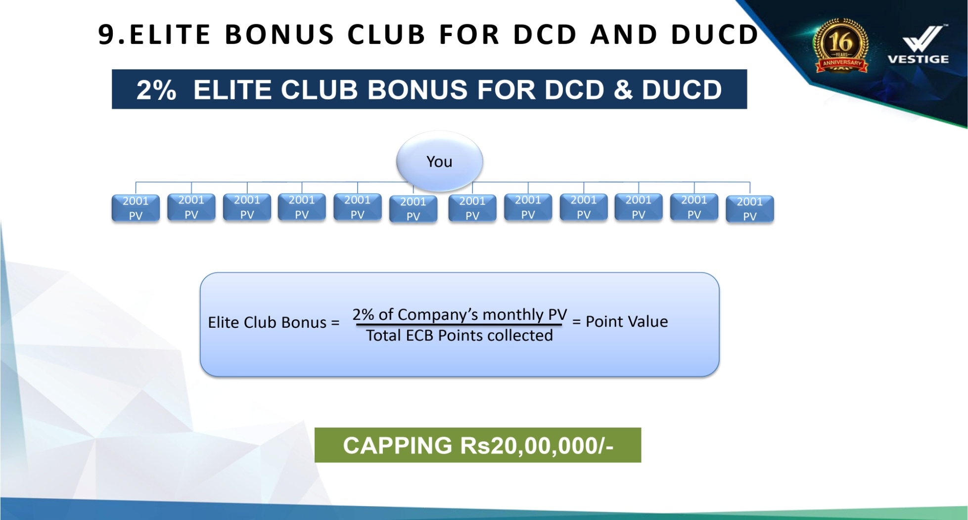
What is Elite Club Bonus? Who is eligible for this?
Elite Club Bonus is one of the new income which Vestige announced from their 16th Anniversary, with maximum capping Rs. 20,00,000/- per month. DCD and DUCD are eligible for this Elite Club Bonus.

Slide 29
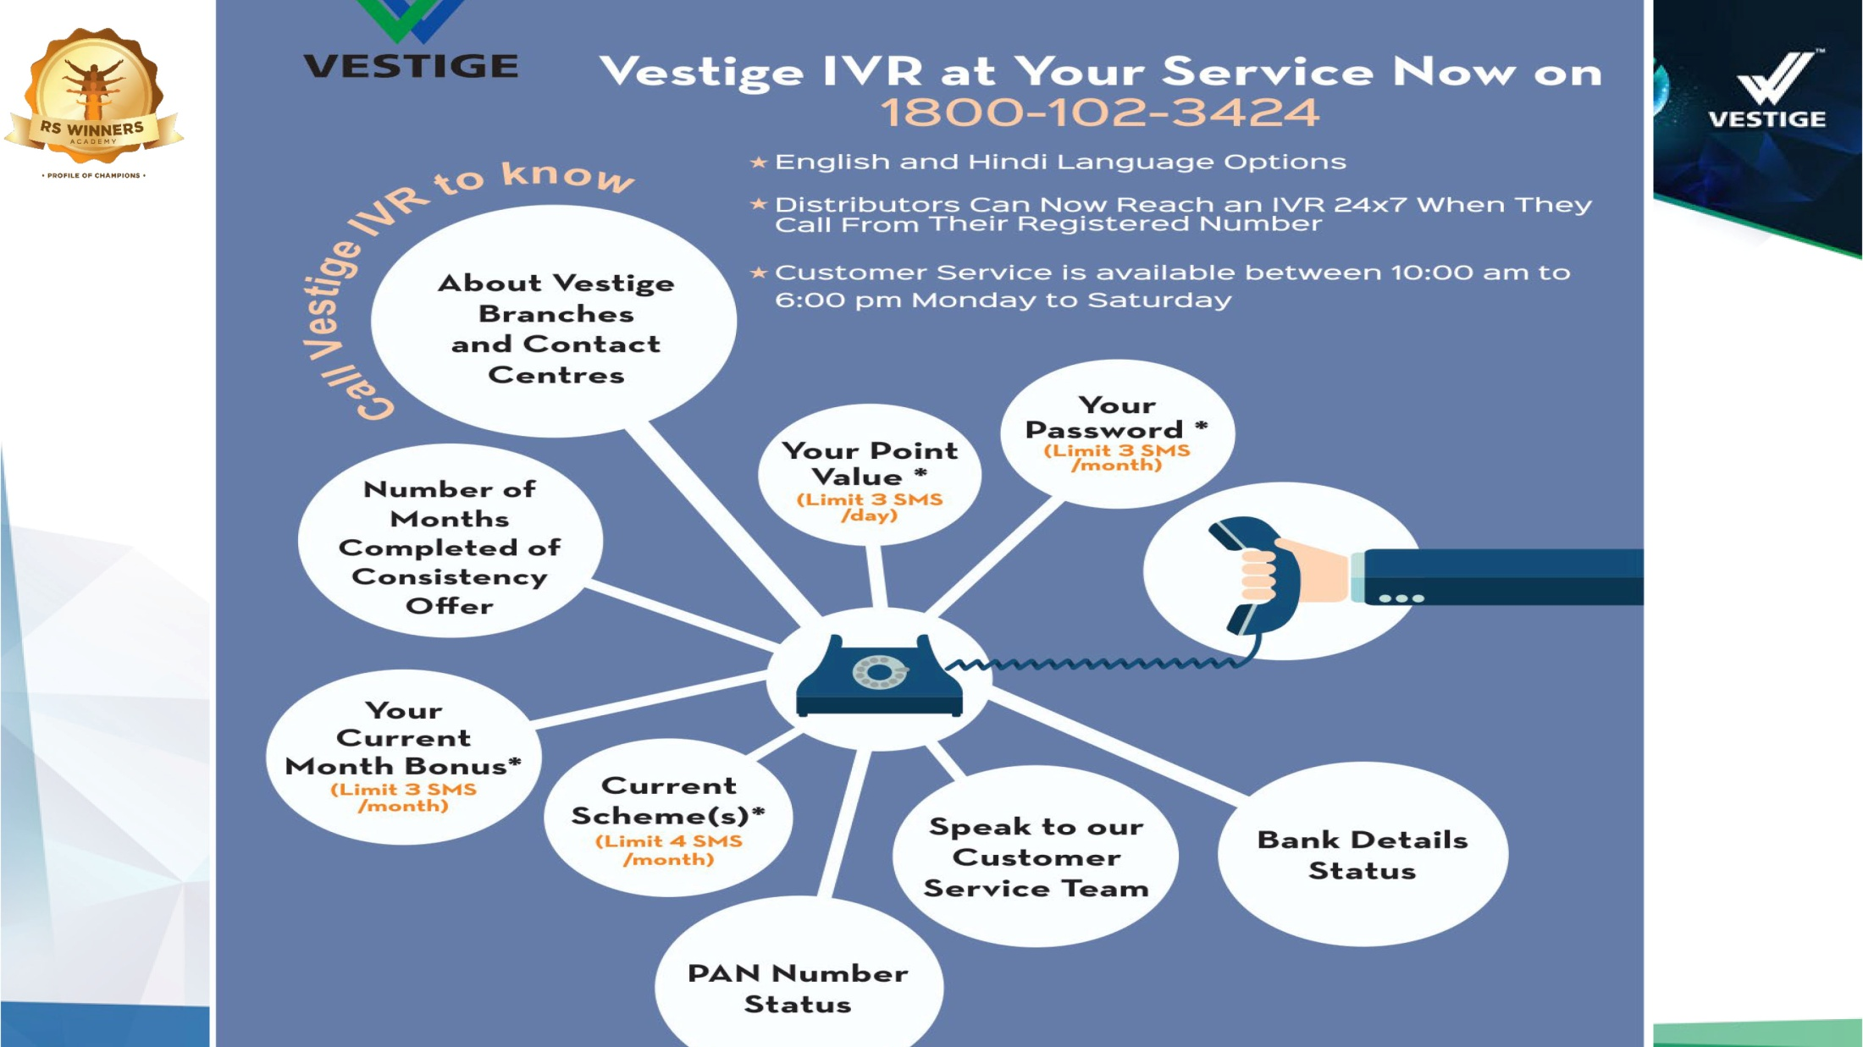
I forgot my password. How do I get my password?

Slide 30
I forgot my password. How do I get my password?
Call our Toll free number : 18001023424 or
Just give a missed call from your mobile number registered with Vestige and get an SMS for the service requested.
8422832156 – to know your PASSWORD
8422832154 – to know your CURRENT MONTH BONUS (Service Available from 13th to month end)
8422832155 – to know your latest updated PV
8422832157 – to know your Monthly Schemes
8422832158 – to know your VOUCHERS

Slide 31
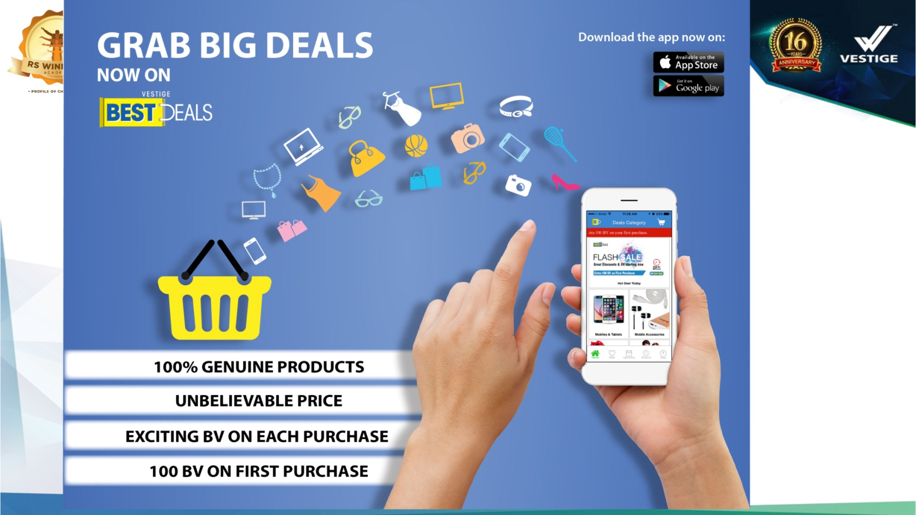
What is Vestige Best Deal ?
Vestige Best Deal is the e-Commerce portal. Here you will be able to find maximum products which are available in the market. It’s an additional advantage for a Vestige Distributor.

Slide 32

For more details please contact your Upline
or
Contact the person who shared this presentation with you.
Website: http://www.vonlineteam.com
Facebook: https://www.facebook.com/vonlineteam
Instagram: https://www.instagram.com/vonlineteam
YouTube: https://www.youtube.com/vonlineteam

Slide 33
Thank You

