Slide 1
VESTIGE PRIME X-TRACT V & X-TRACT F

Slide 3
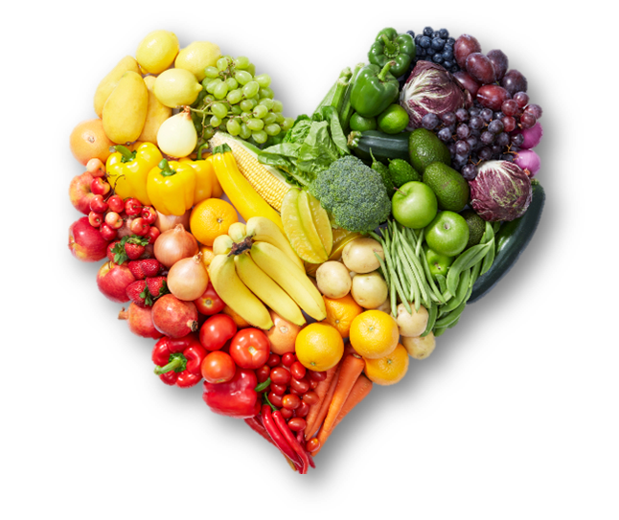
FRUITS & VEGETABLES
Fruits and vegetables are very important components of our daily food plan
They contain important vitamins, minerals and plant chemicals or phytochemicals
They are rich in fibre and are mostly fat free
A diet high in fruits and vegetables can help protect the body against many diseases
When buying and serving fruits and vegetables, aim for variety to get maximum nutrients possible

Slide 4
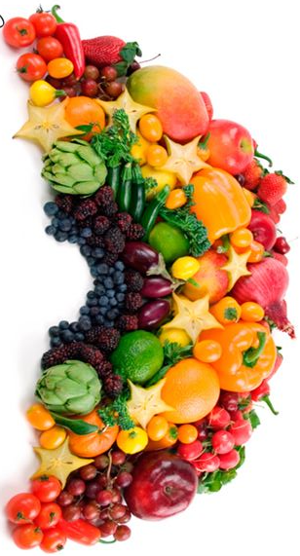
FRUITS & VEGETABLES
WHO recommends a minimum of 400 g of fruits and vegetable a day
Harvard School of Public Health reports that daily intake of fruits and vegetables gives a variety of nutrients and phytochemicals needed to help lower the risk of heart disease, prevent cancer & maintain optimal health

Slide 5
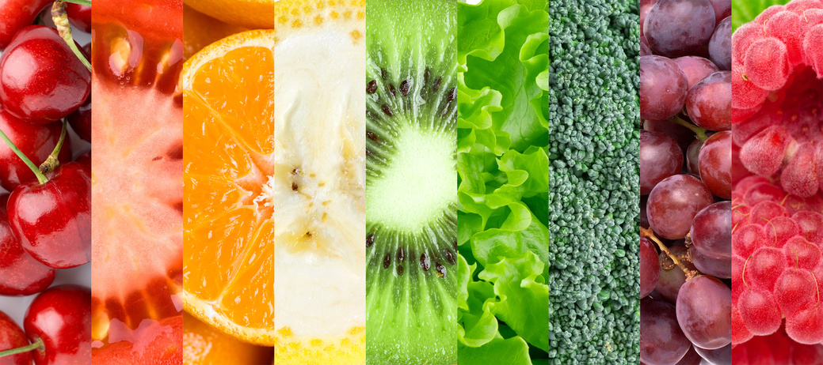
PHYTONUTRIENTS

Slide 6
PHYTONUTRIENTS
PHYTONUTRIENTS = PHYTO (PLANT) + NUTRIENTS = PLANT BASED NUTRITION
Plant foods contains thousands of natural nutrients. These are called phytonutrients or phytochemicals
These nutrients help protect the plants from germs, fungi, bugs, and other threats
There are many phytonutrients which are found naturally in fruits & vegetables like carotenoids, lycopene, chlorophyll, anthocyanin, anthoxanthin, flavonoids, etc., which have many health benefits for the human body

Slide 7
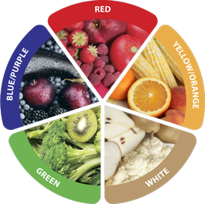
HEART HEALTH
COGNITIVE HEALTH
BOOSTS IMMUNITY
LUNGS HEALTH
BONES HEALTH

Slide 9
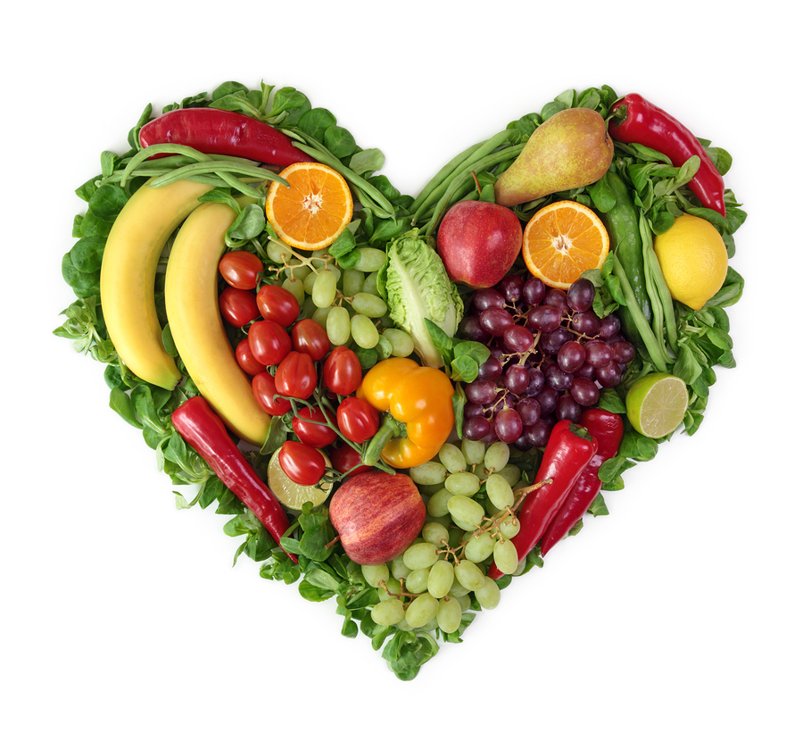
ROLE OF FRUITS & VEGETABLES IN MAINTAINING GOOD HEALTH

Slide 10
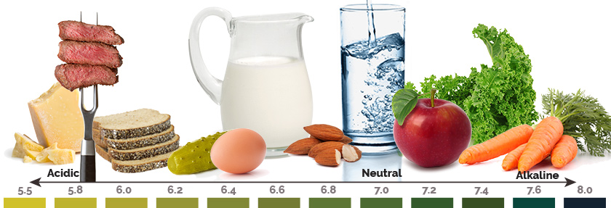
MAINTAINING BODY pH
Alkaline diets have been shown to help in many chronic diseases & ailments such as hypertension, diabetes, arthritis, etc.
Fruits & vegetables are generally considered as alkaline foods
Experts also recommend to start the day with alkaline foods for better digestion and absorption of the nutrients throughout the day

Slide 11
BOOSTING IMMUNITY
Food is one of the most powerful tools that helps us in resisting diseases
A healthy body begins with a healthy immune system
Fruits and vegetables are low in fat, calories and sodium but packed with flavour and essential nutrients
Thus, they help in building a strong immune system which is capable of fighting diseases

Slide 12
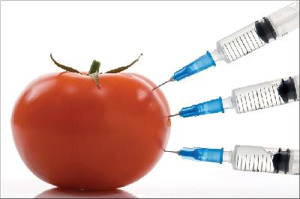
DEGRADATION OF FOOD QUALITY

Slide 13
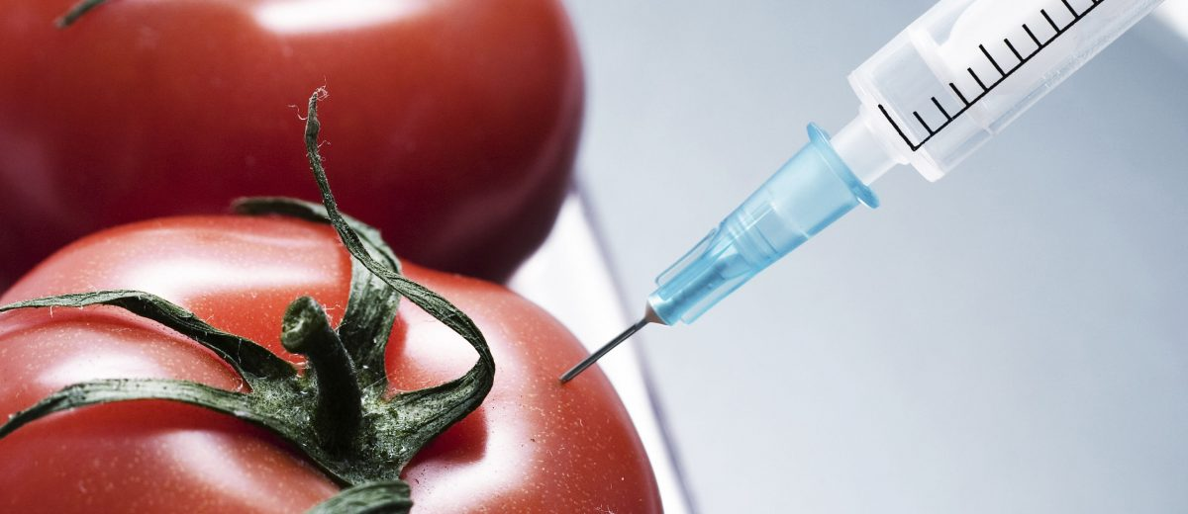
DEGRADATION OF FOOD QUALITY
The quality of our food is not what it used to be about 30 years ago
Crops grown decades ago were much richer in vitamins and minerals than the varieties most of us get today
The researchers found a statistically significant nutrient decrease in the fruits and vegetables

Slide 14
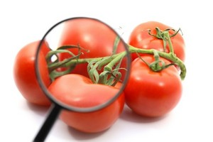
FACTORS AFFECTING FOOD QUALITY
Soil degradation
Overuse of fertilizers
Improper Transportation
Improper Storage
Food Processing
Food Preparation
Food Adulteration

Slide 15
NEWS REPORT ABOUT FOOD QUALITY
Here we have a video of one minute on decreasing food quality
File name: DNA.Mp4

Slide 16
INTRODUCING

Slide 18
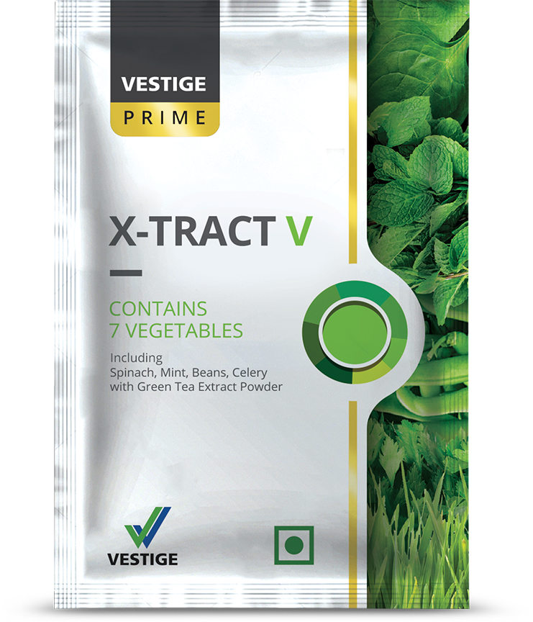
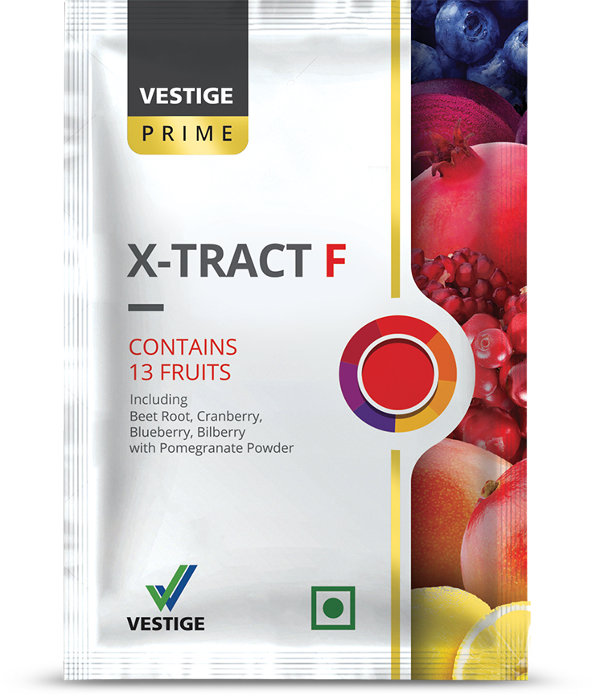
TWIN POWER OF EVERYDAY GOODNESS
Dried powders of fruits and vegetables
Packed with natural goodness
Your daily dose of phytonutrients (nutrients from plants) from fruits and vegetables
Consume daily to fulfill your daily requirements of colourful fruits and green vegetables

Slide 19
Contains 13 Fruits

Slide 20
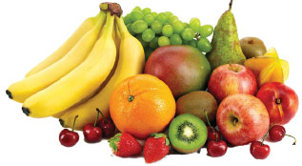
X-TRACT F – Combination of Fruit Powders
Contains 13 fruits:
Cranberry
Blueberry
Bilberry
Pomegranate
Mango
Lemon
Orange
Water melon
Pineapple
Guava
Banana
Papaya
Black Plum
In addition to fruit powders, it contains nutritious additives like – cinnamon, turmeric, spirulina and noni
It also contains Grape Seed extract, Aloe vera, Alfalfa and Beta Carotene with high antioxidant value

Slide 21
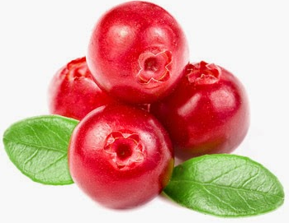
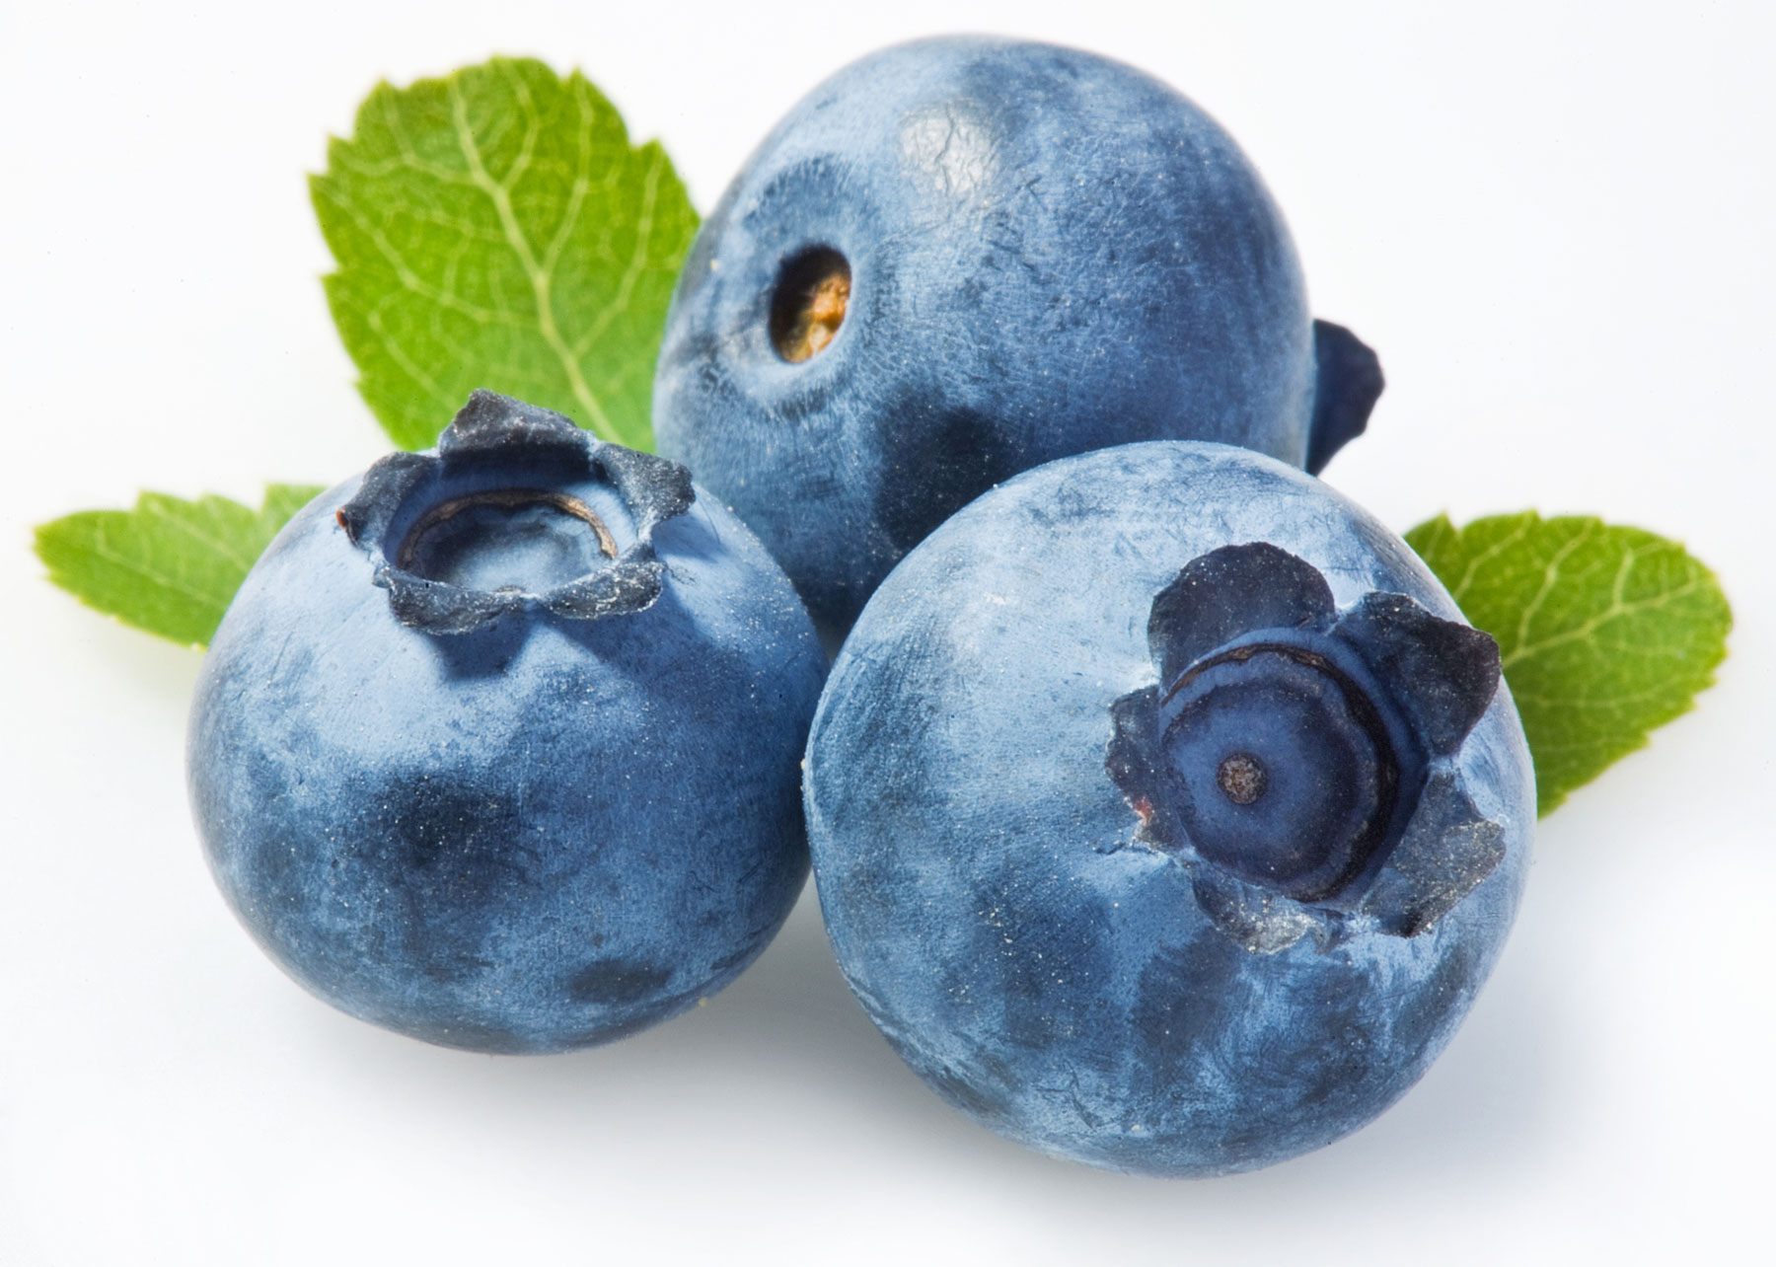
The Key Ingredients of X-tract F
INGREDIENTS | BENEFITS (of individual ingredients)
Cranberry | Improves immune system Prevents Urinary Tract Infection Has anti-cancerous properties, contains anthocyanin (a phytonutrient)
Blueberry | Supports digestion Protects body from free radical damage Lowers blood pressure Improves memory
Bilberry | Effective for digestive problems provides improved vision Prevents hardening of blood vessels Beneficial for GI problems

Slide 22
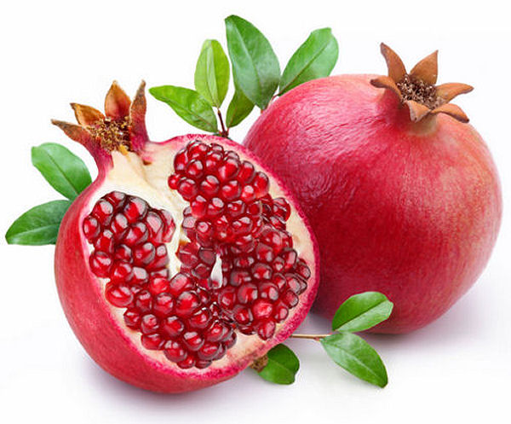
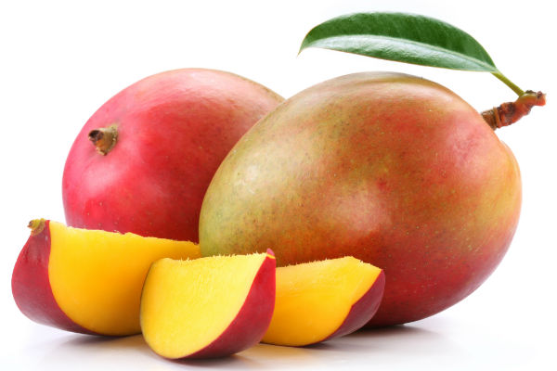
The Key Ingredients of X-tract F
INGREDIENTS | BENEFITS (of individual ingredients)
Pomegranate | Provides anti-inflammatory effects Lowers the risk of heart diseases Helps fight bacterial and fungal infections Improves memory Beneficial for gastro-intestinal disorders
Mango | Also called King of Fruits Alkalizes the body Improves eye health Strengthens the immune system Promotes brain health

Slide 23
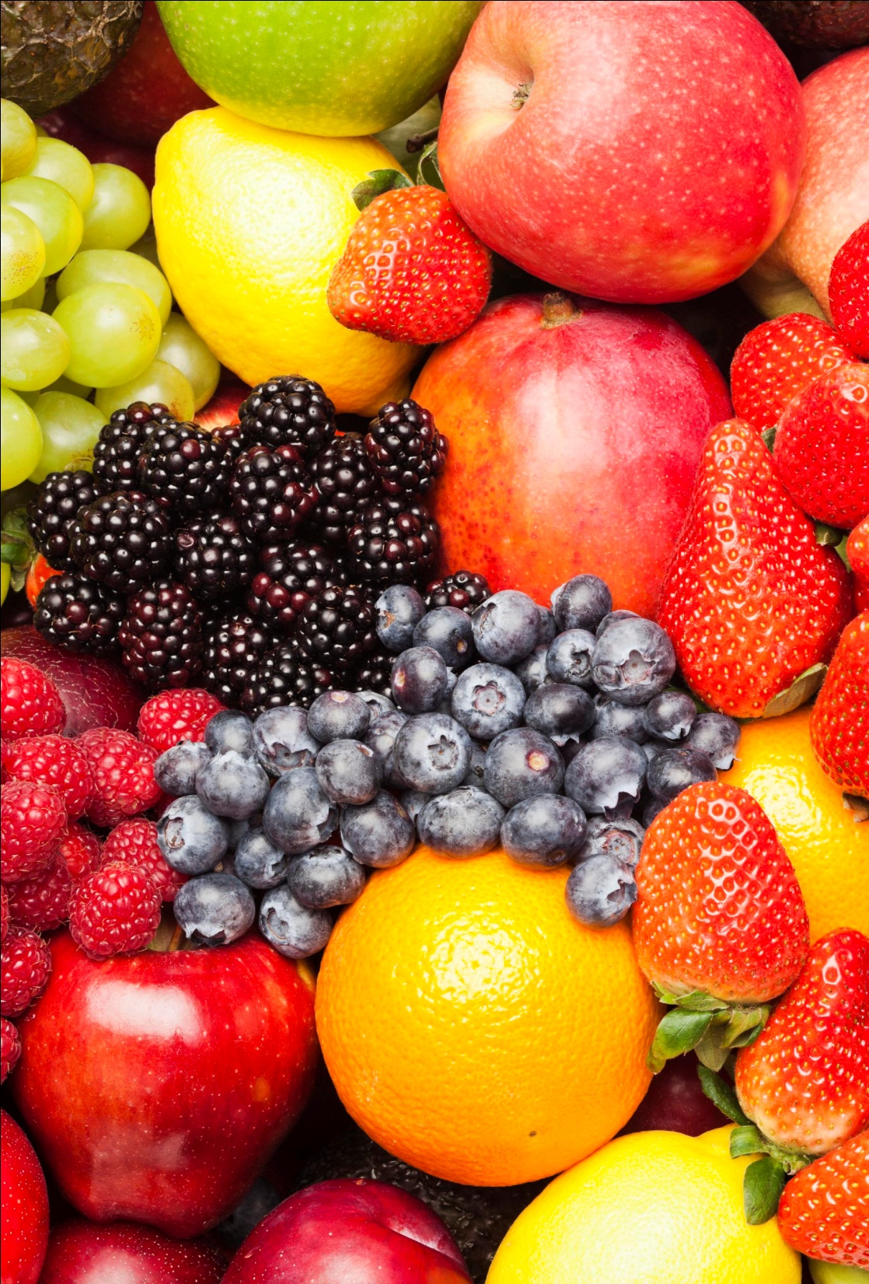
X-TRACT F – Combination of Fruit Powders
Helps to fulfill the daily requirement of essential and colourful fruits ranging from yellow, orange, red, maroon, purple and black
It is full of antioxidants and fibre that helps to fight free radicals and keep you full for longer
The added extracts gives an extra boost of antioxidants and essential vitamins and minerals

Slide 24
Contains 7 Vegetables

Slide 25
X-TRACT V – Combination of Vegetable powders
Contains 7 Vegetables:
Wheat Grass
Spinach
Beans
Mint
Celery
Carrot
Beetroot
In addition to vegetable powders, it contains nutritious additives like – licorice, cinnamon, turmeric, spirulina and noni
It also contains extracts of Green Tea, Grape Seed, Bilberry, Amla, and Aloe Vera
It contains added phytochemicals like Beta Carotene and Quercetin known for their antioxidant properties

Slide 26
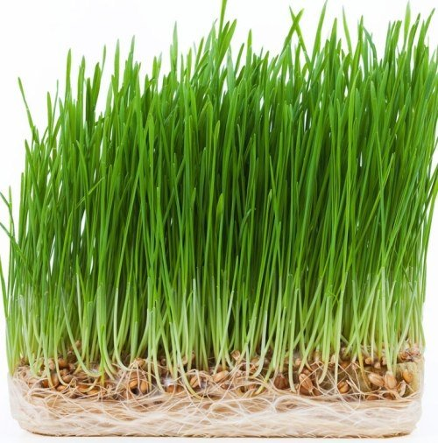
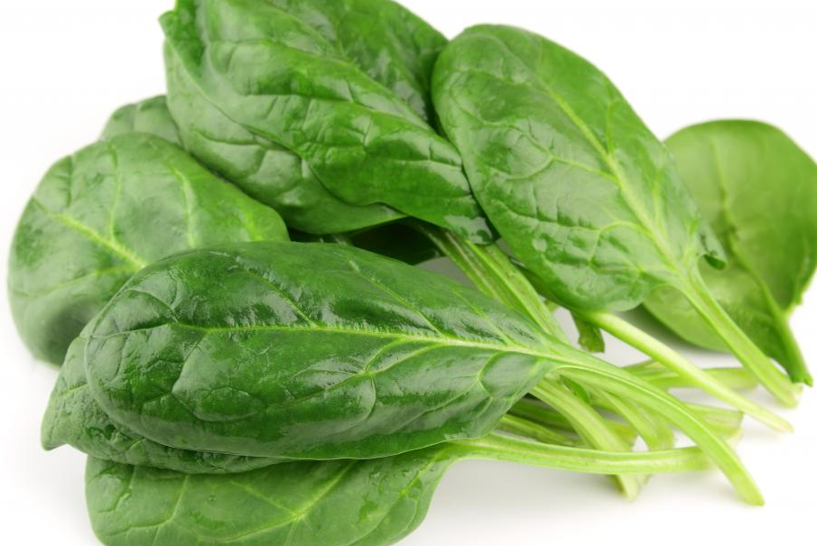
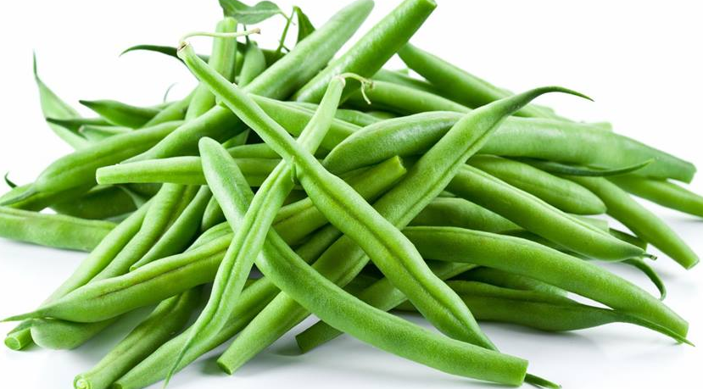
The Key Ingredients of X-tract V
INGREDIENTS | BENEFITS (of individual ingredients)
Wheat Grass | Promotes weight loss Cleanse the liver Stimulates circulation Stimulates thyroid gland Improves digestion
Spinach | Promotes Gastrointestinal health Anti-inflammatory property Boosts immunity Prevents anemia Provides anti-aging benefits
Beans | Reduces cardiovascular risk Improves immunity Improves bone health Promotes eye health

Slide 27
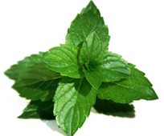
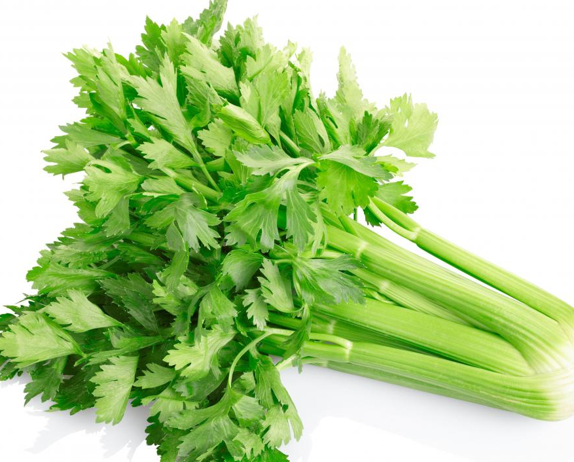
The Key Ingredients of X-tract V
INGREDIENTS | BENEFITS (of individual ingredients)
Mint | Aids in digestion Treats nausea and headaches Prevents respiratory disorders Good for skin Promotes oral health
Celery | Has anti-hypertensive properties Improves liver health Lowers inflammation Boosts digestion and reduces bloating

Slide 28
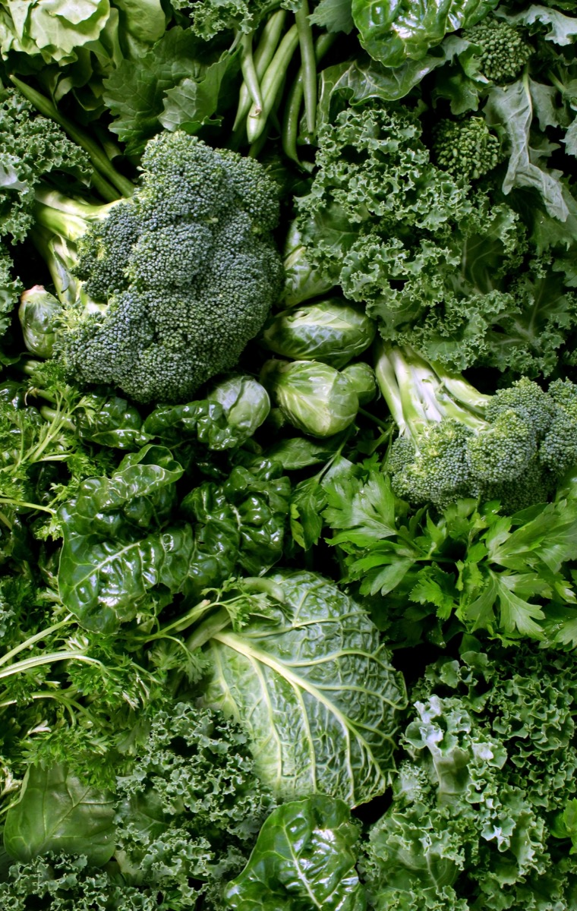
X-TRACT V – Combination of Vegetable Powders
Helps to fulfill the daily requirement of essential and dark green leafy vegetables
It is full of phytochemicals, chlorophyll and fibre that keep you full for longer
The added extracts gives an extra boost of essential vitamins and minerals

Slide 29
Main benefits of X-tract V & F
Detox
Immunity Boost
Weight Loss
Improves Skin & Hair
Snack Replacement

Slide 30
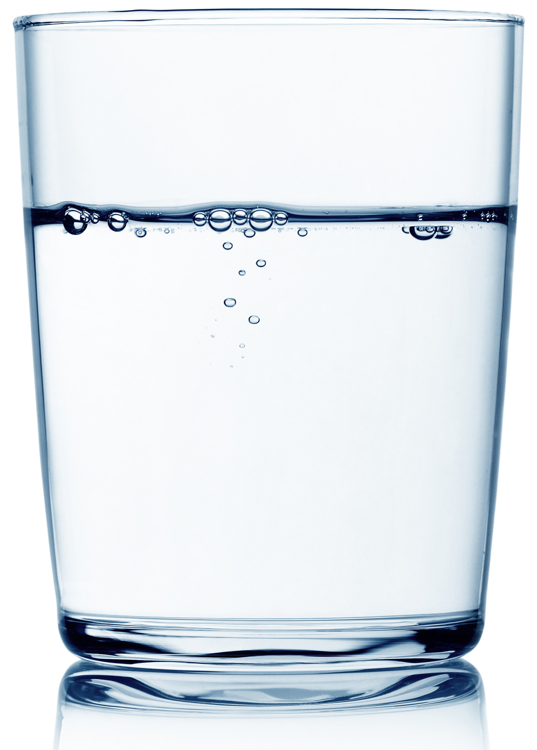
How to consume
Add 1 whole Sachet of Vestige Prime X-tract V or X-tract F in 1 glass of water (200 ml)
Stir thoroughly with spoon or in a shaker
Consume immediately
Once pouch is open, consume immediately

Slide 31
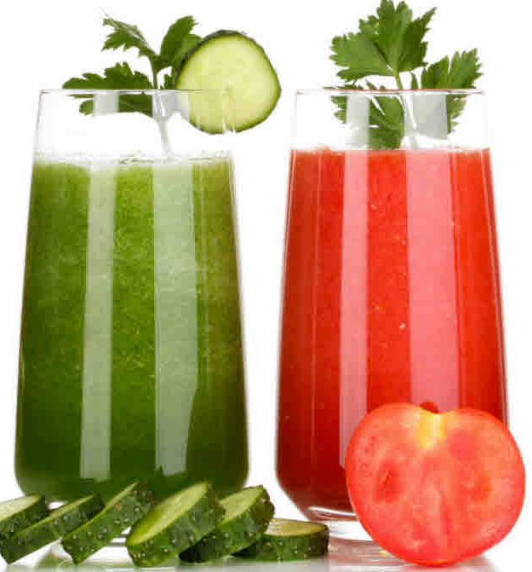
When to consume
It can be consumed in mid-meals
You can start your day with Vestige Prime X-tract V, which will give a feeling of fullness and alkalizes your body
In the evening time you can enjoy Vestige Prime X-tract F which will not only curb your hunger but will also provide you essential phytonutrients

Slide 32
DP- 1100/-
BV- 605.00
PV- 33.61
MRP- Rs.1275/-
DP- 1250/-
BV- 687.50
PV- 38.19
MRP- Rs.1440/-

