Slide 1
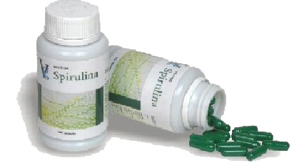
VESTIGE SPIRULINA
WORLD’S NO.1 FOOD SUPPLEMENT

Slide 2
How healthy are you ?
When was the last time you felt totally energized upon waking up ?
Do you get tired easily?
Do you have no appetite?
Do you suffer from indigestion?
Do you have constant back aches & shoulder aches?
YOUR BODY NEEDS HELP !!

Slide 3
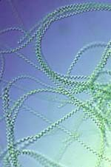
Spirulina ~ The World’s No 1 Prehistoric Vegetable
A spiral-shaped algae named Spirulina
This micro-organism has withstood 3.5 billion years of environmental changes and the harsh elements and continues to flourish
Whole Spirulina has a soft and easily digestible cell wall that has immune stimulating properties in itself.

Slide 4
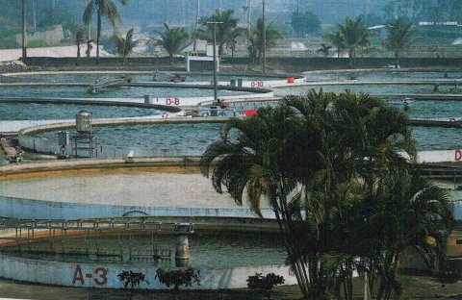
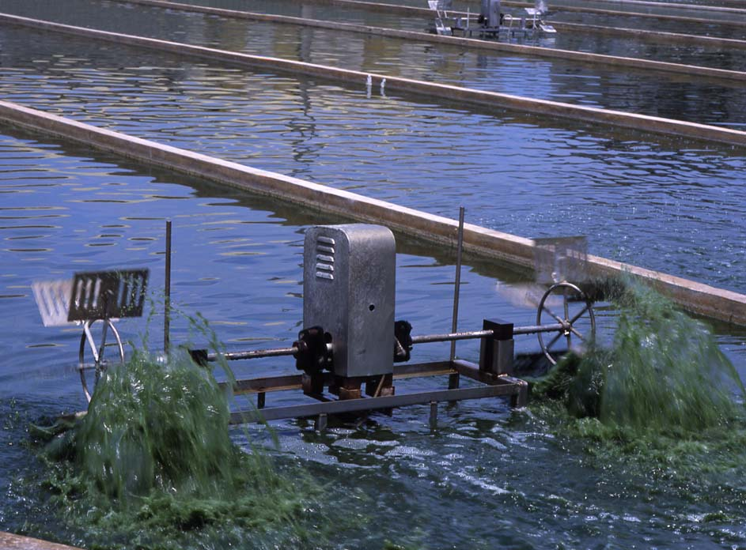
Farms where Vestige Spirulina is cultivated are USFDA, JHFA & KOSHER certified.
Cultivation of Spirulina
The sunlight allows photosynthesis, which encourages growth of the Spirulina.
Fresh Water Cultivation Ponds.
Churning of the water helps in proper Chlorophyll formation.

Slide 5
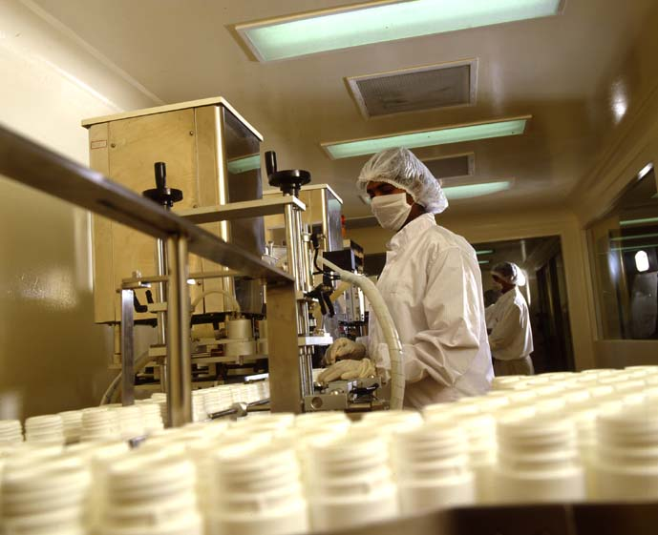
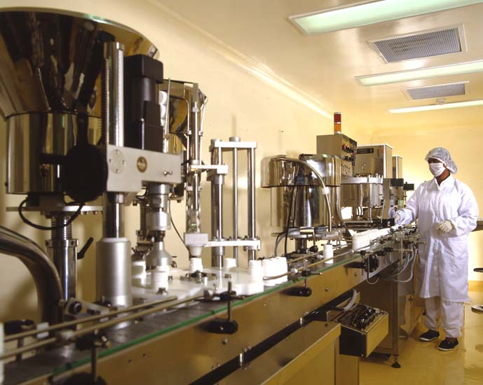
PROCESS FOR BEST QUALITY
Cultivation.
Harvesting.
Rinsing process.
Spray drying.
Spirulina powder.
Capsuling.
Packaging
Ensures best Quality product comes to you.

Slide 6
5 REASONS WHY SHOULD WE TAKE SPIRULINA?
Strengthening the immune system.
Supporting cardiovascular health & Lowering cholesterol.
Improving gastrointestinal & digestive health.
Enhancing natural cleansing & detoxification.
Reducing cancer risks with better antioxidant protection.

Slide 7
BENEFITS OF SPIRULINA
Provides complete daily nutrition need for the body.
Promotes body metabolism.
Neutralizes body acidity.
Fortifies immune system.
Inhibits growth of cancerous cells.
Improves absorption & digestion.
Reduces circulatory problems.

Slide 8
ADVANTAGES OF SPIRULINA
a) Spirulina’s protein content is :
Twice as rich as soybeans.
6 times higher than eggs.
b) An excellent source of quick supply of glucose to the blood.
c) Contains over 13 types of vitamins & richest vegetative source of B12 in the world.
d) Contains more than 13 types of minerals.
e) 4 Natural pigments including beta carotene ( 25 times higher than carrots)
f) Nutritional value 14 times more than cow’s milk.

Slide 9
RICHEST SOURCE OF NUTRITION.
Types Of Vitamin | Deficiency May Lead | Other Nutrient Sources | 12 Caps Of Vestige Spirulina
Beta –Carotene (Pro-Vitamin A) | Acne, Eczema, Dermatitis, Infections. | 56 Glasses of Cow’s Milk OR 550 Apples. | 12 mg.
Vitamin B1 | Reduced body resistance, muscle pains, weak memory, heart malfunctions. | 20 Green Chillies OR 16 Sardines | 0.24 mg
Vitamin B2 | Retarded growth, Eczema, Poor Vision, Cataract,Insomnia, Dry skin | 420 Grapes OR 47 Strawberries. | 0.24 mg
Vitamin B3 | Dermatitis & Hypersensivity of the nerves | 8 Lemons. | 1.02 mg
Vitamin B6 | Heart Diseases, Hypersensivity of nerves, Dermatitis | 90 gms of Bread. | 43.2 mg
Vitamin B 12 | Anemia, fatigue, ageing, problems during menstrual cycle. | 240 gms of Cottage Cheese. | 7.2 mg
Vitamin E | Hypertension, Heart Diseases, Fatigue & Ageing | 6 pieces of Chicken OR 14 glasses of Cow’s milk. | 0.72 mg

Slide 10
WHO CAN HAVE SPIRULINA?
Those who are suffering from:
General Weakness,
fatigue,
early aging
Skin Problems, Acne, dry Skin,
Diabetes
Anemia
Memory Loss
Poor Vision
Hyper acidity
Ulcers
As a complete food supplement.

Slide 11
POSSIBLE IMPROVEMENT ACTIONS
Actions
Possible Reasons
*Fever or slight fever
Spirulina contains 68% protein and other rich nutrients which promote body metabolism to release body heat and hence increase body temperature.
* Fever, excited, sleeplessness at night.
Burning of excessive fat in the body by converting into heat energy is a normal condition.
*Blackish green excreta.
Spirulina helps eliminate accumulated residues in the colon. If the excreta remain green in colour after a period of time, this is due to the green pigments of Spirulina.
*Fart , chest pain.
Symptoms of a malfunctioning digestive system, flatulence.

Slide 12
POSSIBLE IMPROVEMENT ACTIONS
Actions
Possible Reasons
Symptoms of an acidic body condition, liver malfunctions, over exhaustion or having taken too much medicine previously.
Sleepy , tried hands and legs
Pimples, itchiness, red spots, sweating and smelly urine.
Results of detoxification in the body, symptoms of a poor liver function or allergies in body
Running nose, asthma, coughing phlegm.
Symptoms of weak respiratory system.
No action.
Healthy body condition or full recovery from illnesses.

Slide 13
VESTIGE SPIRULINA THE SAFE SUPER FOOD.
SPIRULINA HAS BEEN USED WORLDWIDE FOR MORE THAN 20 YEARS AS A FOOD SUPPLEMENT.
The World’s No 1 In Health Enhancing Benefits
VESTIGE SPIRULINA’s balanced nutritional properties have been proven to be beneficial for all ages.

Slide 14
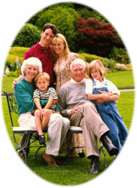
LEAD A HEALTHY LONG LIFE WITH VESTIGE SPIRULINA

