Slide 1
V Online Team
Welcomes you to our YouTube Channel
Visit us on www.vonlineteam.com | www.vestbuy.in | www.vestjoin.com

Slide 2
FAIR USE DISCLAIMER
This video is designed and created by Bappi Dasgupta for VOnlineTeam for training and information purposes. You are hereby prohibited to cut or copy any content/part of this video. Viewers are also prohibited to upload this video again on another YouTube Channel without prior permission of the creator. The viewers can share/like this video and provide feedback in the comment box below.
All rights reserved by Bappi Dasgupta [VOnlineTeam]

Slide 3
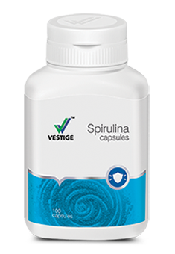
VESTIGE SPIRULINA WORLD’s NO. 1 FOOD SUPPLEMENT

Slide 4
YOUR BODY NEEDS HELP !!!
When was the last time you felt totally energized upon waking up ?
Do you get tired easily?
Do you have no appetite?
Do you suffer from indigestion?
Do you have constant back aches & shoulder aches?

Slide 5
The World’s No 1 In
Health Enhancing Benefits
VESTIGE SPIRULINA’s balanced nutritional properties have been proven to be beneficial for all ages.
Consuming VESTIGE SPIRULINA
Enables you to meet your body’s daily nutritional needs as it is a complete food supplement

Slide 6
VESTIGE SPIRULINA THE SAFE SUPER FOOD.
Spirulina has been used worldwide for more than 20 years as a food supplement.
PRODUCES 20 TIMES MORE PROTIEN PER ACRE THAN SOYBEANS.

Slide 7
SPIRULINA
The World’s No 1 Prehistoric Vegetable

Slide 8
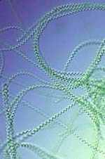
THIS IS A SLIDE TITLE
A spiral-shaped algae named Spirulina
This micro-organism has withstood 3.5 billion years of environmental changes and the harsh elements and continues to flourish
Whole Spirulina has a soft and easily digestible cell wall that has immune stimulating properties in itself.

Slide 9
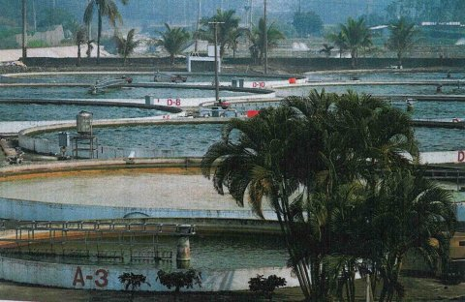
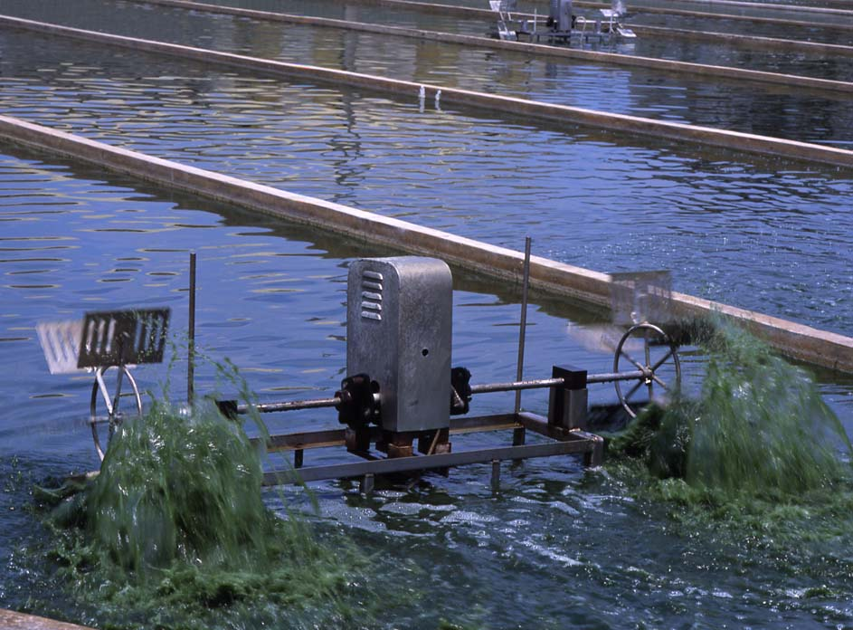
Farms where Vestige Spirulina is cultivated are USFDA, JHFA & KOSHER certified.
The sunlight allows photosynthesis, which encourages growth of the Spirulina.
Fresh Water Cultivation Ponds
Churning of the water helps in proper Chlorophyll formation.

Slide 10
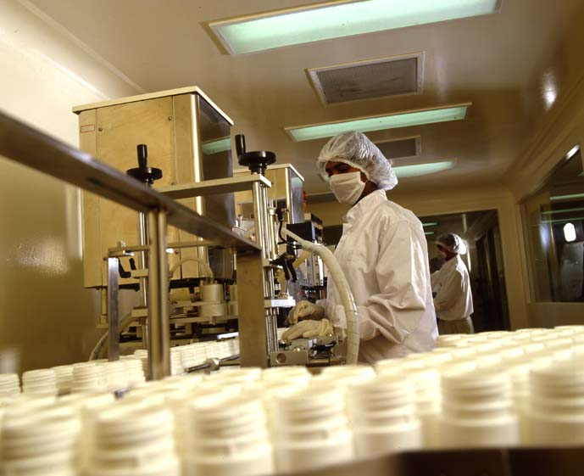
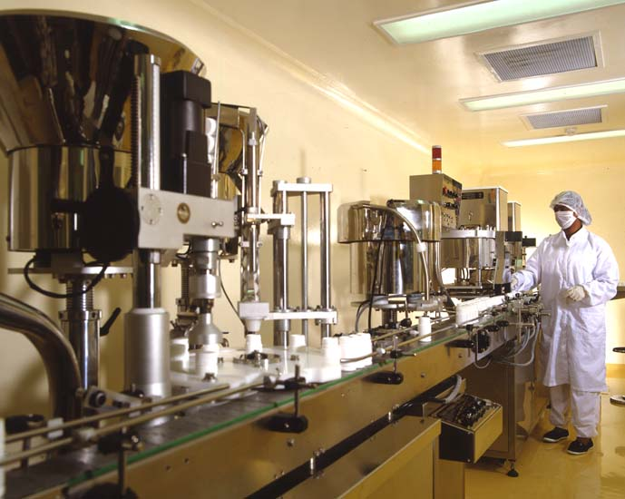
PROCESS FOR BEST QUALITY
Cultivation.
Harvesting.
Rinsing process.
Spray drying.
Spirulina powder.
Capsuling.
Packaging
Ensures best Quality product comes to you.

Slide 11
5 REASONS TO TAKE SPIRULINA
Reducing cancer risks with better antioxidant protection.
Strengthening the immune system.
Improving gastrointestinal & digestive health.
1
3
5
2
4
Supporting cardiovascular health & Lowering cholesterol.
Enhancing natural cleansing & detoxification.

Slide 12
BENEFITS OF SPIRULINA
Provides complete daily nutrition need for the body.
Promotes body metabolism.
Neutralizes body acidity.
Fortifies immune system.
Inhibits growth of cancerous cell.
Improves absorption & digestion. Reduces circulatory problems.

Slide 13
ADVANTAGES OF SPIRULINA
a) Spirulina’s protein content is :
Twice as rich as soybeans.
6 times higher than eggs.
b) An excellent source of quick supply of glucose to the blood.
c) Contains over 13 types of vitamins & richest vegetative source of B12 in the world.
d) Contains more than 13 types of minerals.
e) 4 Natural pigments including beta carotene ( 25 times higher than carrots)
f) Nutritional value 14 times more than cow’s milk.
13

Slide 14
RESULTS SOURCE OF NUTRITION
 | Other Nutrient Sources | 12 Capsules of Vestige Spirulina
Beta-Carotene Pro Vit A | 56 Glasses of Cow's milk or 550 Apples | 12 mg
B1 | 20 Green Chillies or 16 Sardines. | 0.24 mg
B2 | 420 Grapes OR 47 Strawberries. | 0.24 mg
B3 | 8 Lemons | 1.02 mg
B6 | 90 gms of Bread | 43.2 mg
B12 | 240 gms of Cottage Cheese. | 7.2 mg
E | 6 pieces of Chicken OR 14 Glasses of Cow's Milk. | 0.72 mg

Slide 15
POSSIBLE IMROVEMENT ACTIONS
ACTIONS | POSSIBLE REASONS
Fever or slight fever | Spirulina contains 68% protein and other rich nutrients which promote body metabolism to release body heat and hence increase body temperature.
Fever, excited, sleeplessness at night. | Burning of excessive fat in the body by converting into heat energy is a normal condition.
Blackish green excreta. | Spirulina helps eliminate accumulated residues in the colon. If the excreta remain green in colour after a period of time, this is due to the green pigments of Spirulina..
Fart , chest pain. | Symptoms of a malfunctioning digestive system, flatulence.

Slide 16
POSSIBLE IMROVEMENT ACTIONS
ACTIONS | POSSIBLE REASONS
Sleepy , tried hands and legs | Symptoms of an acidic body condition, liver malfunctions, over exhaustion or having taken too much medicine previously.
Pimples, itchiness, red spots, sweating and smelly urine. | Results of detoxification in the body, symptoms of a poor liver function or allergies in body
Running nose, asthma, coughing phlegm. | Symptoms of weak respiratory system.
No action | Healthy body condition or full recovery from illnesses.

Slide 17
THANKS!
Do not forget to Subscribe, Like & Share
Press the Bell icon and never miss an update

