Slide 1
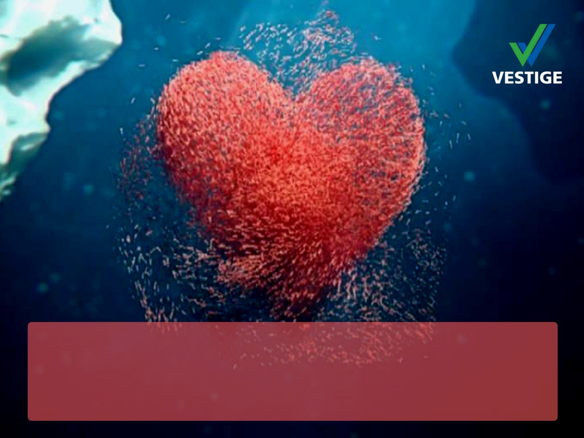

Krill Oil

Slide 2


Vestige Prime
Vestige Prime is the premium healthcare category from Vestige
The products in this category will be superior, exclusive and class apart form the market
These products will be backed by scientific evidence
They will offer truly exceptional quality
Our first product in this range is
  Vestige Prime Krill Oil

Slide 3
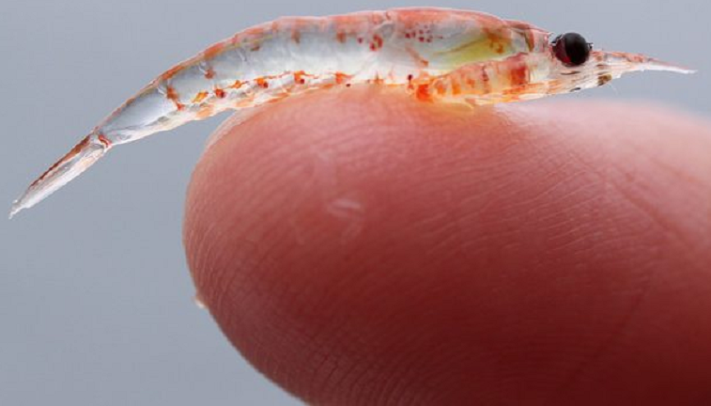
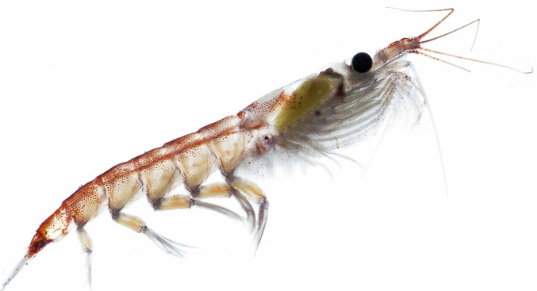
What is Krill?
Krill oil is oil from a tiny, shrimp-like fish
Krill from Antarctic is also called Euphausia superba
They are found in the colder waters of the ocean
Krill is found in the oceans off of Antarctica, Canada, and Japan
Krill primarily serve as a food source for other animals in the ocean, like whales, seals, penguins, squid and fish

Slide 4
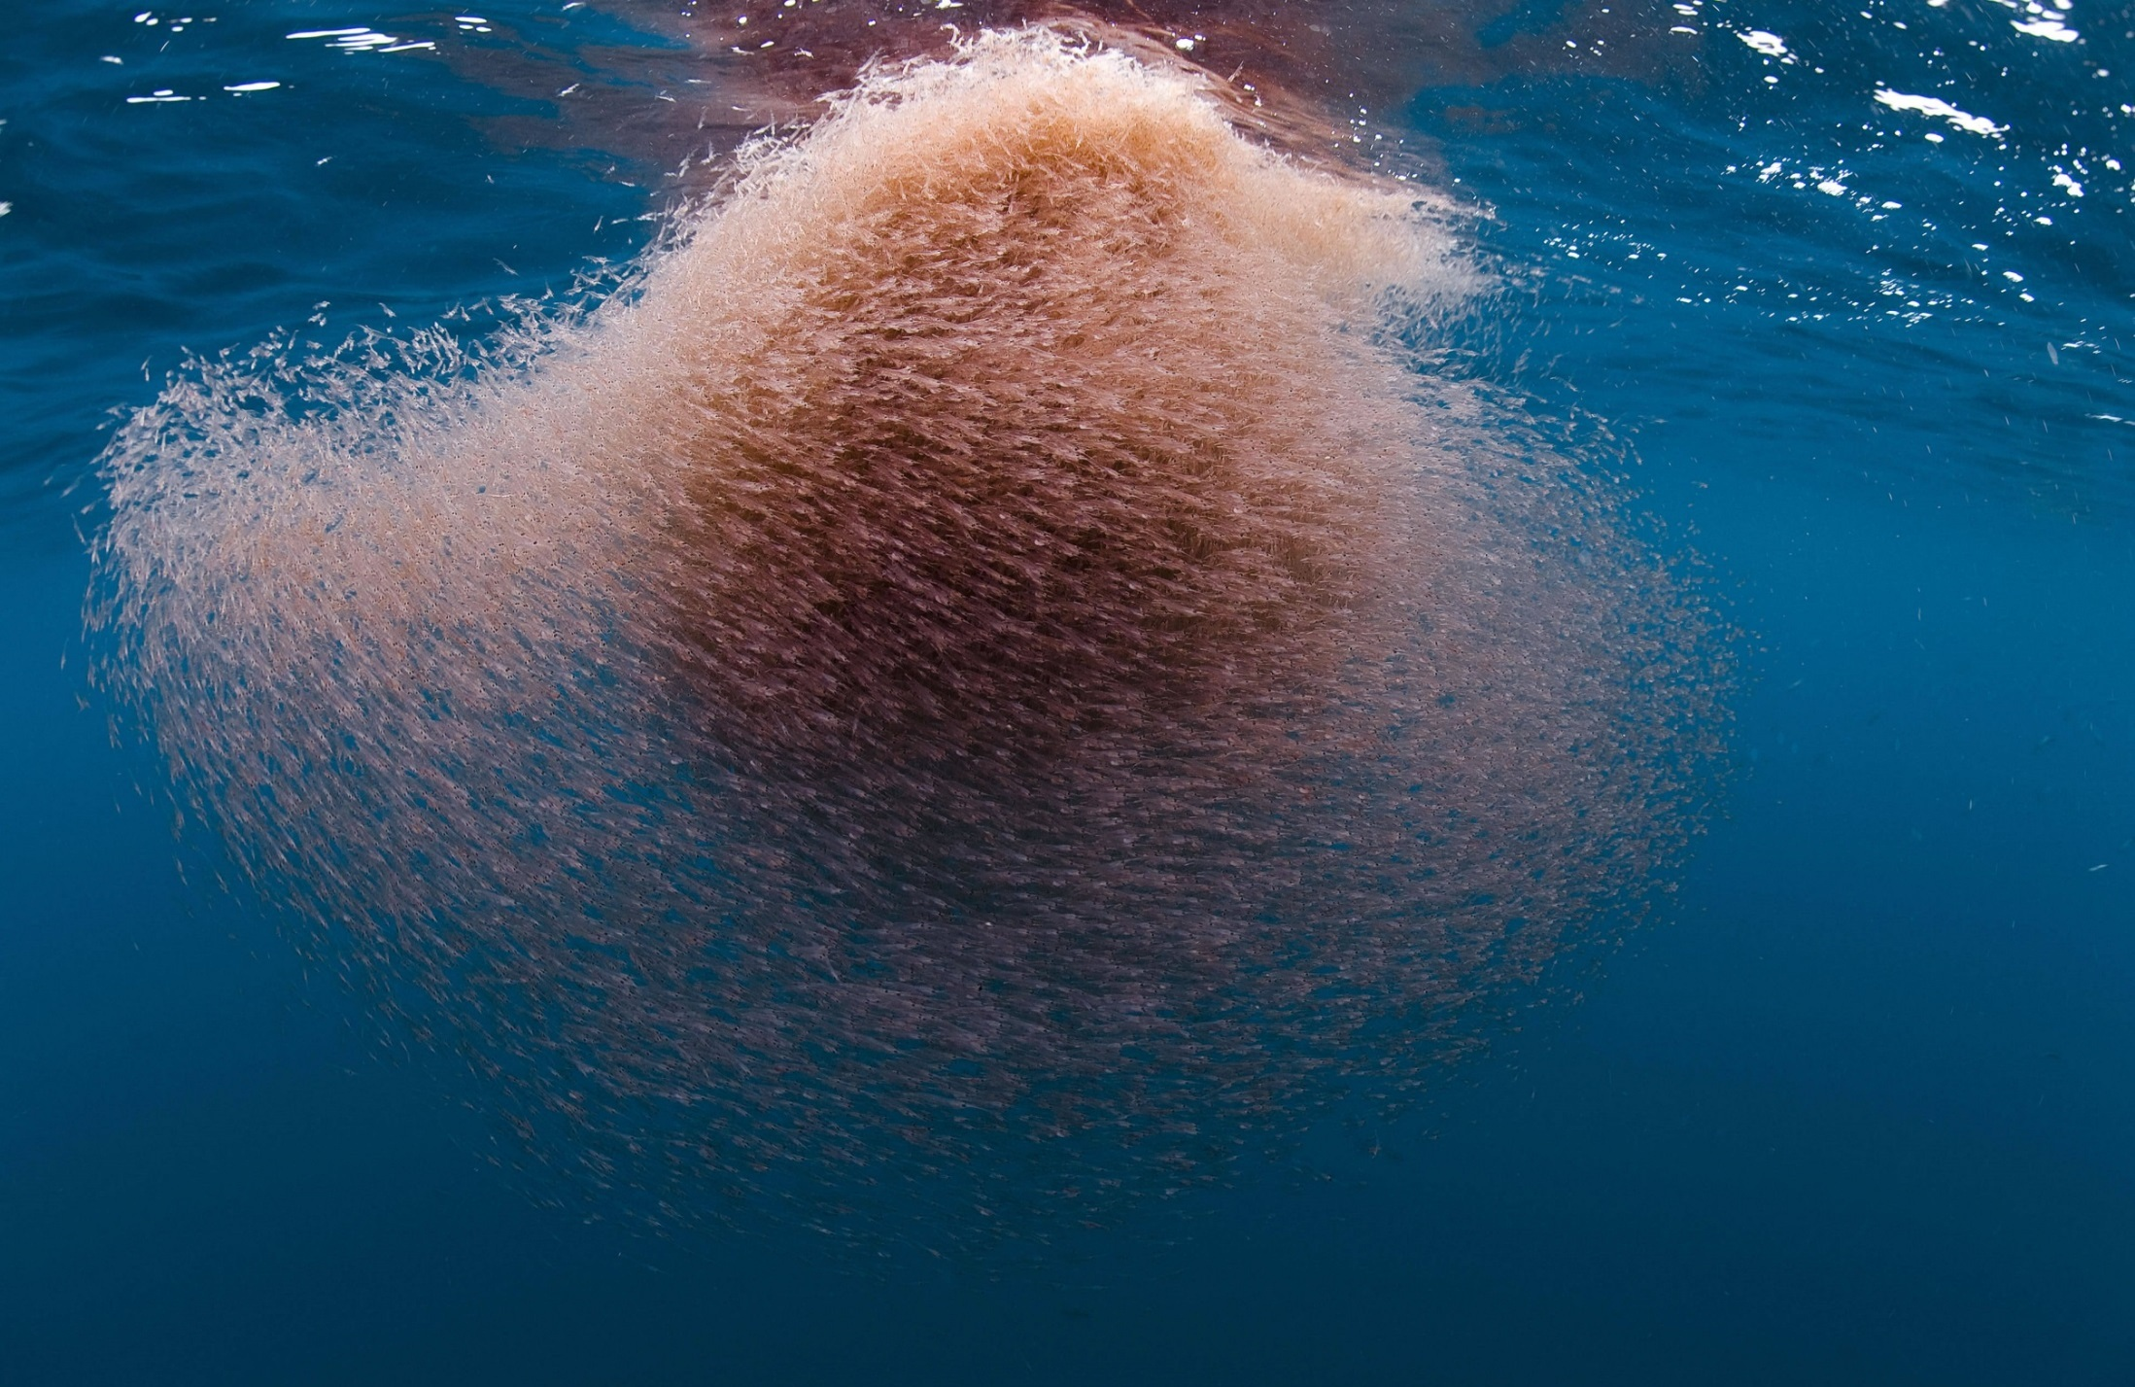
Antarctic Krill (Euphausia Superba)
Antarctic Krill are swimming crustaceans that live in the Antarctic waters of the Southern Ocean

Slide 5
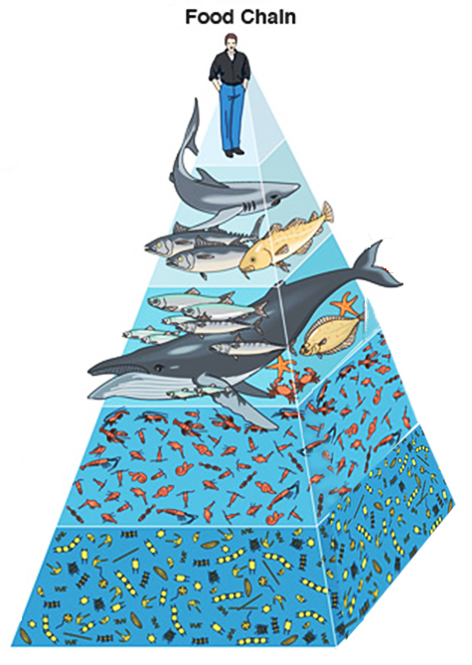

Krill Oil’s Unique Source
The Southern Ocean constitutes one of the most remote areas on our planet, and as such is it isolated from many environmental contaminants
Antarctic krill feeds on plankton, close to the bottom of the food chain, and is therefore free of any accumulation of contaminants such as heavy metals that are typically found in many fishes

Slide 6
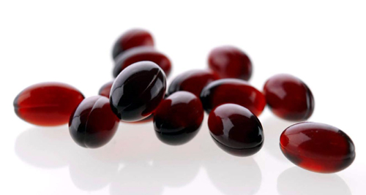
What does Krill Oil Contain?
Krill oil is a rich source of phospholipids and phospholipid bound omega fatty acids
It is a rich source of Omega-3 polyunsaturated fatty acids: EPA (Eicosapentaenoic acid) and DHA (Docosahexaenoic acid)
Unlike fish oil, the omega-3 fatty acids in Krill oil are absorbed and carried to the body's cells in phospholipid form, that reaches and gets assimilated in all major organs
Krill oil also contains a powerful natural antioxidant - Astaxanthin

Slide 7
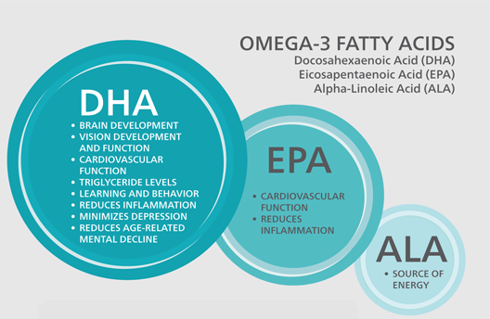
Omega 3 Fatty Acids

Slide 8
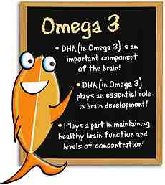
Benefits of Omega 3 Fatty Acids
Omega 3 fatty acids are essential fatty acids that are not produced in the body
Omega-3 fatty acids, in combination with diet and exercise, helps in lowering the body's production of “bad” (LDL) cholesterol and triglycerides, and helps to raise “good” (HDL) cholesterol
Research shows that consumption of EPA and DHA omega-3 fatty acids may reduce the risk of coronary heart disease

Slide 9
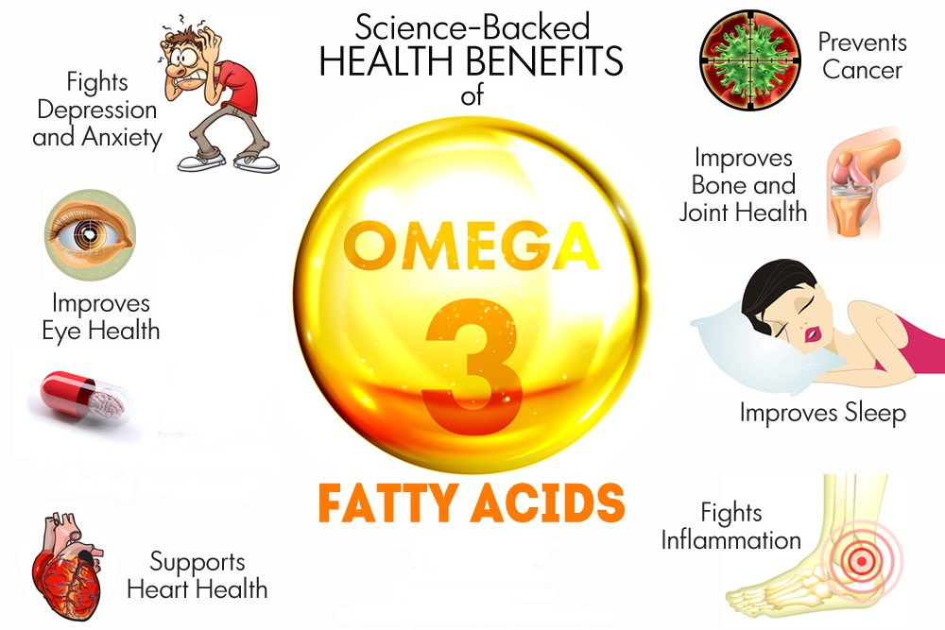

Slide 10
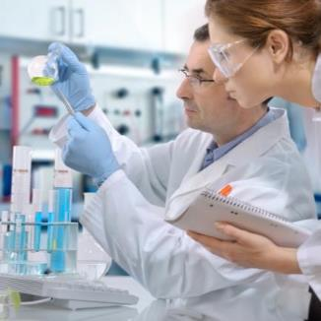
Benefits of Omega-3 are from
Infancy to Old Age
Infants
Seniors
Teenagers
Adults

Slide 11
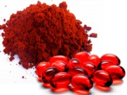
Benefits of Astaxanthin
Astaxanthin is a reddish colored pigment found in marine animals like salmon, lobster, shrimp and krill
Often called "the king of the carotenoids," astaxanthin is 10 to 100 times more powerful than other carotenoids like beta-carotene and lycopene found in vegetarian sources like carrots, tomato etc.
Astaxanthin has powerful UV-blocking properties and protects from sun-related damage
It has shown to help improve skin moisture levels, elasticity, and smoothness and in reducing wrinkles
It also supports heart health

Slide 12
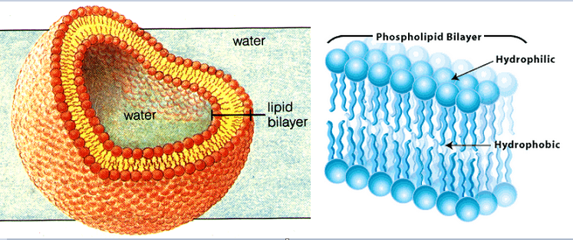
Benefits of Phospholipids
Phospholipids are lipid-protein complexes that bind together to form the cell membrane or “skin” that surrounds every living cell in the body
Phospholipids are among the most plentiful of substances in our body
They are produced by the liver for absorption of many nutrients from the food that we eat
Phospholipids enhances the absorption of fats and other nutrients in the body and helps to reduce the load on the liver
It has beneficial effect on the cognitive function and liver health

Slide 13
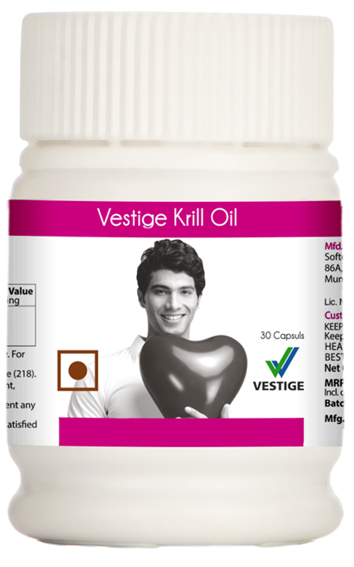
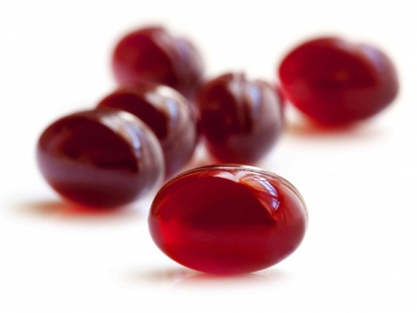
Benefits of Krill Oil
Krill Oil is a phospholipid bound omega-3 product, that is better absorbed into the blood and target organs such as the brain, heart, liver etc.
It supports cardiovascular health
Helps to sustain healthy cholesterol levels
Omega 3 in Krill Oil helps to prevent blood clots that can causes strokes and heart attacks
It helps to improve joint lubrication and overall joint function
Helps to improve mental concentration, alertness, memory and mental focus
Gives a radiant complexion and increased moisture levels in the skin
Astaxathin in Krill oil is a potent antioxidant which protects the body against free radical damage
Consumption of krill oil was shown to have benefits to human health, including heart health, anti-inflammation, liver benefits, muscle benefits, vascular benefits and joint benefits

Slide 14
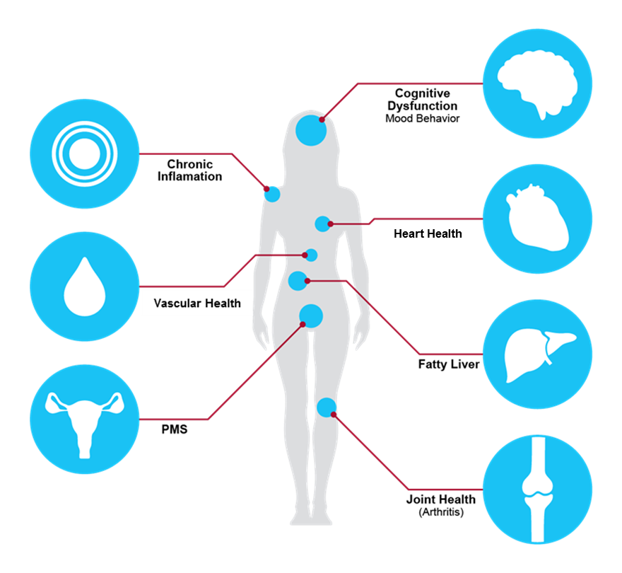
Health Benefits of Krill Oil

Slide 15
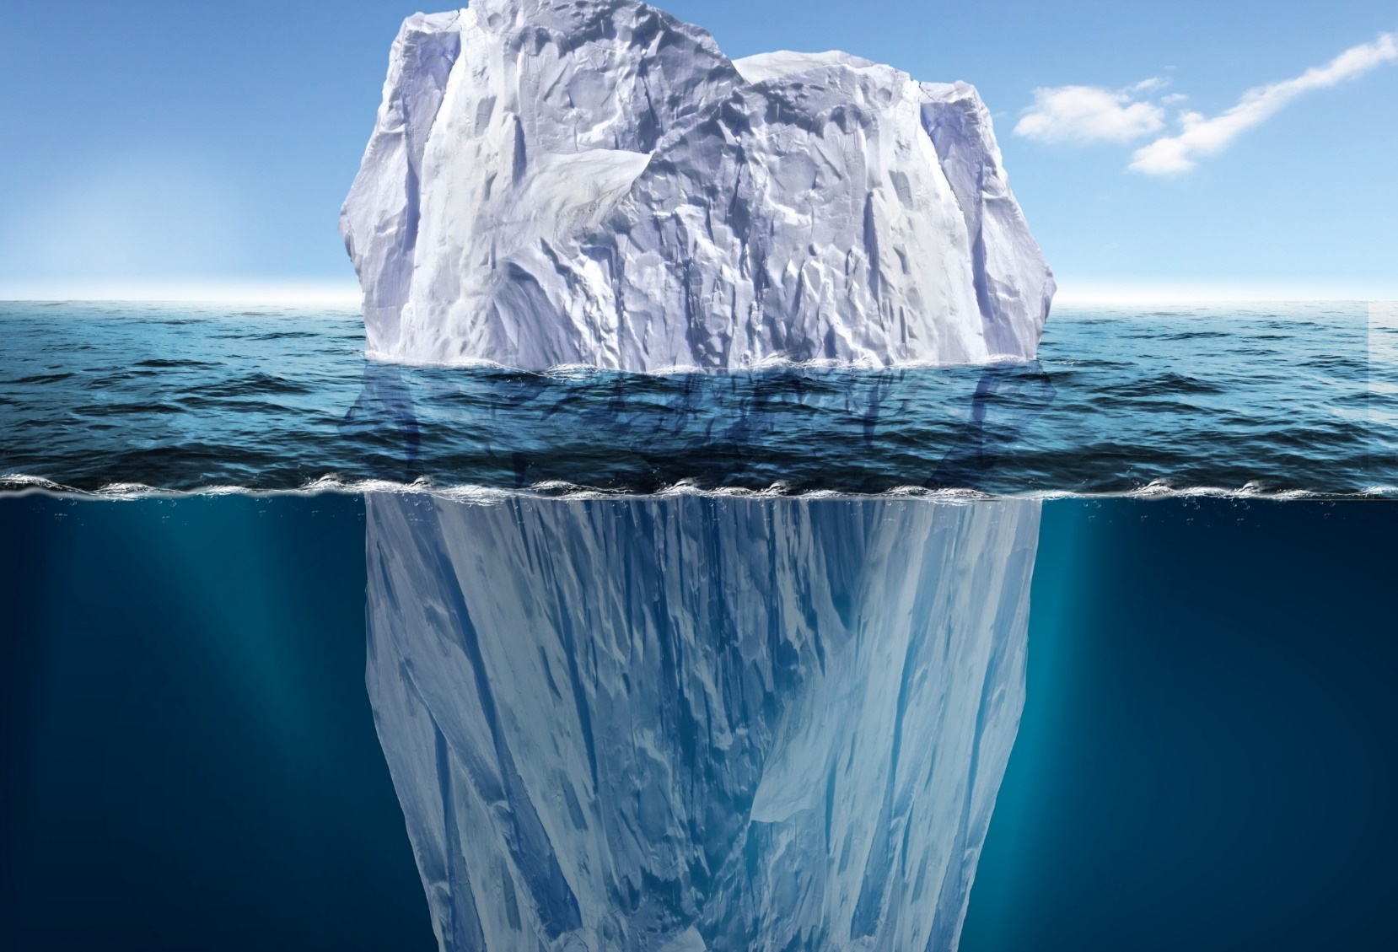





Summary of
Benefits of Krill Oil
Better absorption
Better Efficacy
No fishy burps
Most powerful natural antioxidant (Astaxanthin)
Sustainability

Slide 16
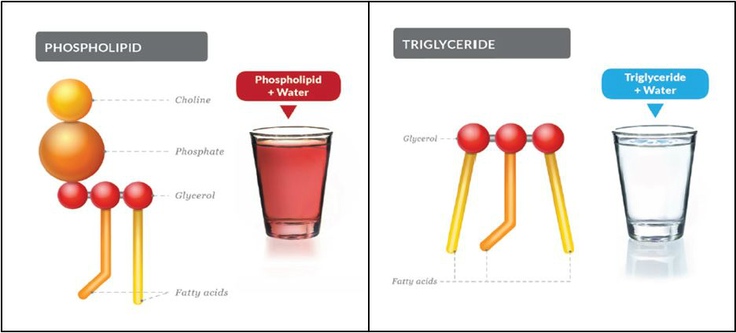
Krill Oil Absorption
Krill oil is better absorbed than fish oil or any other triglyceride bound omega, leading to better efficacy
Krill oil is phospholipid bound Omega fatty acids, that is absorbed in the intestine, hence causes no fishy burps

Slide 17
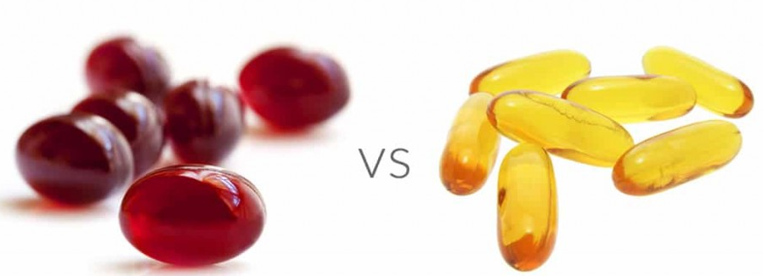
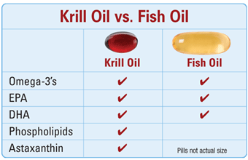

Slide 18
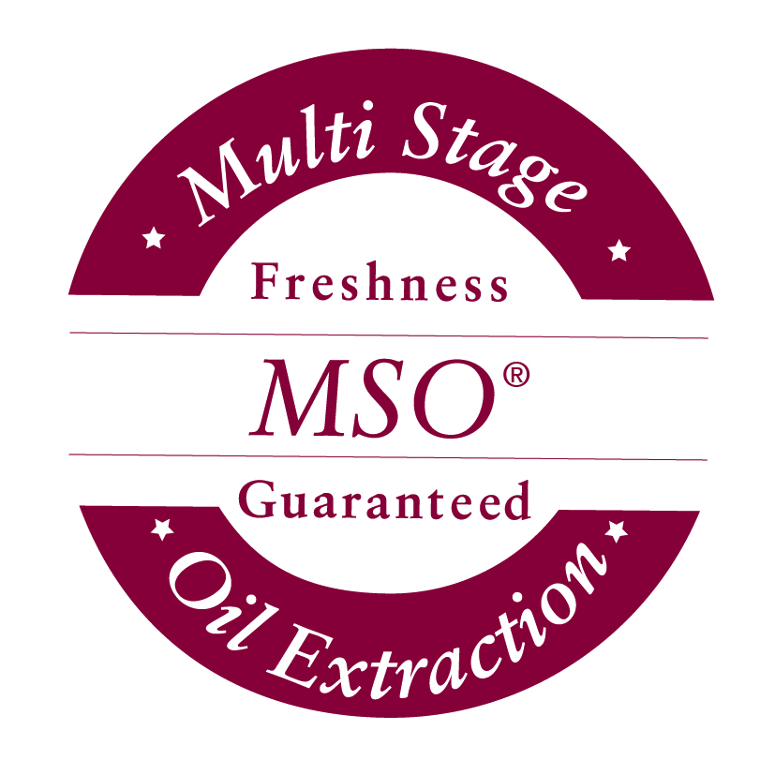
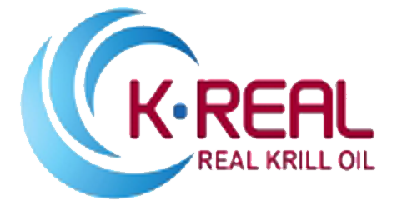
Krill Oil Extraction process
Vestige Prime Kill Oil contains K-Real Krill oil, manufactured by a propriety process called MSO – Multi-Stage Oil Extraction
This process preserves the natural nutrient profile of Krill Oil while removing spoilage components such as
  Trimethylamine (TMA)
  Total Volatile Nitrogen (TVN)
  Other oxidative derivatives
It leads to improves physical properties and odour
  Less fishy odour
  Optimal viscosity and stability
  No fishy burps

Slide 19
Processing of Krill
Krill Biomass
Cooking & Pressing
Extraction from Solid Steam
Crude
Krill Oil

Slide 20
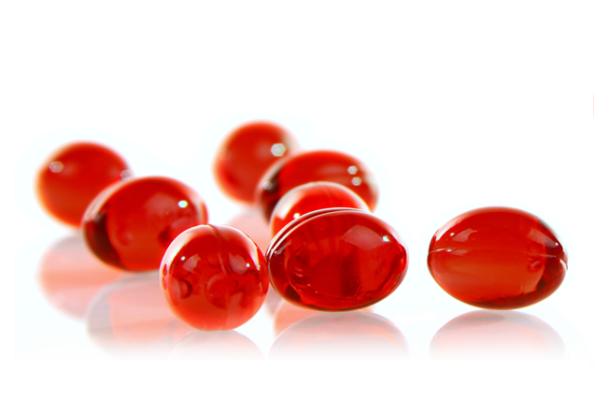
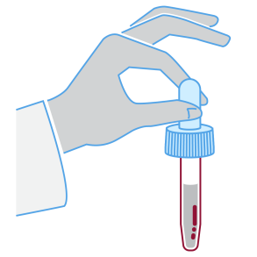
Processing of Krill
Gold standard Krill oil

Slide 21
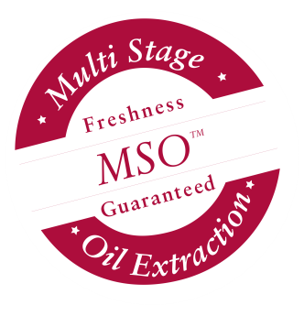
The Advantages of MSO®
Preserves the nutrient properties of fresh krill...
Maintains
natural
phospholipids
structure
®
Maintains
Astaxanthin
Maintains
Omega-3 fatty acids

Slide 22
The Advantages of MSO®
Removes spoilage components
Removes
Smell
®
  Removes
  impurities
Removes
Other oxidative elements and derivatives

Slide 23
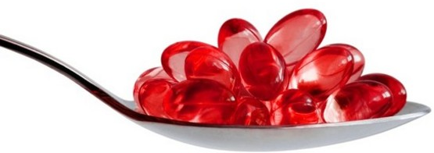
Recommended Use
Therapeutic doses range from 1000-1500 mg krill oil (2-3 capsules) per day, with maintenance dosing of 500 mg daily (1 capsule)
The recommended daily intakes are
  For cardiovascular benefits 1000mg – 1500mg (2-3 capsules)
  It is reported as better to start with the higher intake and reduce this after about 2 months so long as the benefits can be maintained

Slide 24

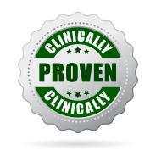

Vestige Prime Krill Oil
Net Content 30 Softgel capsules

Slide 25
Thank you

