Slide 1
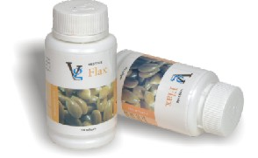
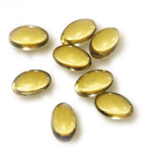
VESTIGE
FLAX SEED OIL.
PRODUCT INFORMATION TRAINING.

Slide 2
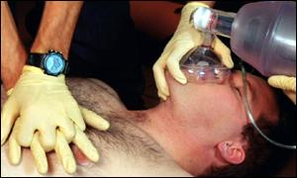
HEART DISEASES ON THE RISE.
There has been a marked increase in the incidence of heart disease in recent years. Heart attacks have become the number one killer in western countries. They rank third in India, after tuberculosis and infections.
Cardiovascular disease is the world's leading killer, accounting for 16.7 million or 29.2 per cent of total global deaths in 2003.

Slide 3
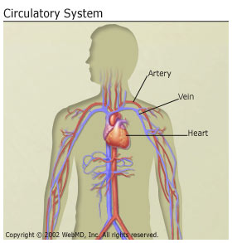
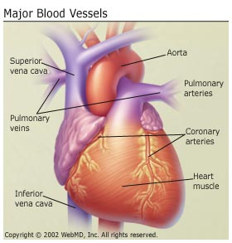
OUR HEART

Slide 4
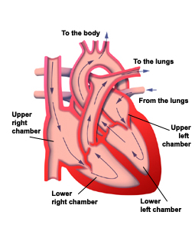
BLOOD FLOW TO & FROM OUR HEART.

Slide 5
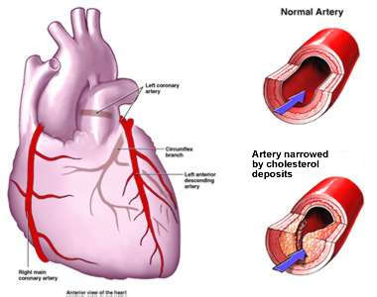
NORMAL & NARROWED ARTERY.

Slide 6
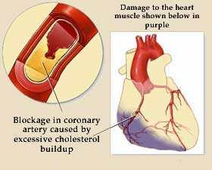
HEART DAMAGE.

Slide 7
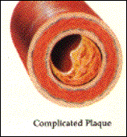
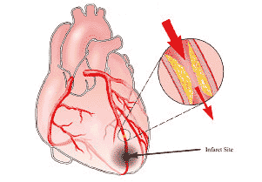
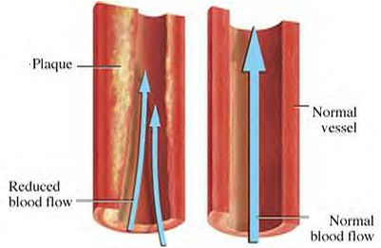
HEART ATTACK.

Slide 8
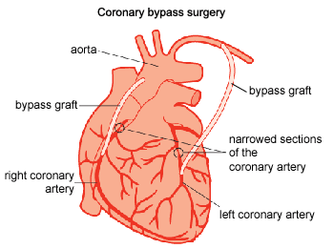
BYPASS SURGERY.

Slide 9
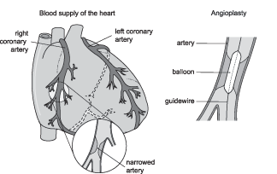
ANGIOPLASTY/BALLOONING.

Slide 10
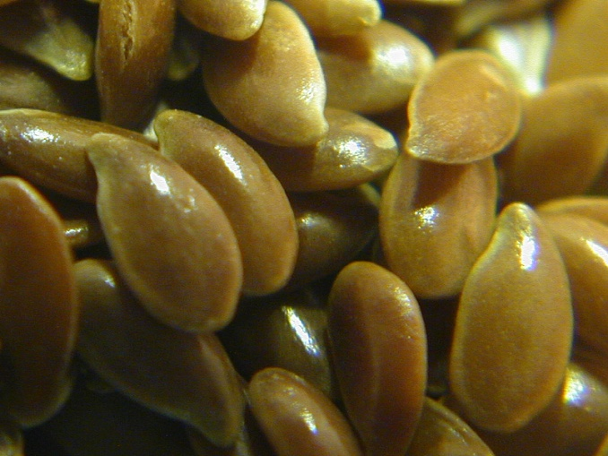
FLAX SEED OIL – HISTORY.
Flax Seed Oil is an ancient crop that has its origins traced back to 3000 B.C.
Flax Seed is also known as Linseed.
In Hindi it is known as ALSI & Flax Seed Oil is known as Alsi Ka Tael.

Slide 11
FLAX SEED OIL – HISTORY.
Flax Seed Oil is the richest known source of Alpha-Linolenic Acid which is also known as Omega-3 & Linolenic Acid which is also known as Omega-6.
Flax Seed Oil Contains approximately 50-60% Omega-3 & roughly 18-20% Omega-6.
Flax Seed Oil also contains Vitamin-B
Potassium
Magnesium
Fiber
Protein & Zinc.
Flax Contains approximately 50% more Omega-3 than FISH OIL.

Slide 12
FLAX SEED OIL – BENEFITS.
Omega-3 helps lower Cholesterol & blood triglycerides & prevent clot arteries, which may result in strokes, heart attack.
Flax Seed Oil (20 gms/day) lowers LDL Cholesterol levels by upto 18%.
Helps prevent the accumulation of fatty deposits inside the blood vessels, especially the large & medium sized arteries, that many people experience during aging process.
Contains Vitamins & Minerals.

Slide 13
FLAX SEED OIL – BENEFITS.
Makes Blood platelets less “Sticky” due to conversion of Alpha Linolenic acid to EPA- Eicosa Pentaenonic Acid.
Lowers Elevated Blood pressure in hypertension.
Improves the functioning of the liver.
Improves Eyesight .
Shortens recovery times for fatigued muscles after exertion.
Increases the body’s production of energy & increases stamina

Slide 14
THANK YOU
ENJOY A HEALTHY LIFE WITH VESTIGE FLAX SEED OIL.
PREVENTION IS BETTER THAN CURE.

