Slide 1


VESTIGE
CURCUMIN PLUS
Introducing
3rd October, 2018

Slide 2

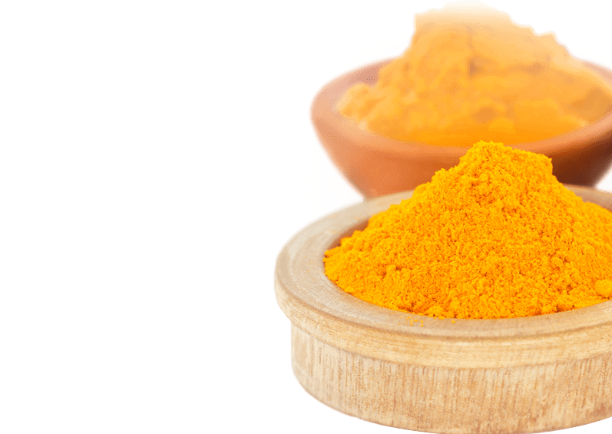
INTRODUCTION to Curcumin
Curcumin is a naturally occurring chemical compound found in Turmeric
From centuries turmeric was used for many known health condition
Curcumin has been used extensively in Ayurvedic medicine for centuries, as it is nontoxic and has a variety of therapeutic properties including anti-oxidant, analgesic, anti-inflammatory and antiseptic activity
Curcumin is now being recognized and used worldwide in many different forms for multiple potential health benefits
It is used in cosmetics, food flavouring and as food coloring ingredient

Slide 3
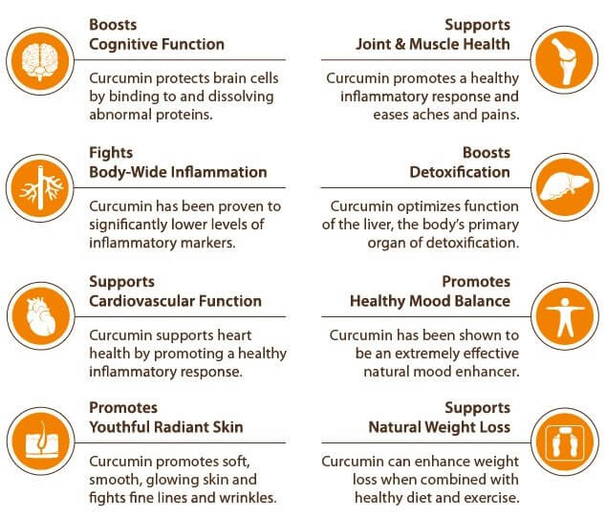
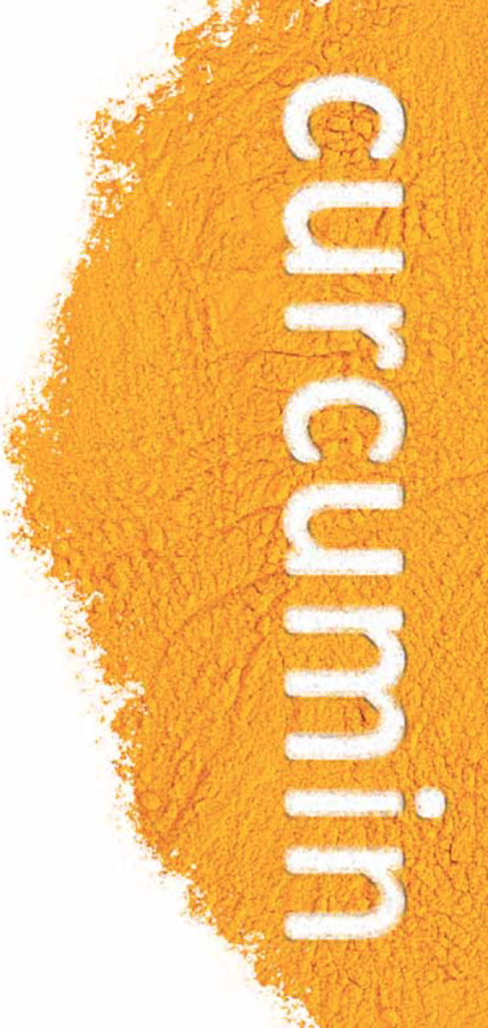
BENEFITS of Curcumin

Slide 4

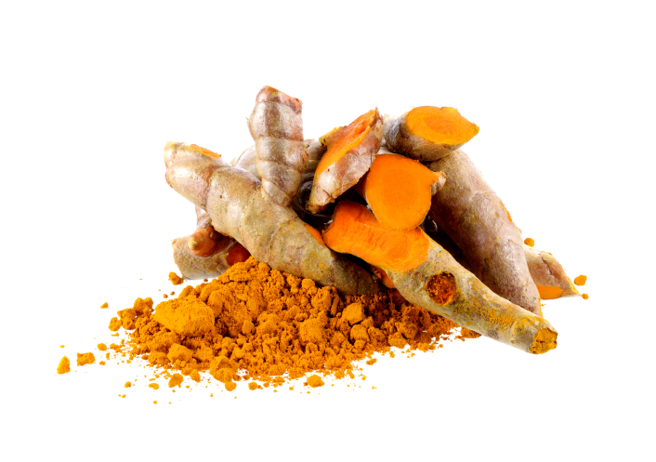
ANTI-CARCINOGENIC Properties of Curcumin
Curcumin has shown anti-proliferative effect in various types of cancers
Curcumin has been shown to have a wide variety of therapeutic effects, ranging from anti-inflammatory, chemo-preventive and anti-proliferative
Curcumin's potent anti-oxidant properties plays an important role in the inhibitory effects of the compound on the initial stages of carcinogenesis
Supports and makes chemotherapy more effective & protects healthy cells from damage
Studies suggest it prevents cancer by slowing down its spread and tumor growth
Interferes with tumor invasion & blocks molecules from penetration to healthy tissues
Daily use of miracle compound helps in flushing out toxin from our body
* Source: Curcumin: A review of anti-cancer properties and therapeutic activity in head and neck squamous cell carcinoma, Wilken et al. Molecular Cancer 2011, 10:12

Slide 5
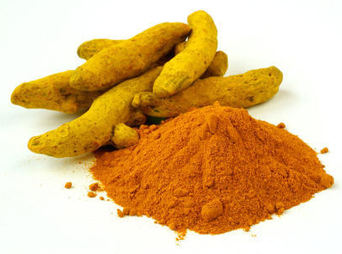
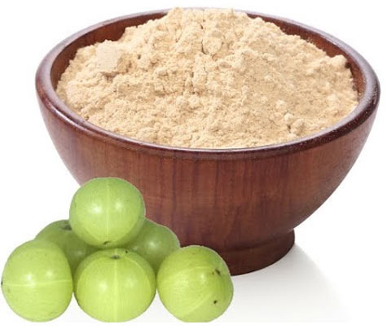
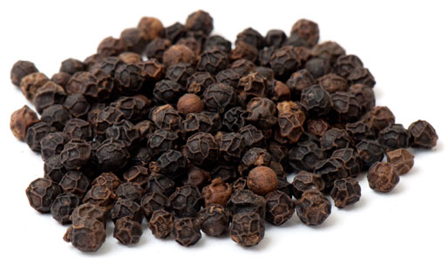
VESTIGE Curcumin Plus
PICTURE | INGREDIENTS | FUNCTIONS
 | Curcumin | A potent anti-oxidant, anti-inflammatory and analgesic. Supports respiratory function, cardiovascular function, joint health and flexibility. Prevents abnormal cell growth
 | Amla tannins | Potent anti-oxidant and anti-ageing ingredient
 | Piprine | Helps in increasing the bio-availability of the nutrients. It has anti-inflammatory properties and improves metabolism

Slide 6
BENEFITS of Vestige Curcumin Plus
Hepato-protective Effects: It has shown liver-protective properties as it protects the liver from free radical damage
Anti-inflammatory Effects: It has found to be very effective in instances of acute inflammation as well as for chronic inflammation
Anti-carcinogenic Effects: It has the ability to inhibit carcinogenesis at three stages: tumor promotion, angiogenesis, and tumor growth.
Antimicrobial Effects: Curcumin helps in inhibiting the growth of a variety of bacteria, parasites, and pathogenic fungi
Cardiovascular Effects: Curcumin’s protective effects on the cardiovascular system include lowering cholesterol and triglyceride levels
Gastrointestinal Effects: It has protective effects on the gastrointestinal tract
Immunity Booster: It helps in increasing antibodies and enhancing immunity
It may also help in the management of exercise-induced inflammation and muscle soreness, thus enhancing recovery and subsequent performance in active people

Slide 7
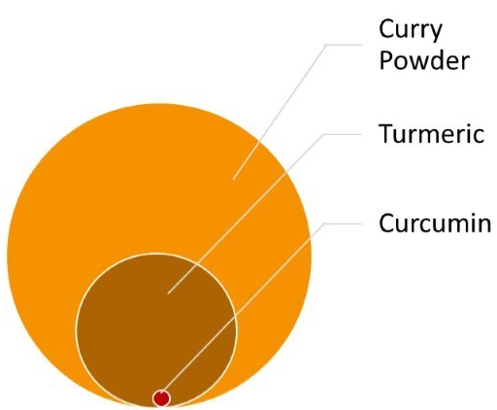
DIFFERENCE between Turmeric & Curcumin
The plant turmeric (Curcuma longa) is very well known in India
The root is harvested, cleaned, dried, and powdered to be used as a spice (turmeric gives curry its beautiful golden yellow color) and as a medicine
But, a typical turmeric root contains about 2-5% curcumin, so taking an unstandardized, powdered turmeric root product means that very large amounts would be required to get a beneficial amount of curcumin
While turmeric is excellent when used as a spice, a curcumin extract is a better choice for specific health benefits

Slide 8
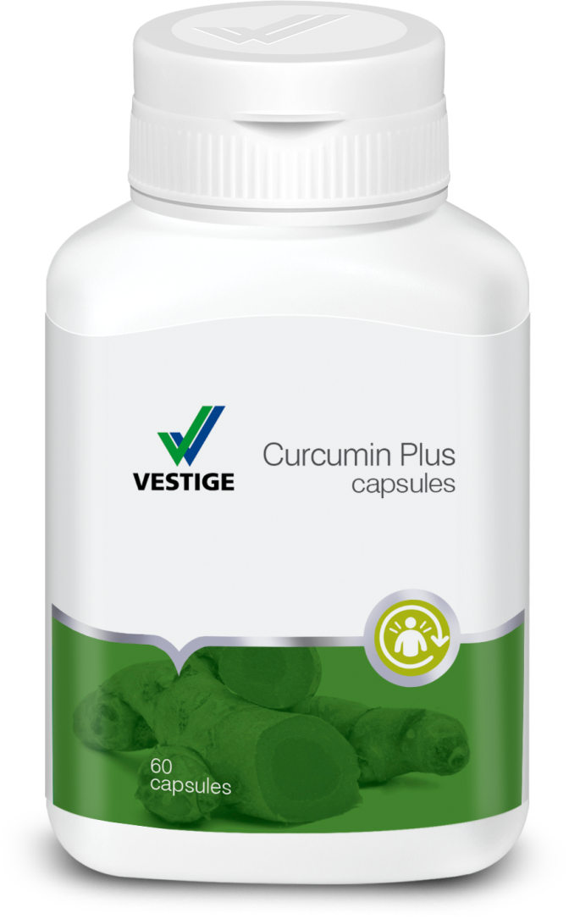
DOSAGE of Vestige Curcumin Plus
One capsule thrice daily or as advised by the physician

Slide 9
Vestige Curcumin Plus
60 Capsules
MRP Rs. 1050
DP Rs. 900
BV 540
PV 30

Slide 10


