Slide 1
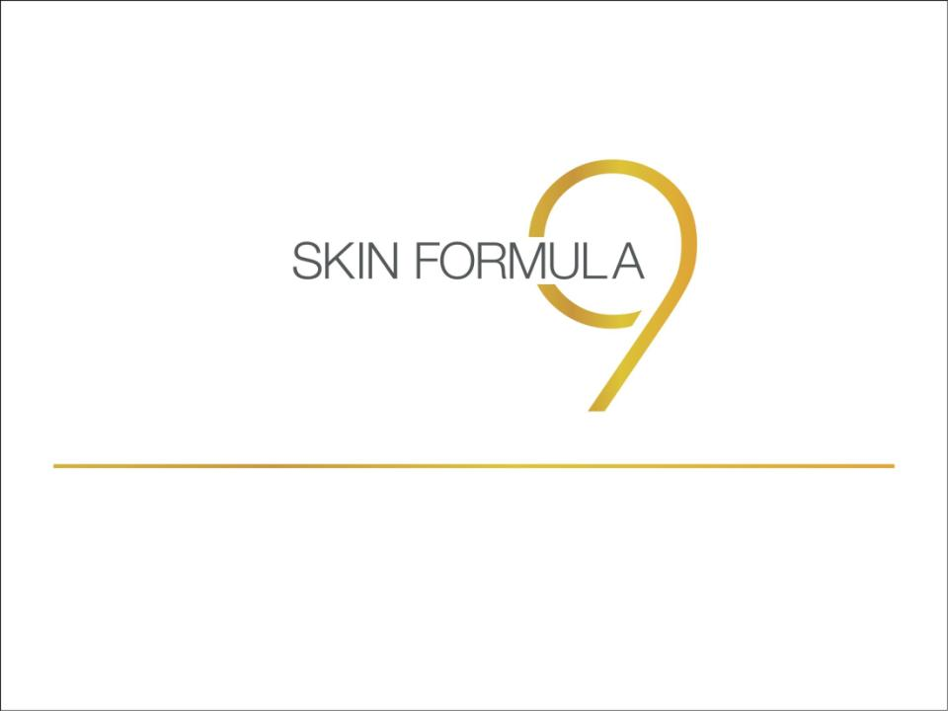
Product Training

Slide 2
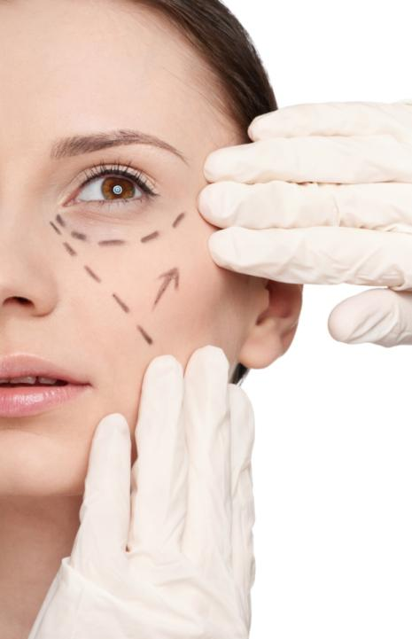
The Ageing
Phenomenon
Ageing is an inevitable and natural part of our life
It’s happening to all of us, and it’s mostly visible on the skin
Skin ageing is predominantly caused by UV exposure over long periods of time. UV rays break down collagen and elastin and slow the production of new collagen which aids in skin repair and gives skin its strength.

Slide 3
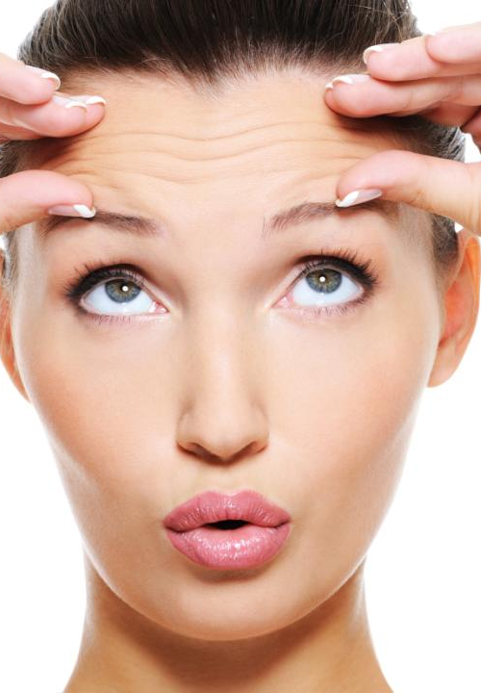
The Ageing Phenomenon
There are several factors that affect skin ageing:
  Genetic factors – DNA damage
  Free radical damage
  Hormonal imbalance
  Lifestyle disorders – excessive smoking, alcohol, stress, poor sleeping habits, poor diet
  Environmental Pollution
  Prolonged sun exposure
  Harsh skin care products and improper cleansing techniques

Slide 4

Age
Related
Problems

Slide 5
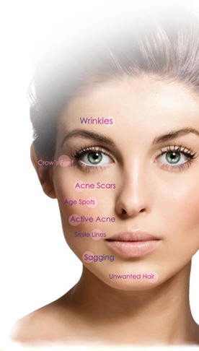
Age Related Skin Problems
Pigmentation and age spots
Wrinkles and fine lines, dull and rough complexion
Dry and dehydrated skin
Blemishes and acne marks
Excessive oily and shiny skin
Under eye dark circles, Puffy Eyes and Crow’s Feet

Slide 6
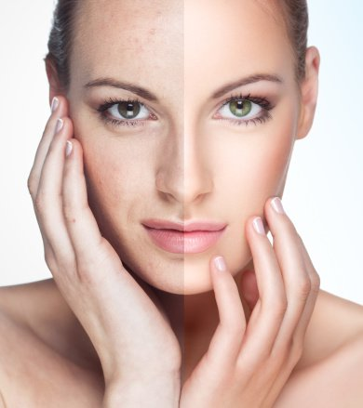
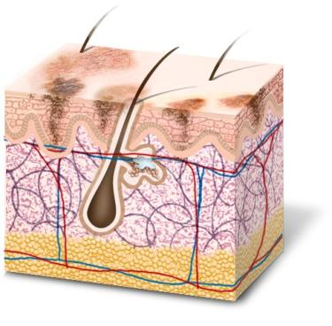
Pigmentation & Age Spots
Dark patches
Freckles
Age spots

Slide 7
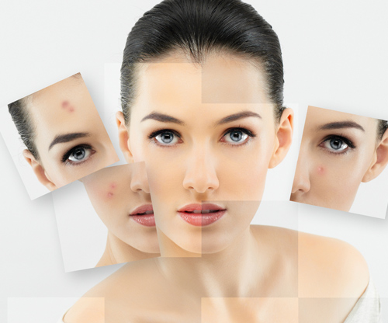
Pigmentation & Age Spots
Causes
Excessive sun exposure
Hormonal imbalance
Lack of certain nutrients
Previous acne problem

Slide 8
Solution
Skin Formula 9
Brightening Treatment
Reveal Your True Radiance

Slide 9
Useful for:
Hyper-pigmentation
Dull skin
Uneven skin tone
Blemish and age spots
Key Features :
A corrective radiance-inducing multi-action formula
Lightens spots
Clarifies skin to give a flawless even complexion
Detoxifies the skin and efficiently fights free radicals

Slide 10



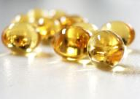
Key Ingredients:
Claripure Stem cell blend:
  Detoxifies skin cells
  Decreases formation of melanin
Daisy flower extract:
  Skin lightening agent
  Lightens freckles and age spots
Essential Narcissus Flower Wax
  It has calming and astringent effect
Vitamin B3
  Lightens skin by interfering in melanin transfer

Slide 11
How to use
Apply few drops directly on cleansed and toned face
Start from the neck up to the face
Use upward circular motions only
Let it absorb completely into the skin before applying anything else
Use regularly to lighten pigmentation spots
When to use
Use in the morning before applying sunscreen
Use at night as night cream
If applying with Intense Hydration Cream apply after Hydration base
If applying with Youth Elixir, apply before Youth Elixir

Slide 12
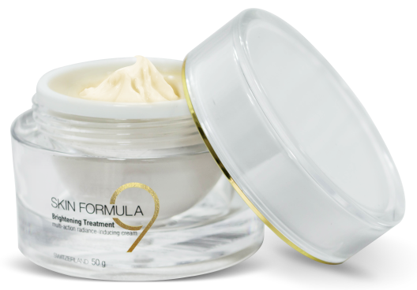
Brightening Treatment
PV 71
BV 1136
DP Rs. 1900
MRP Rs. 2200

Slide 13
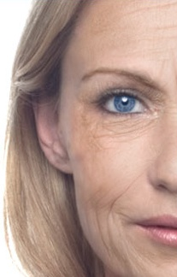
Wrinkles &
Fine lines
Fine lines and deep wrinkles near lips, eyes and forehead
Sagging skin due to reduced collagen in the skin

Slide 14
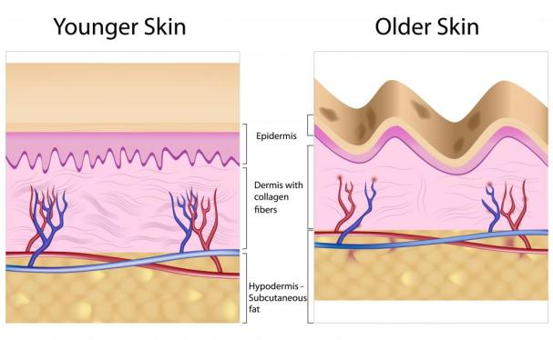
Wrinkles & Fine lines
Causes
Reduced collagen (structural protein) synthesis in the skin
Excessive Sun exposure – causes collagen damage
Excessive dryness
Lifestyle disorders

Slide 15
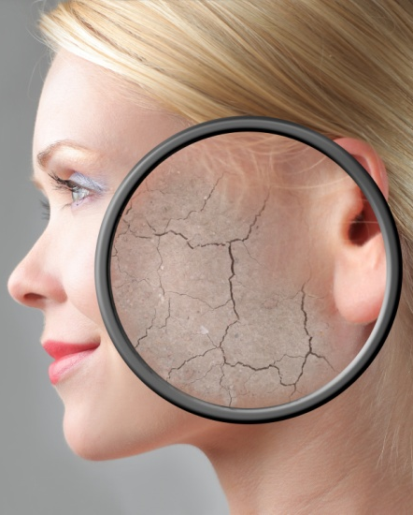
Dull & Rough
Complexion
All over rough skin
Premature ageing
Irregular age spots
Uneven skin tone

Slide 16
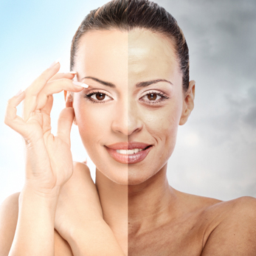
Dull & Rough
Complexion
Causes
Slow cell renewal
Lack of exfoliation
Lack of skin nutrition due to broken blood vessels
Prolonged sun exposure

Slide 17
Solution
Skin Formula 9
Youth Elixir
Secret of youth in a bottle

Slide 18
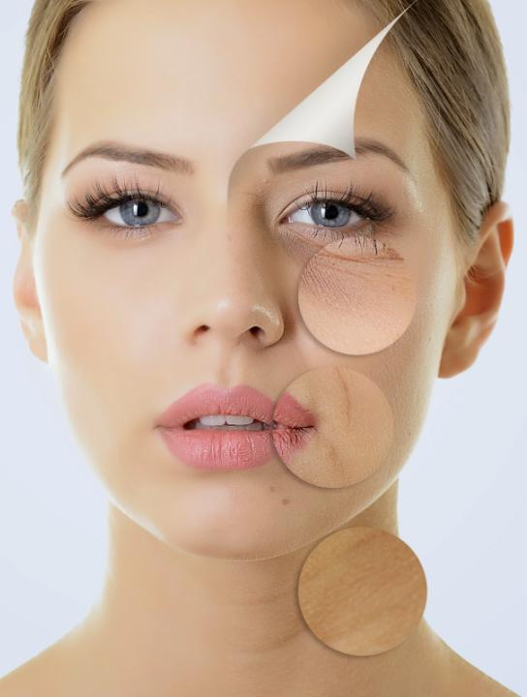
Useful for:
Deep and fine lines
Rough and scaly skin
Dull and lack of radiance
Key Features :
Boosts the skin’s elasticity and suppleness by stimulating collagen production
Dramatically reduces the appearance of fine lines and wrinkles
Contains precious gold dust that enhances radiance and gives a warm glow

Slide 19
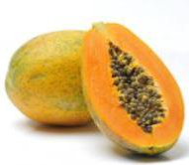
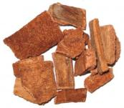
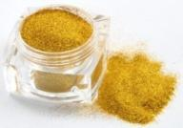

Key Ingredients:
ATP-Papaya-Algin blend:
    Rich in Vit. A, improves appearance of wrinkles
Chuchuhasi extract:
    Skin healing tonic
    Anti-oxidant and anti-inflammatory
24-Carat Gold Dust:
    Provide an instant glow to skin
    Has anti-aging benefits
Vitamin C
    Boosts collagen production
    Reduces appearance of wrinkles
    Improves skin elasticity and firmness
    Neutralizes free radicals

Slide 20
How to use
Apply few drops directly on cleansed and toned face
Start from the neck up to the face
Use upward circular motions only
Let it absorb completely into the skin before applying anything else
Use regularly to lighten pigmentation spots
When to use
Use in the morning before applying sunscreen
Use at night as night cream
If applying with Intense Hydration Cream apply after Hydration base
If applying with Youth Elixir, apply before Youth Elixir

Slide 21
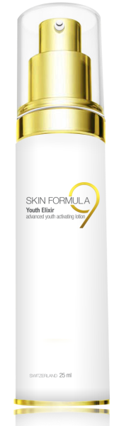
Youth Elixir
PV 54
BV 864
DP Rs. 1450
MRP Rs. 1670

Slide 22
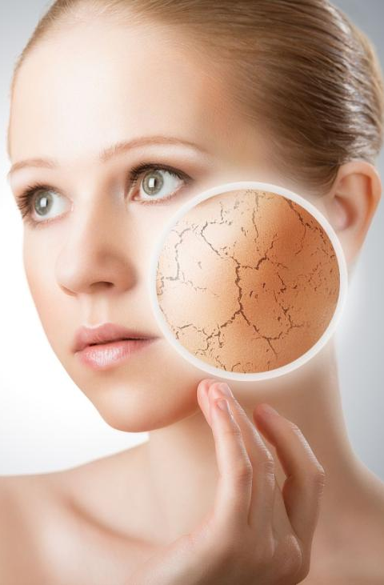
Dry &
Dehydrated Skin
Patchy, blotchy appearance
Scaly skin
Redness due to dryness
Itchy and tight

Slide 23
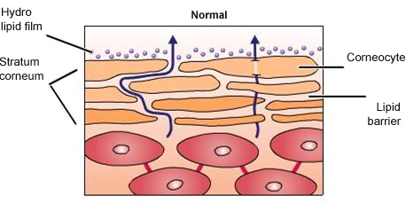

Dry & Dehydrated Skin
Causes
Loss of Hydrolipid film – sweat and oil film, that prevents moisture loss
Loss of skin’s natural moisture balance
Use of harsh cleansers

Slide 24
Solution
Skin Formula 9
Intense Hydration Cream
Breathe life into your skin

Slide 25
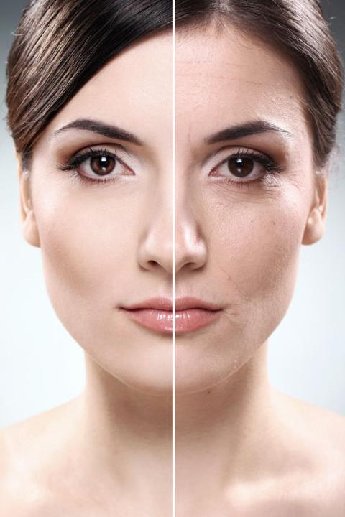
Useful for:
Dehydrated skin
Patchy and flaky skin
Wrinkles due to tight skin
Scaly skin
Key Features :
Moisturizes and nourishes skin from deep within
Forms a protective layer on the skin and shields against water loss
Provides hydration for longer periods

Slide 26

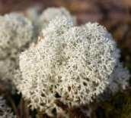
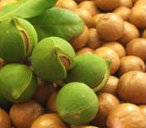
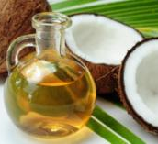
Key Ingredients:
Multi-functional Moisturizing complex
  Helps retain moisture in the skin
  Boosts water absorption from the atmosphere
Icelandic Moss
  Helps to absorb and store water in cells to maintain skin moisture
Organic Macadamia nut oil and Coconut oil
  Soothes and conditions skin
  It has anti-aging benefits
Coconut Oil
  It has soothing, moisturizing and film-forming properties

Slide 27
How to use
Apply few drops directly on cleansed and toned face
Start from the neck up to the face
Use upward circular motions only
Let it absorb completely into the skin before applying anything else
Use regularly to get rid of dry skin problem
When to use
Use in the morning before applying sunscreen
Use at night as night cream
If applying with Brightening Treatment / Youth Elixir, first apply Hydration cream

Slide 28
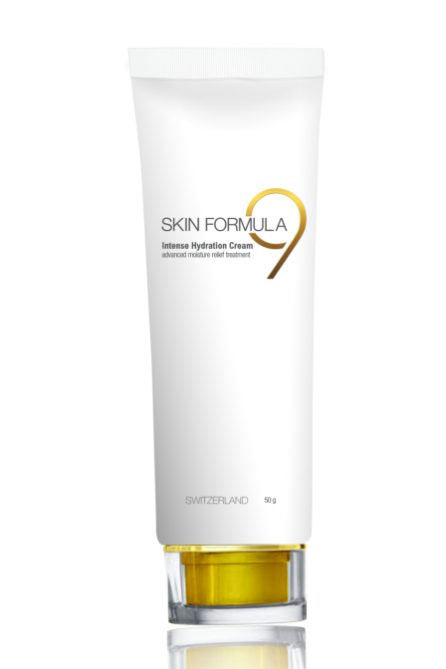
Intense Hydration
Cream
PV 45
BV 720
DP Rs. 1200
MRP Rs. 1380

Slide 29
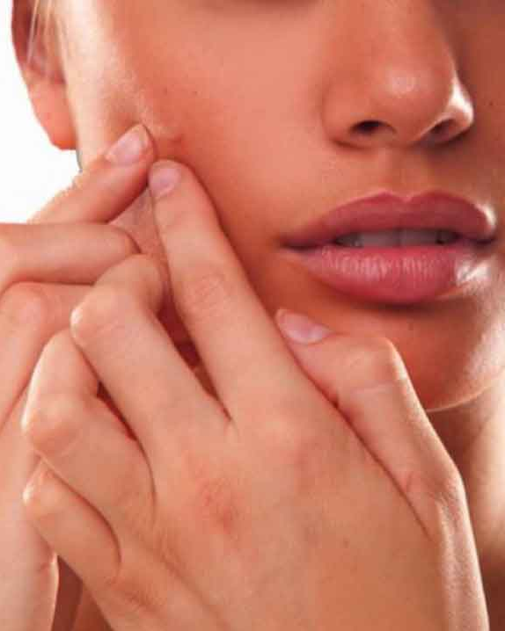
Blemishes &
Acne Marks
Acne marks
Dark spot underneath an acne or pimple
Age spots

Slide 30
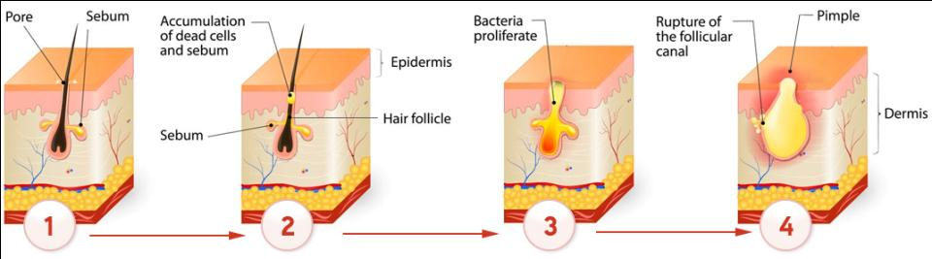
Blemishes & Acne Marks
Causes
Excessive oily skin
Skin prone to acne and pimples
Excessive sun exposure
Hormonal imbalance
Lifestyle and eating habits

Slide 31
Introducing
Solution
Skin Formula 9
Blemish Gel
Targeted for anti-imperfections

Slide 32
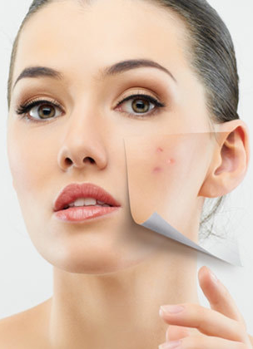
Useful for:
Skin imperfections
Acne and Blemishes
Dark acne spots
Inflammation
Key Features :
Targets, treats and reduce the appearance of dark spots, blemishes and acne spots, leaving the skin flawless
A light weight, fast absorbing and non-comedogenic formula dries up blemishes overnight
It helps to calm inflammation and deeply exfoliates and unclogs pores

Slide 33

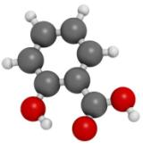


Key Ingredients:
Pre- and Pro-Biotic Symbiotic Complex
  Stimulates natural defense mechanism of the skin
  Helps to smooth, restructure and nourish the skin
Salicylic acid
  It hydrates the skin
  It is harsh on impurities and favors exfoliation
Tea Tree oil
  It has antibacterial, antifungal and anti-inflammatory properties
Eucalyptus oil
  It has antiseptic, purifying and toning activity on the skin that effectively acts on acne and blemishes

Slide 34
How to use
After thoroughly cleansing the face and neck, apply precisely on problem areas of the skin using the applicator directly
Let it dry for few seconds and follow with make-up and/or sunscreen
Clean the mouth of the applicator after every use to avoid further proliferation
When to use
For best results use twice daily or as often as required
Avoid direct sun exposure after application

Slide 35
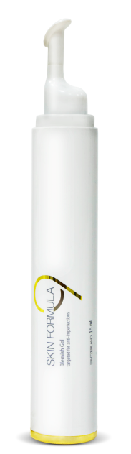
Blemish Gel
PV 31.87
BV 510
DP Rs. 850
MRP Rs. 1000

Slide 36

Excessive Oily & Shiny Skin
Oily Skin is characterized by:
Enlarged pores
Over activity of oil glands
Dull, shiny & thick complexion
Prone to blackheads, pimples and blemishes

Slide 37
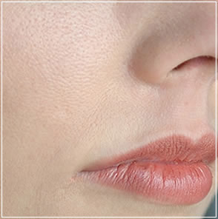
Excessive Oily & Shiny Skin
Causes
Lack of cleansing and toning
Over washing or under washing of face using harsh chemicals
Stress
Excessive exposure to humidity
Hormonal imbalance
Clogged pores

Slide 38
Introducing
Solution
Skin Formula 9
Deep Cleansing Oil
Advanced skin refining & renewing

Slide 39
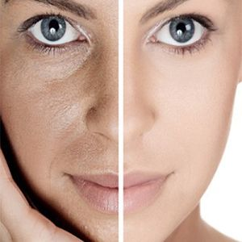
Useful for:
Oily skin
Sensitive / Dry skin
Maintain skin moisture level
Superior cleansing
Key Features :
Deeply cleanses without stripping the skin's natural oils
Effectively dissolves makeup, impurities, dirt, oil and grim leaving the skin healthy, soft and refreshed
Flushes away deep pores on the skin, leaving absolutely no residue
Perfect cleanser for dry, sensitive skin, and for acne/clog prone and ageing skin

Slide 40
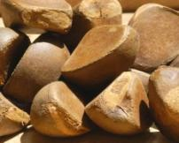
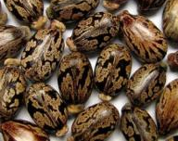
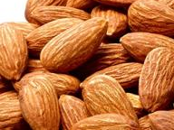

Key Ingredients:
Andiroba oil
    It has superior healing and soothing properties and calms the skin
Castor Seed oil
    It has superior moisturizing and purifying properties that penetrates deep into the skin and effectively restore skin hydration
Sweet almond oil
    This vitamin rich oil has soothing and relaxing effect on the skin
    It also helps lighten skin and nourishes the skin from within.
Berry Complex
    It has strong moisturizing action on skin cells and effectively restores hydration

Slide 41
How to use
For cleansing, pump a few pumps of oil onto dry hands and massage on dry face and neck for about 30 seconds
Wet your hands with few drops of water and then massage your face and neck again. The oil will turn into a smooth lotion
Rinse your face with plain water and pat dry
Avoid contact with eyes, if product goes into the eyes, splash cold water several times
When to use
For best results use twice daily, especially before going to bed, to relieve skin of all impurities, makeup and residue
Effective yet gentle, this cleansing oil is suitable for all skin types and leaves the face soft and perfectly cleansed, without any residue or oily film

Slide 42
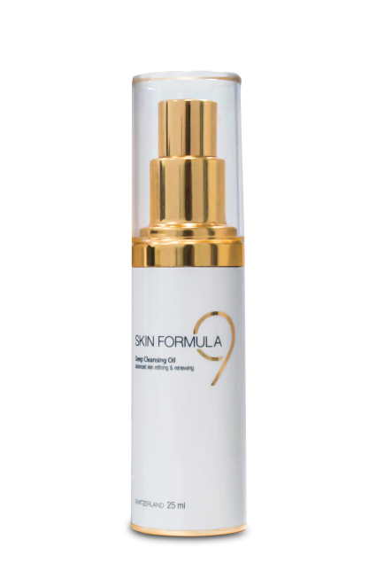
Deep Cleansing Oil
PV 45
BV 720
DP Rs. 1200
MRP Rs. 1400

Slide 43

Under Eye Dark
Circles, Puffy Eyes
& Crow’s Feet
Puffiness under the eyes
Darkening around the eyes
Hyper-pigmentation
Wrinkles and fine lines

Slide 44
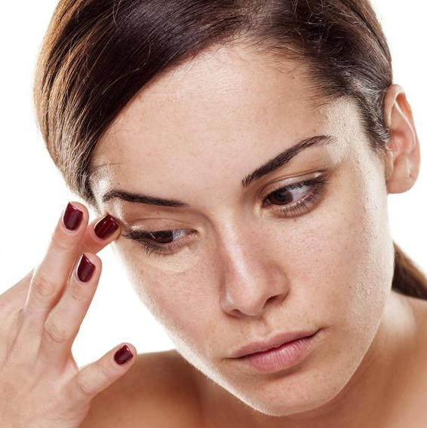
Under Eye Dark
Circles, Puffy Eyes
& Crow’s Feet
Causes
Lack of nutrition especially iron
Sleep disorders or lack of sleep
Age causes thinning of skin
Allergies and certain medication can cause dark circles under eyes

Slide 45
Introducing
Solution
Skin Formula 9
Under Eye Serum
Anti-wrinkle and firming serum

Slide 46

Useful for:
Dark circles under eyes
Pigmentation under the eyes
Puffiness under eyes
Wrinkles and Crow’s feet
Key Features :
Helps to soothe visible fine lines and crow's feet around the eyes
Helps to improve skin tone and firmness by reducing excess puffiness and boosting natural collagen production
The light weight texture easily absorbs into the skin for instant perfection, leaving the eyes looking brightened and youthful

Slide 47
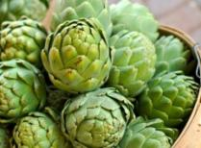
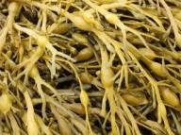
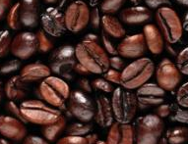
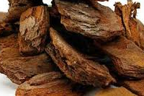
Key Ingredients:
Artichoke leaf peptides
  It counteracts the loss of elasticity, dryness and deepening of wrinkles caused due to hormonal imbalance
  It restores skin hydration and improves suppleness.
Channeled Wrack Extract
  It inhibits free radicals and stimulates the synthesis of collagen
  It improves skin moisturisation, tone and firmness
Caffeine
  It refreshes, restores lost radiance and reduces puffiness under the eyes
Mediterranean Pine Bark extract
  It neutralizes free radicals, protecting collagen and elastin
  It also helps to maintain skin moisture and elasticity

Slide 48
How to use
Apply small amount on cleansed skin around eye area – under eyes, outer corners and eyelids, using gentle strokes and smooth in until thoroughly absorbed
When to use
For best results use twice daily, especially before going to bed, to boost skin's ability to recharge and rehydrate during the nightly repair process
Avoid using anything on the serum, use night cream leaving the areas around the eyes

Slide 49
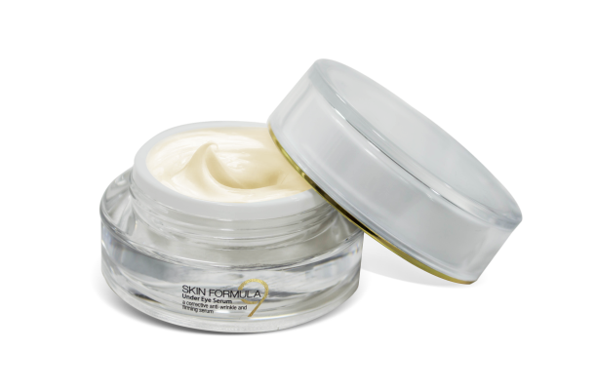
Under Eye Serum
PV 31.87
BV 510
DP Rs. 850
MRP Rs. 1000

Slide 50
THANK YOU

