Slide 1
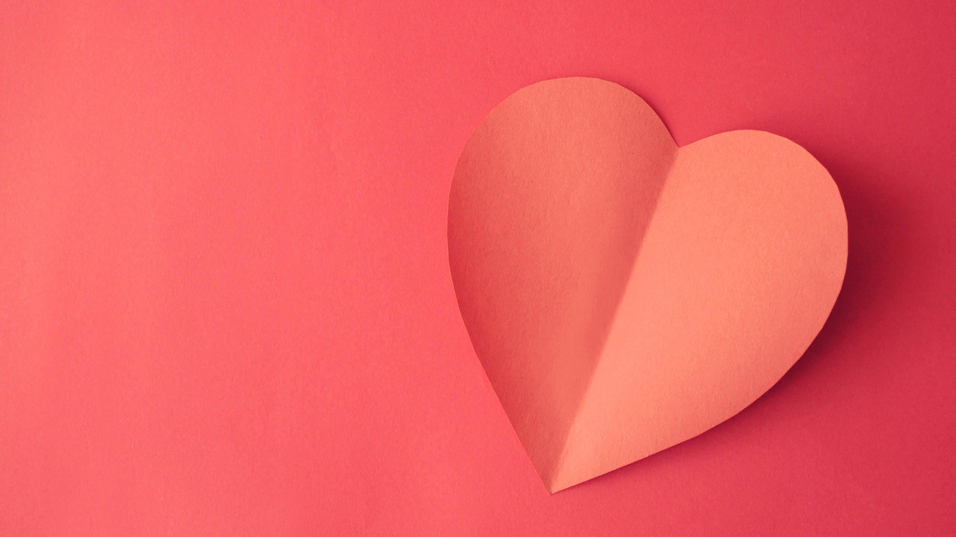
08th Feb 2017
Valentine Season
New Launch

Slide 2
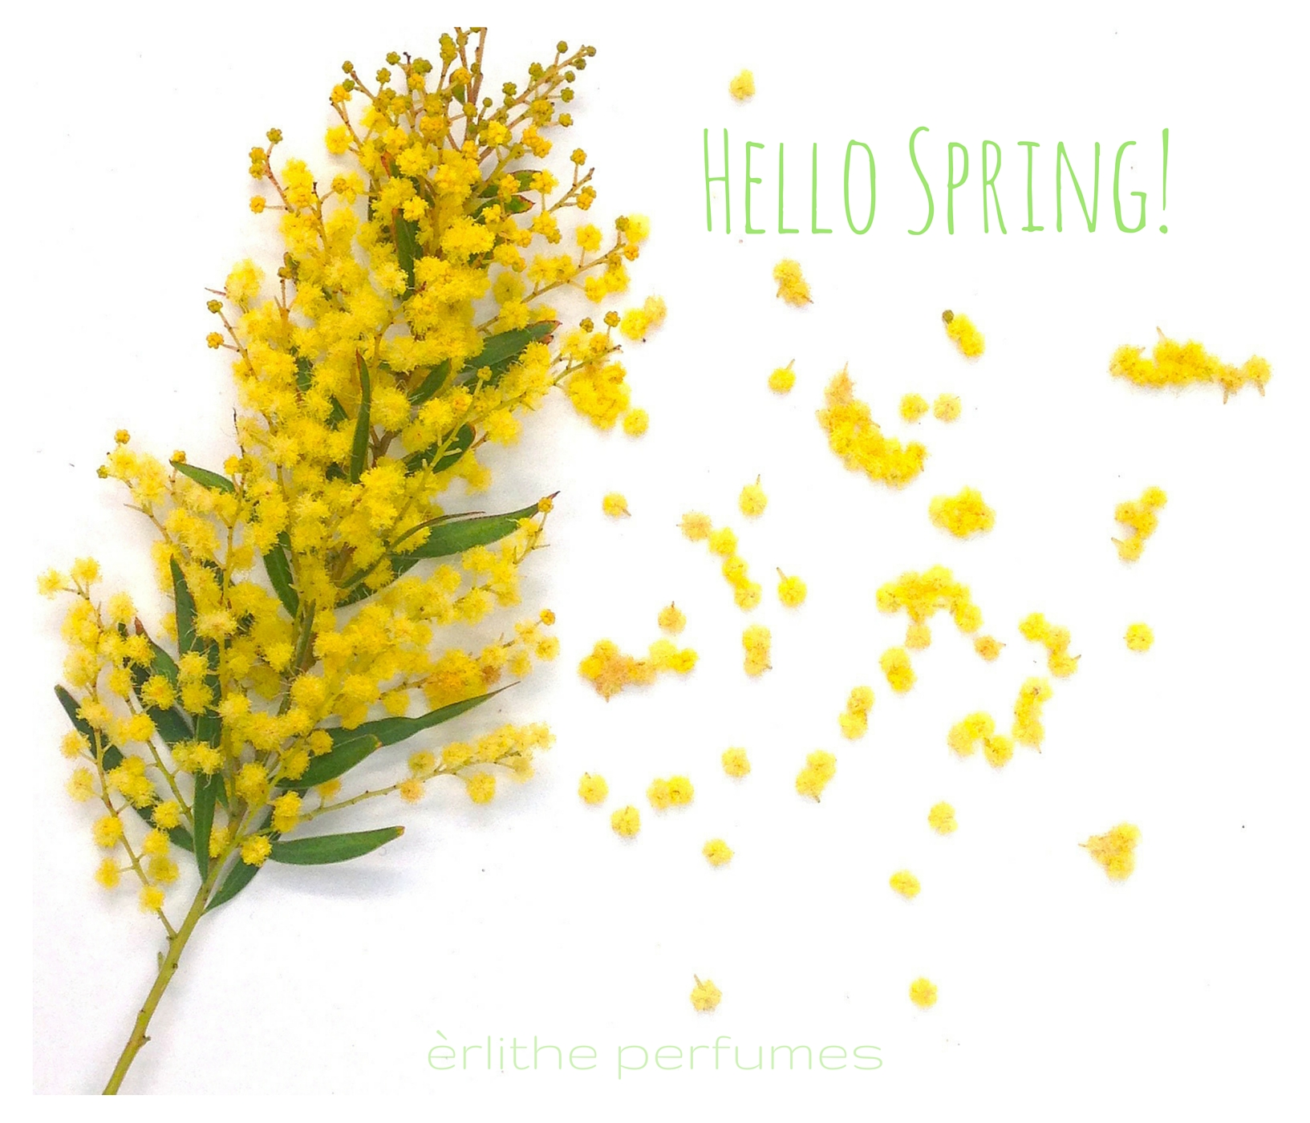
And time for love in the air!

Slide 3
Spring, when life is alive in everything!
Spring is the king of seasons— a time of sunshine and cheer, love and creativity. We begin to feel more energetic.
Lets us welcome the season that follows Winter and precedes Summer with open arms!
The nature wakes up after the winter hibernation. And we wake up with it.
Spring gives a chance for a fresh start.
Spring means new life.
Spring means discoveries.
Flowers are in bloom and field of grass makes us happy. Thanks to Spring, we get beautiful flowers during this temperate season.

Slide 4
Spring, Signifies Rebirth!
Commit to cleansing your body and your home.
Ganoderma, Dietary Fibre, Neem, Foot Patch
Ayusante ToxClean
Hyvest
Get active. Update or begin an EXERCISE program.
Adapt Your Diet. Enjoy fresh seasonal fruits and vegetables at their organic best. Use more honey and have sprouts as they have high amounts of many vitamins, minerals, and amino acids.
Spring
Rebirth
(Body)

Slide 5
Spring is the season of the LIVER and GALL BLADDER
Liver Health, Aloe Vera & Amla.
Take care of your liver by avoiding chemicals /toxins in your diet and environment.
Avoid junk foods and fats. Eat light, warm foods. Avoid cold, heavy foods.
NUTRITIONAL SUPPLEMENTS can support you with season change.
Antioxidants protect your body from stress and chemical pollutants. Use Ayusante Vital Complex.
To maintain overall health and vigour use CoenzymeQ10, Spirulina, L-arginine, Colostrum & Protein Powder.
Spring, Signifies Rebirth!
Spring
Rebirth
(Body)

Slide 6
Feel the NEW ENERGY of Spring. This is the season of re-birth. This is the season to plan your new year, for the new YOU. Creativity is the word for Spring, as are new beginnings.
Get outside. Enjoy the warmer weather and sunshine.
Choose a new hobby. Learn new things.
Become a volunteer. Spend those few extra hours of daylight saving time to do good for someone else.
Spring, Signifies Renewal!
Spring
Renewal
(Mind)

Slide 7
Use the spring months to CLARIFY YOUR PLANS and deepen the potential spiritual awakening or progress.
Allow the inspiration and motivation to arise from within and fill your cells and body, your brain and heart. Just make a start, and a space for your enlightenment!
Above all, give yourself the time to truly experience NATURE.
Spring, Signifies Regrowth!
Spring
Regrowth
(Soul)

Slide 8
And of course
LOVE
Spring
Rebirth
(Body)
Regrowth
(Soul)
Renewal
(Mind)

Slide 9
And of course
LOVE
Spring brings the season of Love, yes its Valentine’s Season!
In the springtime, as temperatures rise and flower buds peek out of the soil to greet the sun, the body begins making adjustments of its own.
Dopamine, a chemical in the brain associated with the excitement, it stimulates the brain to take note of every smile, laugh or special moment shared with a significant other.
Spring, Signifies Love!
Spring

Slide 10
Show him Your affection!
Men are much more sentimental than you imagine. They may project a tough exterior, but actually they’re not so different from us.
So don’t hold back. Let your creative side loose, and show him how you feel about him and how special you think he is.
Lets share some great gift ideas for the loved one.

Slide 11
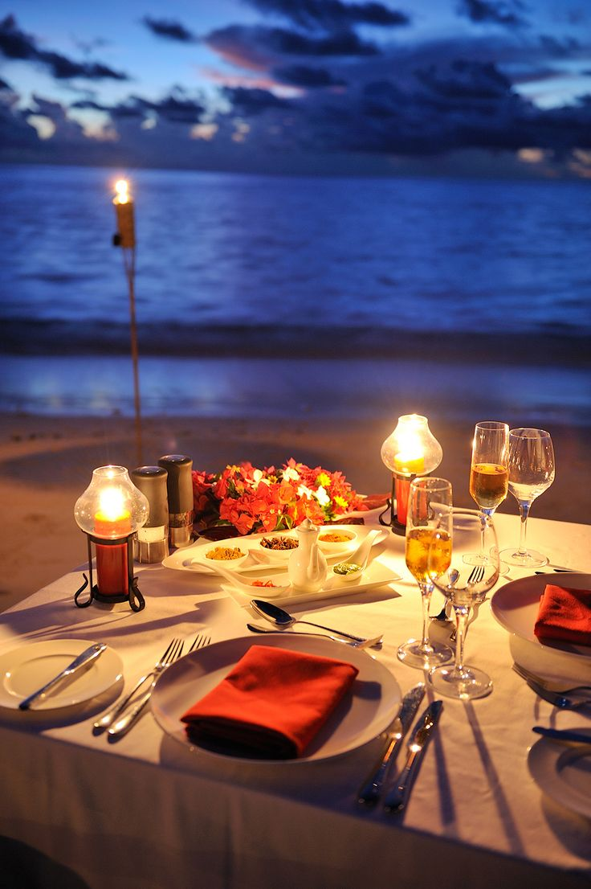
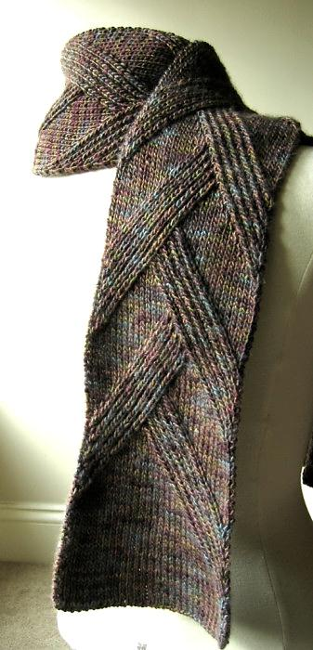
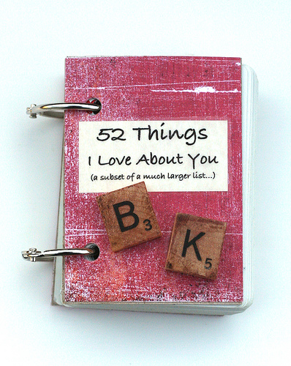
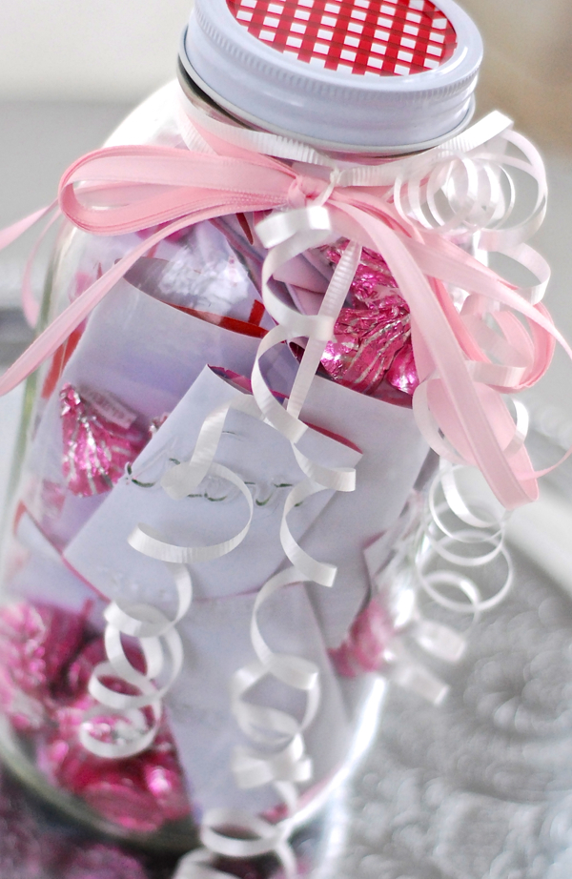
A dinner Date/picnic
A diary about him
A handmade scarf
A bottle with appreciation notes

Slide 12
Now we come to what we ladies want?!!
And the surprise awaits, from your one love Mistral of Milan to all Gorgeous ladies!

Slide 13
All you need is love. But a little Makeup now and then doesn't hurt!
As we say…

Slide 14
Valentine Collection
Let's Unveil
By Mistral Of Milan

Slide 15
GROUP SHOT

Slide 16
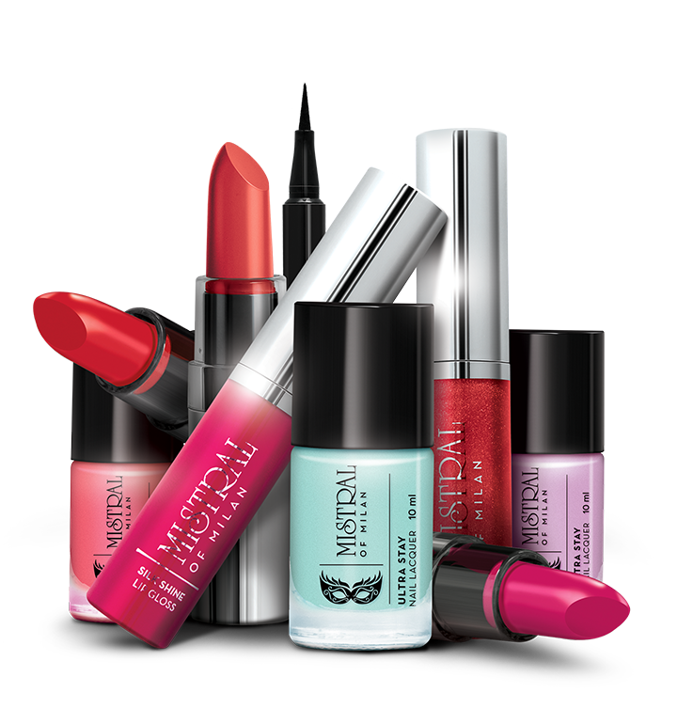

Slide 17
The Classic Crème Lipstick
High Definition.
High coverage.
Intense pigments.
Comfortable on lips.
Rosy hues.
Available in new 6 exotic and lovely shades.

Slide 18
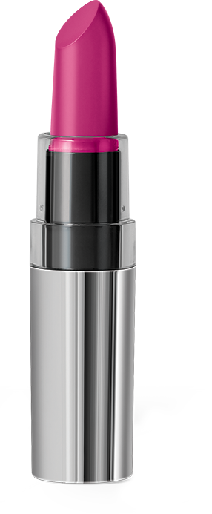
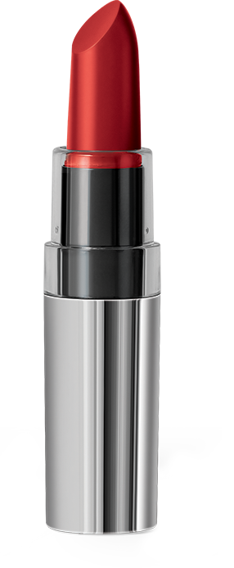
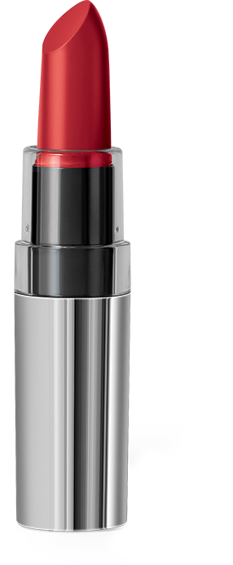
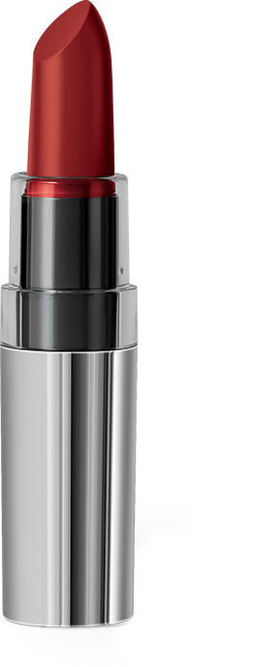
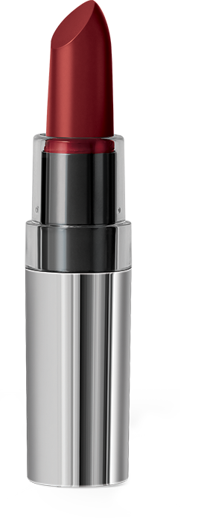
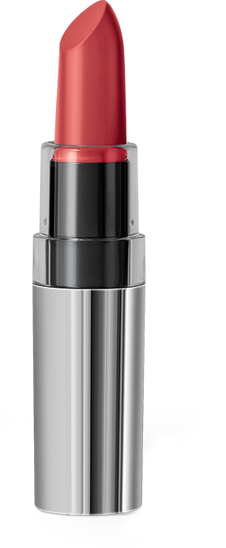
Be Bold This Valentine Season with
Mistral of Milan Classic Crème Lipsticks
That Pink!
037
Bold Red
034
Undercurrent
038
Desert Rose
035
Cherry-on-top
033
Golden Peach
036
MRP | DP
Rs 515 | Rs 440
BV | PV
264 | 14.67

Slide 19
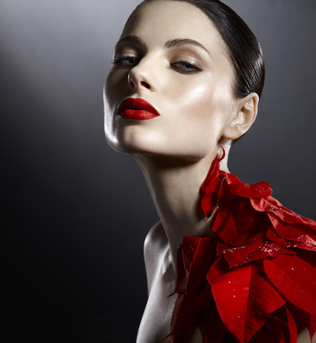
Bold Red
034
Cherry-on-top
036

Slide 20
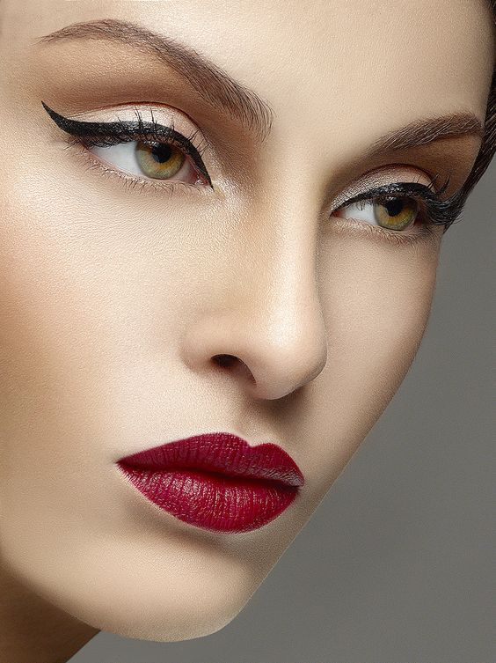
Golden Peach
036
Desert Rose
035

Slide 21
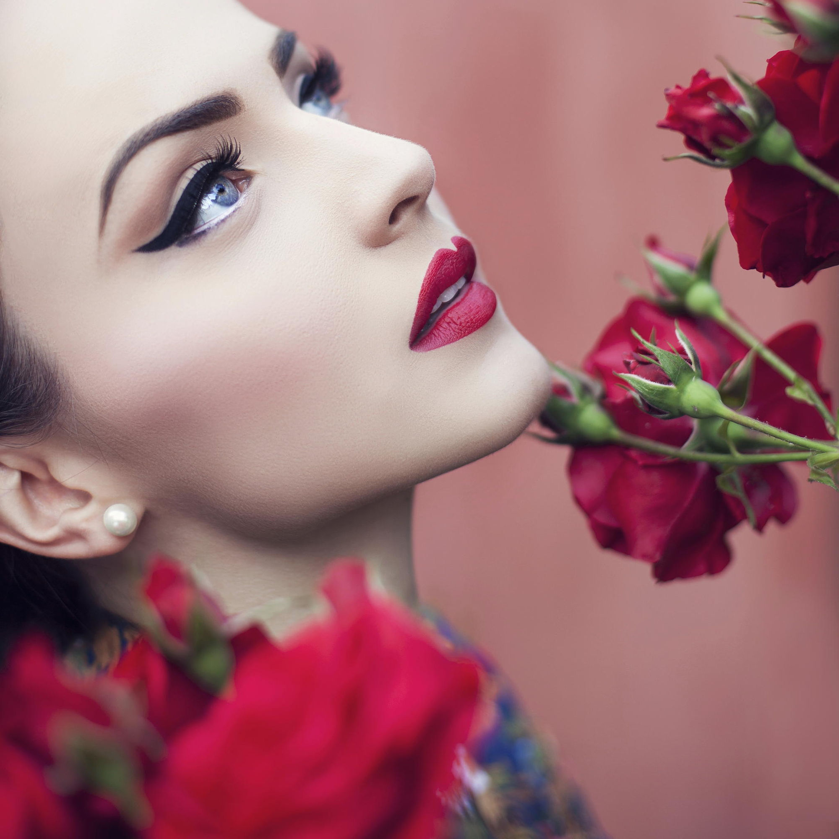
That Pink!
037
Undercurrent
038

Slide 22
The Silk Shine Lip Gloss
For the lips that dazzle with brilliance.
Brilliant Shine
Lightweight Texture
Silky Soft Feel
Available in new 4 sweet shades.

Slide 23
Be Cute This Valentine Season with
Mistral of Milan Silk Shine Lip Gloss
Pink Me
010
Cherry Blossom 008
Gold Rush
007
MRP | DP
Rs 355 | Rs 305
Innocence
009
BV | PV
183 | 10.17

Slide 24
excellent color pay-off
even & playful lining
ultra-fine or dramatic line
Silky Finish
water-resistant & quick drying
no feathering & smudge proof
lasts all day (14 hours and more)
comes off easily without a trace
dermatologically tested & approved
ophthalmologically tested & approved
EyeRule Eyeliner Pen

Slide 25
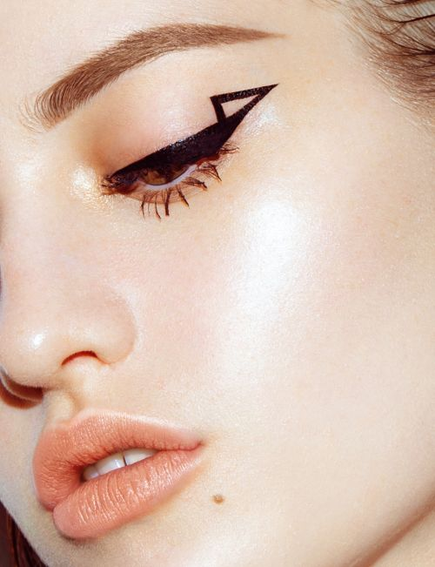
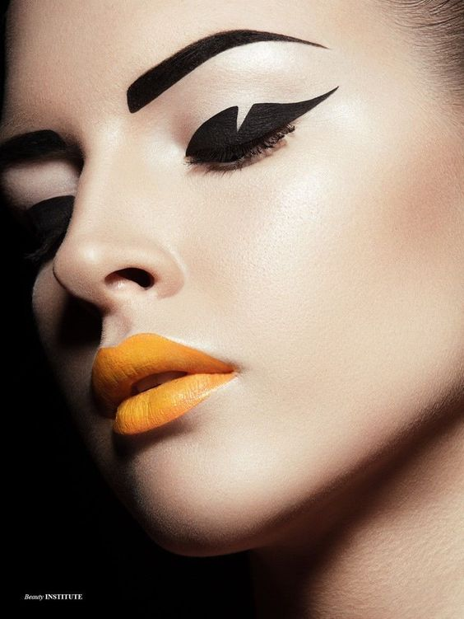
MRP | DP
Rs 550 | Rs 450
BV | PV
270 | 15

Slide 27
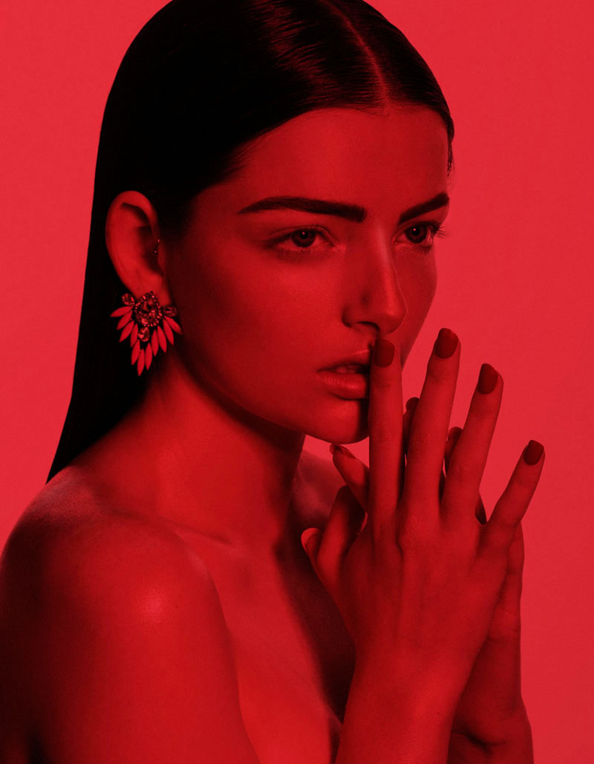
New Ultra Stay Nail Lacquer
MRP | DP
Rs 220 | Rs 190
Pop colors , perfect for your every mood.
Shades that will have you twinkling like a fairy this Valentine season.
BV | PV
114 | 6.33

Slide 28
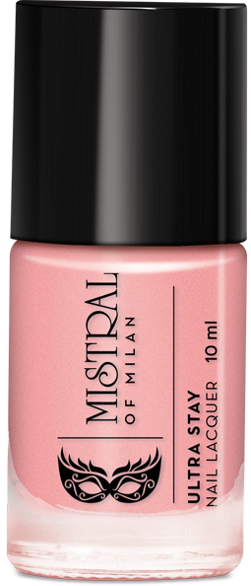
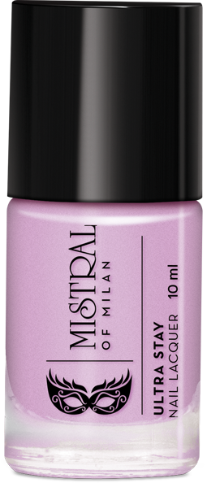
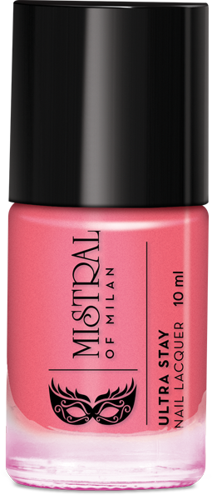
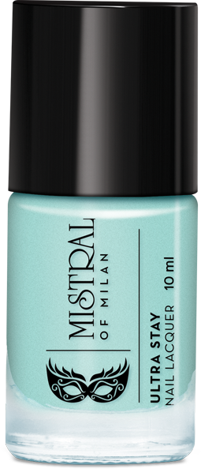
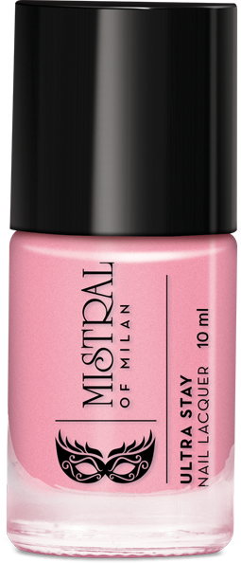
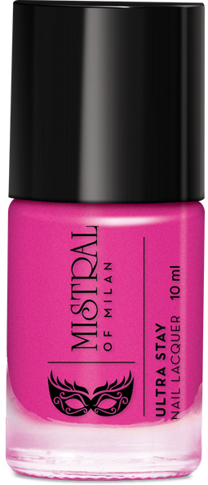
When in doubt, just add some pop!
Mistral of Milan Ultra Stay Nail Lacquer
Peaches
047
Dreamy Rouge 050
Lavender Luck 045
Rose Bud
049
Lilly Pink
048
Aqua Marine 046

Slide 29
Easy DIY Nail Art

Slide 30
Special Launch scheme
SCHEME
ALERT!!

Slide 31
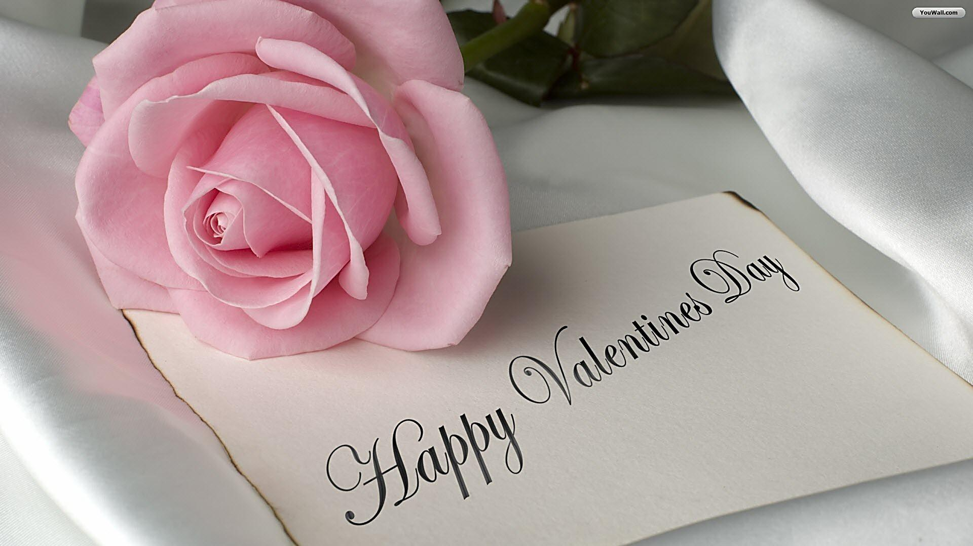

Slide 32
Thank you.

