Slide 1


Slide 2
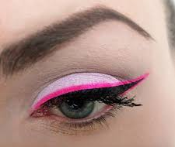
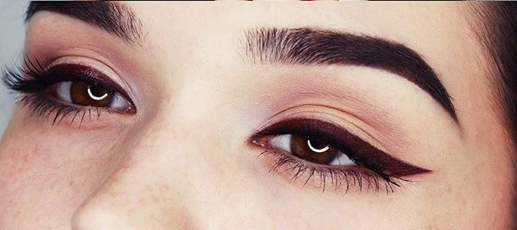
Liquid Lipstick as an Eyeliner
We all know winters are almost here and we want that bright & deep colour eyeliners. Why Not? Use our Liquid Lipstick shade matching your dress as an eyeliner with the help of the lip filler brush.

Slide 3

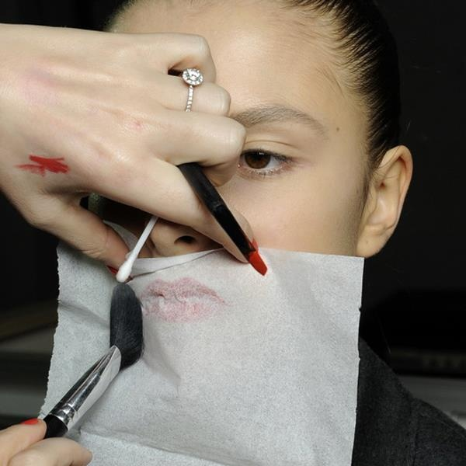
How to make Crème Lipstick Long last
To make the lipstick long last, first apply lip liner & then top up with your favourite Crème Lipstick shade. Now, take a thin tissue paper place it on your lips and apply some compact powder over it. You will get a Matt finish base & long lasting lip colour.

Slide 4
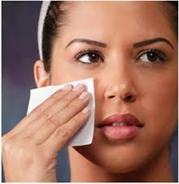

Blot That Oil From Face
We all know the struggle when our face gets oily & shinier after the application of Foundation or BB Cream in some hours. Not to worry!!! Before re-applying the compact on your oily face. You should first dab your face with the thin tissue paper, this will soak up the oil & sebum. You are then ready for re-touch with the compact powder.

Slide 5
THANK YOU

