Slide 1

Perfect Blend foundation
By
Mistral of Milan
16th March, 2017

Slide 2
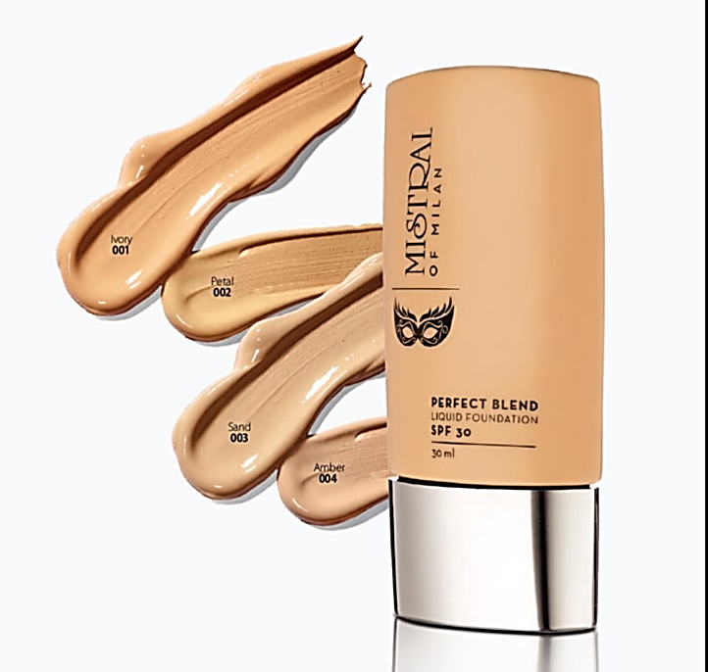
Ivory 001
Petal 002
MRP | DP | BV
450 | 385 | 231
Sand 003
Amber 004

Slide 3
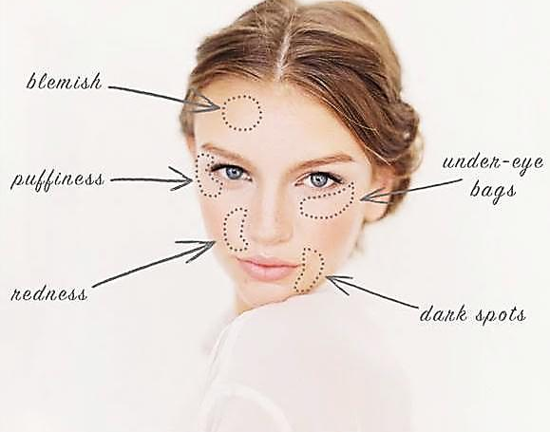
Excellent for covering up flaws. For example, puffy eyes after a busy schedule, dark circles under eyes. It can also serve to brighten the face and camouflage blemishes, visible pores, uneven tone , pimples, age spots and even some scars.

Slide 4

Perfect Blend foundation
Looks natural on skin. Gives a super coverage and a translucent matte finish. It is light and velvety to touch, it minimizes flaws and pores, without clogging them.
Easy to apply, it dries quickly and is not greasy or sticky!
With Advanced Luminous Technology which deeply moistures the skin giving to the skin a radiant color and a silky glow.

Slide 5

Active Ingredients
SWEET ALMOND OIL:
  An oil known for its softening, hydrating, nourishing and soothing properties, the sweet almond oil is rich in proteins, carbohydrates, minerals, vitamins A and B. It fights skin ageing and heals dry, reddened and sensitive tissues.
SKINCHROME:
  Derived from plant extracts that fights against oxidation. This ingredient improves skins brightness and reduces redness and blemishes.

Slide 6

Protection from UV
It has UV filters and SPF 30 which protects the skin from UV rays.
You can apply it daily and keep your skin beautiful, young, moisturized and protected!

Slide 7
The Tri Active System
The Tri Active System
smoothens
protects
moisturizes
  A functional system that
  smoothens,
  moisturizes and
  protects the skin,
  and the face appears immediately more luminous and younger.

Slide 8

How to choose the perfect shade?
  Determine your basic skin tone: fair, medium, medium deep or deep?
  Then you need to carefully examine your under-tone. – green, blue or neutral (Remember last Be-Gorgeous Day lesson?!!)
  pick colors that appear to be close to your skin tone.
  Test them on a clean jaw line before you make your choice.
  Now you’re ready to find your perfect foundation!

Slide 9
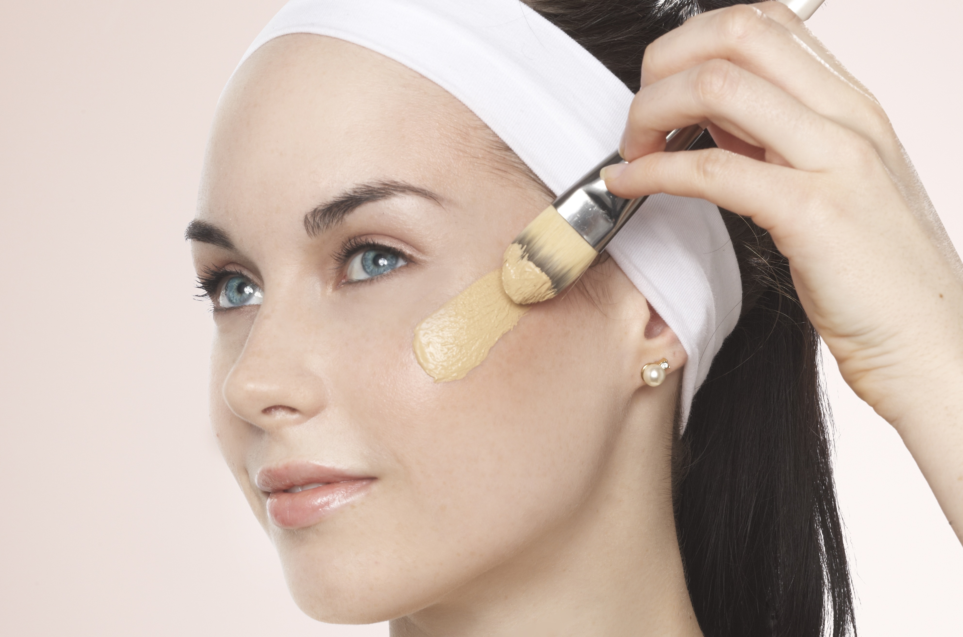

Pro Tips!
  Choosing the correct shade is very essential.
  Checking shade under natural light is definitely crucial.
  you must apply foundation on your jaw line.
  The best color will be one that blends well on your skin color.
  In some cases, you might have to blend foundation colors to find the right tone for your skin.

Slide 10
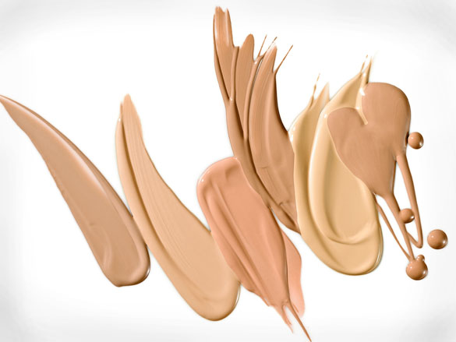
How to apply Foundation?
Time of year. Remember that your skin color varies throughout the year. A color that works in the dead of winter will probably be too light in summer, when skin is darker and gets more sun – and vice versa.
Application method. use a sponge for a very smooth, even finish. You can also use your finger with light pressure. For more coverage, try flat brush.
Portion control. put the foundation on the back of your hand and pick up color as needed. If you slap on whatever comes out of the bottle, you’ll likely end up with too much on your face.

Slide 11
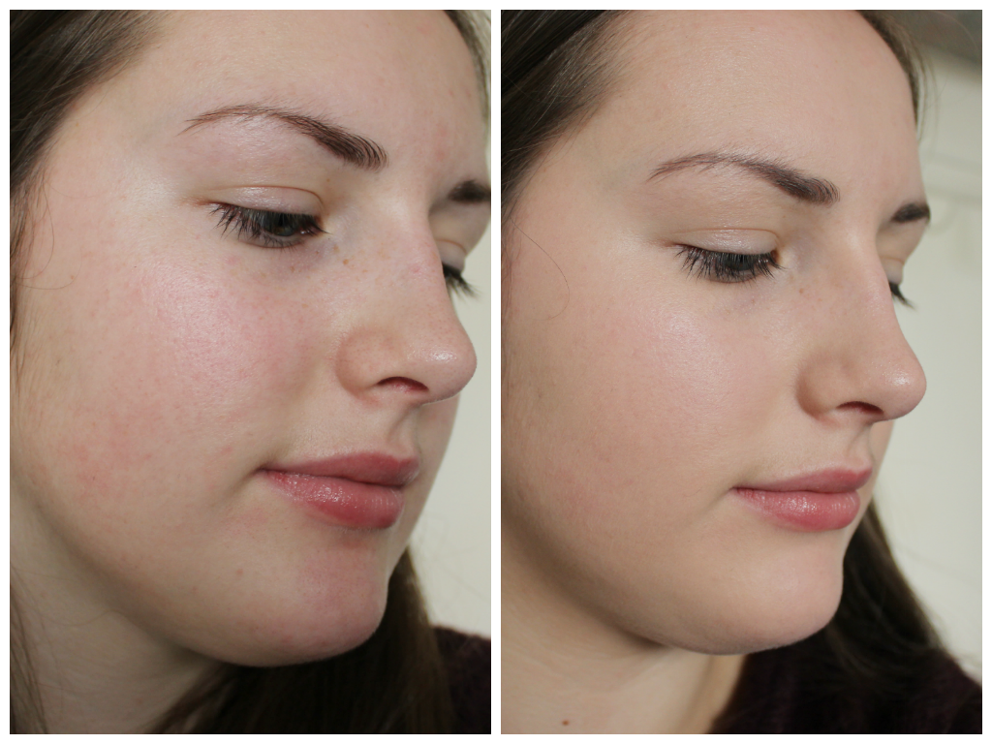
How to apply Foundation?
Less is more. Just because you’re applying foundation, it doesn’t mean you have to look like you’re wearing foundation. Try to use as little as possible for everyday wear to keep skin looking natural. Use a little more for a more polished look. Blend the foundation so that it looks natural on your skin.
Foundation direction: Always try to apply your foundation in downward, and never upwards strokes. Applying it downwards will give a streak-free look and will make your facial hair less prominent.

Slide 12
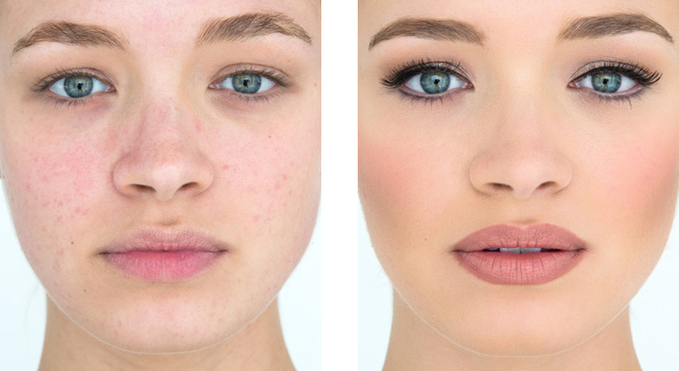
How to apply Foundation?
Trouble spots. For any areas that need more coverage, like dark spots or blemishes, dab on a little foundation with your finger and blend.

Slide 13

Let’s Practice!

Slide 14
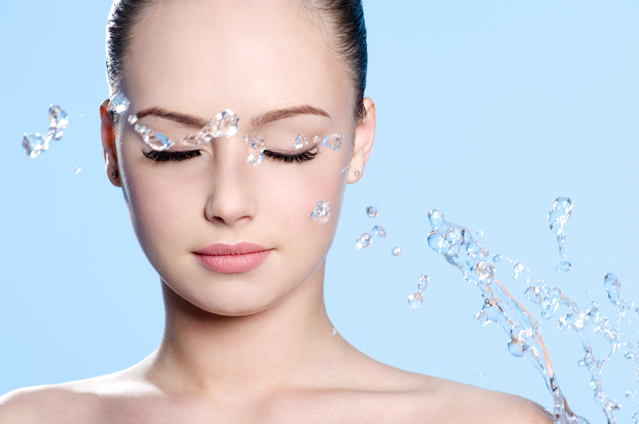
Step One!
Prep your skin: Prepping your skin is the most important part when it comes to foundations. Always begin with a clean, well moisturized face.
  First, make sure your skin is clean, exfoliated, and you have clean hands and applicators. Prepare your face by applying a toner.
  Moisturize: Apply a good moisturizer first. Otherwise, makeup won’t go on smoothly and will highlight dry patches.

Slide 15

Step Two!
Foundation direction: Always try to apply your foundation in downward, and never upwards strokes. Applying it downwards will give a streak-free look and will make your facial hair less prominent.

Slide 16

Step Three!
Always start from the middle: Your t-zone is the highlighted and problematic area and thus needs maximum coverage. So, it’s always advisable to begin with your t-zone and then blend outwards and downwards.

Slide 17

Step Four!
Always use powder: it is necessary for the t-zone. This is the area where we all sweat and the area where the foundation starts to appear discolored.
It will help to set the foundation and make it last long.

Slide 18
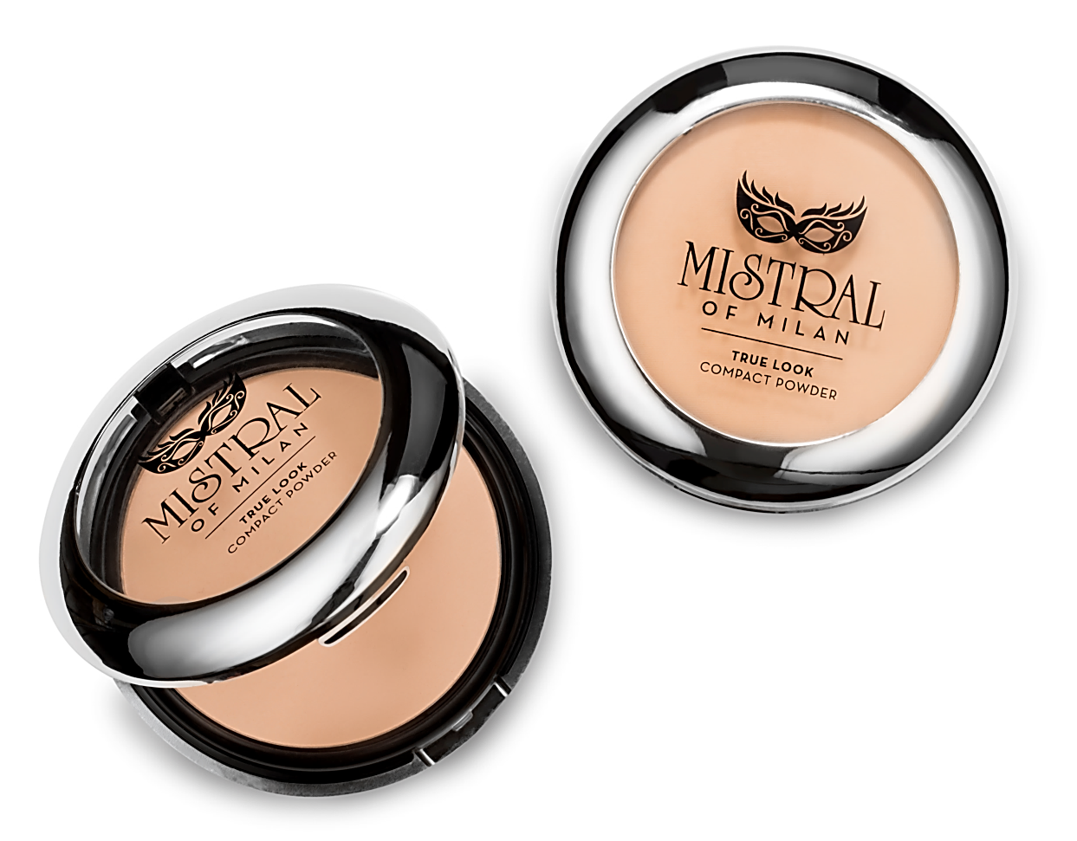
Setting The Foundation Right!
True Look Compact Powder: For most occasions, for a fresh, natural look use just a little powder to set the foundation.
Application method and where to apply: We recommend applying powder with a fluffy powder brush or puff along the t-zone, where the face can get oily.
Less is more: Use a light touch when applying powder. If you use too much, it can look cakey and fake, and make you look old in an instant by accentuating wrinkles.

Slide 19

Pro Tips!
  If you know you’re going to be photographed – at a wedding or any occasion with bright lights – powder is not optional, unless your skin is very very dry . Any bit of shininess is highlighted very aptly in photos.

Slide 20
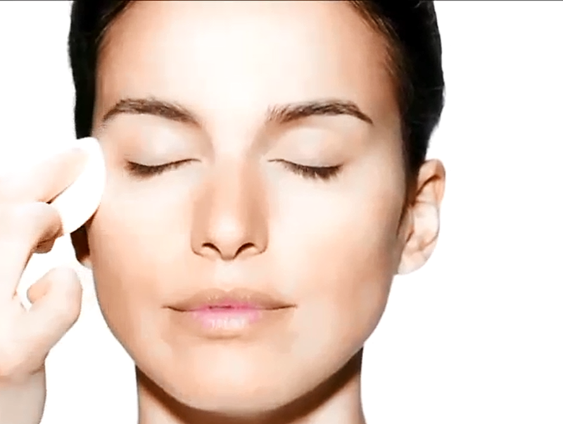
Perfect Foundation Application

Slide 21
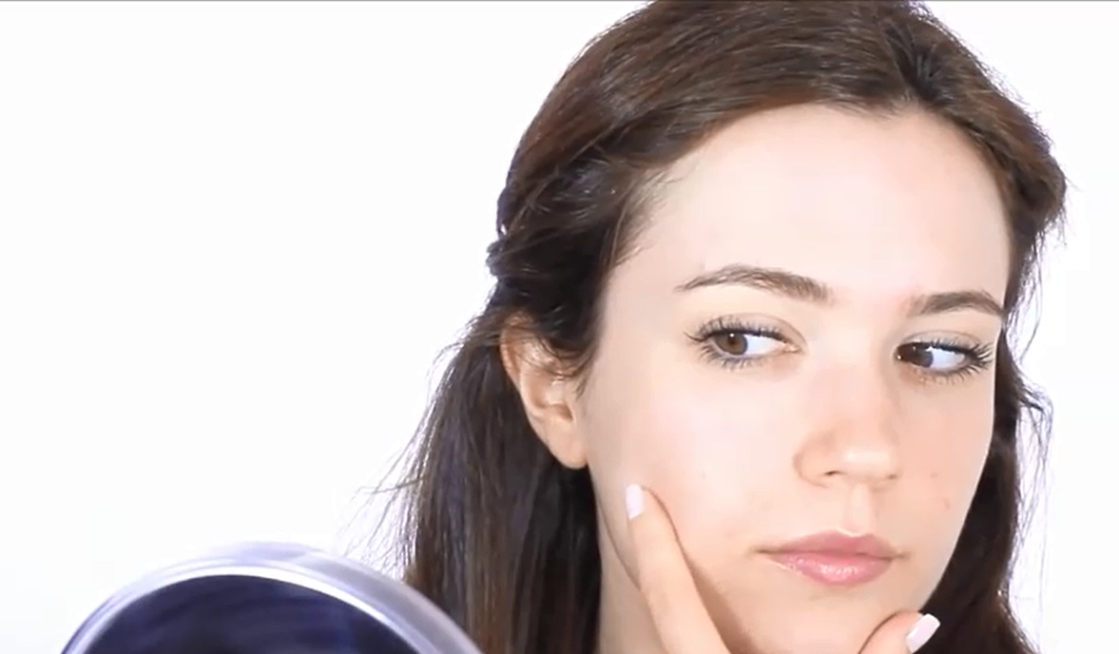
All About Base Makeup

Slide 22
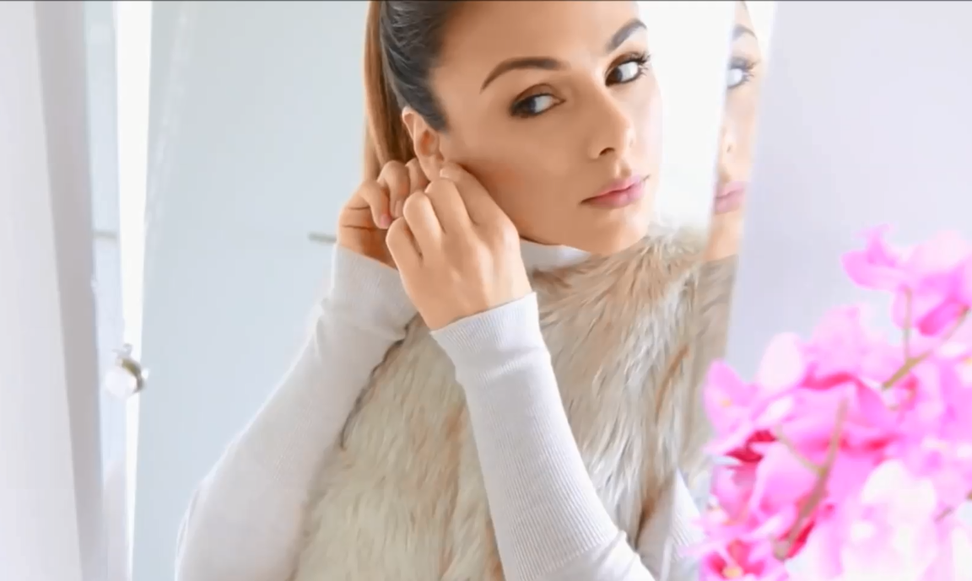
Day Time Makeup

Slide 23
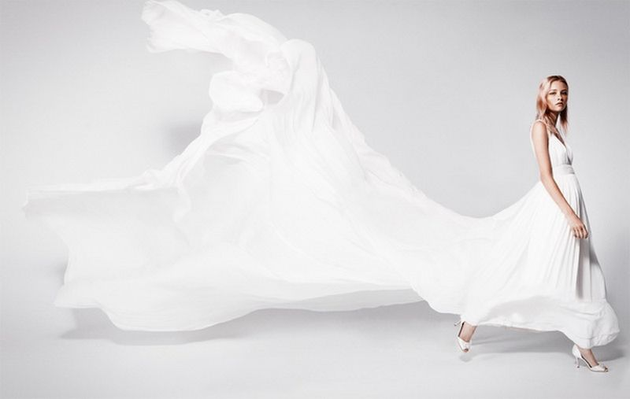
Thank you.

