Slide 2
Home Care Category
Hyvest comes from the two core words Hygiene and Vestige
HYGENIUS SOLUTIONS from VESTIGE
Home Hygiene promotes good health and overall wellness for your entire family

Slide 3
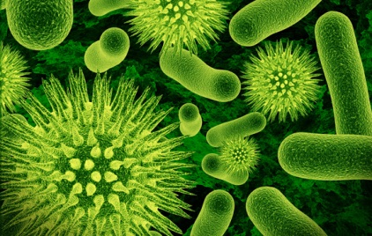
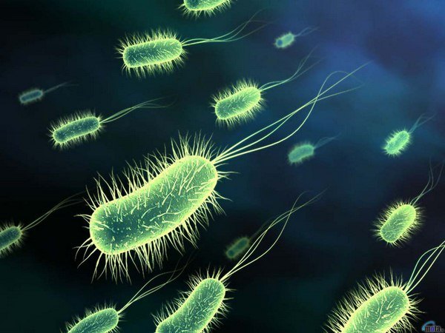
Home Hygiene
Germs and microbes can be found everywhere
They can survive on hard surfaces like floors, doorknobs, handrails etc.
On soft surfaces such as fabric furniture and beddings, they can survive for long time
If the germs aren't allowed into the home, it is easier to protect your family
A clean home would prevent illness before it begins
It would also prevent the spread of disease if practiced on a day to day basis

Slide 4
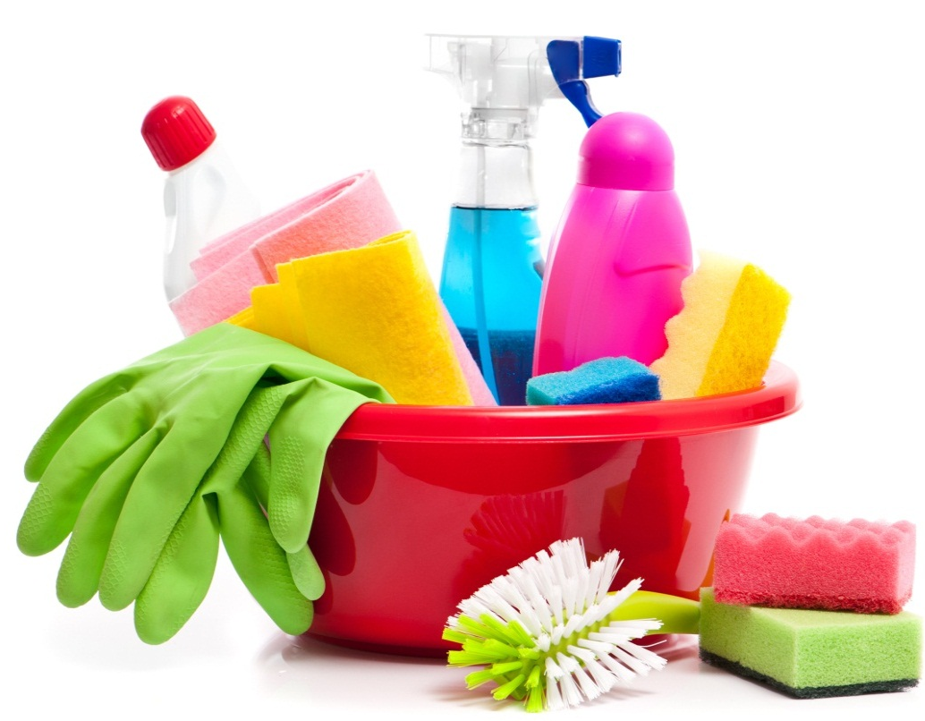
Daily Protection
Maintaining cleanliness at home is not just a “do it and forget it” activity
It should be in the daily to-do list of every household for healthy living
What to do to keeps germs at bay –
Clean the dust
Keep flies away
Remove garbage everyday
Keep the bathroom clean and dry
Allow sunlight into the rooms
Ventilate the rooms
Keep kitchen clean and hygienic at all times

Slide 5
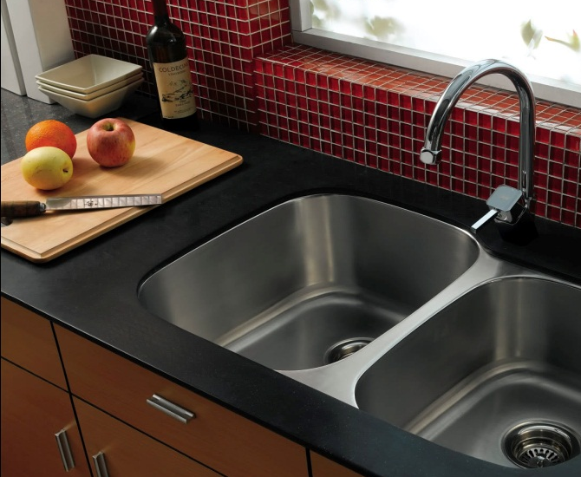
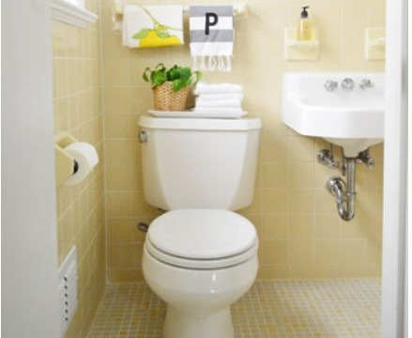
Dirtiest places in your House
KITCHEN
Kitchen is the favourite ground for germs to grow
The items that require frequent cleaning in the kitchen:
BATHROOM
It’s no surprise that the place where you scrub dirt and grim off your body holds a lot of germs
Due to moisture build up, it is the perfect place for germs growth
Spots that need special attention:
Dishwashing sponge/scrub | Cutting board
Countertops | Refrigerator
Kitchen sink | Kitchen towel
Shower tub | Floor
Drains | Towels
Taps

Slide 6
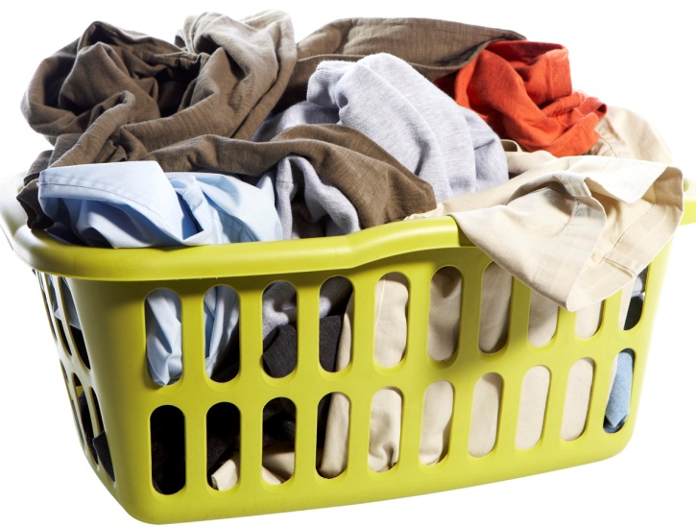
Dirtiest places in your House
LAUNDRY AREA
Dirty clothes left in the laundry bucket attract a lot of germs due to sweat, food stains, dirt and grime that feed the germs
Wet laundry left in a machine can cause germs to flourish
LIVING ROOM
Remote controls, keyboards, phones, and tablets are often shared by everyone in the house
These surfaces also contribute to bacteria growth and proliferation
A carpet can hold up to eight times its weight in dirt, dust, mites and microbes – bacteria, mildew, mould etc.

Slide 7
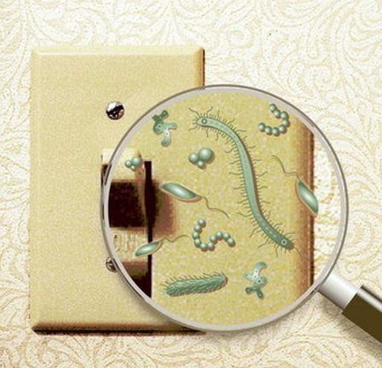
Dirtiest places in your House
KNOBS, HANDLES, AND SWITCHES
Handles, knobs, light switches are obvious places for germs
Many studies have shown severe bacterial and virus growth on:
Bathroom light switches
Refrigerator handles
Door Knobs
Stove knobs
Microwave handles
Clean these spots once a week with sanitizing solution

Slide 8
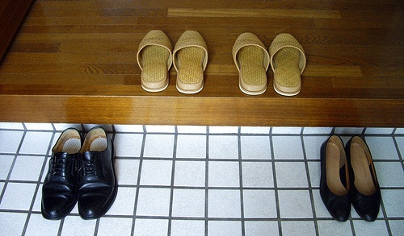
Practicing Good Habits
One way of minimising germs from spreading is keeping things clean
Clean the dirtiest places in your home daily for healthy living
Wash your hands often with a good antibacterial hand wash to ward of germs and avoid illness
Keep hand sanitizers handy if soap is not available
Take your shoes off before walking into the house

Slide 9
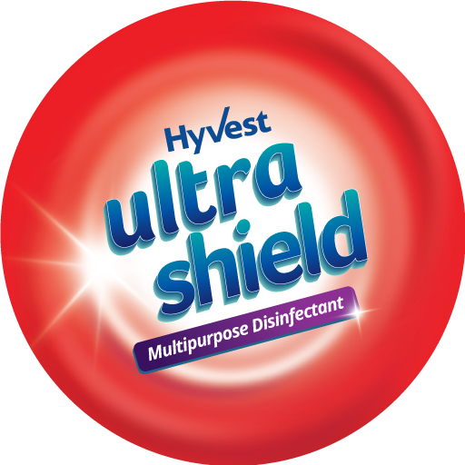
Introducing

Slide 10
Microbes Around Us
WHO recognizes microbes and the infections they spread, as a leading cause of death in the world today

Slide 11
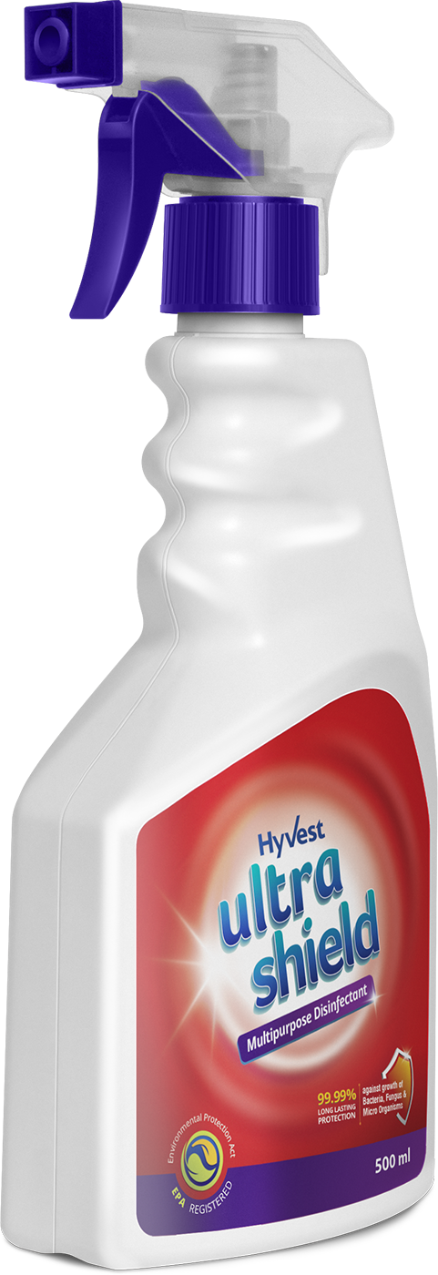
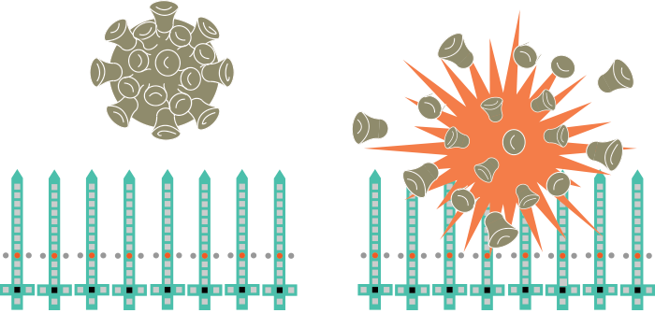
Ultra Shield – Multipurpose Disinfectant
It is a water-based biostatic surface protectant that can be applied to any surface, including fabrics, porous or non-porous
The active ingredient in it creates an invisible barrier that inhibits the growth of odour causing bacteria
It prevents up to 99.99% of the bacteria, mould and mildew growth
Provides a long lasting protection on hard and soft surfaces and continues for upto 15 days
Effective even on fabrics and upholstery

Slide 12
Ultra Shield – How it Works
When applied to a surface it creates a Micro-biostatic Antimicrobial Coating on the surface that inhibits growth of bacteria, mould and mildew
The Micro-biostatic Antimicrobial Coating forms a nano bed of spikes that disrupts the microorganism's membrane resulting in its death
This revolutionary technology provides a perfect approach to inhibiting microorganisms without the use of unsafe heavy metals or poisons and this mode of action is entirely unique compared to other antimicrobials
The molecule is the long chain of atoms that makes up the spike to pierce the cell walls of microbes
It carries a strong positive charge that attracts negatively charged bacteria/microbe

Slide 13
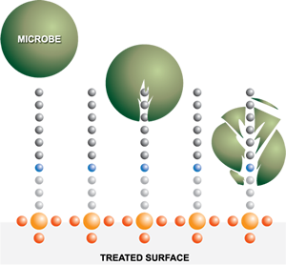
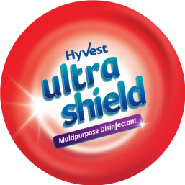
Ultra Shield – How it Works

Slide 14
Hyvest Ultra Shield vs Other Cleaning sol.
Hyvest Ultra Shield | Traditional Cleaning Method
Surface Protectant: It’s use is not meant to replace the current cleaning protocols but will greatly enhance traditional cleaning methods. Remains active for upto 15 days | Cleaning Solutions: It makes microbes inactive for a limited time period usually for 10-15 minutes
It forms a bond with the surface & remains active for days | After evaporation there is no effect of the disinfectant
Long term protection | Short term protection
Can be used on both porous & non-porous surfaces | Only effective on hard surfaces
It is both bactericidal & bacteriostatic | It is only bactericidal for a short period

Slide 15
Ultra Shield – Benefits
It neutralises offensive odours
Prevents the growth of mould and mildew
Protects from disease-causing pathogens
Works on all solid surfaces and fabrics
Registered with the Environmental Protection Agency (EPA) & classified as non-toxic and non-hazardous
Safe for environment

Slide 16
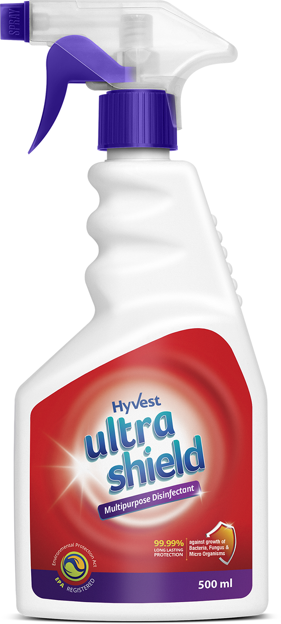
Ultra Shield – Application
Clean the surface to be treated
Apply Ultra Shield on the surface to be treated and let it dry for 3 minutes
Wipe using dry cloth if required
If spotting occurs, wipe with moist cloth
Perform routine cleaning methods regularly
(mopping floors, cleaning bathrooms, dusting, washing etc.)
Hyvest Ultra Shield can be sprayed on hard, soft, porous or non-porous surfaces

Slide 17
Ultra Shield – Application
Curtains
Furniture

Slide 18
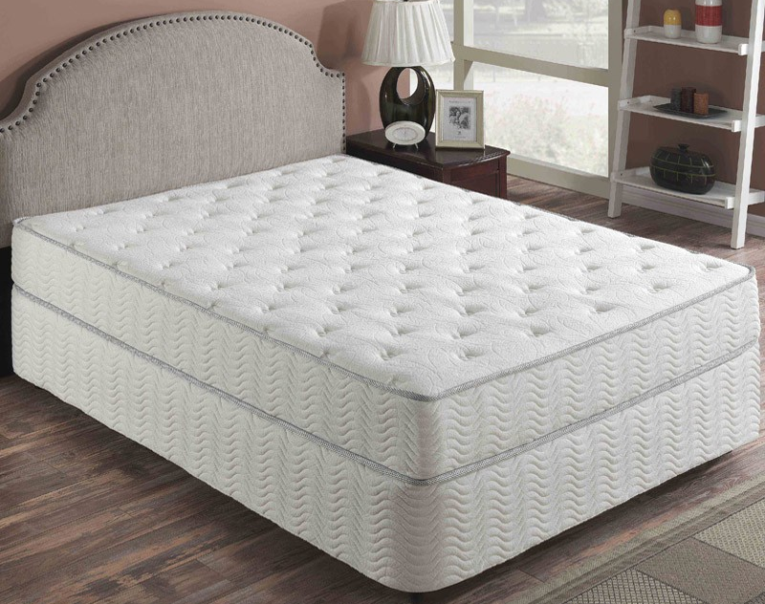
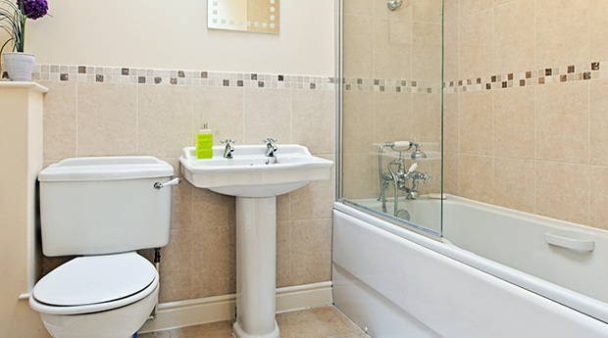
Ultra Shield – Spray On
Mattresses
Restrooms
Floor, Walls & Ceilings

Slide 19
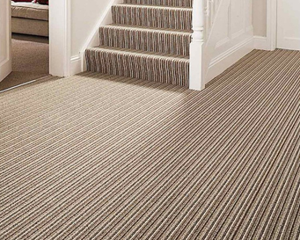
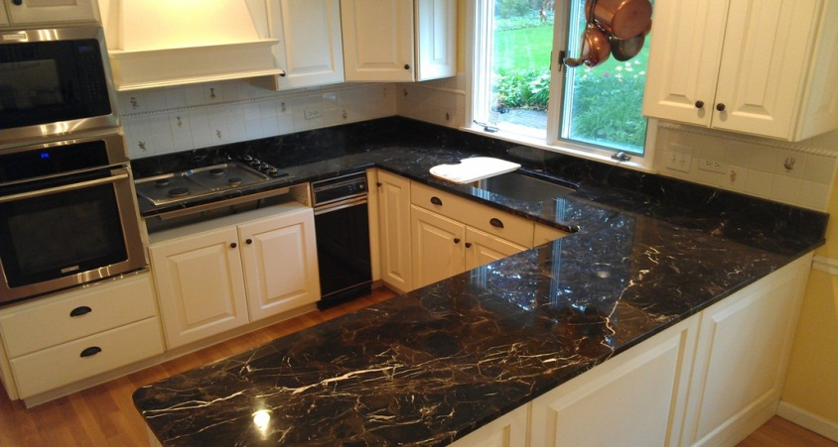
Ultra Shield – Spray On
Carpets
Kitchen Slabs
Door Handles
Footwear
Toys
Mobile Phones

Slide 20
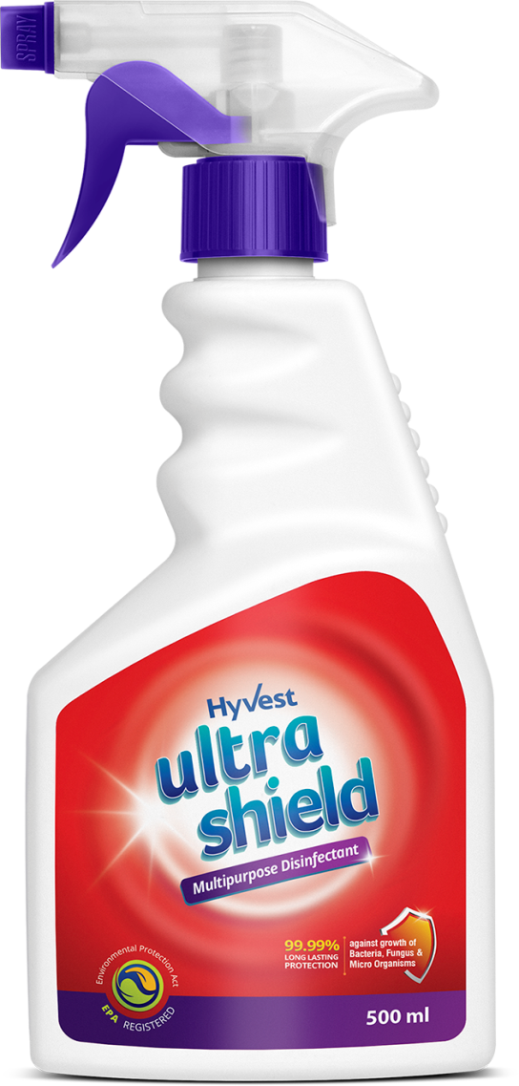
Ultra Shield – Multipurpose Disinfectant
Water based protectant
Non-toxic
Non-hazardous
Odourless and colourless
Reduces the spread of germs
Non-leaching
Long Term protection
Does NOT create Super Bugs
MRP Rs. 600.00
DP Rs. 535.00
BV 321 PV 17.83

Slide 21
VIDEO

Slide 22
THANK YOU

