Slide 1
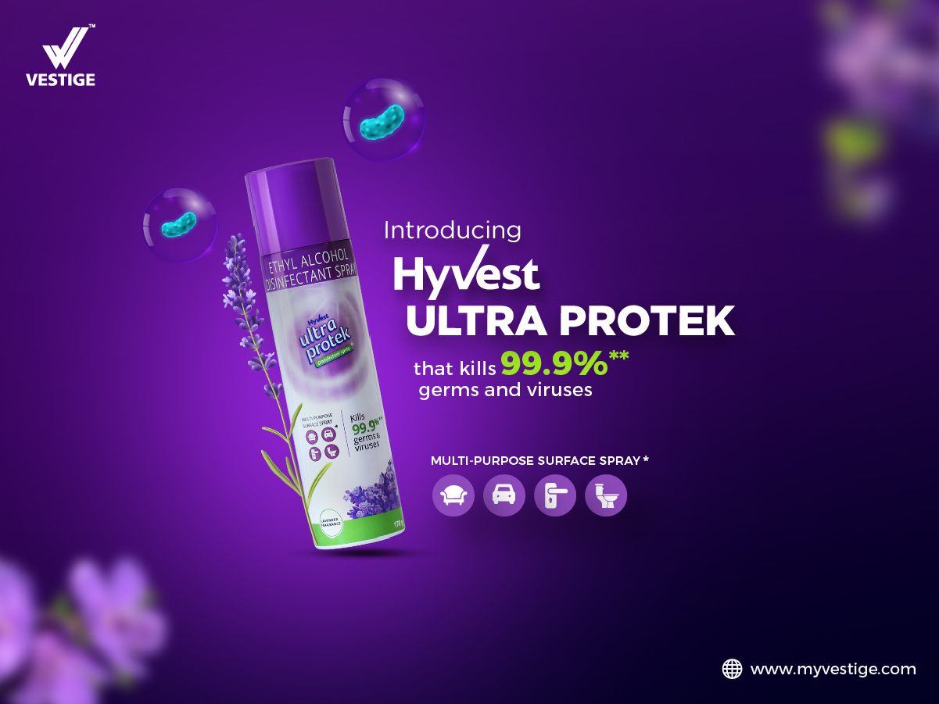

Slide 2

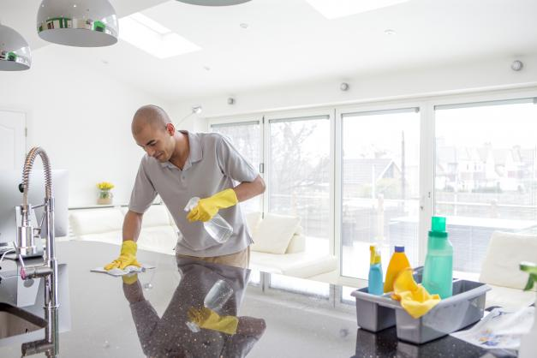

The current times have made us more aware of the importance of sanitation and hygiene.
We strive to make our surroundings ultra-clean and free of any bacteria and viruses.

Slide 3
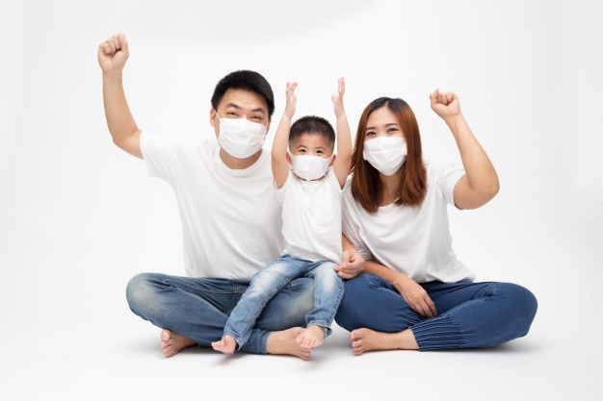
During these trying times, we need to keep ourselves and our loved ones safe.
Due to the recent pandemic, we disinfect everything in many ways and that has become a part of our life.

Slide 4
Presenting,
An easy and effective way to disinfect and sanitise your surroundings and surfaces to protect you from any viruses and bacteria.

Slide 5

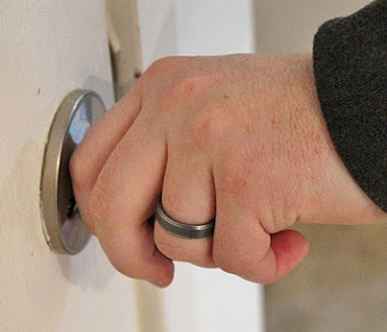
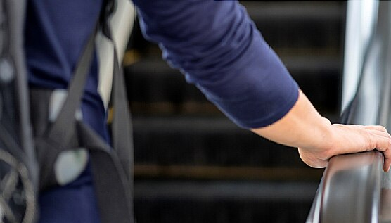
Because,
Throughout the day we come in contact with different surfaces and objects like doorknobs, railings, parcels, desks, etc, which are touched by others and are susceptible to germs and viruses.
To ensure that we remain safe and secure, it is important to clean such surfaces with a disinfectant on a regular basis.

Slide 6
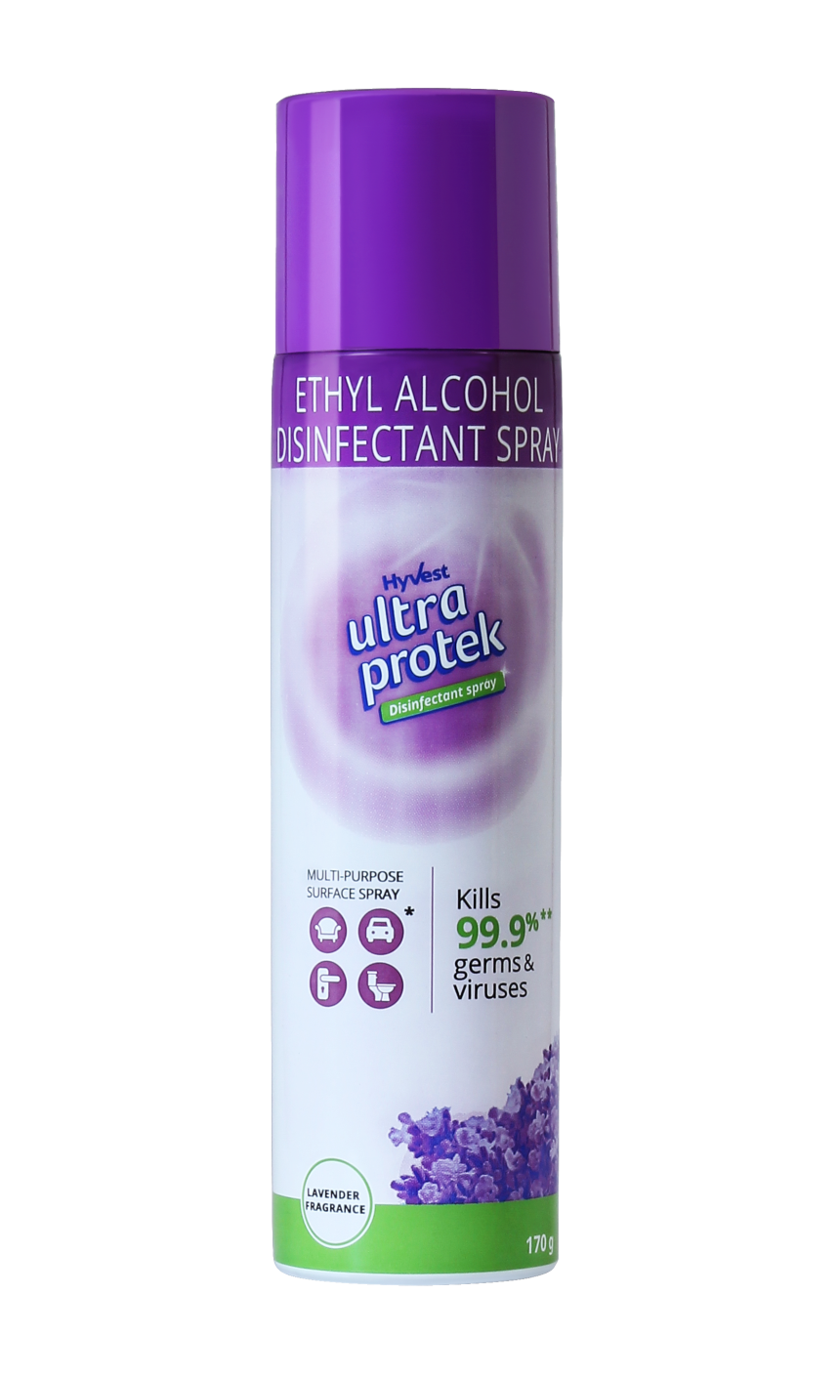
HYVEST ULTRA PROTEK
This is a disinfectant which is designed to inactivate or destroy microorganisms from surfaces.
Hyvest Ultra Protek disinfectant spray protects you and your family from illness-causing bacteria and viruses.
It is effective on a wide variety of both hard and soft surfaces.
It is incredibly versatile with a fresh and pleasant smell.

Slide 7
HYVEST ULTRA PROTEK SPRAY is a 70% w/w Alcohol disinfectant spray

Slide 8

Hyvest Ultra Protek
Kills 99.9% of germs and viruses
No need to wipe. Hyvest Ultra Protek disinfects and deodorises in one easy step.
This versatile, multipurpose, zero-contact spray can be used on various hard and soft surfaces.

Slide 9
Maintaining hygiene, be it at home or anywhere else, is the new normal these days.
People are adopting stringent measures to ensure well-being, with hygiene playing a pivotal role.
This is not restricted to personal hygiene but also extends to frequently touched, high-contact surfaces.
Therefore,
To make this essential process more convenient and effective, Hyvest Ultra Protek disinfectant spray is your one stop solution for sanitisation.

Slide 10
HOW DOES AN ALCOHOL DISINFECTANT SPRAY WORK?
Alcohol is known to act on germs and viruses by breaking apart proteins.
Alcohol kills a broader variety of bacteria and viruses when the concentration exceeds 60%, and it works faster as the concentration increases. Maximum efficacy is reached at 90-95% concentration.
Germs and viruses don't develop a resistance to it, so alcohol doesn't lose effectiveness with continued use.

Slide 11
COMPOSITION
Ethyl Alcohol (Denatured) 95% v/v I.P. 73.68%w/w
Eq. to Absolute Alcohol 70.00%w/w
Propellant base Q.S.

Slide 12
WHERE TO USE
Disinfect high-traffic surfaces such as tables, doorknobs, chairs, keys, packages, etc, with one easy spray.
Usable on other surfaces such as:
Kitchen sink
Dustbin
Tabletops and desks
Chairs and sofas
Doorknobs
Shower taps
Mattresses
Car seats
Curtains
Carpets
Toilet area (including toilet pot)

Slide 13
HOW TO USE
Shake the can well.
Hold the can 15-20 cm away from the pre-cleaned surface and spray on the surface until its covered with the mist.
Allow to air dry. NO NEED TO WIPE.
Do not use on silk/rayon/acetate/satin/fabric/brass/copper/polished wood/painted surfaces/acrylic plastics.

Slide 14

HYVEST ULTRA PROTEK
Net Content - 170 g
MRP – Rs. 325
DP - Rs. 280
PV - 9.33

Slide 15


