Slide 1


Slide 2


Home Care Category
Hyvest comes from the core words Hygiene and Vestige
  HYGENIUS SOLUTIONS from VESTIGE
Home Hygiene promotes good health and overall wellness for your entire family

Slide 3
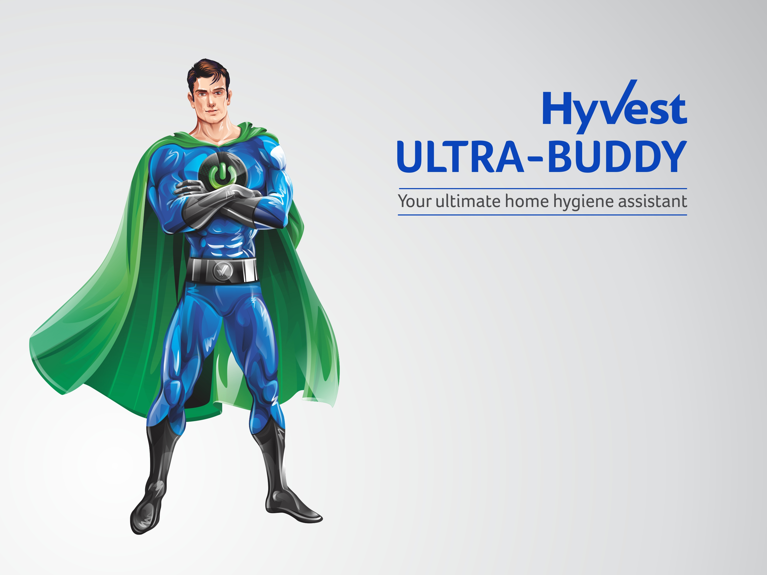
Your home hygiene assistant helps you to provide continuous protection of your loved ones against everyday illnesses.
Germs enter our homes, through people (who may have an infection or are carriers of germs), contaminated food, domestic animals, and sometimes through water or via air.
Good hygiene plays an important part in reducing the burden of infectious diseases in our homes and also prevents them from spreading.

Slide 4
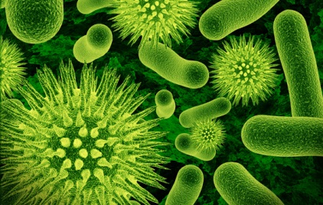
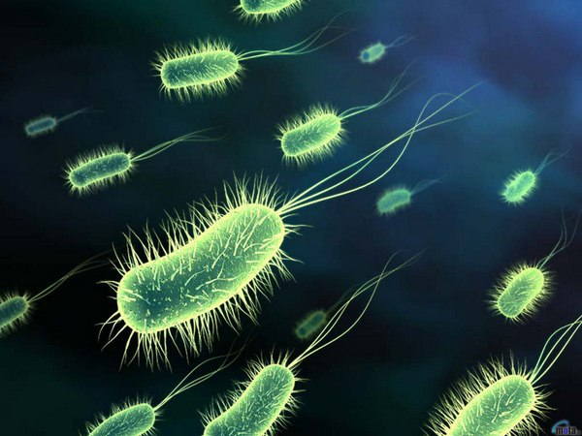
Home Hygiene
Germs can be found everywhere
They can survive on hard surfaces such as floors, doorknobs, handrails etc. for about 24 hours
On soft surfaces such as fabric furniture and beddings, they can survive for 20 – 30 minutes
If the germs aren't allowed into the home, it is easier to protect your family
A clean home would prevent illness before it begins
It would also prevent the spread of disease if practiced on a day to day basis

Slide 5
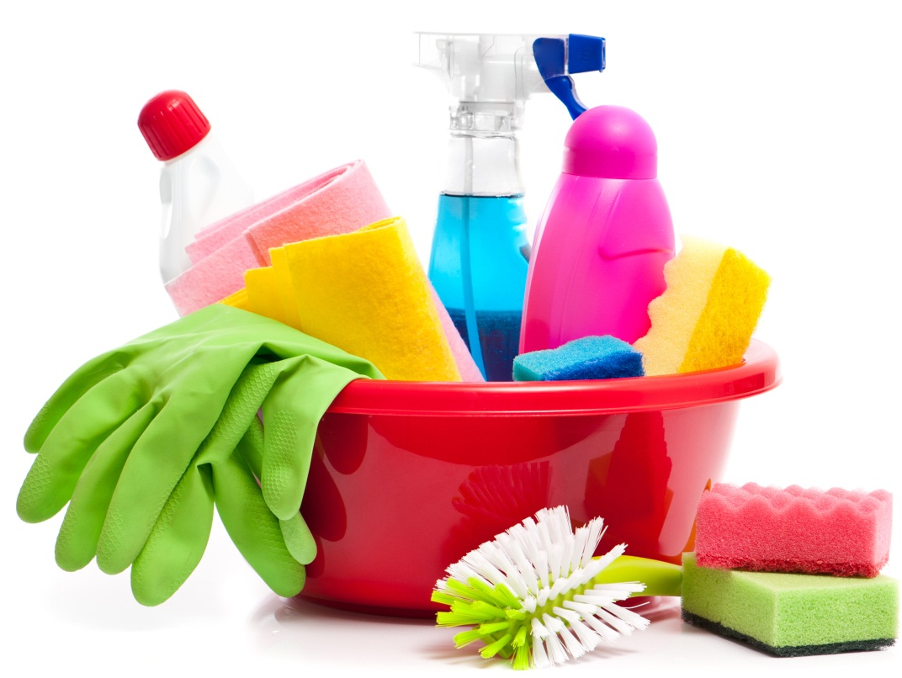
Daily Protection
Maintaining cleanliness at home is not just a “do it and forget it” activity
  It should be in the daily to-do list of every household for healthy living
What to do to keeps germs at bay –
  Clean the dust
  Keep flies away
  Remove garbage everyday
  Keep the bathroom clean and dry
  Allow sunlight into the rooms
  Ventilate the rooms
  Keep kitchen clean and hygienic at all times

Slide 6
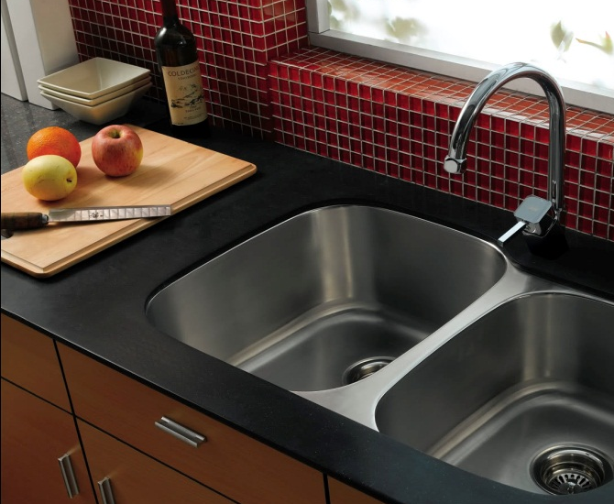
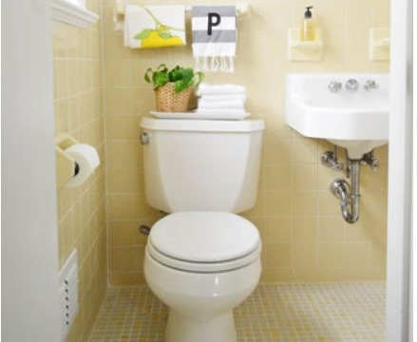
Dirtiest places in your House
KITCHEN
  Kitchen is the favourite ground for germs to grow
  The items that require frequent cleaning in the kitchen:
BATHROOM
  It’s no surprise that the place where you scrub dirt and grim off your body holds a lot of germs
  Due to moisture build up, it is the perfect place for germs growth
  Spots that need special attention:
Dishwashing sponge/scrub | Cutting board
Countertops | Refrigerator
Kitchen sink | Kitchen towel
Shower tub | Floor
Drains | Towels
Taps | Toothbrushes

Slide 7
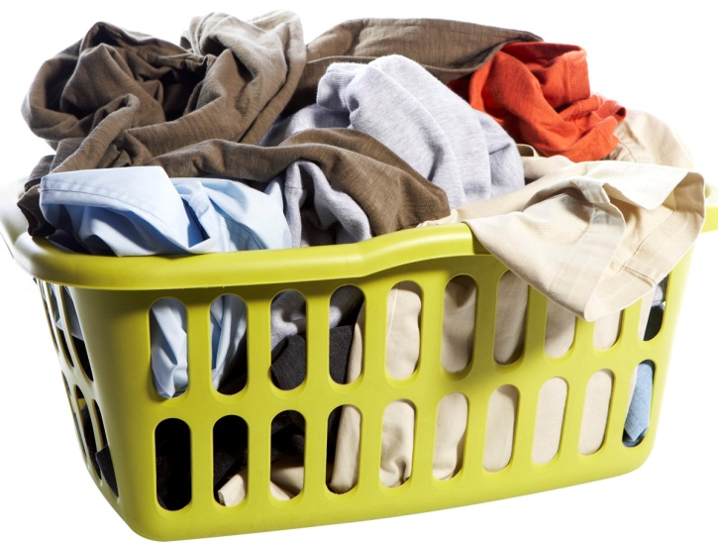
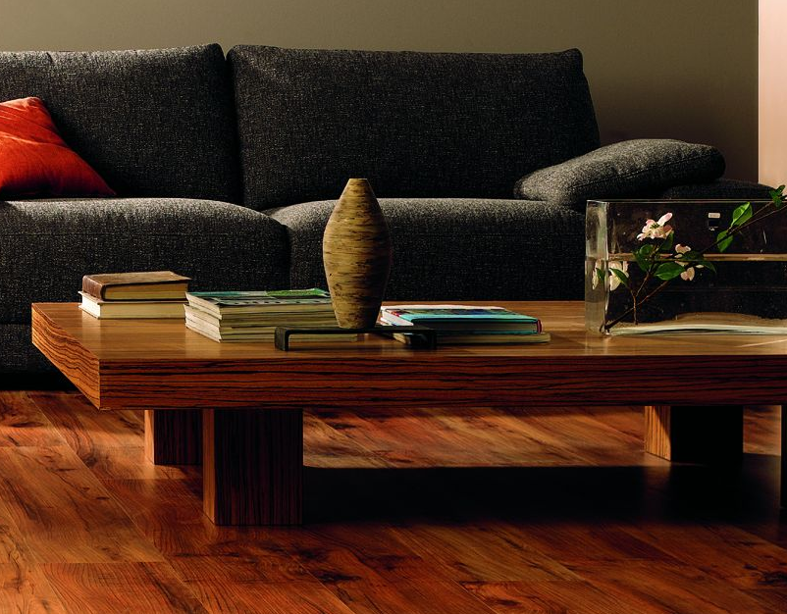
Dirtiest places in your House
LAUNDRY AREA
  Dirty clothes left in the laundry bucket attract a lot of germs due to sweat, food stains, dirt and grime that feed the germs
  Wet laundry left in a machine can cause germs to flourish
LIVING ROOM
  Remote controls, keyboards, phones, and tablets are often shared by everyone in the house
  These surfaces also contribute to bacteria growth and proliferation
  A carpet can hold up to eight times its weight in dirt, dust and mites

Slide 8
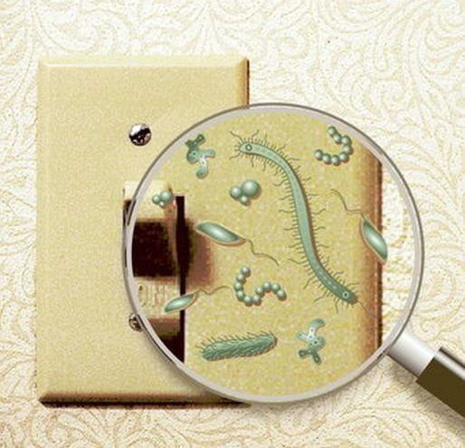
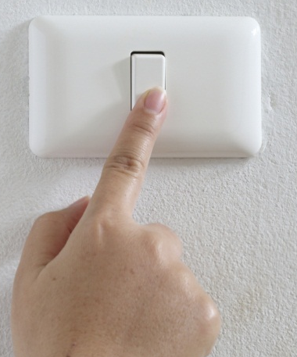
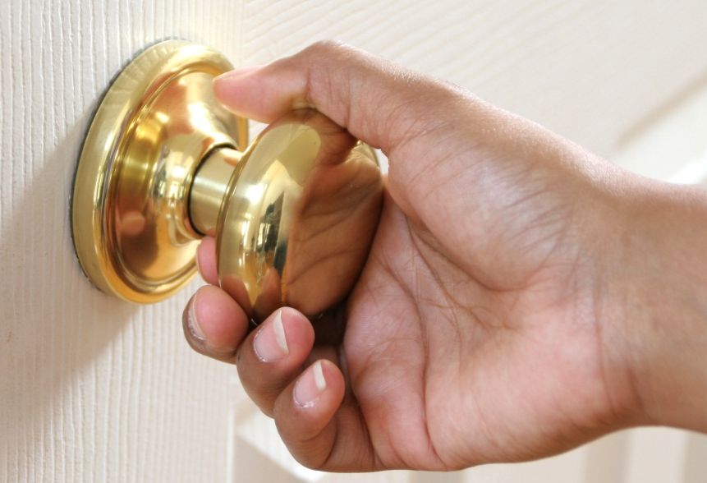
Dirtiest places in your House
KNOBS, HANDLES, AND SWITCHES
  Handles, knobs, light switches are obvious places for germs
  Many studies have shown bacterial and virus growth on:
    Bathroom light switches
    Refrigerator handles
    Door Knobs
    Stove knobs
    Microwave handles
  Clean these spots once a week with sanitizing solution

Slide 9
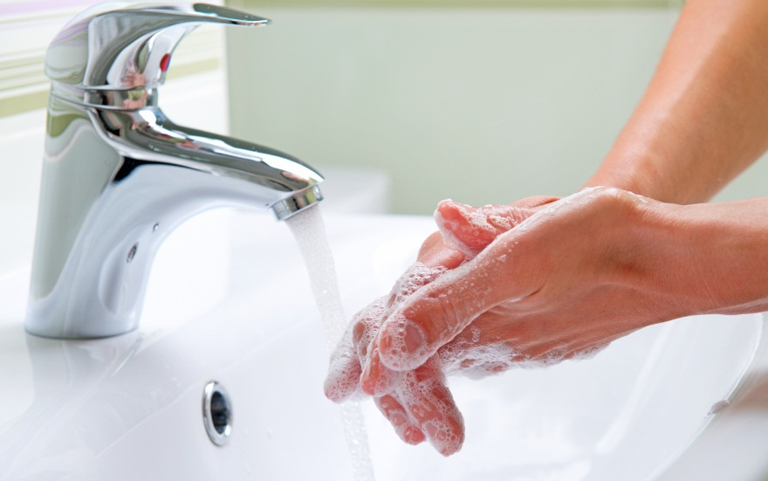
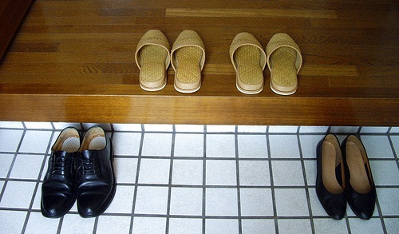
Practicing Good Habits
One way of minimizing germs from spreading is keeping things clean
Clean the dirtiest places in your home daily for healthy living
Wash your hands often with a good antibacterial hand wash to ward of germs and avoid illness
Keep hand sanitizers handy if soap is not available
Take your shoes off before walking into the house

Slide 10

Introducing

Slide 11
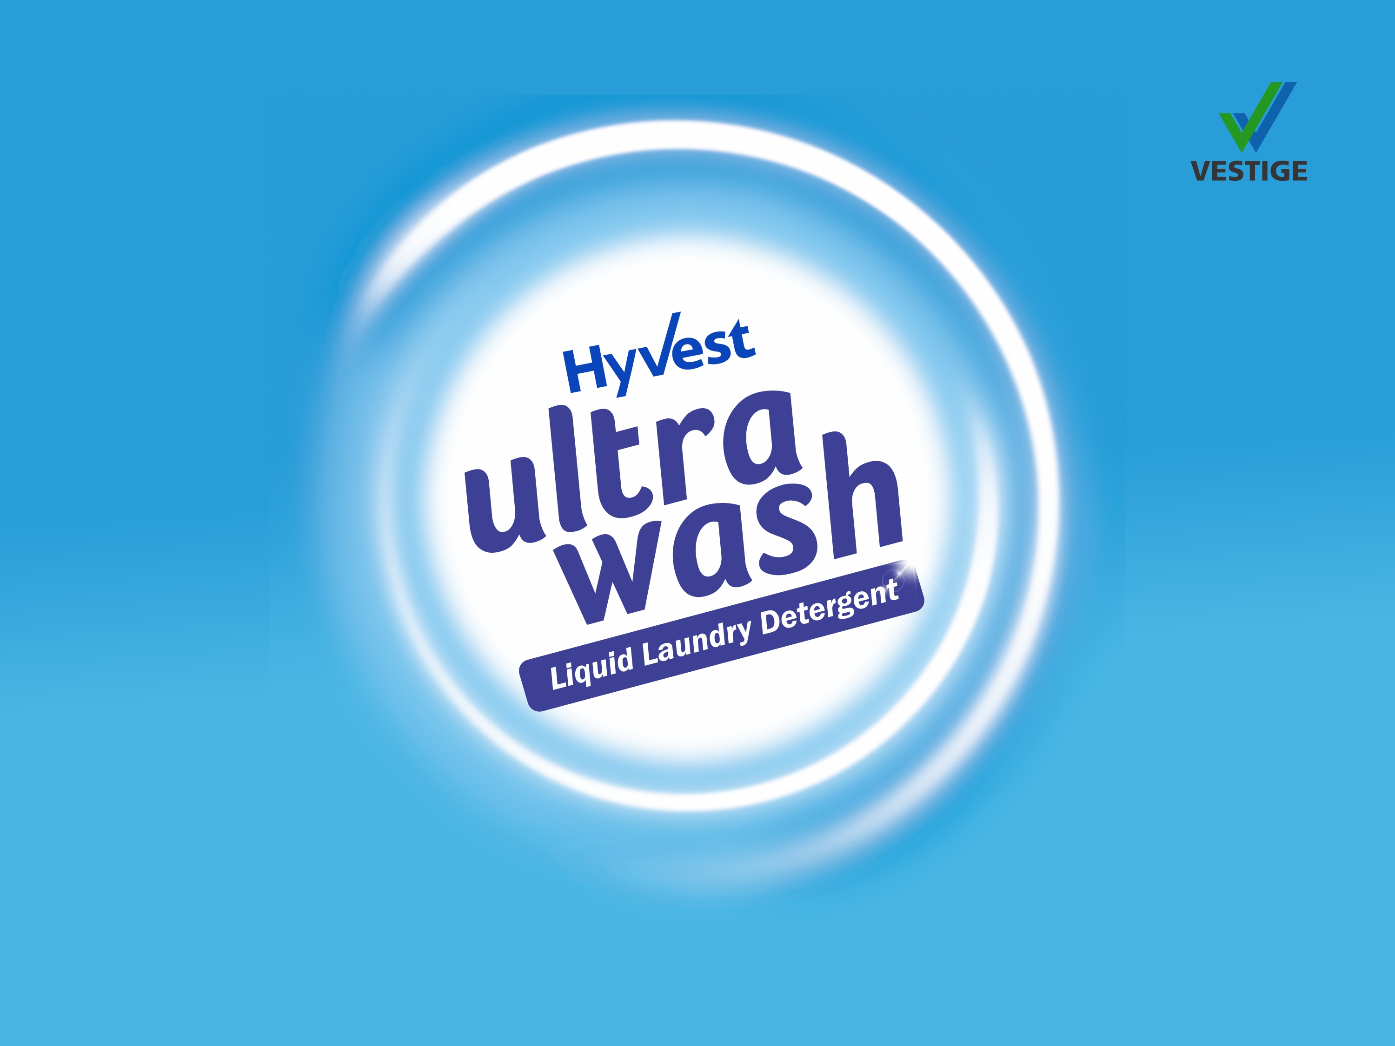

Slide 12
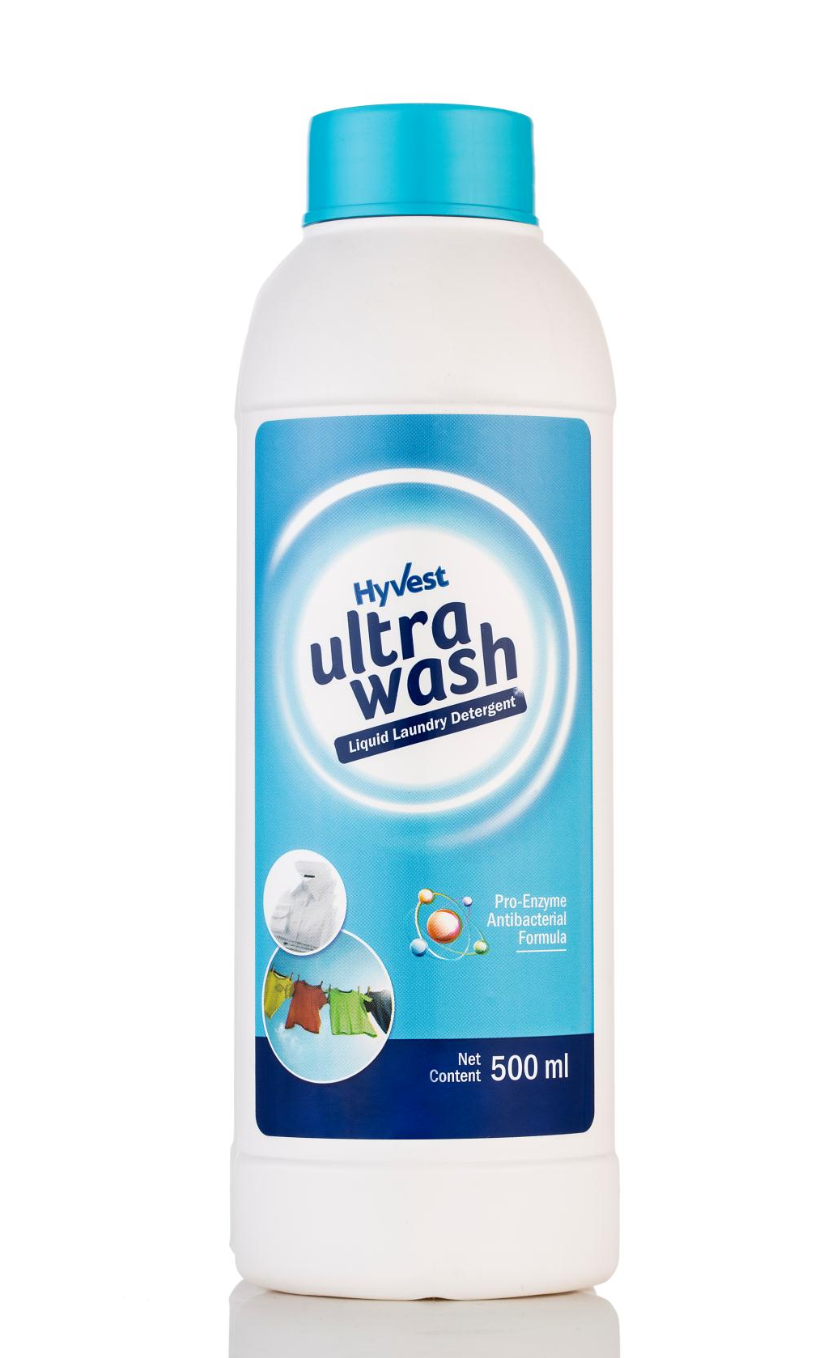
Ultrawash – Liquid Laundry Detergent
Concentrated antibacterial formula with active enzyme technology that is tough on stains and gentle on clothes and hands
Superior cleaning properties effectively removes dirt, grime and unpleasant odour from all types of clothes
Protects and leaves the fabric soft and shining like new
Protects the coloured clothes and brightens up the white clothes
Requires less water for washing compared to popular detergent powders and liquids
  Enriched with antifoaming agents
Enriched with antibacterial Neem extract
Effective for both machine and hand wash

Slide 13
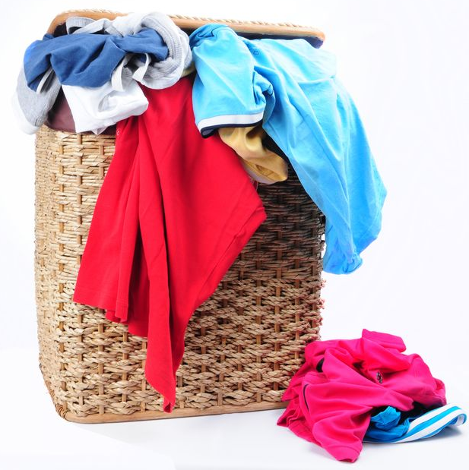
Ultrawash – Liquid Laundry Detergent
USE ON:
All types of clothes including
  Cottons
  Synthetics
  Chiffons
  Georgette
  Jeans
  Sheets
  Quilts
  Baby Clothes etc.
*Not suitable for woolens and silk

Slide 14
Ultrawash – Liquid Laundry Detergent
Application and Cost per use:
Application | Amount | Cost per Use | No. of Uses per bottle
Bucket wash | ½ capful (5 ml) in half bucket (7 L) of water | Rs. 3.45* | 100 Half bucket washes
Machine wash | Regular / Medium Load: 1 capful (10 ml) | Rs. 6.90* | Washes 50 Regular Loads
 | Full / Dirty Load: 2 capful (20 ml) | Rs. 13.80* | Washes 25 Full / Dirty Loads
*cost as per MRP

Slide 15
Ultrawash – Liquid Laundry Detergent
MRP Rs. 345.00
DP Rs. 300.00
BV 180
PV 11.05

Slide 16
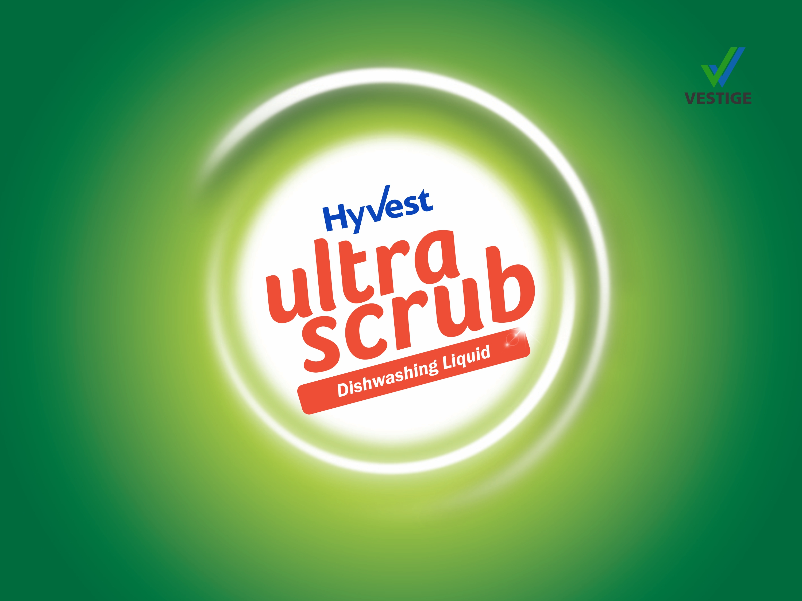

Slide 17
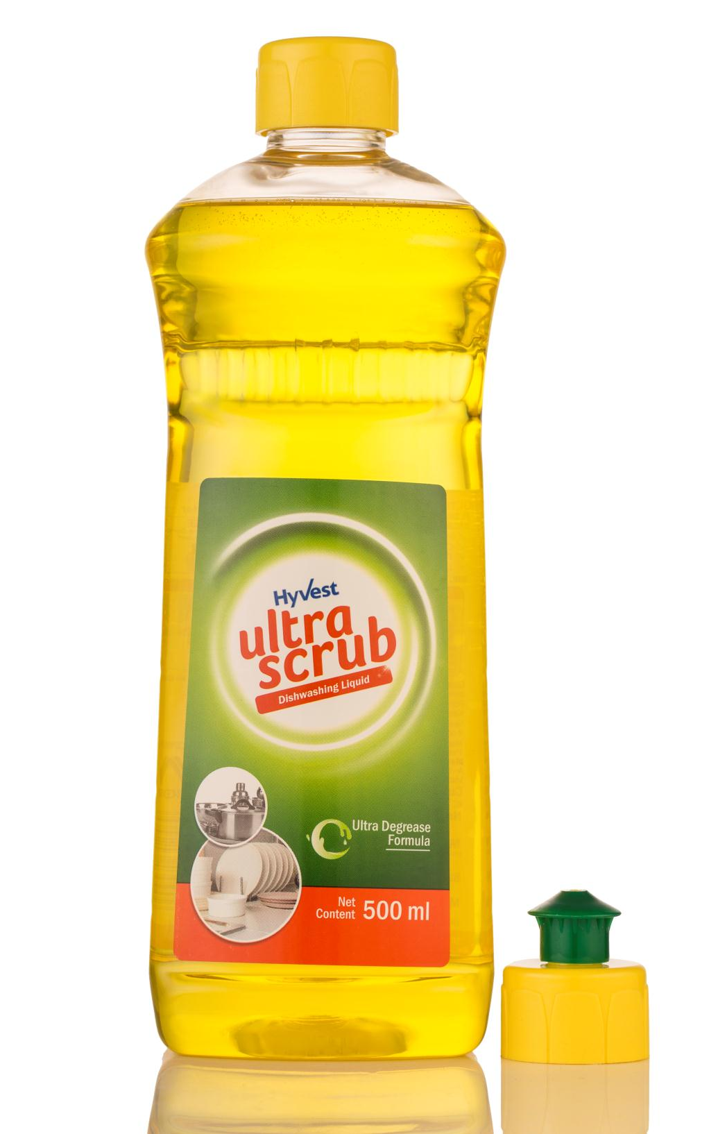
Ultrascrub – Dishwashing Liquid
Concentrated formula for cleaning dishes and utensils
Possesses superior oil and grease removal properties
Gentle on hands
Easily and effectively removes stubborn grease from iron and steel utensils leaving them shining like new
High degreasing strength with power of lemons
Cuts through toughest grease and oily residue
Removes food smell
Leaves utensils sparkling clean

Slide 18
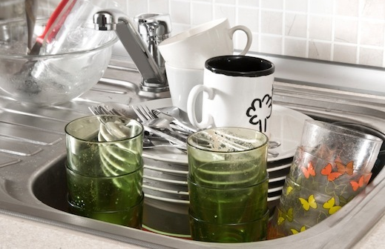
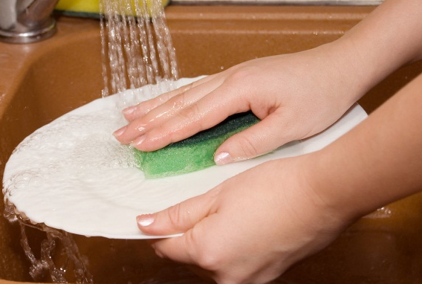
Ultrascrub – Dishwashing Liquid
USE ON:
All types of utensils:
  Stainless steel
  Aluminium
  Iron
  Non-stick cookware
  Glass ware
  Bone china
  Melamine
  Ceramic crockery etc.
FOR REGULAR USE:
  Mix few drops of concentrate in a bowl of water, use on utensils with scrubber pad or sponge
FOR TOUGH STAINS:
  Take one drop of concentrate directly on the scrubber
  Use on utensil with water to scrub off tough stains easily

Slide 19
Ultrascrub – Dishwashing Liquid
Application and Cost per use:
Application | Amount | Cost per Use | No. of Uses per bottle
Regular use: A sink full of Utensils | 1 spoon (5 ml) Ultrascrub in a bowl (100 ml) of water | Rs. 1.85* | 100 sink full of Utensils
Tough Stains | 1 drop (0.5 ml) on scrubber pad | Rs. 0.19* | 1000 drops
*cost as per MRP

Slide 20
Ultrascrub – Dishwashing Liquid
MRP Rs. 185.00
DP Rs. 160.00
BV 96
PV 6.0

Slide 21

DEMONSTRATIONS

Slide 22
Ultrawash – Demo
Take a jar half filled with water
Put a drop of Ultrawash in the jar
Close the lid of the jar and shake vigorously
You will see very less foam formed in the jar*
Ultrawash is designed to form less foam but that does not make it less effective on stains or dirt
Because of this property of Ultrawash, it uses less water for the entire washing and rinsing cycle
*compared to popular detergents

Slide 23
Ultrascrub – Demo
Dip a spoon in oil / margarine / butter
Take out the spoon and remove extra oil or margarine using your fingertips
Put a drop of Ultrascrub in half a glass of water and dip the oily spoon into the glass
Stir the spoon vigorously several times in the glass as if mixing sugar
Remove the spoon from water – the oil / butter will be all gone and the spoon will be sparkling clean with no residue
Ultrascrub Dishwashing Liquid has high degreasing strength that requires very less or no scrubbing

Slide 24
THANKYOU

