Slide 1
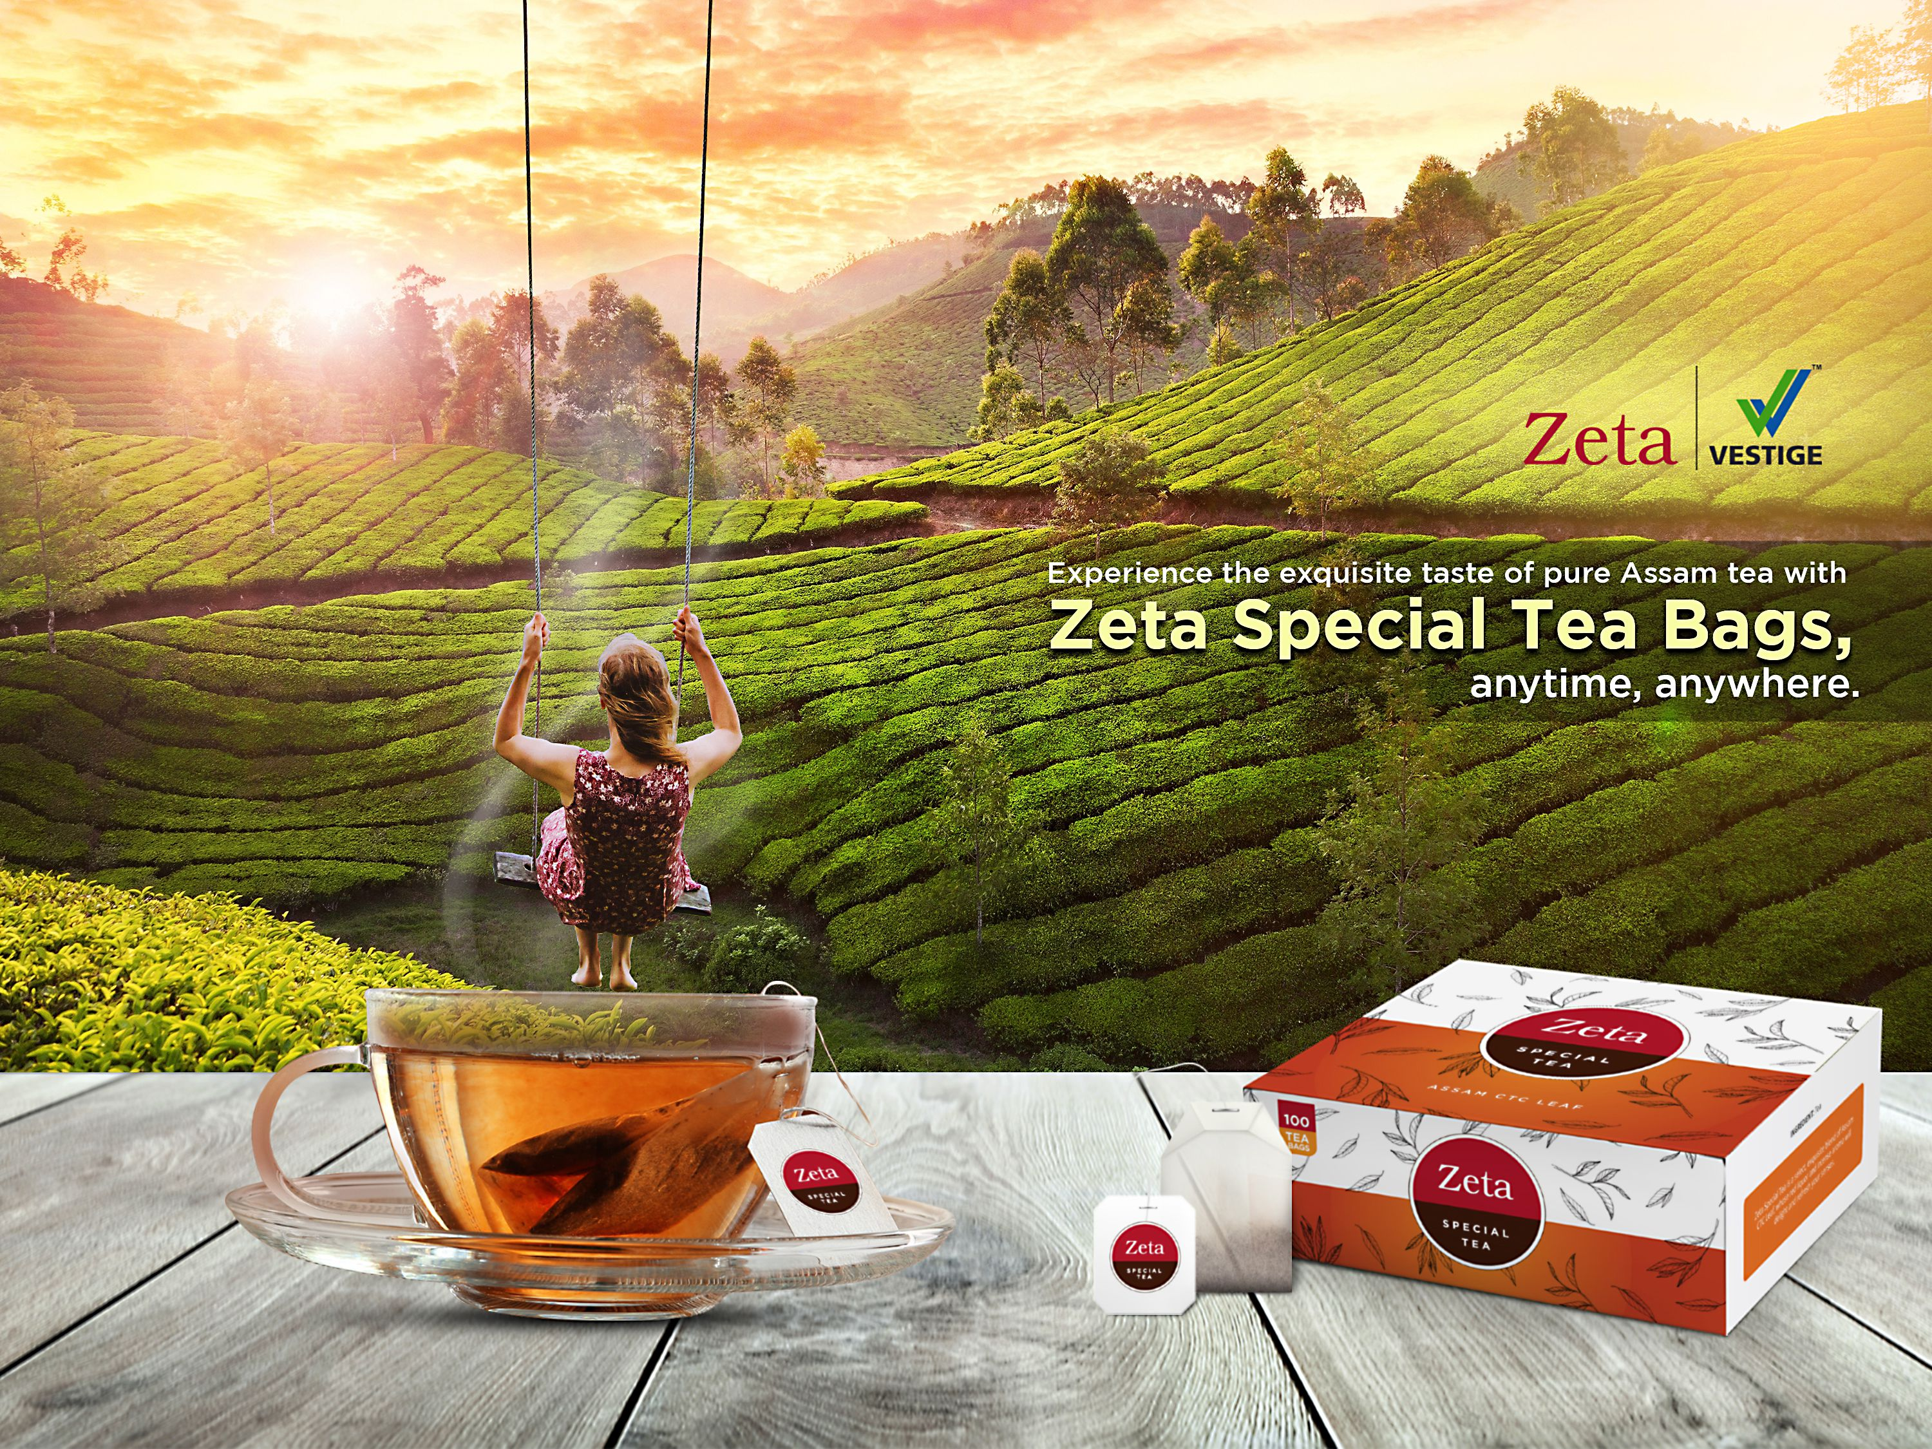

Slide 2
TEA
Tea is the most tasty and accepted beverage by everyone, no matter what the season.
The history of tea is long and complex, spreading across multiple cultures over the span of thousands of years.
Tea is a beverage produced by steeping the young leaves and leaf buds of the tea plant, Camellia sinensis, in freshly boiled water .

Slide 3

INTRODUCING
ZETA SPECIAL TEA BAGS

Slide 4
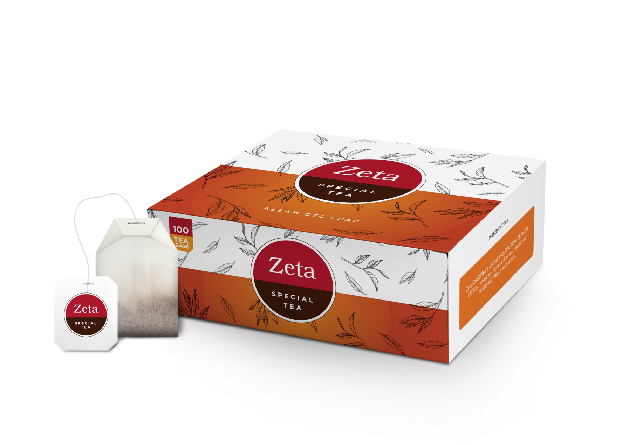
Your favorite Zeta Special Tea, now in a new pack!

Slide 5
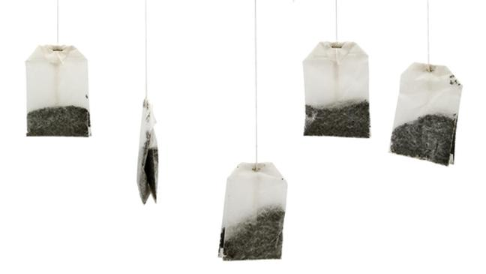
ZETA SPECIAL TEA BAGS
Zeta Special Tea is a select, exquisite blend of Assam CTC leaves with an intense aroma that helps to refresh you with each sip.
The tea bags add extreme convenience in preparing your customised cup of tea.

Slide 6
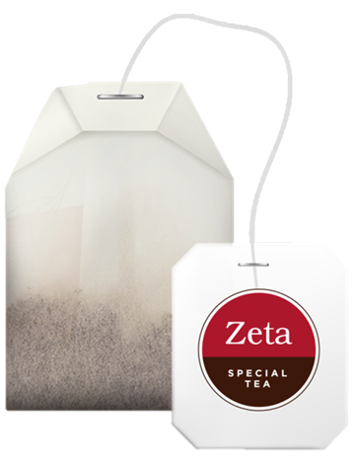
ZETA SPECIAL TEA BAGS
Benefits
It is easy to use.
It helps to refresh you.
It has an intense aroma.
It is rich in antioxidants.
It is convenient and portable.

Slide 7
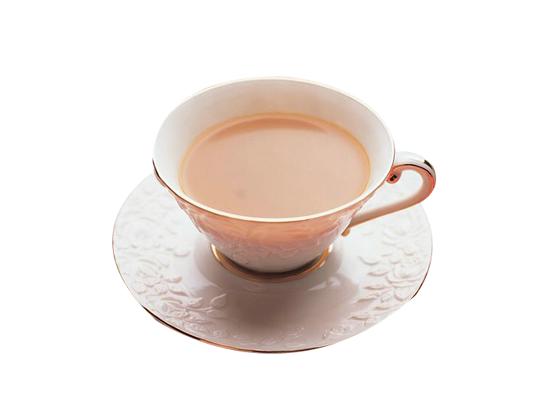
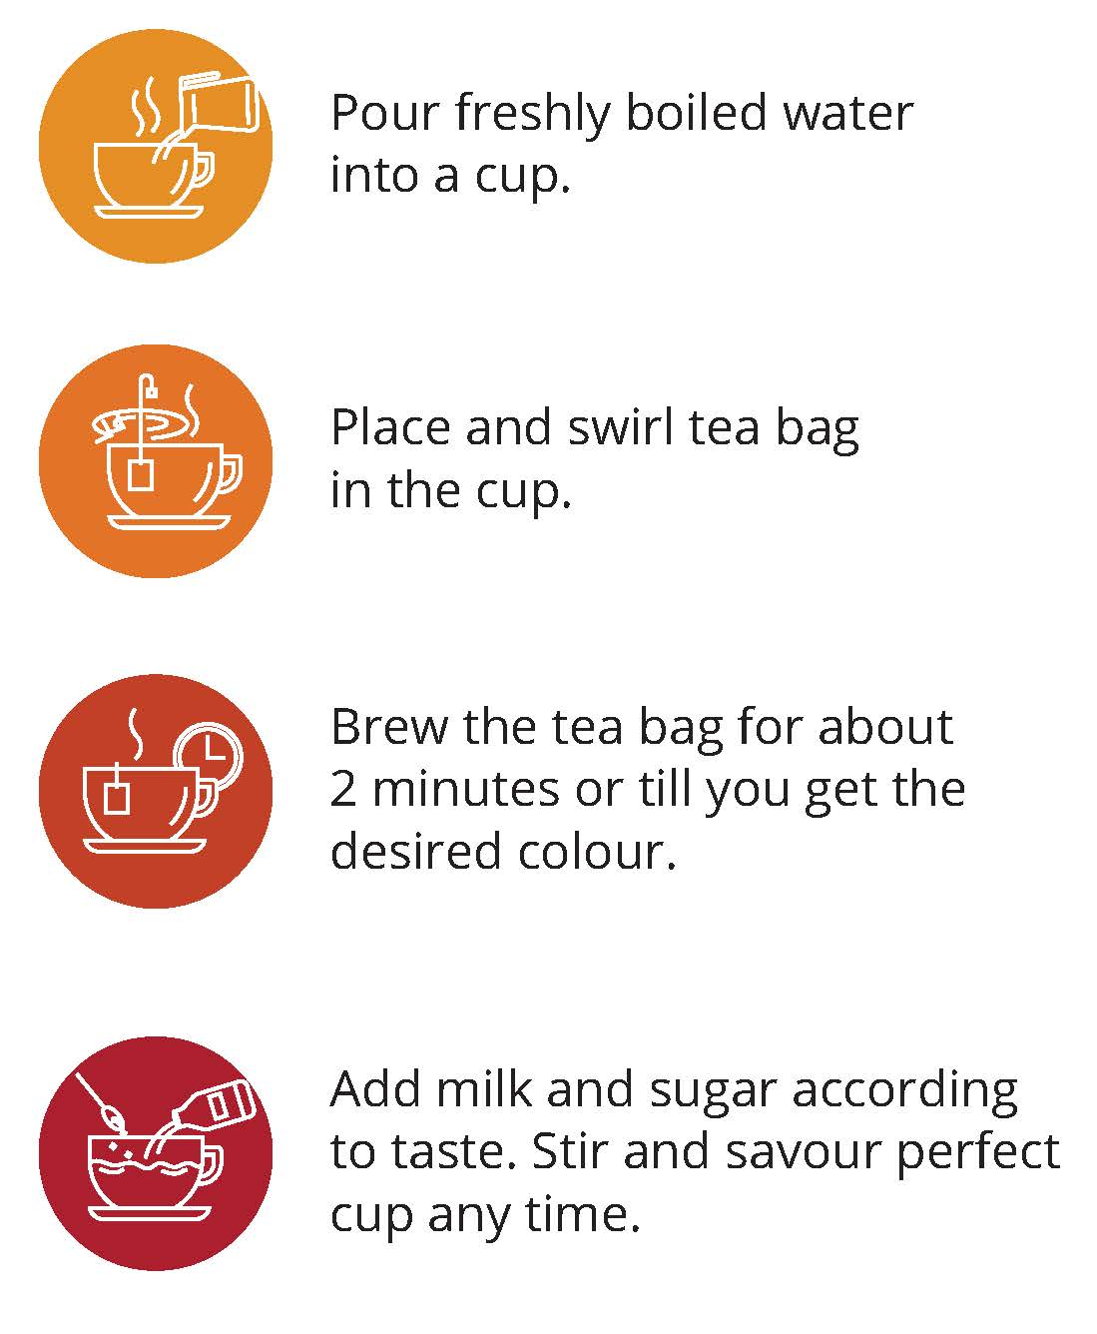
ZETA SPECIAL TEA BAGS
How to prepare

Slide 8
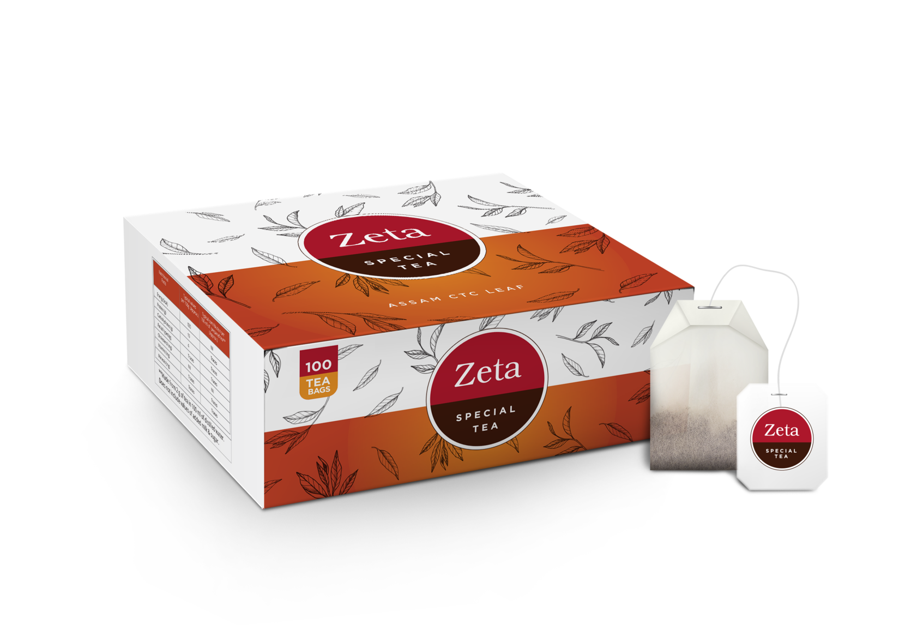
ZETA SPECIAL TEA BAGS
100 Tea bags
MRP Rs 235
DP Rs 200
BV 90
PV 5

Slide 9

THANK YOU

