Slide 1

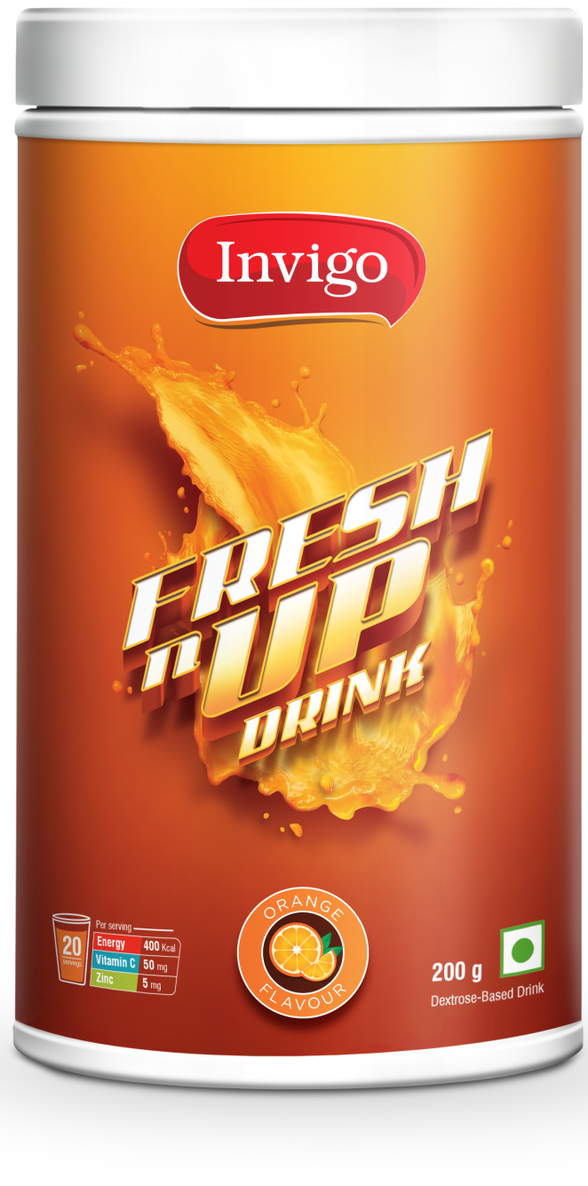
INTRODUCING

Slide 2

Invigo FRESHnUP DRINK
Invigo Fresh nUp Drink has a refreshing orange flavour filled with the goodness of Vitamins C and Zinc that supplies energy to the body
It is easy to prepare and has a fresh juicy taste to give a splash of freshness

Slide 3


IMPORTANCE
OF HYDRATION

Slide 4
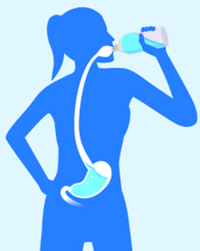
Importance of hydration
Our body is made up of 70% water. Therefore proper hydration is absolutely essential for our body & overall health
Increased summer temperatures & outdoor activities increases water loss—through sweating & evaporation that causes dehydration
In winters we do not feel thirsty & fail to take enough liquids required by the body which causes dehydration
The proper hydration optimizes blood pressure, regulates body temperature, lubricates joints, moves waste out of the body and aids in digestion

Slide 5
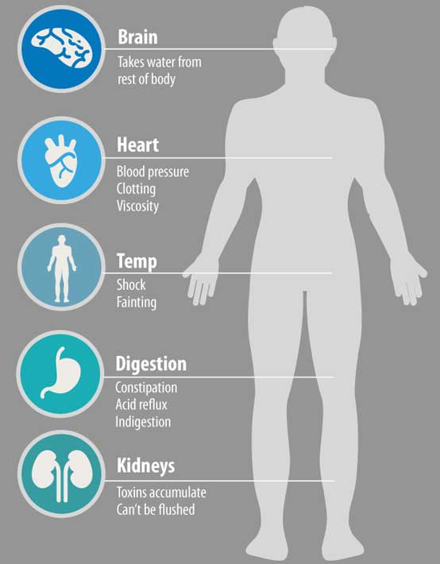
Effects of DEHYDRATION

Slide 6
IMPORTANCE
OF
VITAMIN C
&
ZINC

Slide 7

Importance of VITAMIN C & ZINC
Vitamin C & Zinc have many health benefits:
  Helps in aiding immunity
  Helps in reducing the risk of age-related eye diseases
  Helps in wounds healing
  Helps in reducing the length & severity of a cold
  Helps in the maintenance of the skin

Slide 8

Benefits of Invigo FRESHnUP
DRINK
Refreshing orange taste
Provides energy
Helps to hydrate body
Provides Vitamin C and Zinc
Easy to prepare
No need to add extra sugar*
*Also depends on your taste preference

Slide 9

Dosage of Invigo FRESHnUP DRINK
Dissolve 30 g Invigo FRESH nUP Drink in 200 ml of water
Enjoy the refreshing taste!

Slide 10
Invigo FRESHnUP
DRINK
MRP Rs. 235.00
DP Rs. 200.00
BV 120
PV 6.67

Slide 11


