Slide 1
8th October 2015

Slide 2
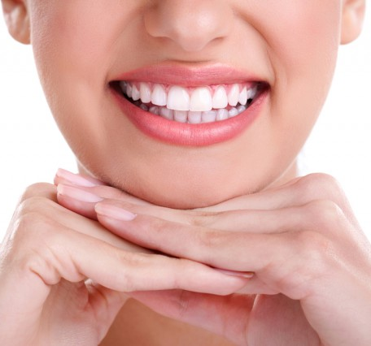
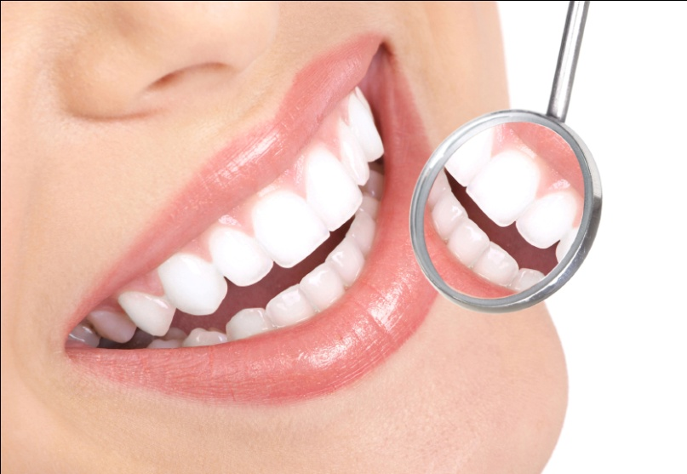
Importance of Oral Health
Oral health means more than just an attractive smile
Condition of the mouth mirrors the condition of the body as a whole
An unhealthy mouth, especially gum disease, may increase risk of serious health problems such as heart attack, stroke, poorly controlled diabetes and preterm labor
Research shows that most of the systemic diseases (diseases that involve many organs or the whole body) have oral symptoms too, including swollen gums, mouth ulcers, dry mouth and excessive gum problems. Such diseases include:
Diabetes
Oral cancer
Pancreatic cancer
Heart disease
Kidney disease

Slide 3
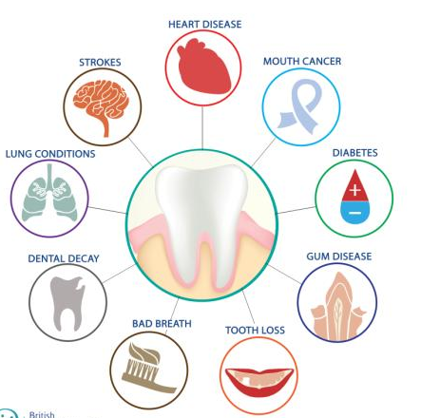
Health Risks of Poor Oral Health
Gum disease can lead to the loss of teeth and an increase the risk of respiratory disease
The bacteria in plaque can travel from the mouth to the lungs, causing infection
Oral inflammation due to bacteria (gingivitis) may also play a role in clogged arteries and blood clots
Diabetic are more susceptible to gum disease and it can put them at greater risk of diabetic complications
Studies also show that pregnant women with poor oral health may be at a higher risk of delivering pre-term, low birth weight babies
Digestion begins with physical and chemical processes in the mouth, and oral problems can lead to intestinal failure, irritable bowel syndrome and other digestive disorders

Slide 4
Parts of a Tooth
Enamel: The hard outer layer of the crown. Enamel is the hardest substance in the body
Dentin: Forms the bulk of the tooth and can be sensitive if the protection of the enamel is lost
Pulp: Soft tissue containing the blood and nerve supply to the tooth
Cementum: The layer of bone-like tissue covering the root
Structures around the tooth
Root canal: Provides the blood vessel and nerves supply to the tooth
Oral Mucosa: These are the moist tissues that lines the mouth
Gingiva (gums): Soft tissue that surrounds and protects the teeth and bone, and provides a lubricated surface

Slide 5
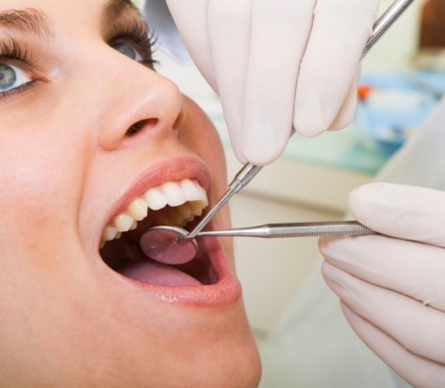
Common Oral Problems
Dental Plaque
Gum Diseases – Gingivitis and Periodontitis
Tooth Cavities
Tooth Sensitivity

Slide 6
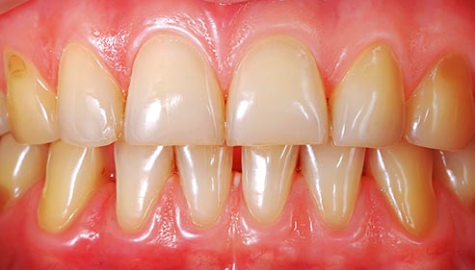
Dental Plaque
Plaque is a sticky layer of material containing bacteria that accumulates on teeth
The bacteria in plaque cause tooth decay and gum disease if not removed regularly through brushing and flossing
After meals the bacteria in plaque use sugar and starch in food to produce acids that eat away tooth enamel
Repeated attacks cause the enamel to break down resulting in a cavity (or hole)
Plaque that is not removed daily between teeth hardens into tartar
As the tartar, plaque and bacteria continue to increase, the gums become red, swollen and bleed during brushing

Slide 7
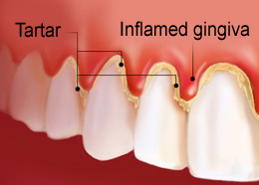
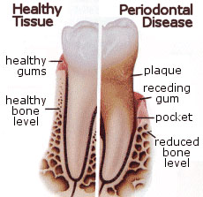
Gum Disease
Gum disease, like inflammation (gingivitis), periodontitis, etc. is usually caused by build up of plaque
Plaque causes the gums to become inflamed and easily bleed during brushing
If left untreated it can progress to more serious periodontitis
The inner layer of gum and bone pull away from the teeth and forms pockets due to bone loss
These small pockets between the teeth and gums collect debris, causing infection in the mouth

Slide 8
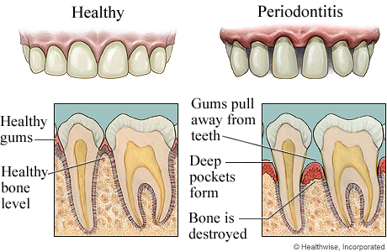
Gum Disease
The three stages of gum disease — from least to most severe — are gingivitis, periodontitis and advanced periodontitis.

Slide 9
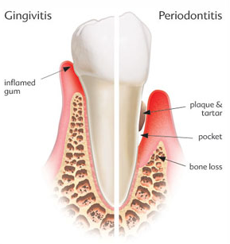
Symptoms
Early symptoms of gum disease include:
Bleeding gums during or after brushing
Red, swollen, or tender gums
Persistent bad breath or bad taste in the mouth
Symptoms of more advanced gum disease (periodontitis)
Receding gum line
Formation of deep pockets between teeth and gums
Loose or shifting teeth

Slide 10
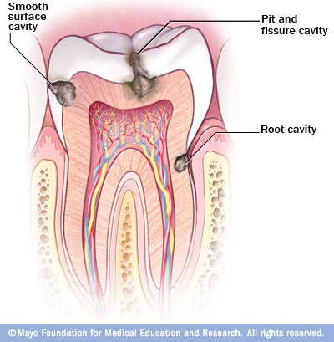
Dental Cavities and Tooth Decay
Dental cavities are holes or structural damage in the teeth
Plaque that gets accumulated on teeth, if not removed turns into tartar that causes tooth decay
The acids in plaque damages the enamel of the teeth, and create holes in the tooth called cavities
They grow very large and affect the nerves
Untreated tooth decay can also destroy the inside of the tooth (pulp)
Cavities refer to tooth decay, that destroys the tooth’s enamel and its underlying layer, the dentin

Slide 11
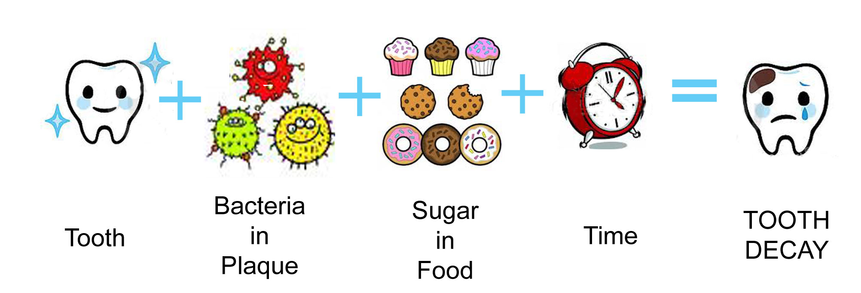
Tooth Decay
When we eat and drink, bacteria in plaque create acids
The acid removes minerals from the enamel, which causes cavity
Decay begins in the main portion of the tooth, the enamel, and as it is broken down the decay goes deeper into the dentin and eventually reach the nerve (or pulp) of the tooth causing infection or tooth fracture

Slide 12
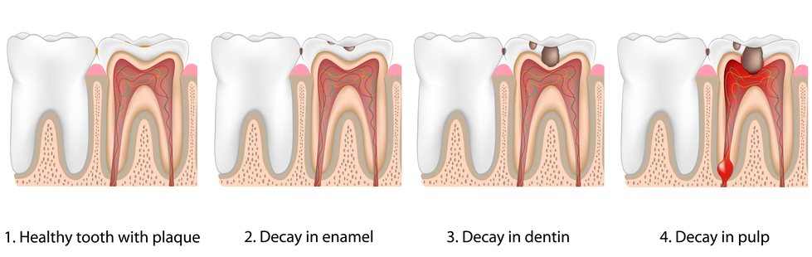
Symptoms
There may be no symptoms for cavities or tooth decay, if they occur it includes:
Tooth pain
Sensitivity to sweet, hot, or cold foods and drinks
Visible pits or holes in the teeth
Pain when chewing

Slide 13
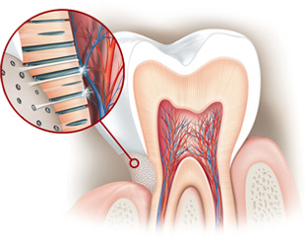
Tooth Sensitivity
Tooth sensitivity — also known as dentin hypersensitivity — affects the tooth or exposed root surfaces
This occurs when the enamel that protects the teeth gets thinner, or when gums pull back and expose the dentin
Dentin is a soft layer makes up the inner part and roots, which have thousands of tiny tubes that lead to the tooth's nerve center (the pulp)
These channels allow the trigger - like, hot, cold, or sweet food - to reach the nerve, which results in pain and sensitivity
Exposed dentin

Slide 14
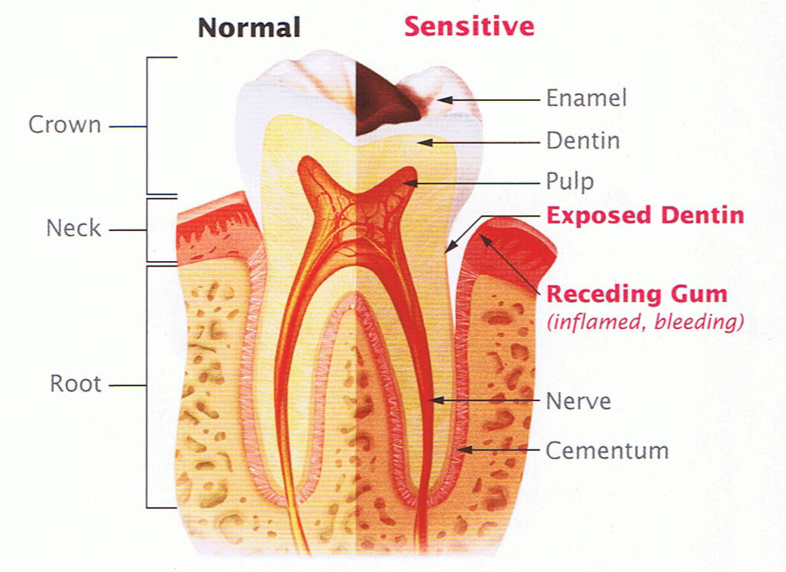
Tooth Sensitivity
Causes include:
Wear and tear - Over time, brushing too hard or using a hard toothbrush can wear down enamel and expose the dentin
Tooth decay near the gum line
Gum disease - Inflamed and sore gums pull back and expose the roots
Damage - Chipped or broken teeth may fill with bacteria, which can enter the pulp, causing inflammation
Plaque buildup - The presence of plaque on the root surfaces can cause sensitivity
Acidic foods - Food and drinks with a high acid content, like citrus fruits, tomatoes, pickles, and tea, can wear down enamel

Slide 15
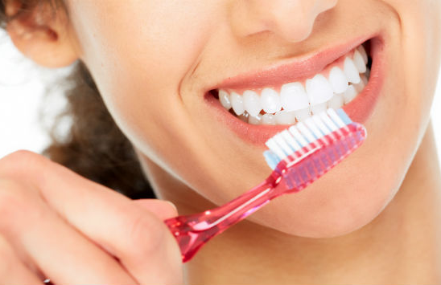
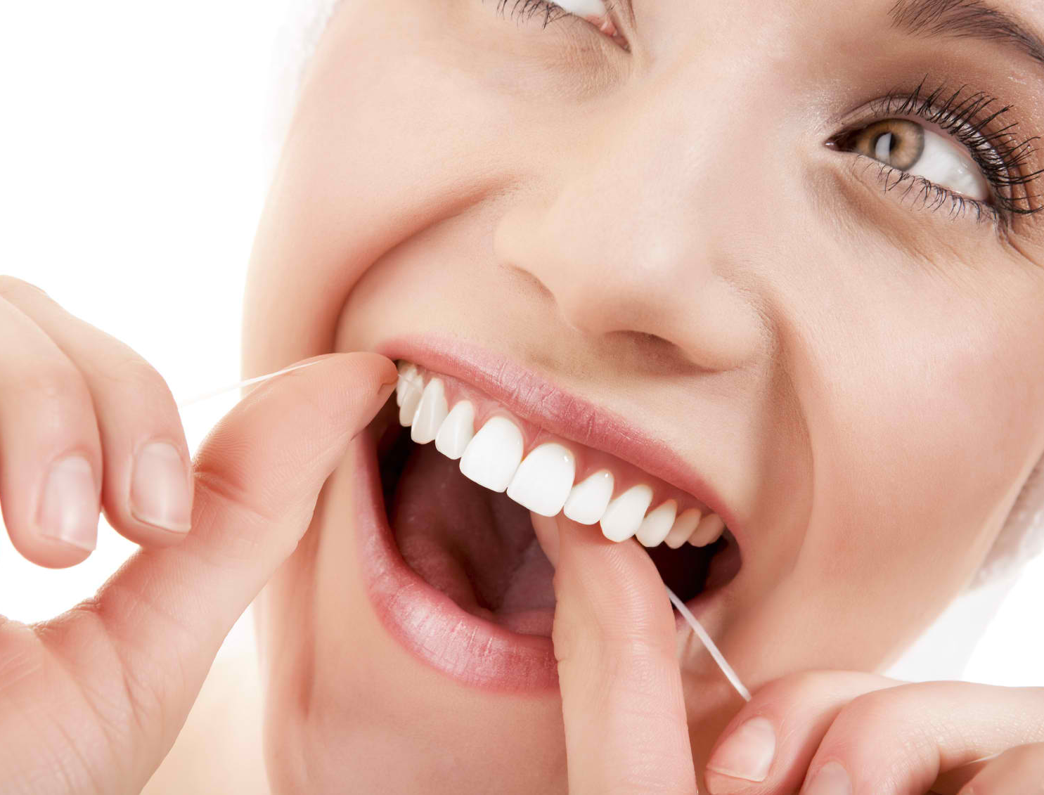
How to avoid Dental Problems?
Maintaining good oral hygiene is important to ensure a healthy mouth
Good oral health is important to overall well-being
Brush twice a day, using a soft-bristled toothbrush and fluoride – containing toothpaste to remove plaque from tooth surfaces
Clean between teeth daily with floss or an interdental cleaner to remove plaque from the places where the toothbrush can’t reach
Flossing is also essential to prevent gum diseases
The tongue harbors bacteria, carefully brushing the tongue also helps reduce bad breath. Use a tongue scraper or a toothbrush that has a built-in tongue cleaner

Slide 16
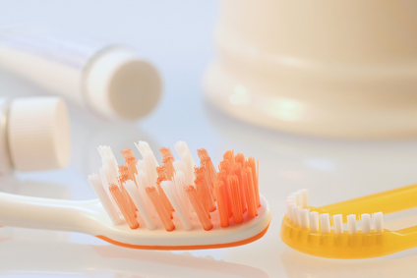
How to avoid Dental Problems?
Eat a balanced diet and limit between-meal snacks, which provide sugar for the bacteria in plaque to convert into decay-causing acids
Keep your mouth moist by avoiding tobacco and drinking plenty of water — not coffee, soft drinks or alcohol, which can lead to a drier mouth. Chew gum or suck on candy (sugarfree) to stimulate saliva
Change your toothbrush when it becomes frayed, about every 3-4 months, and choose a soft-bristled toothbrush with a tongue cleaner
Visit your dentist on a regular basis — generally once or twice a year — for professional cleanings and oral exams

Slide 17
Fluoride
Fluoride is a mineral that occurs naturally in all water sources
Research has shown that fluoride helps to reduce cavities and helps repair the early stages of tooth decay
Reduces the formation of plaque acids
Helps prevent mineral loss caused by plaque acids
Promotes re-mineralisation of early decay

Slide 18
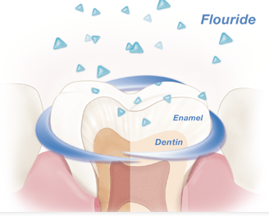
How it works for the teeth?
Food particles left behind in the mouth break down into sugars that is broken down into cavity causing acids by bacteria
Acids dissolve minerals from the tooth enamel, a process called demineralization
This makes teeth weaker and results in tooth decay
That's where fluoride comes in. When fluoride reaches the teeth, it gets absorbed into the enamel
It helps to repair the enamel by replenishing the lost calcium and phosphorous strengthening the teeth – process called re-mineralization
When fluoride is present during re-mineralization, the minerals deposited into the tooth enamel help strengthen teeth
This way fluoride helps stop the decay process
Always use fluoride containing toothpaste atleast twice daily to keep cavities at bay
It is effective and safe to use even for children

Slide 19
Ensures Complete Dental Hygiene for Your Family

Slide 20
Dentassure Toothpaste
Dentassure Toothpaste is a foaming fluoridated paste for daily use
It is a unique formula with dual protection of Neem and Clove that fights germs and prevents dental cavities
It also helps support gum health
It contains calcium that strengthens the teeth
Use it daily for fresh breath and stronger teeth
Neem fights germs
Clove prevents cavities and supports gum health

Slide 21
Dentassure Toothbrush
An international quality toothbrush, scientifically designed to take complete care of your teeth and gums
Dentassure Toothbrush is made of 100% DuPont bristles with rounded ends that reach between teeth and remove food particles and help prevent dental plaque
Its unique gum massager gently cleans the teeth and massages the gums
It has a special tongue cleaner for better oral health
Dentists recommend replacing your toothbrush every 3-4 months

Slide 22
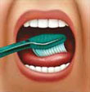
How to brush your teeth
Proper brushing takes at least two minutes
Use short, gentle strokes, paying attention to the gumline, hard-to-reach back teeth and areas around fillings, crowns etc.
Concentrate on thoroughly cleaning each section as follows:
Tilt the brush at a 45° angle against the gumline and sweep or roll the brush away from the gumline | Gently brush the outside, inside and chewing surface of each tooth using short back-and-forth strokes | Gently brush your tongue to remove bacteria and freshen breath

Slide 23
Whitening Toothpaste
Introducing

Slide 24
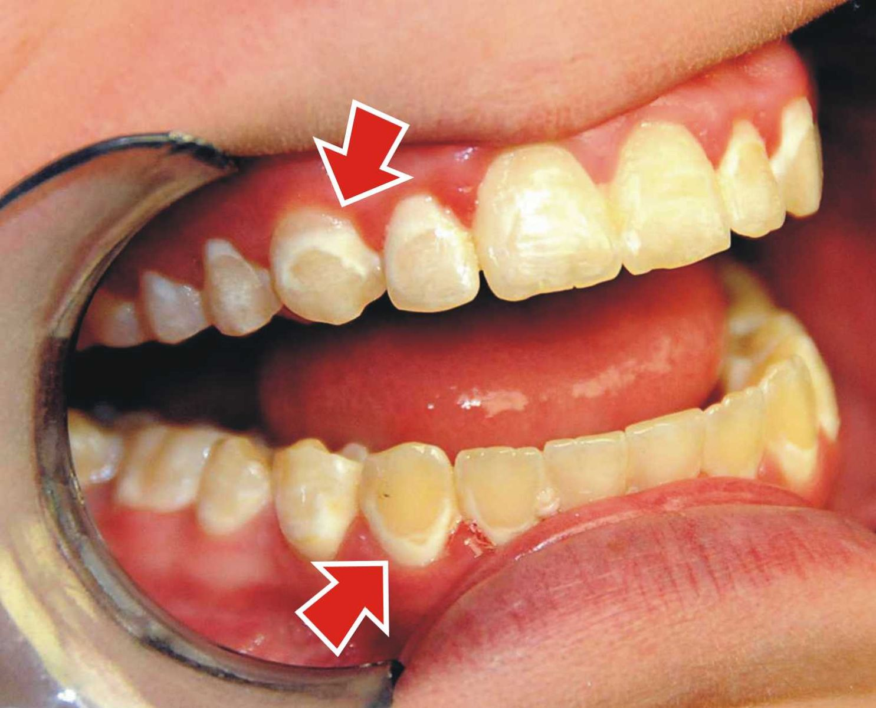
Teeth Discolouration
Our teeth become yellow due to stains over time – both deep and surface level
Our teeth are not perfectly white by nature
Tooth enamel – the hard white surface of teeth, underneath which is a pale brown substance called dentin
Thick enamel looks white, but as enamel erodes it allows dentin tones to show through, making teeth look yellow
Enamel naturally wears with age, and acids from sugary foods also erodes the enamel surface

Slide 25
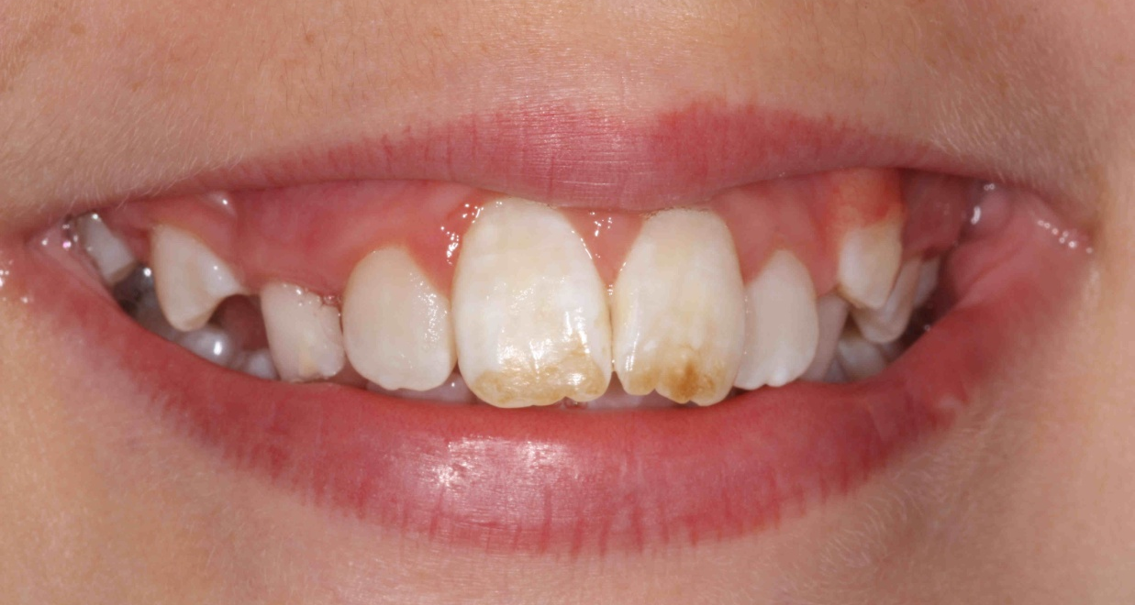
Teeth Discolouration
There are two types of stains that cause discolouration of teeth
Intrinsic stains that develop inside the tooth enamel. These can be due to mother’s antibiotic use while pregnant or childhood exposure to fluoride
Extrinsic stains are the result of certain habits
The most common reasons for teeth to get yellow or stained are:
Using tobacco
Drinking dark-coloured liquids such as coffee, cola, tea and red wine
Not taking good care of your teeth

Slide 26
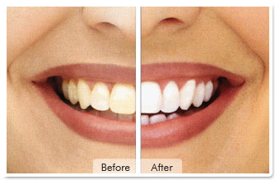
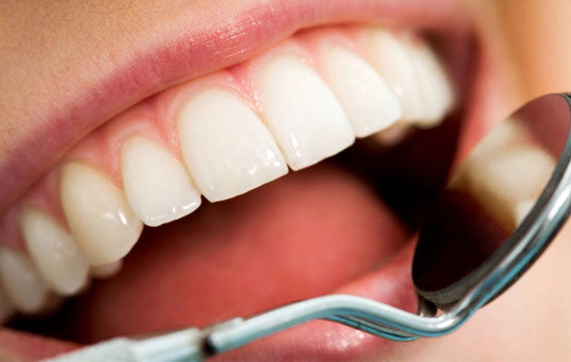
Dentassure Whitening Toothpaste
Dentassure Whitening Toothpaste whitens teeth by removing surface stains, such as those caused by drinking coffee or smoking
It gently polishes the teeth and removes stains
It helps to retain natural whiteness of the teeth
Cool mint flavour gives long lasting fresh breath

Slide 27
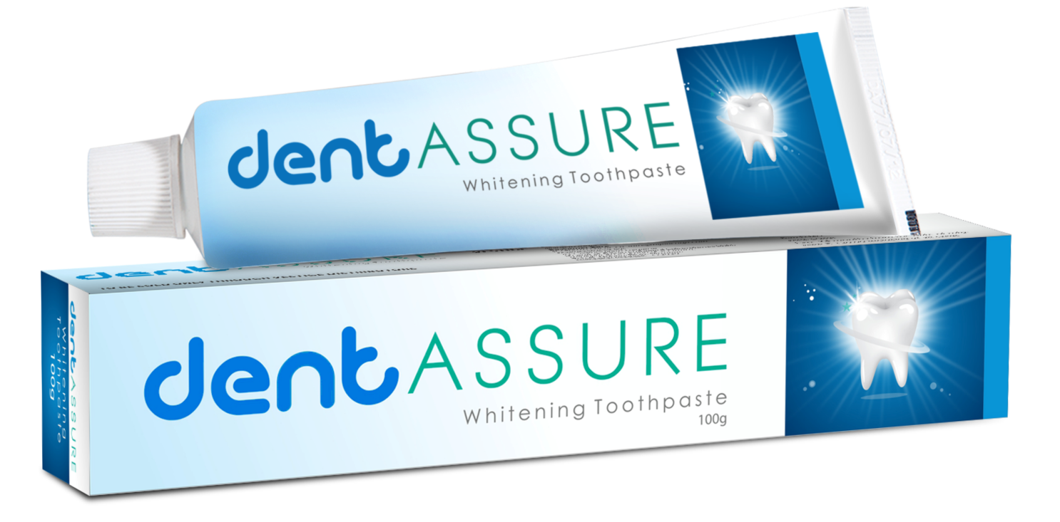
Whitening Toothpaste
MRP Rs. 130.00
DP Rs. 110.00
BV 66
PV 4.12

Slide 28
Thank you
QUIZ

