Slide 1
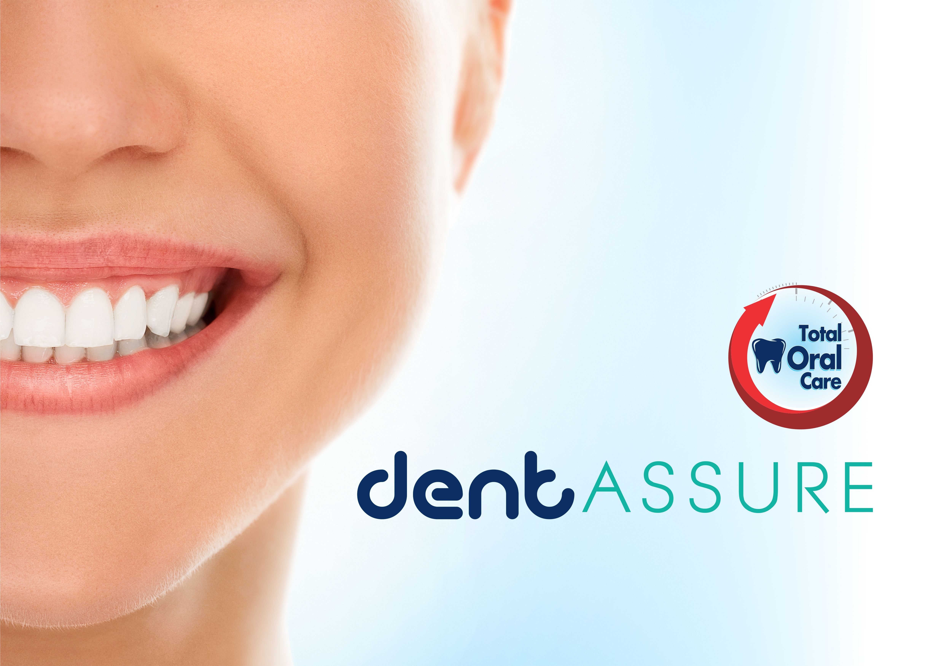

Slide 2
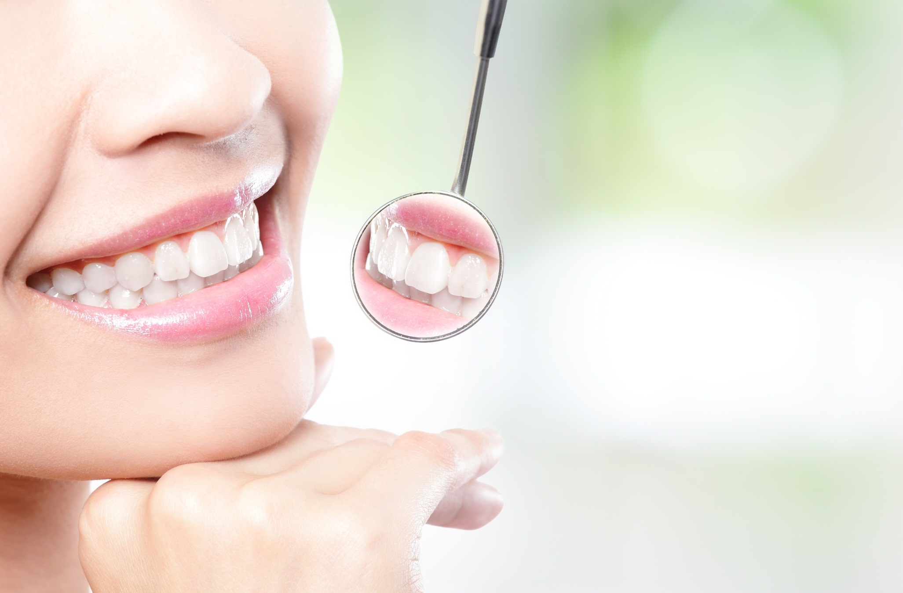

Importance of Oral
Health
Health of the mouth mirrors the health of the body as a whole
An unhealthy mouth, especially gum disease, may increase risk of serious health problems such as cardiovascular disease, poorly controlled diabetes and preterm labor
Research shows that many diseases that involve many organs of the body have oral symptoms too, including swollen gums, mouth ulcers and dry mouth. Such diseases include:
  Diabetes
    Oral cancer
    Pancreatic cancer
    Heart disease
    Kidney disease

Slide 3
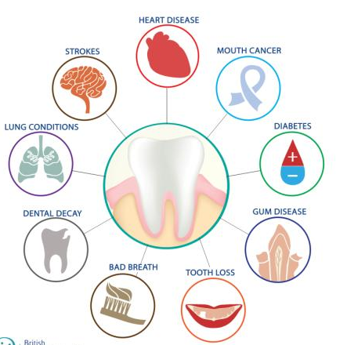
Health Risks of Poor Oral Health
Gum disease can lead to loss of teeth
The bacteria in plaque can travel from the mouth to the lungs, causing infection
Oral inflammation due to bacteria (gingivitis) may also play a role in clogged arteries and blood clots
Diabetics are more susceptible to gum disease
Studies also show that pregnant women with poor oral health may be at a higher risk of delivering pre-term and low birth weight babies
Oral problems can also lead to intestinal failure, irritable bowel syndrome and other digestive disorders

Slide 4
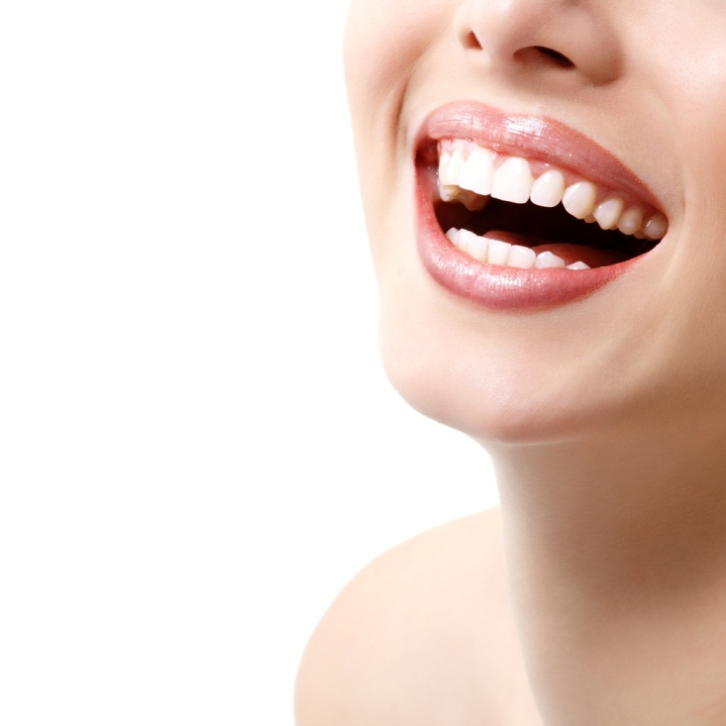
Common Oral Problems
Dental Plaque
Gum Diseases – Gingivitis & Periodontitis
Tooth Cavities
Tooth Sensitivity

Slide 5
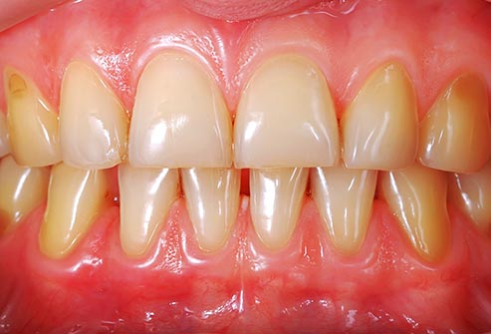
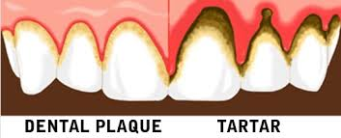
Dental Plaque
Plaque is a sticky layer of material containing bacteria that accumulates on teeth
After meals the bacteria in plaque use sugar in food to produce acids that eat away tooth enamel
Plaque that is not removed daily between teeth hardens into tartar
As the tartar, plaque and bacteria continue to increase, the gums become red, swollen and bleed during brushing

Slide 6
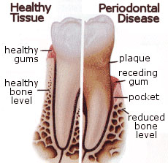
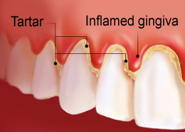
Gum Disease
Gum disease, like inflammation (gingivitis), periodontitis etc. is usually caused by build up of plaque
Plaque build up causes the gums to become inflamed and cause it to bleed during brushing
The three stages of gum disease — from least to most severe — are gingivitis, periodontitis and advanced periodontitis.

Slide 7
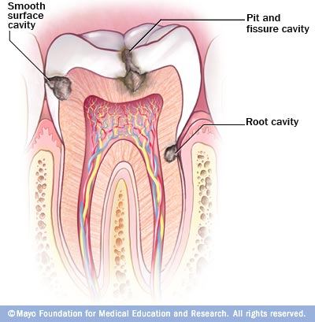
Dental Cavities and Tooth Decay
Dental cavities are holes or structural damage in the teeth
Plaque and tartar causes tooth decay
The acids in plaque damages the enamel of the teeth, and create holes in the tooth forming cavities
They grow very large and affect the nerves
Untreated tooth decay can also destroy the inside of the tooth (pulp)
Cavities destroys the tooth’s enamel and its underlying layers

Slide 8
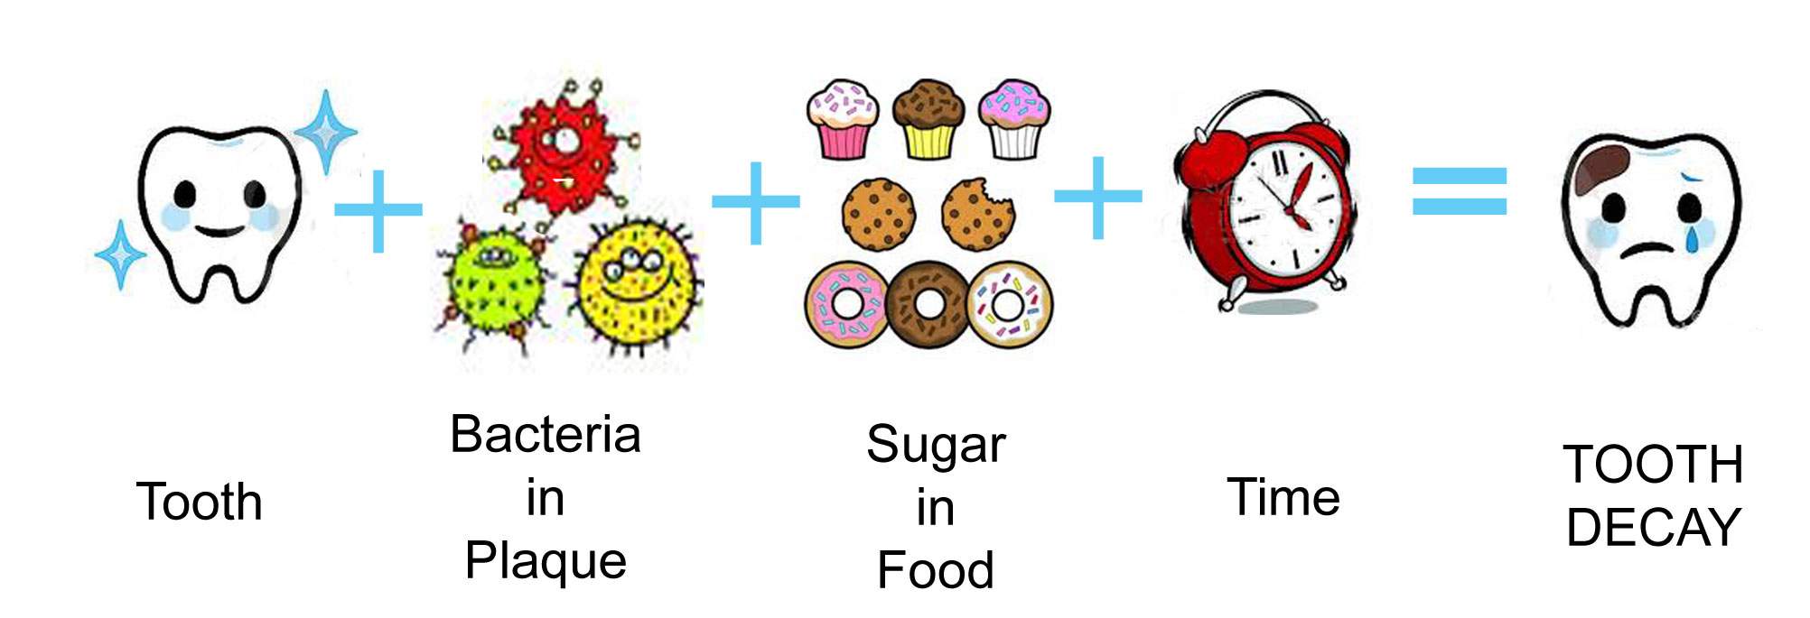
Tooth Decay
When we eat and drink, bacteria in plaque create acids
The acid removes minerals from the enamel, which causes cavity

Slide 9
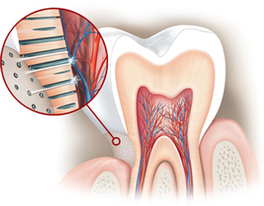
Tooth Sensitivity
Tooth sensitivity — also known as dentin hypersensitivity — affects the tooth or exposed root surfaces
This occurs when the enamel that protects the teeth gets thinner, or when gums pull back and expose the dentin
Dentin has thousands of tiny tubes that lead to the tooth's nerve center (the pulp)
These channels allow the trigger - like, hot, cold, or sweet food - to reach the nerve, which results in pain and sensitivity
Exposed dentin

Slide 10
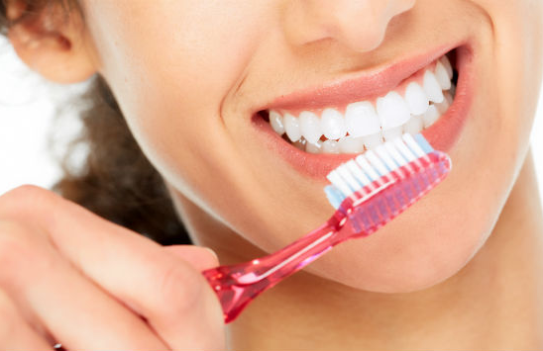
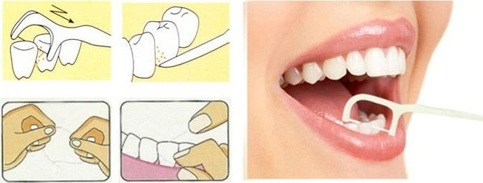
How to avoid Dental Problems?
Maintaining good oral hygiene is important to ensure a healthy mouth and overall well being
Brush twice a day, using a medium / soft - bristled toothbrush and fluoride – containing toothpaste to remove plaque from tooth surface
Change your toothbrush every 3 months, and choose a toothbrush with a tongue cleaner and gum massager
Clean between teeth daily with dental floss or an interdental cleaner to remove plaque from the places where the toothbrush can’t reach
Flossing is also essential to prevent gum diseases

Slide 11
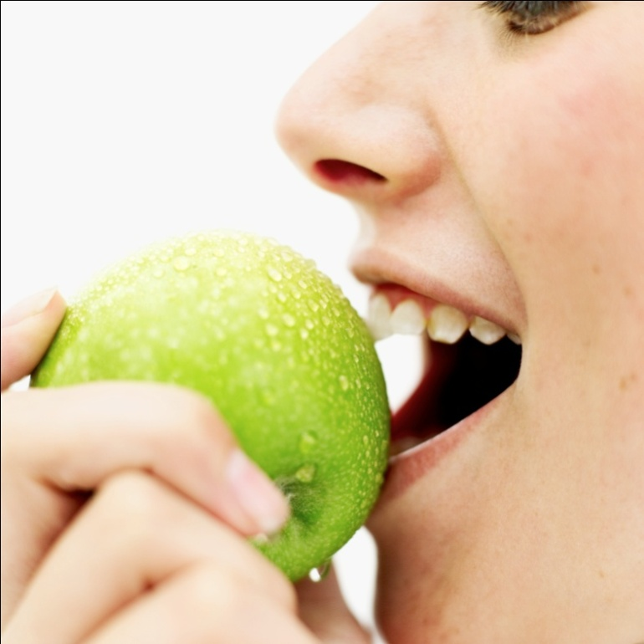
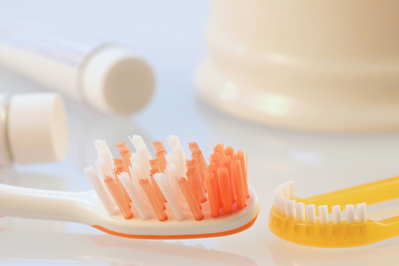
How to avoid Dental Problems?
The tongue harbors bacteria, gently brushing the tongue also helps reduce bad breath. Use a tongue scraper or a toothbrush that has a built-in tongue cleaner
Eat a balanced diet and limit between-meal snacks, which provide sugar for the bacteria in plaque to convert into acids that causes tooth decay
Keep your mouth moist
Visit your dentist on a regular basis — generally once or twice a year — for professional cleanings and oral exams

Slide 12
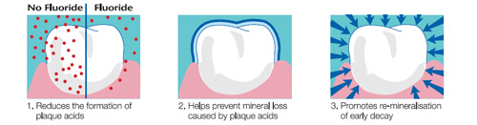
Fluoride
Fluoride is a mineral that occurs naturally in all water sources
Research has shown that fluoride helps to reduce cavities and help to prevent tooth decay
It helps to re-mineralize the teeth by preventing mineral loss caused due to plaque built up
Always use fluoride containing toothpaste, at least twice daily to keep cavities at bay
It is effective and safe to use even for children (above 6 years)
Reduces the formation of plaque acids
Helps prevent mineral loss caused by plaque acids
Promotes re-mineralisation of early decay

Slide 13
Ensures Complete Dental Hygiene for Your Family

Slide 14

Multi-Action Toothbrush
Introducing

Slide 15
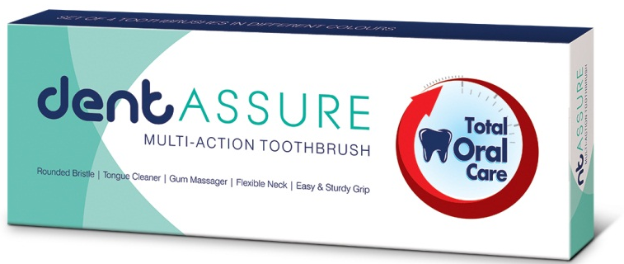
Dentassure Multi-Action Toothbrush
The new Dentassure Multi- Action toothbrush provides superior all round cleaning of the entire mouth
It is made of 100 % DuPont bristles with rounded ends that reach between teeth and remove food particles and help prevent dental plaque

Slide 16
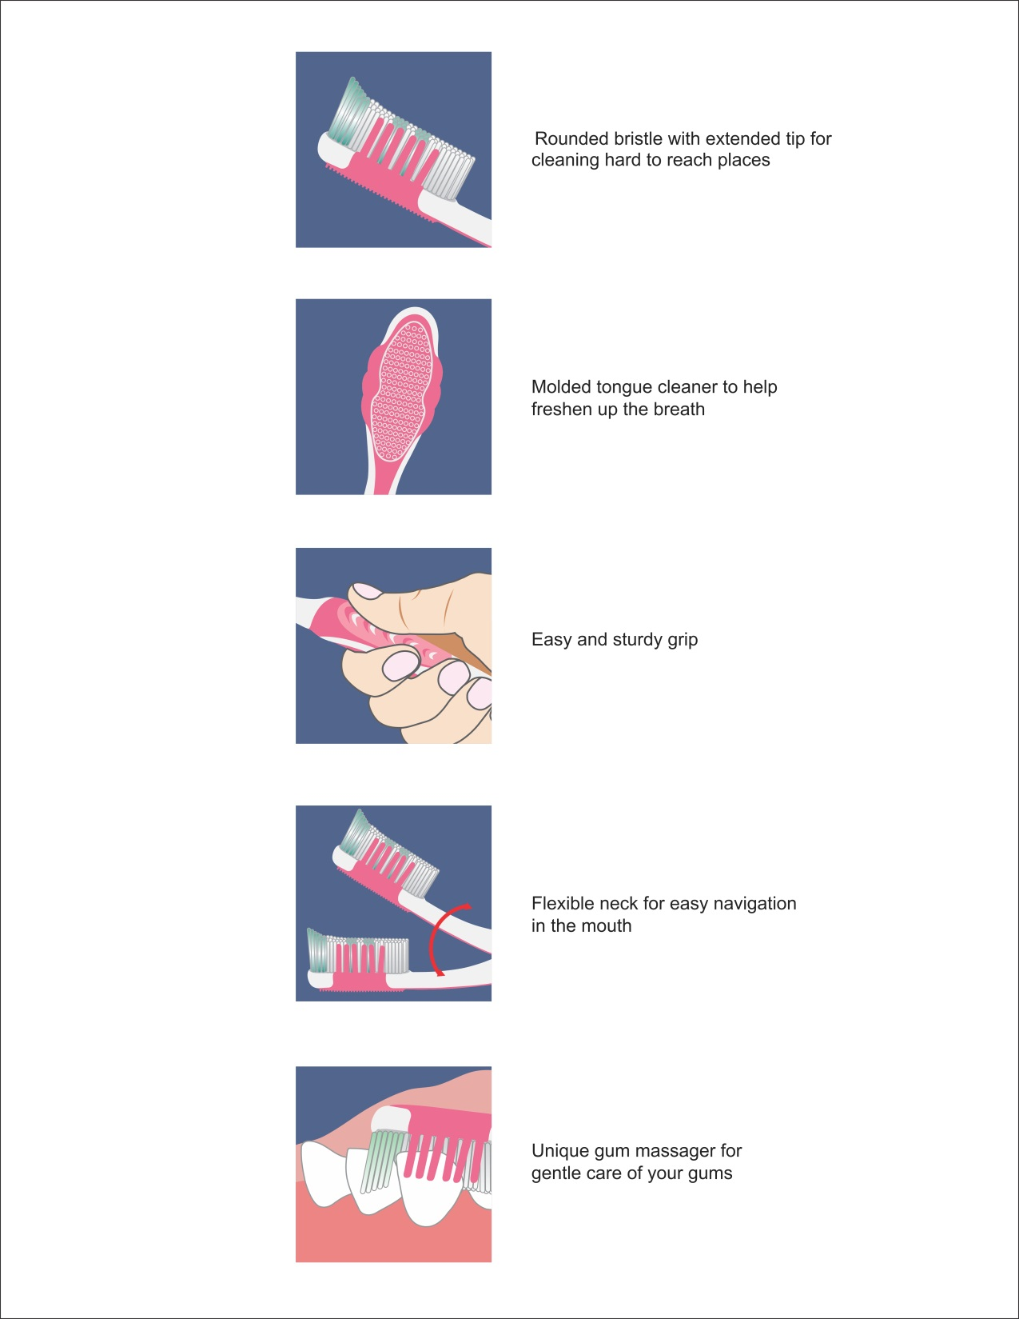
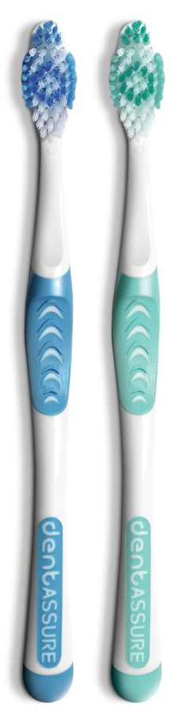
Dentassure Multi-Action Toothbrush
It is designed to take complete care of your teeth, gums and tongue
Rounded bristles with extended tip for cleaning hard to reach places
Flexible neck for easy navigation in the mouth
Specialized tongue cleaner to help freshen up the breath
Unique gum massager for gentle care of your gums
Easy and sturdy grip

Slide 17
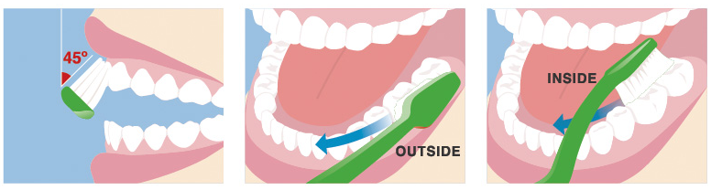
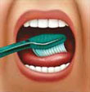
How to properly brush your teeth
Proper brushing takes at least two minutes
Use short, gentle strokes, paying attention to the gum-line, hard-to-reach back teeth and areas around fillings, crowns etc.
Concentrate on thoroughly cleaning each section as follows:
Tilt the brush at a 45° angle against the gum-line and sweep or roll the brush away from it | Gently brush the outside, inside and chewing surface of each tooth using short back-and-forth strokes | Gently brush your tongue to remove bacteria and food debris Scrape using the back of the brush

Slide 18

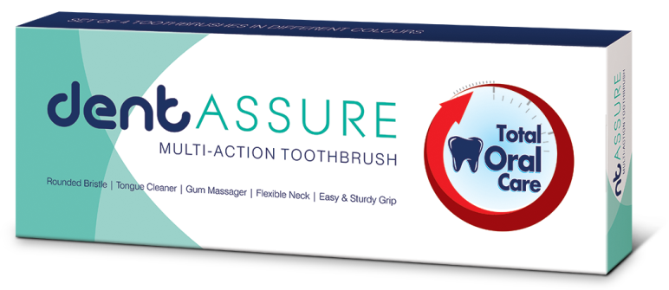
Dentassure Multi-Action Toothbrush
Pack of 4 (in beautiful pastel shades)
MRP Rs. 250.00
DP Rs. 208.00
BV 124.8
PV 7.80

Slide 19
Dental Floss Sticks
Introducing

Slide 20
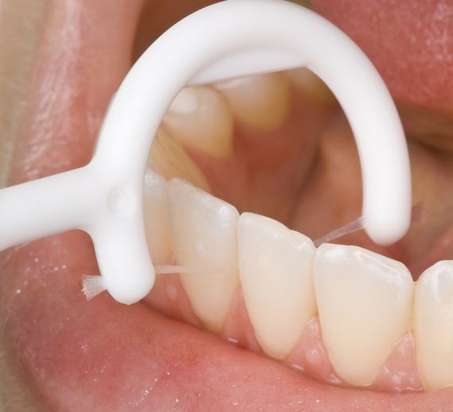
Importance of Flossing for Oral Hygiene
Flossing is vital for maintaining oral health
Toothbrush cleans the top and outer surface of the teeth and gums
Floss is an interdental cleaner
  It is specifically designed to clean the tight spaces between the teeth and under the gums
  It removes the stubborn tartar and bits of food that lodges between the teeth
Dentists suggest flossing before brushing at bedtime that makes brushing more effective
Flossing should be done with waxed floss

Slide 21
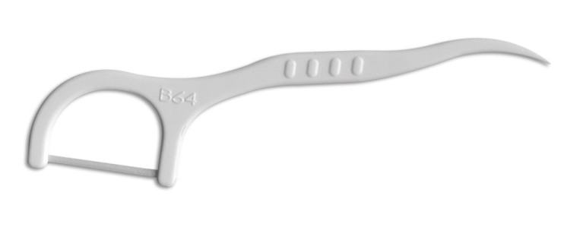
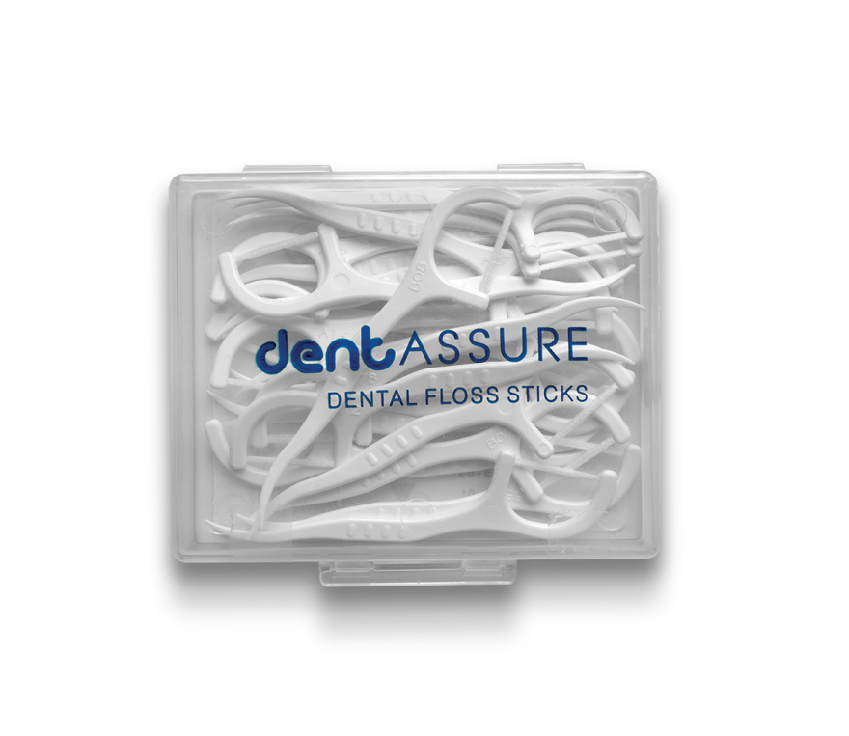
Dentassure Dental Floss Sticks
Wax coated thread
This unique 2-in-1 floss stick provides dual benefits of flossing and interdental cleaning at the same time
On one side is the interdental cleaning, wax coated high impact polyester thread
On the other side is a pointed tooth pick for removing debris between the teeth
Studies have shown that interdental flossing have several benefits:
  Reduces plaque
  Prevent tooth decay
  Fights bad breath
  Removes food debris between the teeth
Interdental tooth pick

Slide 22
How to properly use floss sticks
Hold the floss with the thread facing towards the teeth
Guide the floss between the teeth using a gentle rubbing motion
When the floss reaches the gum line, curve it into a C shape against one tooth
Gently slide it into the space between the gum and the tooth
Gently rub the side of the tooth, moving the floss away from the gum with up and down motions
Repeat this method on the rest of the teeth
Once finished throw the floss away
A used piece of floss won’t be as effective as it could harbor a lot of plaque causing bacteria

Slide 23
Dentassure Dental Floss Sticks
Pack of 25 sticks
MRP Rs. 115.00
DP Rs. 100.00
BV 60
PV 3.75

Slide 24

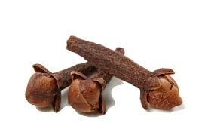
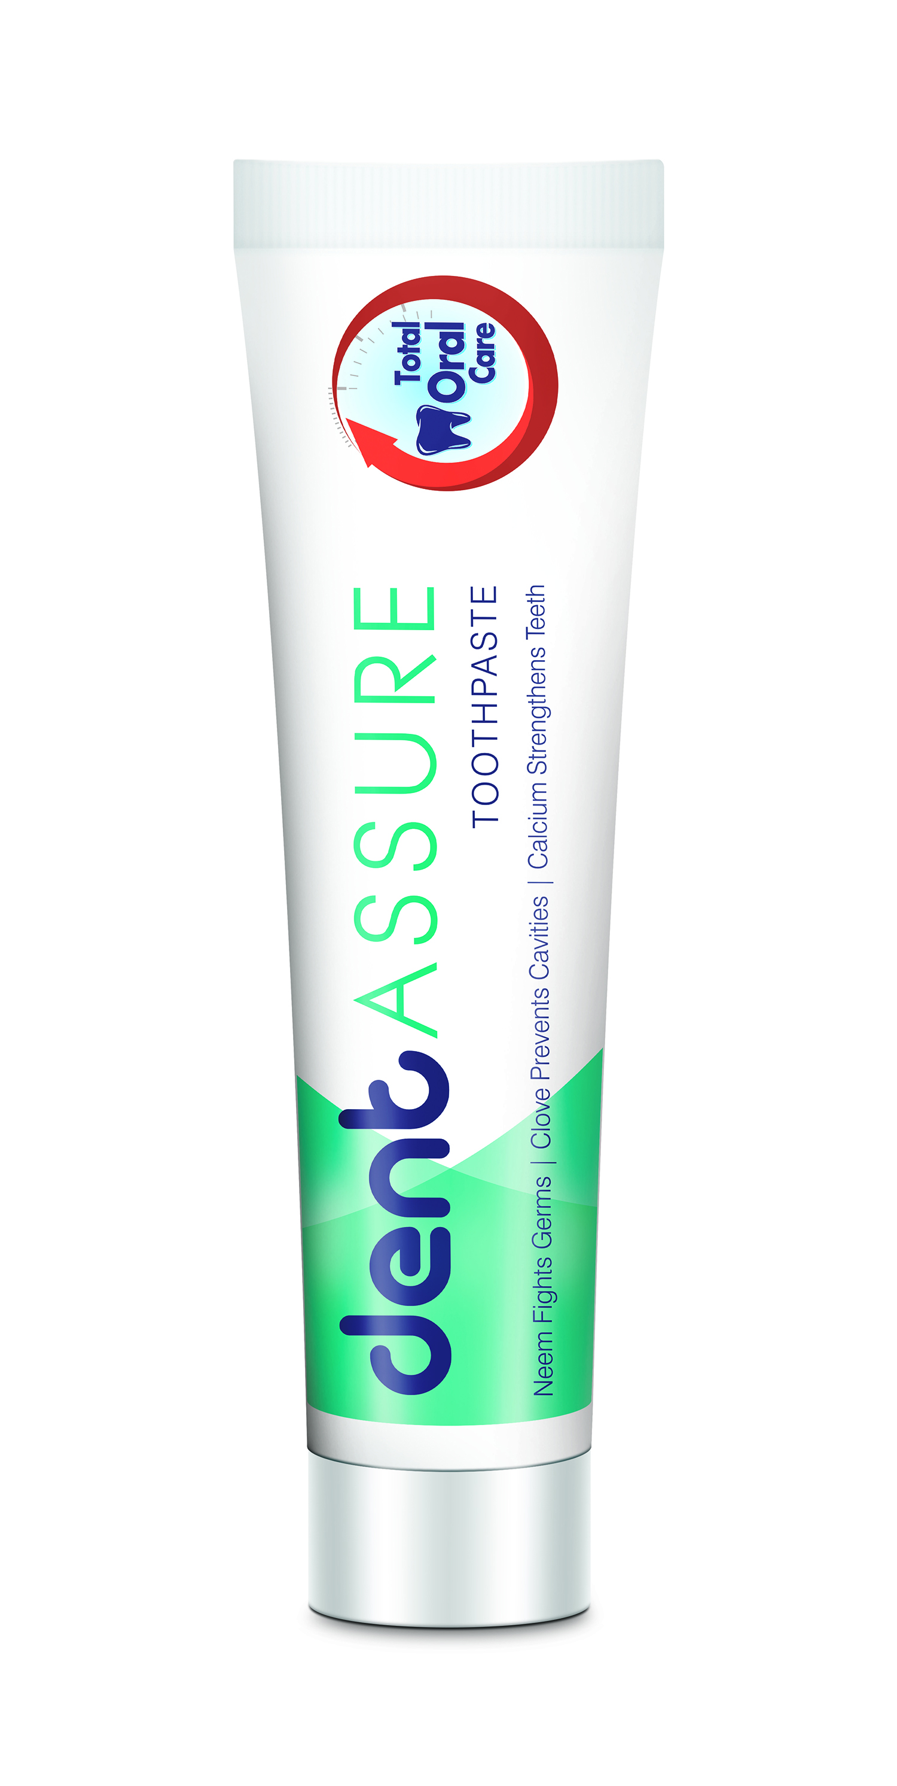
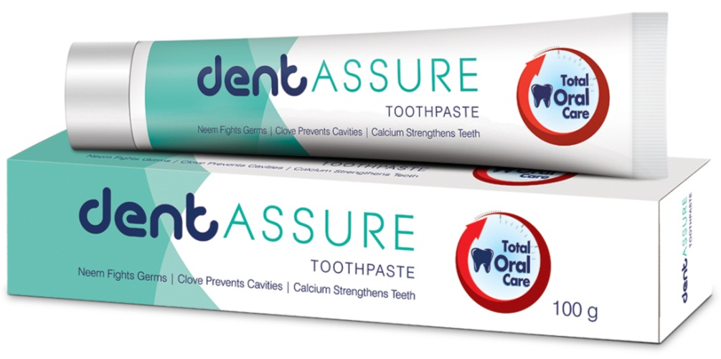
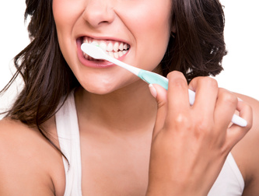
Dentassure Toothpaste
Dentassure Toothpaste is a foaming paste with fluoride for daily use
It is a unique formula with dual protection of Neem and Clove that fights germs and prevents dental cavities
It also helps support gum health
It contains calcium that strengthens the teeth
Neem fights germs
Clove prevents cavities and supports gum health

Slide 25
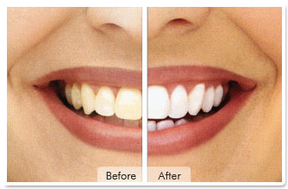
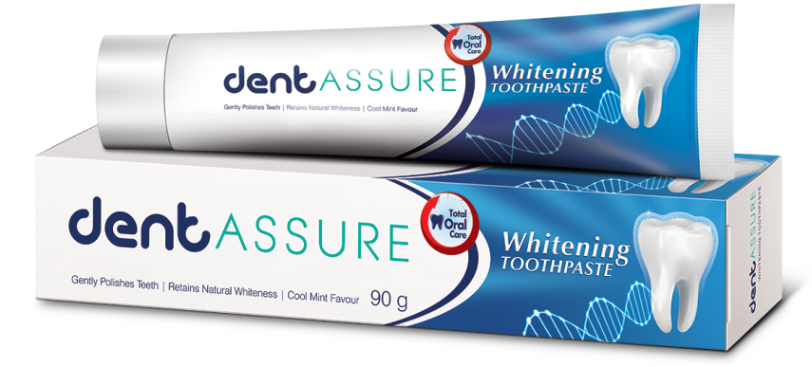
Dentassure
Whitening Toothpaste
Dentassure Whitening Toothpaste whitens teeth by removing surface stains, such as those caused by drinking coffee or smoking
It gently polishes the teeth and removes stains
It helps to retain natural whiteness of the teeth
Cool mint flavour gives long lasting fresh breath

Slide 26
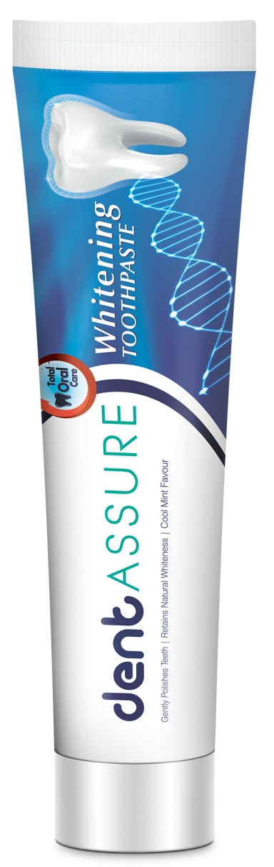
Dentassure Toothpaste
Dentassure Whitening Toothpaste
Net Content 100 g
MRP Rs. 66.00
DP Rs. 56.00
BV 33.6
PV 2.10
Net Content 90 g
MRP Rs. 133.00
DP Rs. 113.00
BV 67.80
PV 4.24

Slide 27
Thank you

