Slide 1


Slide 2
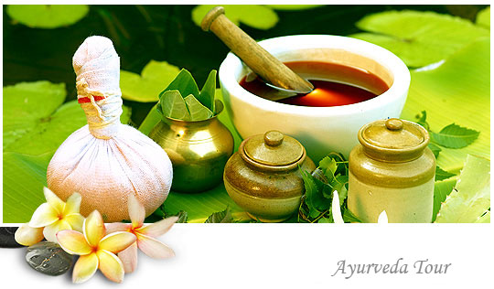

?
Why

Slide 3

Our Purpose
Taking Ayurveda Global with the help of Scientific Validation and Extensive Research.

Slide 4
Our Mission
Scientific Validation – Safety, Purity, Efficacy
Safety
Safety
Purity
Efficacy
Safety studies undertaken to ensure that heavy metals, pesticides, harsh solvents and micro-organisms are within permitted safety limits
Purity
Fingerprinting of ingredients and recipes to confirm to standards
Efficacy
Claim substantiation through modern biology & testimonials, validated by experts to conform to Ayurvedic scriptures

Slide 5
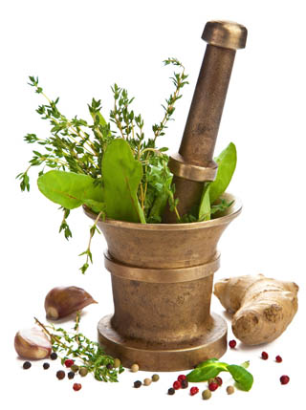
What is Ayurveda?
Ayurveda is a science of life
  In sanskrit, Ayur means life, Veda means science or knowledge
It has been practiced for over 5,000 years
It provides a holistic approach to health designed to help people live long, healthy, and well-balanced lives
The basic principle of Ayurveda is to prevent and treat illness by maintaining balance in the body, mind, and consciousness through proper drinking, diet, and lifestyle, as well as herbal remedies

Slide 6
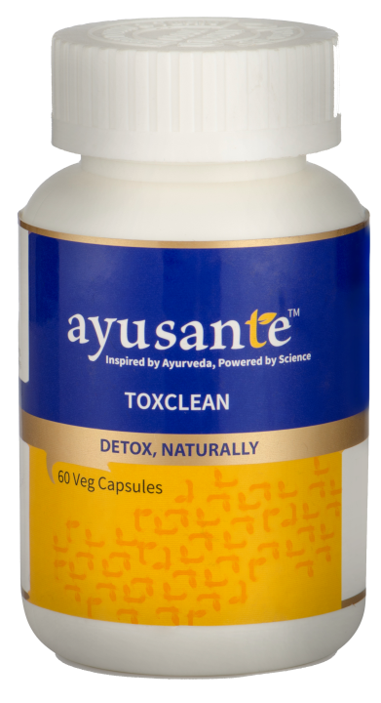
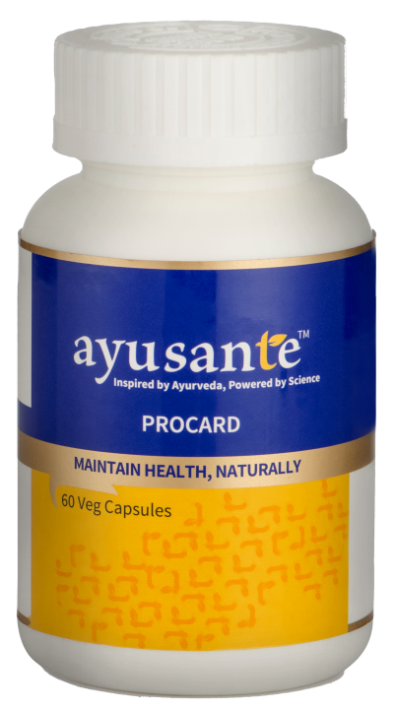
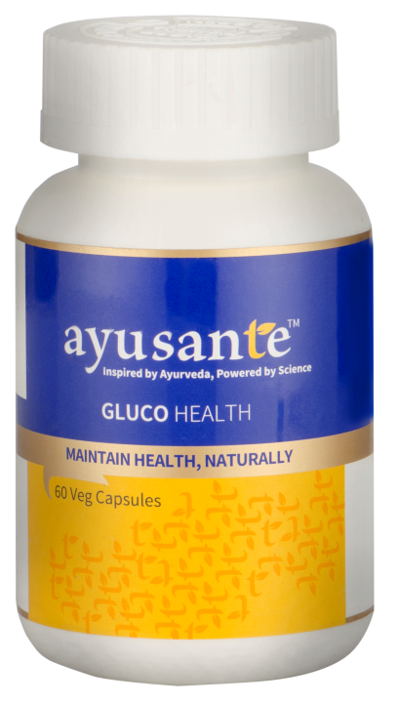
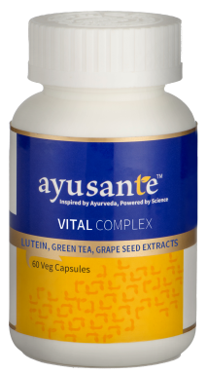
Ayusante Products
At Vestige, we have always believed in offering highly effective and natural health products
Ayusante is already paving way into people’s lives and bringing health and wellness, with a holistic approach

Slide 7

Introducing
Vital Complex

Slide 8
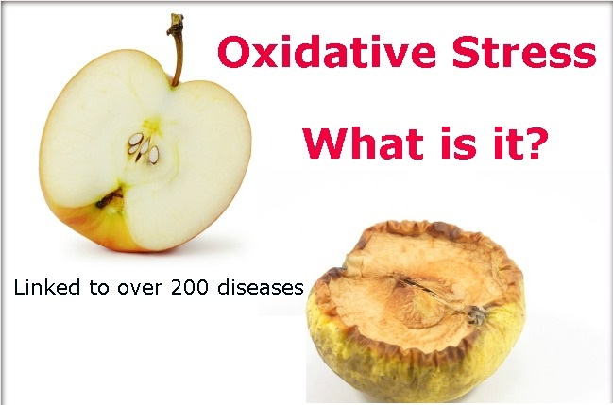
Oxidative Stress
Oxidative stress is an imbalance between the production of free radicals and the ability of the body to counteract or detoxify their harmful effects through neutralization by antioxidants

Slide 9
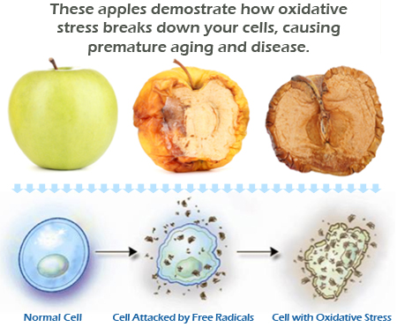
Oxidative Stress

Slide 10
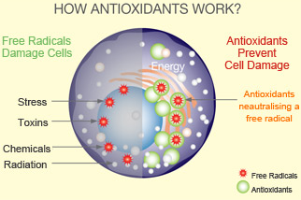
What are Antioxidants?
Antioxidants are synthetic or natural substances that prevents or delay some types of cell damage by free radicals
Cellular damage is a common pathway for cancer, aging, and a variety of diseases
Antioxidants are found in many foods, including fruits and vegetables, in the form of essential vitamins (like Vitamin A, C, E, K and H)

Slide 11


Vital Complex
Lutein, Green Tea, Grape Seed Extracts

Slide 12
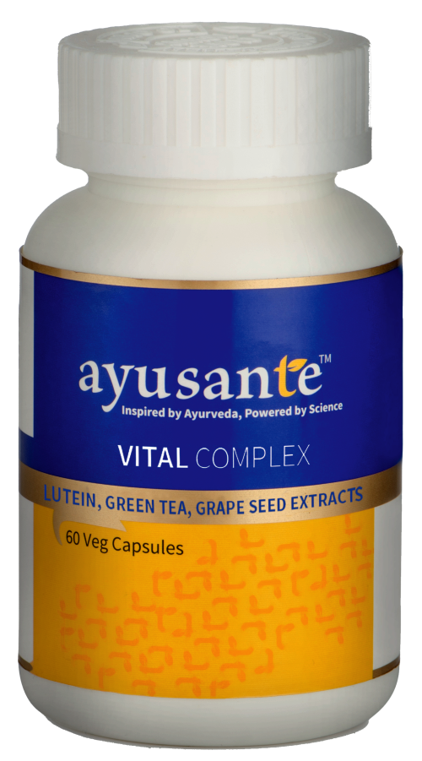
Benefits
Protects from the damage of oxidative stress
Helps to nourish body tissues
Accelerates cell regeneration processes
Facilitates better immunity
Tackles fatigue
Provides strength, dynamism and vitality to withstand stress
Assists in prevention of lifestyle diseases

Slide 13
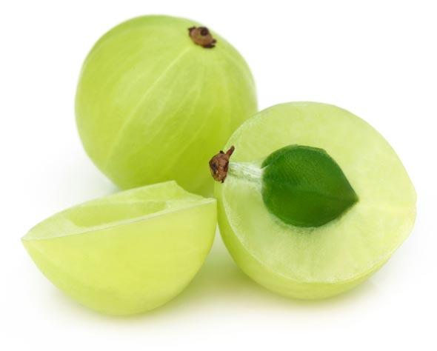
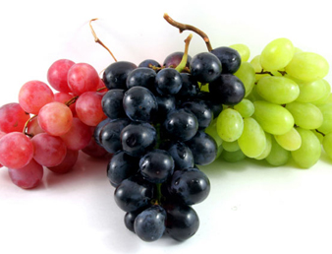
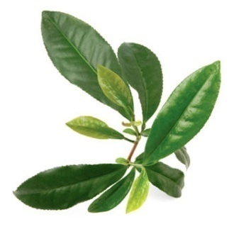
Key Antioxidant Ingredients in Vital Complex
 | BOTANICAL NAME | COMMON NAME | BENEFITS
 | Emblica officinalis | Amalaki | Also known as Indian Gooseberry, it is a very rich source of Vitamin C, and contains many minerals and vitamins like Calcium, Phosphorus, Iron, Carotene and Vitamin B Complex, making it a powerful antioxidant agent
 | Vitis vinifera | Draksha, Angoor | It contains powerful antioxidants known as polyphenols. It is also rich in resveretrol, beta-carotene, Vitamin C and K that possess potent antioxidant activity. It also protects the skin from the harmful effects of free radicals and reverse the appearance of wrinkles
 | Camellia sinesis | Chai | Rich source of flavanoids and catechins that possesses both antioxidant and anti-microbial activitiy

Slide 14
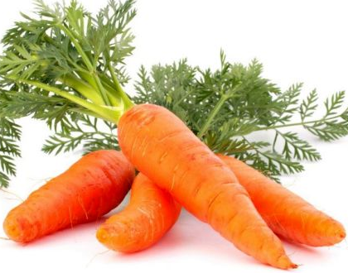
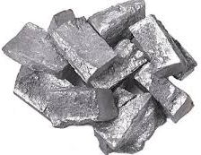
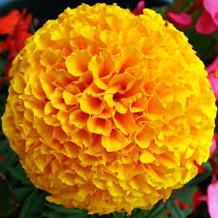
Key Antioxidant Ingredients in Vital Complex
 | BOTANICAL NAME | COMMON NAME | BENEFITS
 | Daucus carota | Carrot | Rich in carotinoids and Vitamin A that has potent antioxidant activity. It protects the skin from sun damage and protects the heart
 | Yashad Bhasma | Dus puti | Supports immune system, vital for fertility, crucial role in enzymatic actions, vital for vision, and has potent health benefits, including antioxidant activity
 | Tagetes erecta | Jhadu, Genda-phool | Contains Lutein and Zeaxanthin, that are responsible for central vision and visual sharpness. Potent antioxidant and has anti-inflammatory properties. It is also rich in flavanoids and Vitamin C that help to prevent various diseases

Slide 15
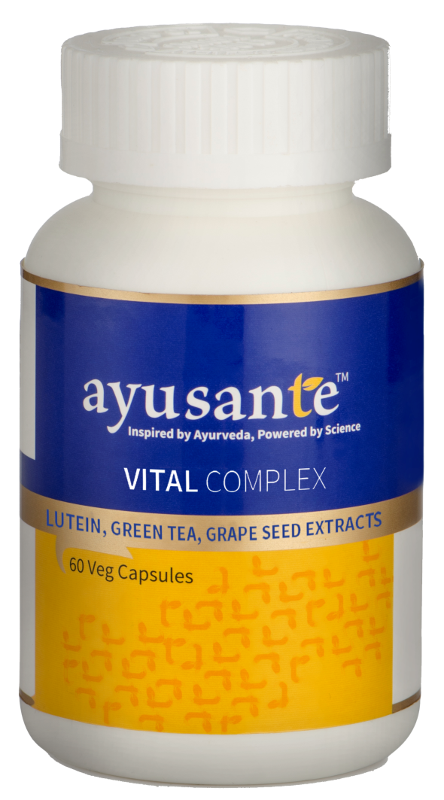
Vital Complex
Dosage: One Capsules Twice daily (before food)
MRP Rs. 750.00
DP Rs. 650.00
BV 390
PV 24.38

Slide 16
Product Range

Slide 17

Diabetes
Diabetes affects more than 22 crores people worldwide
India is home to 6.7 crores diabetics, and is expected to rise to 10 crores in 2030, the largest number of patients in the world
Nearly 52% of Indians are not aware that they are suffering from high blood sugar
7.72 crores people in India suffer from Pre-diabetes
Diabetes kills more than 10 lakh Indians every year
Annual cost of diabetes in India - Rs.34,000 crore
(cost includes medicines, consultation and hospital charges)
One third of diabetics develop Coronary Artery Disease (CAD)
Source: *Public Health Foundation of India (PHFI) & World Health Organization (WHO)

Slide 18
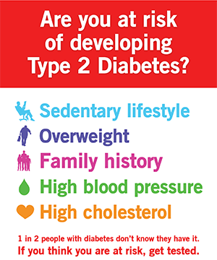
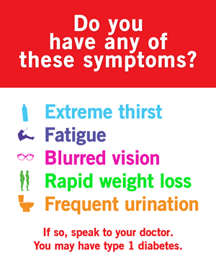
Symptoms of Diabetes
Diabetes can affect anyone, don’t ignore any symptoms

Slide 19
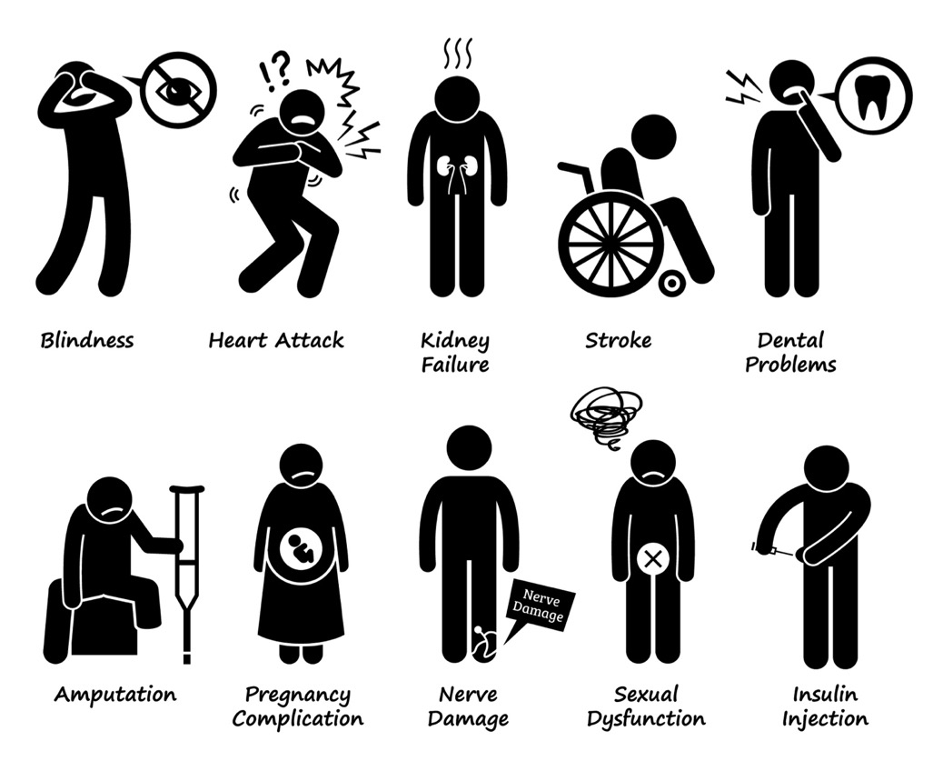
Complications associated
with Diabetes
Blindness
Kidney Failure
Heart Attack
Stroke
Periodontal disease
Foot amputation
Nerve Damage

Slide 20
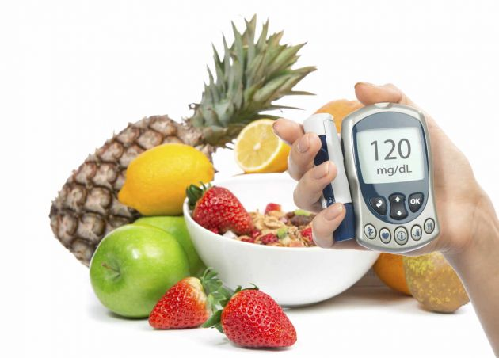
Glucohealth
Maintain Health, Naturally!

Slide 21
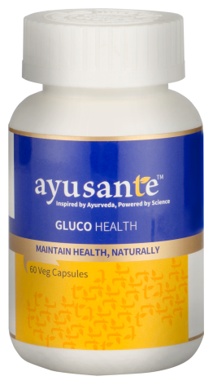
Glucohealth Benefits
Assists the body to maintain normal glycemic health
Helps strengthen the pancreas
Helps to optimize insulin secretion
Facilitates gradual glucose absorption
Helps to prevent oxidative damages
Regulate appetite to maintain a healthy body weight
Helps to provide strength to keep body free from chronic ailments of hyperglycemia

Slide 22
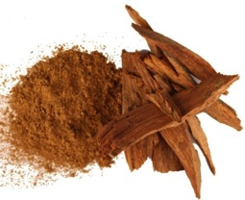
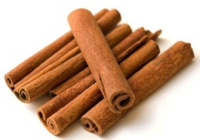
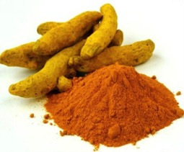
Key Glycemic Supporting Ingredients in Glucohealth
 | BOTANICAL NAME | COMMON NAME | BENEFITS
 | Pterocarpus marsupium | Vijay Sar | Is an effective blood glucose lowering agent and enhance regeneration of pancreatic β-cells that produces insulin in the body. It is hypo-cholesterolemic, increases insulin secretion and helps modulate glucose utilization by tissues
 | Cinnamomum zeylanicum | Cinnamon, dal-chini | It plays a regulatory role in glucose and cholesterol levels in the blood. It also helps to reduce triglyceride levels while raising HDL. It improves insulin sensitivity and slows the absorption of carbohydrates in the small intestine
 | Curcuma Longa | Turmeric, Haldi, Haridra | Curcumin in turmeric fights diabetes risk in pre-diabetics. Studies have shown that turmeric normalizes insulin and triglyceride levels and boosts antioxidant defenses in the body reducing risk of developing diabetes and heart disease

Slide 23
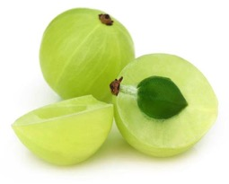
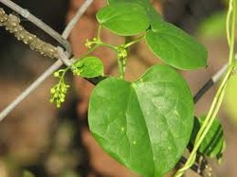
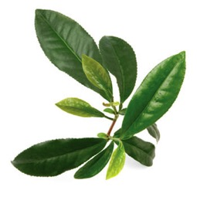
Key Glycemic Supporting Ingredients in Glucohealth
 | BOTANICAL NAME | COMMON NAME | BENEFITS
 | Emblica officinalis | Amla, Amalaki | It stimulates cells that secrete the hormone insulin, thereby reducing the blood sugar level in diabetic patients. The fruit helps in proper absorption of insulin which simultaneously reduces the level of high sugar level
 | Tinospora cordifolia | Guduchi | Helps to lower blood glucose, promotes hepatic health, acts as an antioxidant and prevents oxidative damage. It help reduction in weight associated with diabetes.
 | Camellia sinesis | Chai, Chaha | Hypoglycemic and antioxidant effects by decreasing serum glucose levels and oxidative stress

Slide 24
Glucohealth
Dosage: Two Capsules Thrice daily
MRP Rs. 680.00
DP Rs. 575.00
BV 345
PV 21.56

Slide 25

Heart Disease
Heart disease is the number one killer worldwide and India is set to see a dramatic number of working age people (35-65 years old) die of cardiovascular disease in the next 25 years
  Times of India
1 out of every 4 Indians between the age–group of 20–29 years have high cholesterol which is makes them prone to heart and liver diseases
    Times of India
38% Indians have high cholesterol level — which means that 2 out of every 5 Indians are vulnerable to heart diseases
      Times of India
When cholesterol level is too high in the blood, or the levels of its two types – LDL and HDL are out of balance (dyslipidaemia), it can clog the arteries affecting the flow of the blood or cause Arthrosclerosis
It also increases the risk of developing heart disease

Slide 26
Know your Lipid Profile*
 | Optimal / Desirable | Near optimal | Borderline high risk | High risk | Very high risk
Total blood cholesterol | Below 200 |  | 200 to 240 | Above 240
LDL cholesterol | Below 100 | 100 to 130 | 130 to 160 | 160 to 190 | Above 190
HDL cholesterol | Above 60 |  |  | Below 45
Triglyceride | Below 150 |  | 150 to 200 | 200 to 500 | Above 500
* All values are in milligram/decilitre (mg/dl)
* Indian Medical Association

Slide 27

Procard
Maintain Health, Naturally!

Slide 28
Procard Benefits
Acts as a cardio-tonic
Helps to manage lipid profile and reduce the risk of atherosclerosis
Helps regulates cholesterol and LDL – “Bad Cholesterol” levels in the blood
Helps to improves HDL – “Good Cholesterol” levels in the blood
Helps to improves blood circulation and useful in management of cardio vascular disease

Slide 29
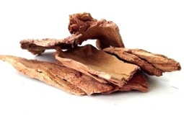
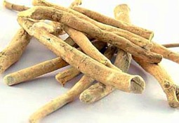
Key Cardio Supportive Ingredients in Procard
 | BOTANICAL NAME | COMMON NAME | BENEFITS
 | Terminalia arjuna | Arjuna | Popularly known as a heart tonic. It helps in maintaining healthy heart function, relieving mental stress and nervousness It helps maintain a healthy cardiovascular system. It helps to brings down the level of harmful lipids in the blood. It also help to maintain normal blood pressure. Arjuna also helps to enhance overall energy levels, stamina, immunity and cellular health.
 | Withania somnifera | Ashwa-gandha | It’s a powerful cardio-protective agent and adaptogen. It stimulates the synthesis of antioxidant enzymes and protects the heart from harmful free radicals. It also helps to lower the risk of developing heart disease. It helps correct the imbalances caused due to stress

Slide 30
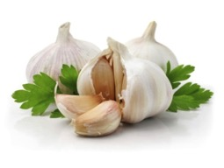
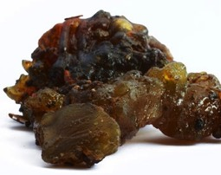
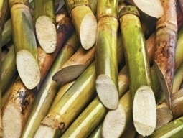
Key Cardio Supportive Ingredients in Procard
 | BOTANICAL NAME | COMMON NAME | BENEFITS
 | Allium sativum | Garlic, lehsun, lashuna | It supports healthy heart rate, helps in lowering cholesterol levels in the blood. It acts as a cardio-protective agent, helps to reduce blood pressure and improves blood flow
 | Balsamodendron mukul | Guggul | Helps in reduction of cholesterol. It strengthens the heart. It helps in increasing HDL and lowers LDL levels in the blood. It also has anticoagulant and anti-platelet activity inhibits the formation of blood clots.
 | Saccharum officinarum | Ikshu, sugar cane | Policosanol in Saccharum officinarum is beneficial in lowering serum cholesterol levels and in prevention of the onset of atherogenesis. Inhibits cholesterol bio-synthesis and maintains healthy lipid profile

Slide 31
Procard
Dosage: One to Two Capsules Twice daily
MRP Rs. 820.00
DP Rs. 700.00
BV 420
PV 26.25

Slide 32
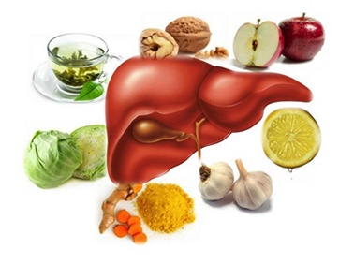
Detoxification
Detoxification is the process of clearing toxins from the body
Poor digestion, colon dysfunction, reduced liver function, and poor elimination from the body, all add to increased toxicity in the body
Naturally, the body clears toxins in the liver and excrete through the kidneys, skin and lungs
When the liver gets overburdened, it starts to store toxins in the fat tissues, and these re-circulate in the blood and lead to many diseases

Slide 33
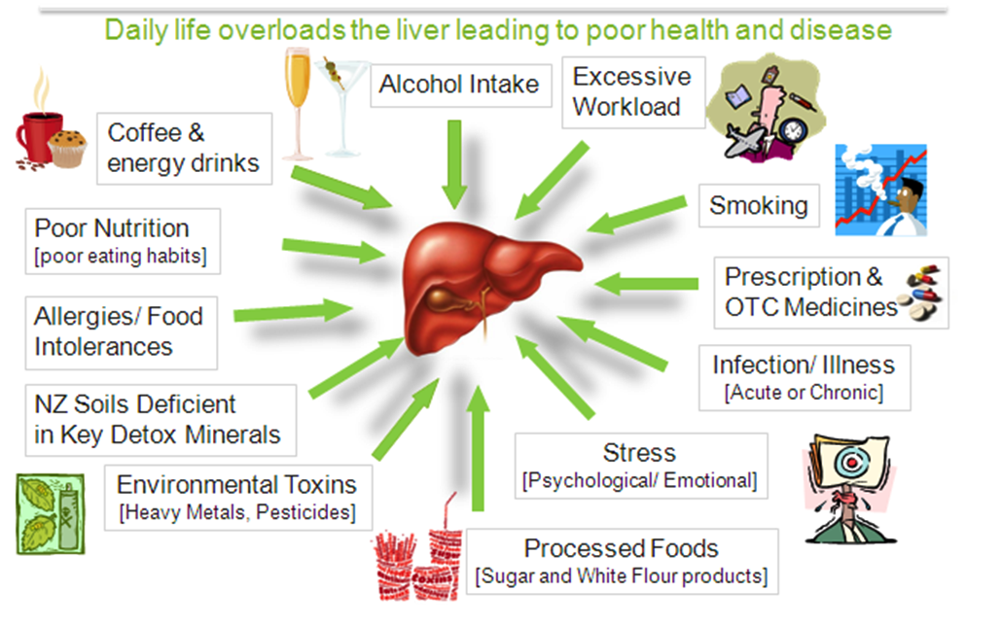
Accumulation of Toxins in the Body

Slide 34
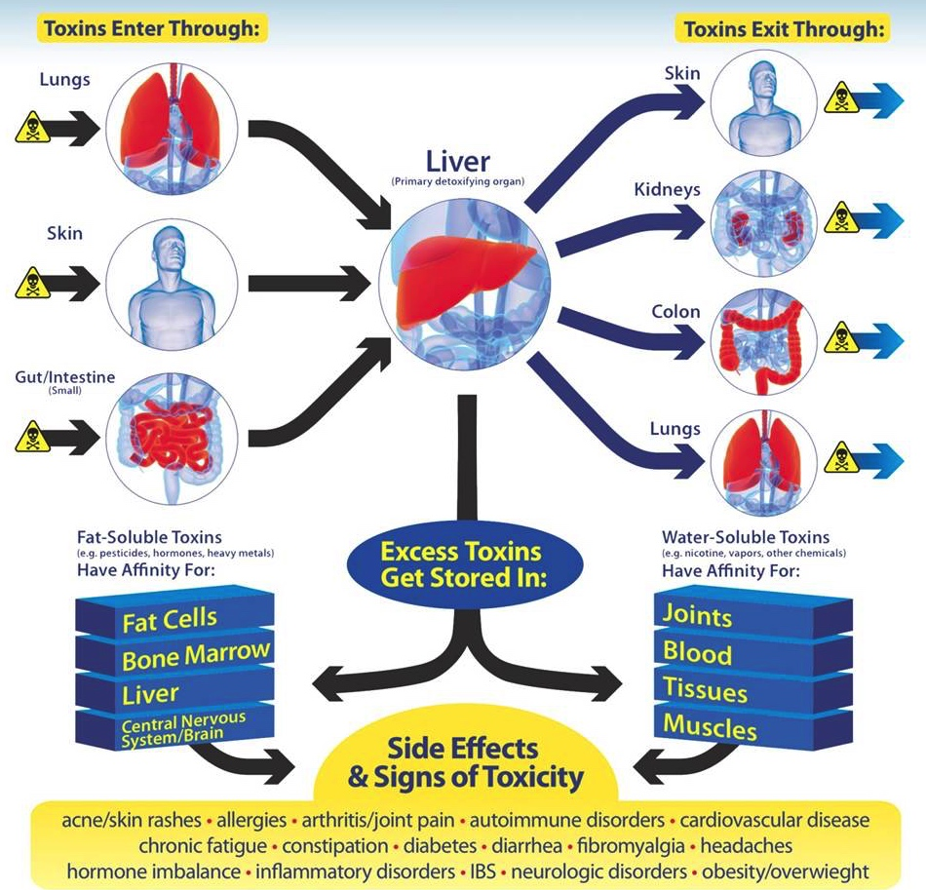
Process of Detoxification & Elimination

Slide 35
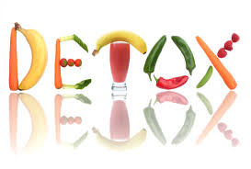
Toxclean
Detox, Naturally!

Slide 36
Toxclean Benefits
Helps to cleanse colon and purify blood
Helps to relieve constipation
It has Hepato-protective properties – helps to support liver function
Helps to regulate digestion and metabolism
It has anti – microbial properties and helps promote skin health (acne, pimple, etc.)

Slide 37
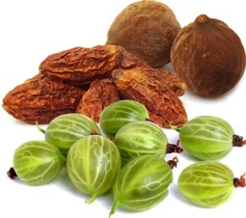
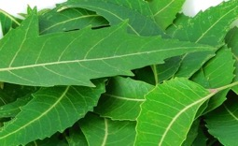

Key Detoxifying Ingredients in Toxclean
 | BOTANICAL NAME | COMMON NAME | BENEFITS
 | Triphala (Emblica officinalis, Terminalia bellirica, Terminalia chebula ) | Triphala | Regulate digestion Relieve constipation Flush out toxins Purify blood Helps cleanse the colon
 | Azadirachta indica | Neem, Nimba | Immunomodulatory Broad Spectrum Anti microbial Anti inflammatory
 | Curcuma longa | Haldi, Haridra | Anti inflammatory Anti microbial Hepato protective – supports liver function

Slide 38
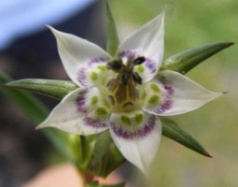
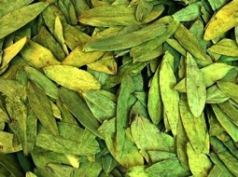
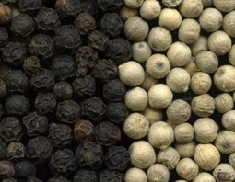
Key Detoxifying Ingredients in Toxclean
 | BOTANICAL NAME | COMMON NAME | BENEFITS
 | Swertia chirata | Chiretta | Aids in combating constipation, upset stomach, bloating, loss of appetite, intestinal worms and skin diseases. It is considered good for liver and helps in detoxification
 | Cassia augustifolia | Svarnapatri | A natural laxative A natural diuretic Restores metabolic imbalance lost due to indigestion
 | Piper nigrum | Mircha, Maricha | Aids the digestive process by improving gut function Helps to detoxify deep tissues It has bacteriostatic and fungistatic properties

Slide 39
Toxclean
Dosage: Two Capsules Thrice daily
MRP Rs. 710.00
DP Rs. 600.00
BV 360
PV 22.50

Slide 40
THANK YOU
QUIZ

