Slide 1

LIVERHEALTH

Slide 2
LIVER DISORDERS IN INDIA
According to the latest WHO data published in may 2014 Liver Disease Deaths in India reached 216,865 or 2.44% of total deaths.
Liver diseases affect one in 5 Indians (As per TOI , 4th March’2014)
In more than 90% cases, patients don’t realise that they have a liver disease until it’s too late

Slide 3
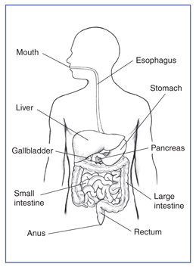
WHAT IS LIVER ?
Largest and the heaviest organ in the body
Weigh some 1.8 kg in men and 1.3 kg in women
About 60% of the liver is made up of liver cells (hepatocytes), which absorb nutrients and detoxify harmful substances from the blood

Slide 4
FUNCTIONS OF LIVER
Liver functions include:
Processing digested food in the intestine.
Controlling fat levels
Neutralising and destroying all drugs and toxins
Manufacturing bile
Storing iron, vitamins and other essential chemicals
Breaking down food and turning it into energy
Making enzymes and proteins which are responsible for most chemical reactions in the body

Slide 5
LIVER DISORDERS
Hepatitis: Hepatitis is swelling and inflammation of the liver because of viral infections
Acute hepatitis – lasting less than six months
Chronic hepatitis – lasting longer than six months
Fatty Liver Disease / Steatosis: Accumulation of Fat in liver cells
Alcoholic fatty liver disease - Chronic alcohol intake
Non-alcoholic fatty liver disease - Obesity, Diabetes

Slide 6
LIVER DISORDERS
Liver Fibrosis/ Cirrhosis: Excessive accumulation of collagen in response to liver diseases is known as Fibrosis
Prolonged liver fibrosis results in Cirrhosis
Cause: fatty liver, Hepatitis

Slide 7
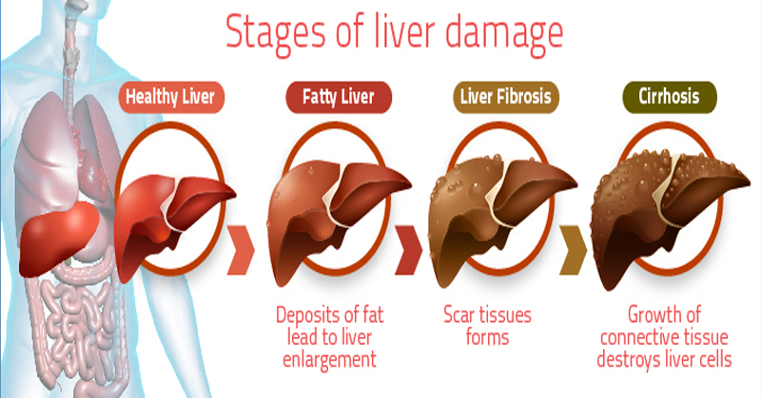
LIVER DISORDERS

Slide 8
SYMPTOMS OF LIVER DISORDERS
Jaundice
Poor digestion, Anorexia, nausea & vomiting, bloating
3. Weight loss
4. Fever
5. Pain & tenderness in right upper quadrant of abdomen

Slide 9
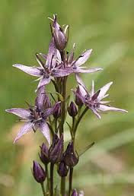
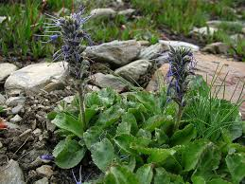
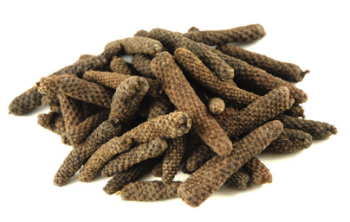
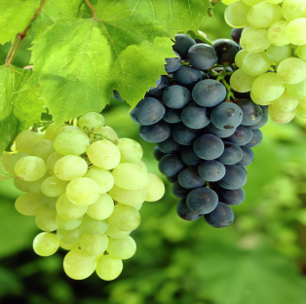
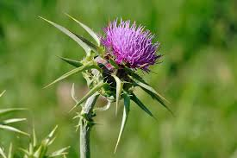
ROLE OF INDIVIDUAL COMPONENTS
COMPONENTS | COMMON NAMES | ROLE | IMAGE
Swertia Chirata | Ciraita | Help in rejuvenating the damaged liver cells.
Picrorhiza kurroa | Kutuka | Shows anti-inflammatory action in hepatitis, effective in liver regeneration.
Piper longum | Pipali | Stimulates regeneration by restricting fibrosis, but offers no protection against acute damage or against cirrhosis.
Vitis vinifera (COMMON GRAPE) | Draksha | Useful drug for treatment of chronic liver diseases. Improves the concentration of liver enzymes which help in rejuvenation of liver.
Silybum marianum | Bhatkataiya | The major active constituent of silymarin is silibinin Helps in rejuvenation of liver cells.

Slide 10
RECOMMENDED DOSAGE :
One capsule thrice daily
ABOVE 14 YEARS ONLY
AVOID:-
Not to be given to pregnant females.
Patients of Gastric Ulcers

Slide 11
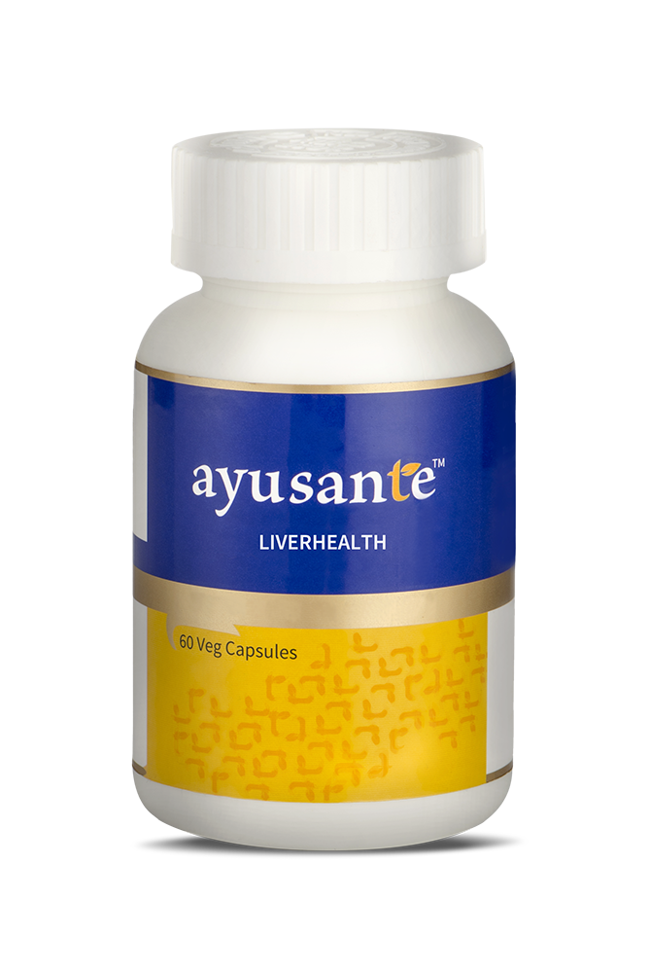
PRESENTATION DETAILS
Presentation – 60’s capsules in bottle pack
MRP | DP | BV | PV
Rs.655/- | Rs.560/- | 336 | 21

Slide 12
SUMMARY
The ingredients in Ayusante Liverhealth helps in:
Rejuvenating the damaged liver cells
Anti-inflammatory action in hepatitis
Stimulating regeneration by restricting fibrosis
Useful ingredients for treatment of chronic liver diseases
Improve the concentration of liver enzymes which help in rejuvenation of the liver

