Slide 2
KIDNEY DISEASE IN INDIA
One in every 10 adults in India suffers from chronic kidney disease (CKD), and at any given point, nearly five lakh patients are in need of life-long dialysis or transplant, according to Sanjay K. Agarwal, Professor and Head of Nephrology, AIIMS.
The National Kidney Foundation of India estimates that 100 people in a million suffer from kidney ailments in India

Slide 3
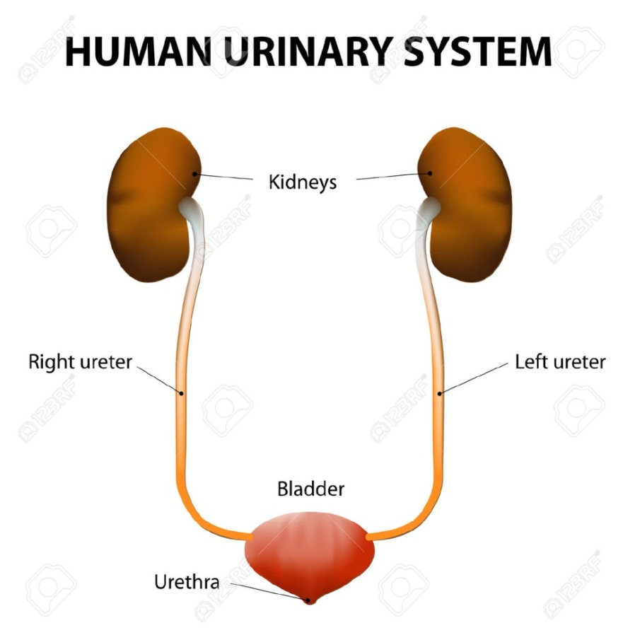
KIDNEY
The kidneys are bean - shaped organs that serve several essential regulatory roles.
The kidneys are a pair of organs located in the back of the abdomen.
Each kidney is about 4 or 5 inches long -- about the size of a fist.
There are two kidneys, each about the size of a fist, located on either side of the spine at the lowest level of the rib cage.
Each kidney contains up to a million functioning units called nephrons

Slide 4
IMPORTANCE OF KIDNEY
The kidneys are powerful chemical factories that perform the following functions:
Kidneys filter extra water and wastes out of your blood and produce urine
Remove waste products from the body
Balance the fluids in the body
Release the hormones that regulate blood pressure
Produce an active form of Vitamin D that promotes strong and healthy bones

Slide 5
CAUSES OF KIDNEY DISEASE
Anyone can develop kidney disease, regardless of their age. The main risk factors for developing kidney diseases are:
Diabetes
High blood pressure
Cardiovascular (heart and blood vessel) disease
A family history of kidney failure

Slide 6
COMMON SYMPTOMS OF KIDNEY DISORDERS
Changes in urination —More or less urination than usual, changes in the color of urine, foamy or bubbly urine
Swelling of the feet, ankles, hands, or face — Fluid the kidneys can't remove stays in the tissues
Fatigue or weakness — due to build-up of wastes
Shortness of breath —Because the excess fluid can build up in the lungs
Itching — waste build-up in the body can cause severe itching, especially in the legs
Loss of appetite
Nausea and vomiting

Slide 7
COMMON KIDNEY DISORDERS
Common kidney problems include
Cysts
Stones
Urinary Infections

Slide 8
KIDNEYHEALTH

Slide 9
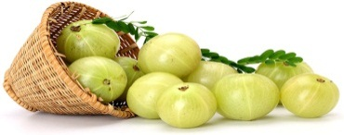
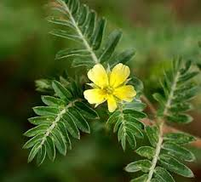
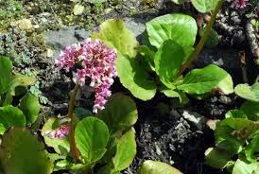
ROLE OF INDIVIDUAL COMPONENTS
COMPONENTS | COMMON NAMES | ROLE | IMAGE
Emblica officinalis | Amla | Considered as the stonebreaker Given to avoid burning urination
Crataeva nurvala | Varun | The herb neutralizes the enzyme responsible for stone formation and reduces the production of stone forming chemicals by the body.
Tribulus terrestris | Gokshur | Gokshura works as diuretic which makes Gokshura as a good choice for body that has tendencies of fluid retention
Saxifraga ligulata wall | Pashanbheda | The word Pashanbheda, made of two words, Pashan, which means stone and Bheda, which means breaker, has a special place in Ayurveda as it is a main drug for stones formed in kidney and urinary bladder.

Slide 10
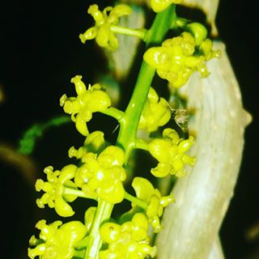
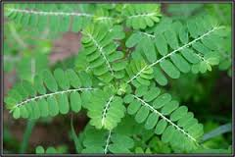
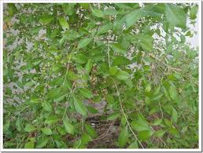
ROLE OF INDIVIDUAL COMPONENTS
COMPONENTS | COMMON NAMES | ROLE | IMAGE
Tinospora cordifoilia | Giloe | Described as ‘the one who protects the body against diseases’. It is a rejuvenator that enhances the healing process and immunity.
Phyllanthus niruri | Bhumi amla | Interferes with the different stages of stone formation, reduces crystal aggregation
Swet parpati |  | Painful urination is relieved It helps in treatment as well as prevention of urinary tract infections Urinary calculi can also be treated very well It soothes down irritation, itching, and burning sensation in the urinary organs

Slide 11
Use :
Ayurvedic product effective in urinary diseases and renal calculi
DOSE & DURATION :
One capsule thrice daily
EXCLUSION CATEGORY :
Not to be given to those below 18 years of age
Can be given to pregnant women only on doctor’s suggestion.

Slide 12
PRESENTATION DETAILS
Presentation – 60’s capsule in a bottle pack
MRP | DP | BV | PV
Rs.645 | Rs.550 | 330 | 20.63
Notes:
Presentation : 60 capsules

Slide 13
SUMMARY
Ideal treatment for kidney stones with the following advantages :
Considered as the stonebreaker
The herb neutralises the enzyme responsible for stone formation and reduces the production of stone forming chemicals by the body.
Works as diuretic which makes it a good choice for body that has tendencies of fluid retention
Contains important ingredients for treating stone in kidneys and urinary bladder
It is a rejuvenator that enhances the healing process and immunity.
Interferes with the different stages of stone formation, reduces crystal aggregation and modifies their structure and composition

