Slide 1
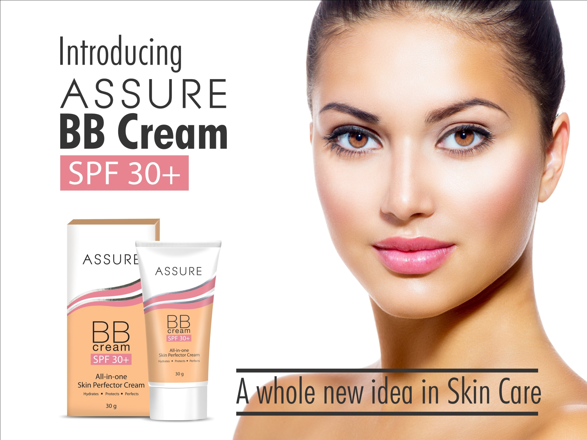

Slide 2
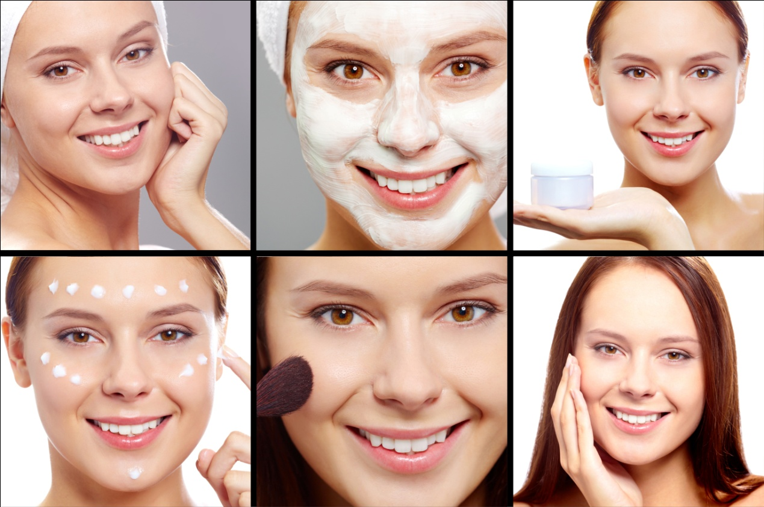
What is BB Cream
BB stands for Beauty Balm or Beauty Benefit cream
An all-in-one moisturizer that does the job of 6 other products
  Moisturizer
  Sunscreen
  Primer
  Concealer
  Foundation
  Skin treatment
It combines skincare with minerals to even skin tone, illuminate, cover imperfections, with hydration and SPF protection, giving a natural look in just one step

Slide 3
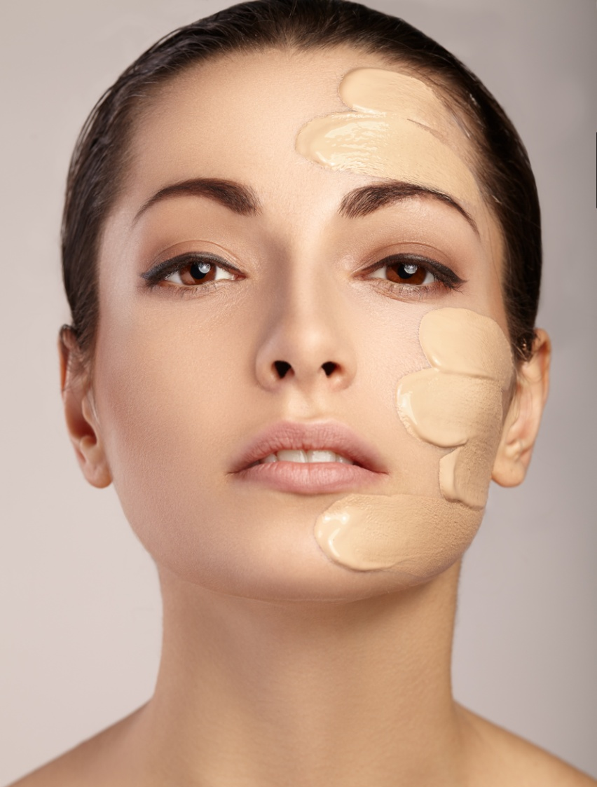
How does it work?
BB cream provides a good base, evens out complexion, covers imperfections and redness, hydrates the skin, brightens and perk-up a dull complexion
It gives instant radiance to the skin along with long lasting sun protection
It doesn’t clog pores like makeup and doesn’t irritate breakouts or acne
With continuous use it helps to even out fine lines and wrinkles and lightens dark spots

Slide 4

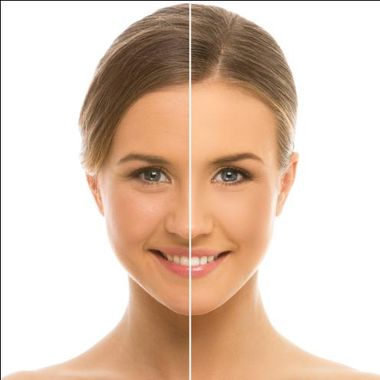
Assure BB Cream SPF 30+
6 results in just one swipe
  Brightens complexion
  Evens skin tone
  SPF 30+ and PA ++ protection
  Instantly covers dark spots
  Reduces appearance of fine lines
  Luminous make-up finish

Slide 5

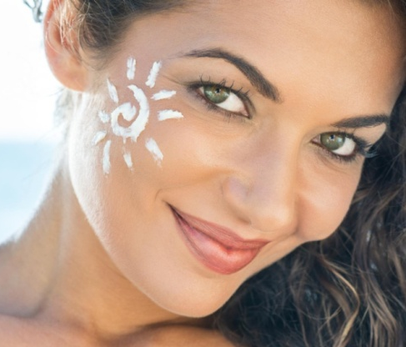
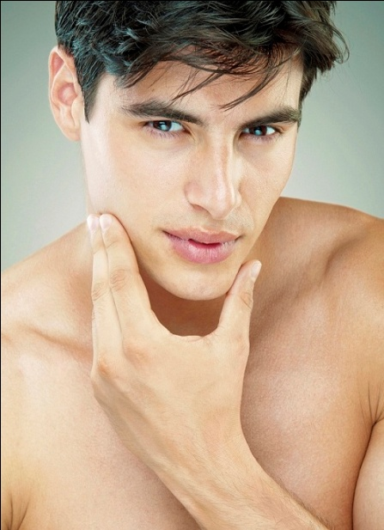
Actives
Toning &
firming –
Haloxyl- for puffy
eyes & dark
circles
Long lasting
effect with
Treated
Pigments
Anti-ageing
&
lightening
Niacinamide
Potent
Sunblock

Slide 6

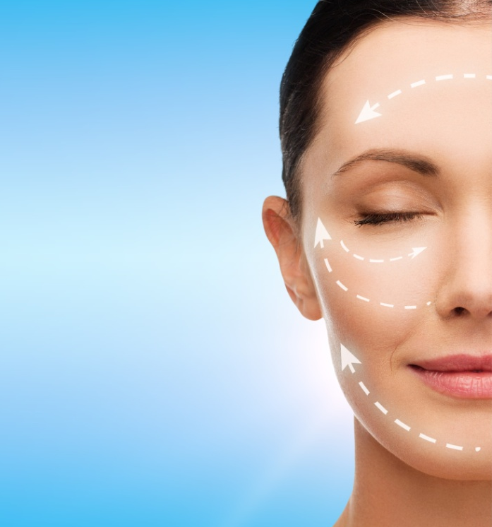
Assure BB Cream SPF 30+
It contains potent sunscreens that protects against harmful UVA and UVB rays of the sun
  Prevents skin from sun burns and premature ageing
Niacinamide or Vitamin B3, help to reduce fine lines and lightens dark spots
It contains ingredients that helps to tone and firm delicate area under the eyes
Made of specialized surface treated pigments that makes the Assure BB Cream waterproof, sweat proof and long lasting

Slide 7
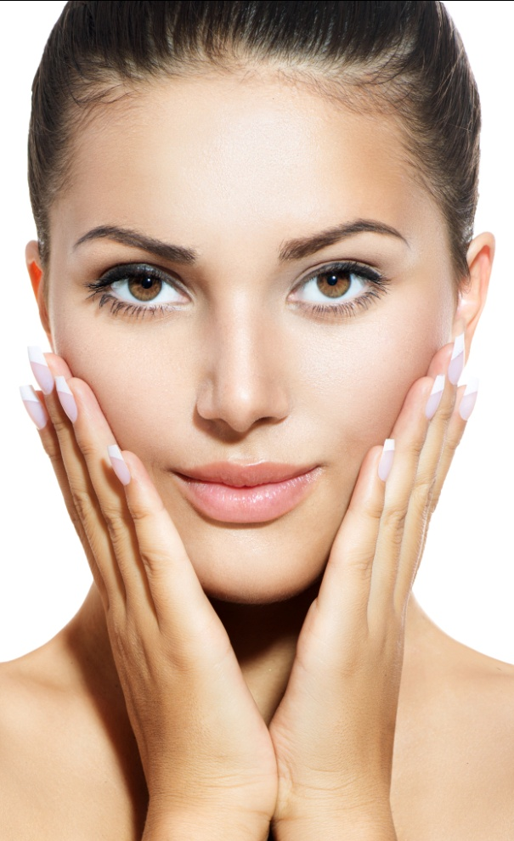
Get the perfect skin tone
Who can use Assure BB Cream?
BB cream can be used by both females and males, on all skin types, all skin tones
It perfectly blends with all skin tones and types
When to use Assure BB Cream?
Use it right after you wash your face and you wont need to use anything else!

Slide 8
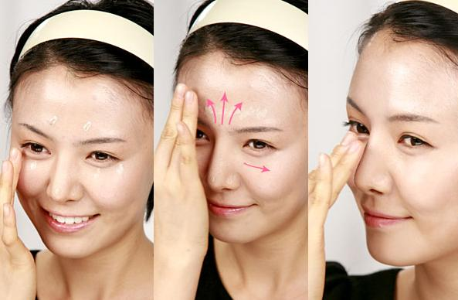
How to use
Squeeze a small amount of Assure BB cream on your finger tips
Dot the entire face and neck, including under eye area, nose, cheeks, forehead, chin and upper lips
Use gentle dabs on areas where the skin tone is darker (like dark spots, dark under eye circles and pigmented skin)
Use small outward strokes on other areas of the face to get a good coverage all over your face
Use it after washing your face in the morning before going out
For best results repeat application 2 or 3 times in the day

Slide 9
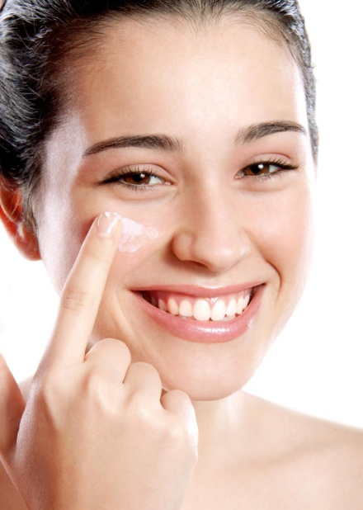
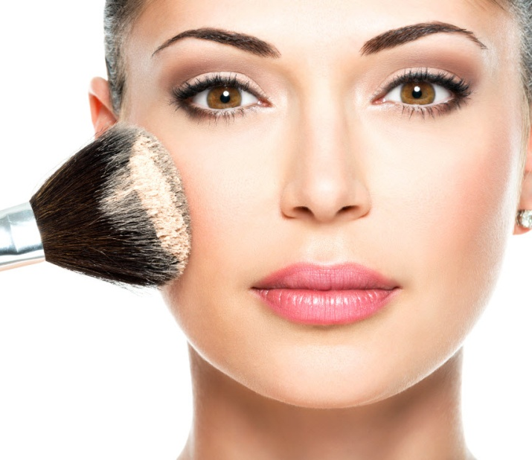
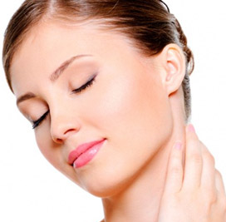

Tips
If you have dry skin, apply a light moisturizer before applying Assure BB cream
Finish with powder: After application and blending BB cream, apply some powder with a puff or brush to let the cream set for all day. It will give a more long lasting effect to the BB cream
For a natural look, apply the BB cream over your neck in the same manner as for the face

Slide 10
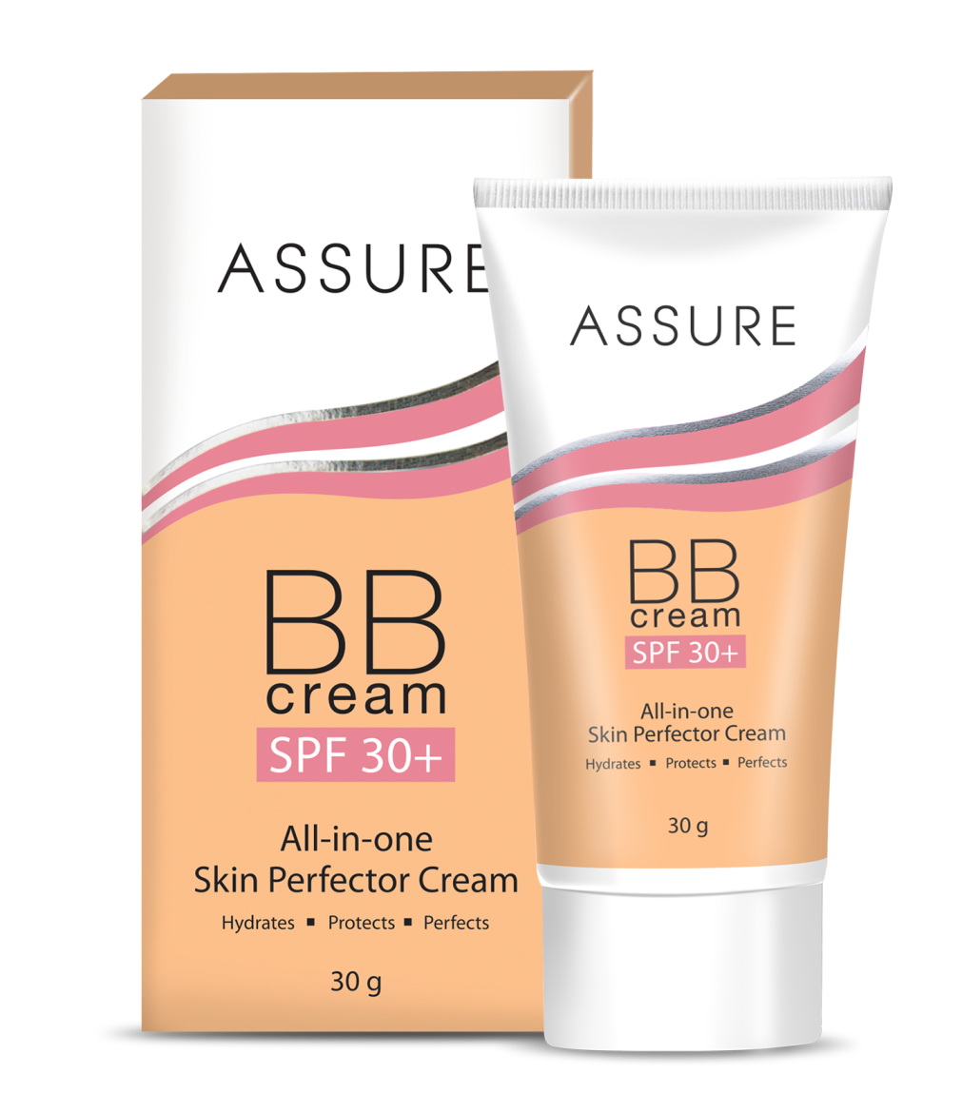


Rediscover flawless radiant skin with Assure BB Cream
Makeup finish without makeup
Fairness cream with anti-ageing benefits
Radiant outside flawless inside

Slide 11
MRP: Rs. 380/-
DP: Rs. 320/-
BV: 192
PV: 12

Slide 12


Slide 13

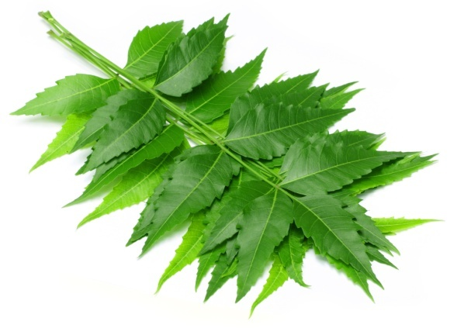

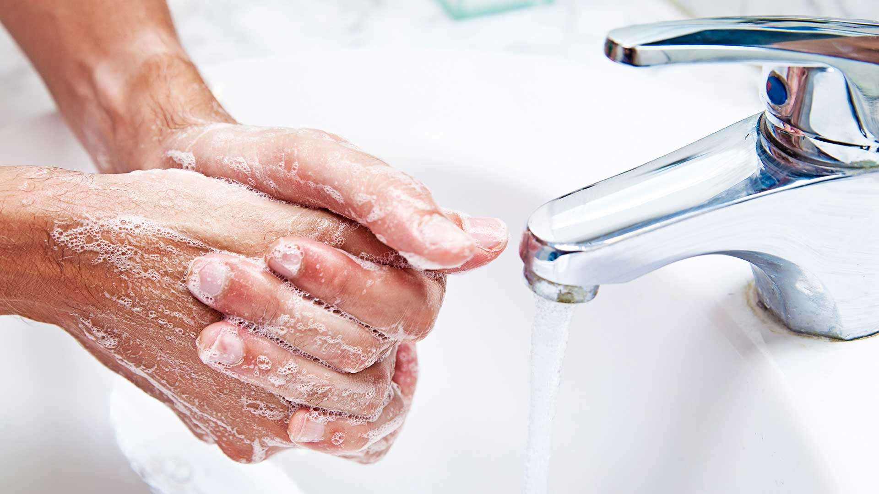
Assure Hand Wash
Enriched with Neem and Aloe Vera extracts
Provide gentle protection and moisturisation to your hands without drying them out
Refreshing fragrance keeps the hands fresh for long

Slide 14
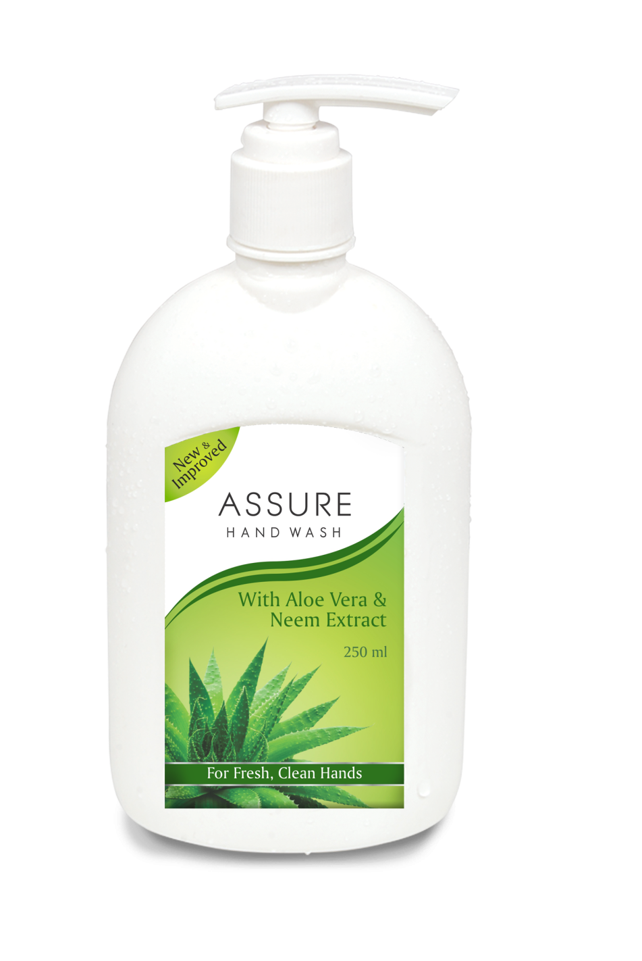

MRP: Rs. 120/-
DP: Rs. 105/-
BV: 63
PV: 3.94

Slide 15
Quiz

