Slide 1
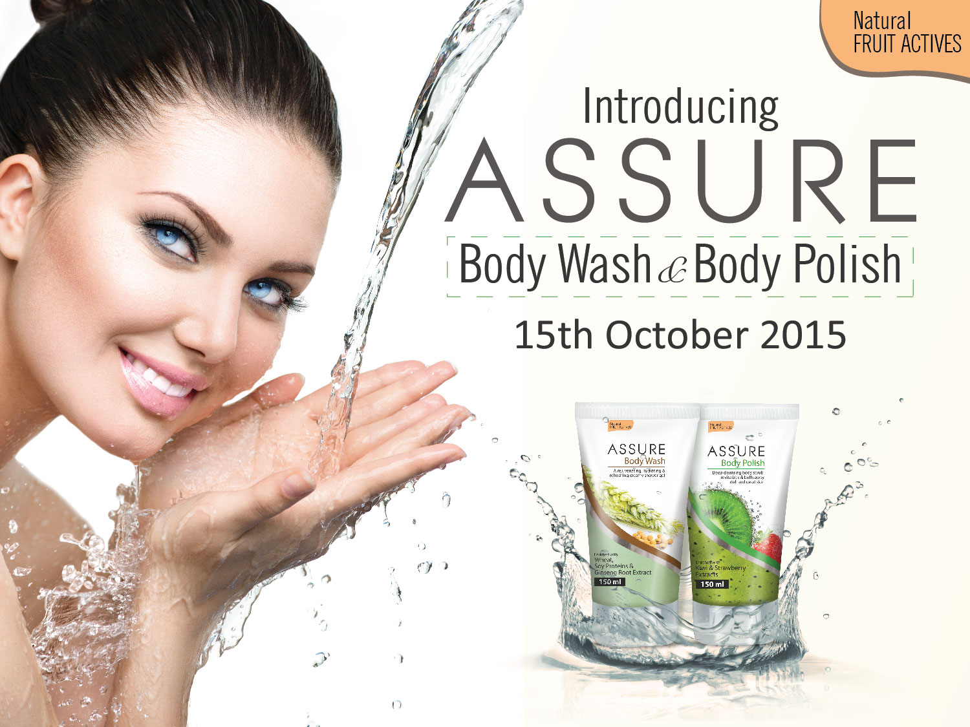

Slide 2
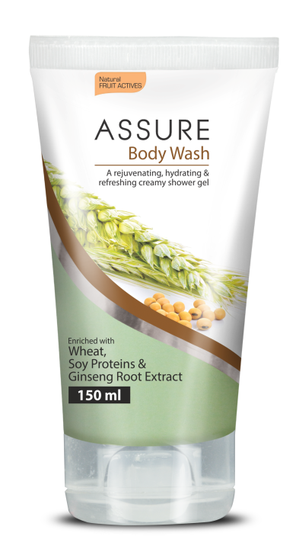
  New
  ASSURE
  BODY WASH
  Enriched with Wheat, Soy Proteins and Ginseng Root Extract

Slide 3
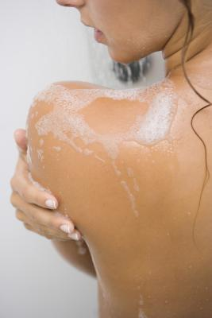
Assure Body Wash
  Enriched with Wheat, Soy Proteins and Ginseng Root Extract
Why do we need to use a Body Wash?
Our body gets exposed to pollutants and lot of dust
Keeping our bodies clean is very essential
Continuous use of soap may disrupt natural pH balance of the skin and making it very dry
Body wash does not dry the skin and is pH-friendly for the skin
It keeps the skin soft and supple
The shower gels are milder than soap, but it is more efficient as they contain gentle cleansing and skin conditioning agents
The Product
Thick foaming cream gently and efficiently cleanse skin while conditioning it. It’s refreshing aroma invigorates the senses keeping you fresh all day.

Slide 4
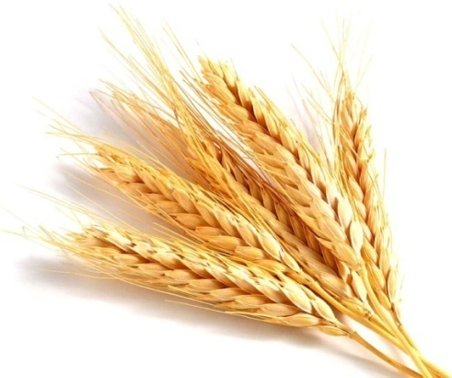
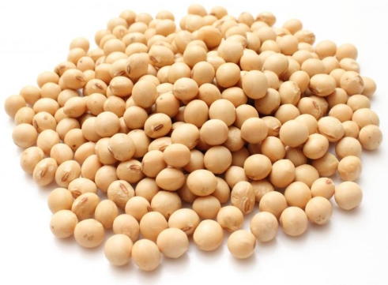
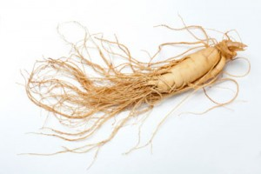
Assure Body Wash
  Enriched with Wheat, Soy Proteins and Ginseng Root Extract
The Performance (Key ingredients)
Wheat and Soy Protein complex: Improves skin elasticity giving a softer after feel and radiant complexion. It keeps the skin smooth and healthy
Skin Benefitting Vitamins: Has antioxidant and skin conditioning properties
Ginseng Root Extract: Helps to maintain skin elasticity, vitality, and regeneration capacity of skin cells
The Benefits
Nourishing and deep cleansing wash, perfect for everyday use
Helps improve skin elasticity and smoothness
Gently cleanses without over drying the skin
Antioxidant vitamins helps improve skin texture and gives a radiant glow
It conditions the skin and locks essential moisture within for long lasting hydration

Slide 5
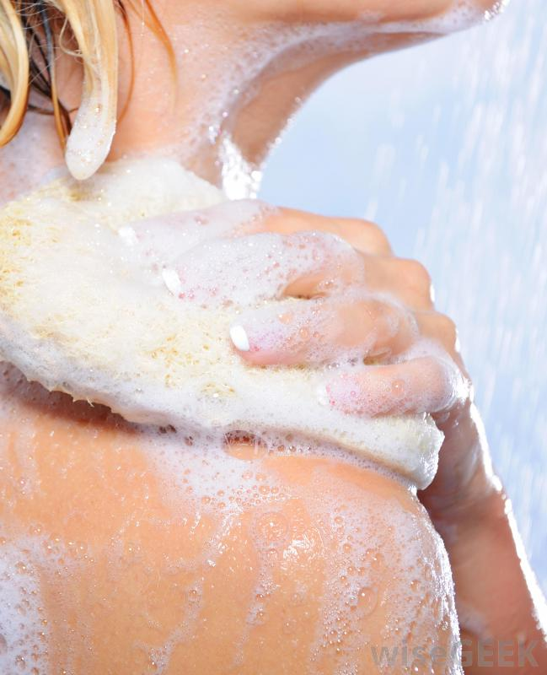
Assure Body Wash
  Enriched with Wheat, Soy Proteins and Ginseng Root Extract
The Application
Apply a liberal amount on wet skin using hands or loofa
Massage well to form rich lather
Rinse thoroughly with water

Slide 6
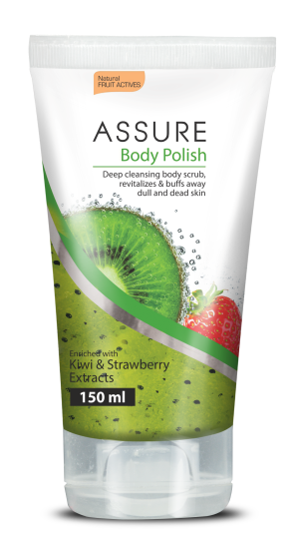
  New
  ASSURE
  BODY POLISH
  Enriched with Kiwi and Strawberry Extracts

Slide 7
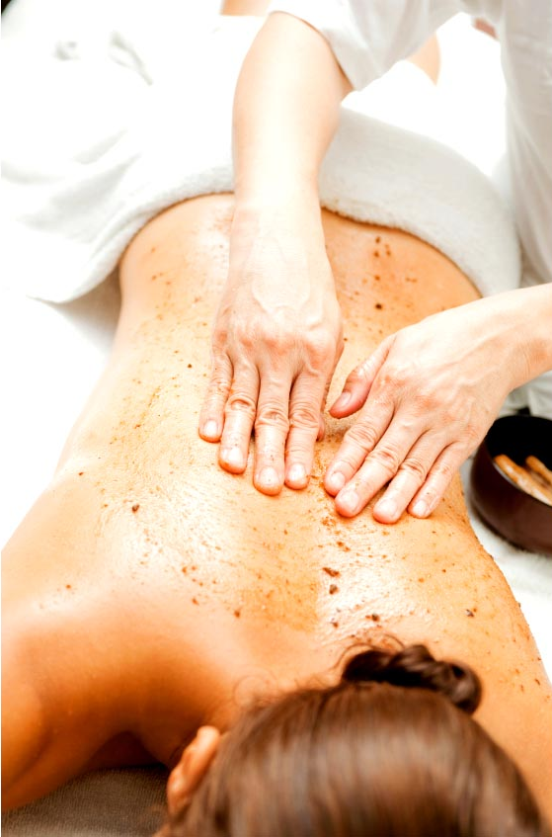
Assure Body Polish
  Enriched with Kiwi and Strawberry Extracts
Why do we need to use a Body Polish?
Our skin renews every 24-40 days, but as we age the cycle time increases making the skin appear dull, unhealthy and unattractive
A body polish is like a body treatment that exfoliates and hydrates the skin, leaving it smooth and soft
It is a primary remedy for attaining radiant skin, its just like a facial for your body
A polished skin looks attractive and healthy
The Product
This exfoliating, foaming gel with real kiwi seeds gently buffs away dead skin cells to leave skin soft and smooth.
It’s sweet fruity scent invigorates the senses for a fresh feel all day.

Slide 8
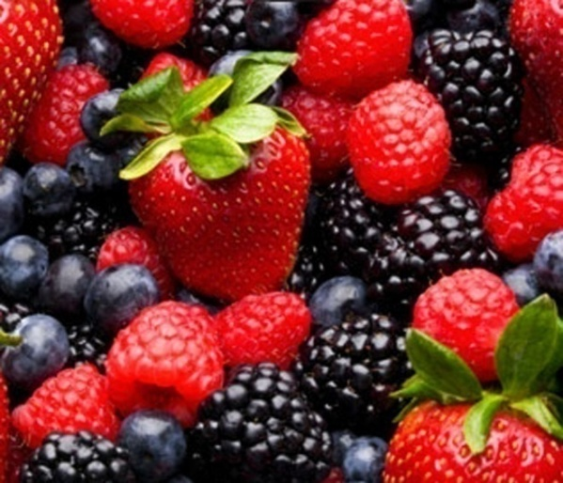
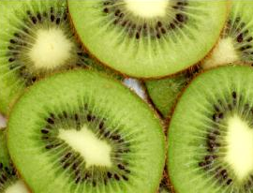
Assure Body Polish
  Enriched with Kiwi and Strawberry Extracts
The Performance (Key ingredients)
Berry Fruit Complex: Consisting of strawberry, blueberry, blackberry, mulberry, pomegranate and raspberry extracts, provides antioxidant benefits and emollience to the skin
It has soothing, astringent and excellent exfoliating properties that buffs away dead skin cells
Natural Kiwi Seeds: Helps to gently buff away uneven skin and dead skin cells making it soft, smooth and supple
The Benefits
The new Assure Body Polish stimulates the skin cells to generate fresh and healthier layers of skin
Helps to brighten, moisturize and sooth tired skin giving it instant glow and healthy look
It remove excessive oil and dirt buildups that clog the skin pores
It provides a healthy glow giving it a youthful complexion from top to toe

Slide 9
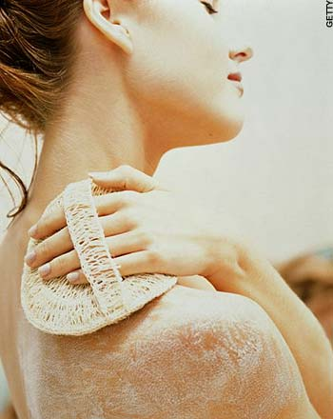
Assure Body Polish
  Enriched with Kiwi and Strawberry Extracts
The Application
Rub a liberal amount onto hands or a luffa
Massage for a few minutes in circular motion forming enough lather
Rinse thoroughly with water

Slide 10
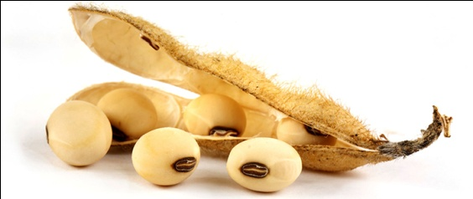
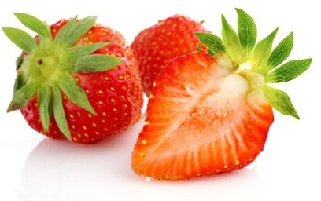
Assure Body Wash & Body Polish
MRP Rs. 280/-
DP Rs. 240/-
BV 144
Pack Size 150 ml
MRP Rs. 340/-
DP Rs. 290/-
BV 174
Pack Size 150 ml

Slide 11

Scalp and Hair Solution
Combines essential phyto-nutrients with time-tested botanical extracts to promote healthy hair growth, and provide strength and natural shine to the hair

Slide 12
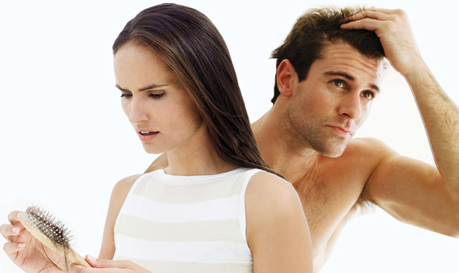
Hair Loss
It is normal to loose 50-100 stands of hair everyday
If it extends more than 100 strands a day, it is a sign of hair fall problem
Both women and men experience hair thinning and are at risk of baldness
Factors causing Hair loss
Age
Hormonal imbalance
  In men, caused due to over secretion of DHT
  In Women, due to irregular cycles, menopause and pregnancy
Inflammation of hair follicle
  Dandruff
  Infection
  Pollution
Disorder of blood circulation to the scalp

Slide 13
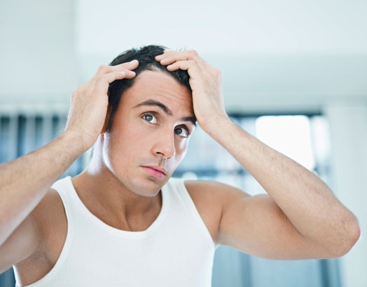
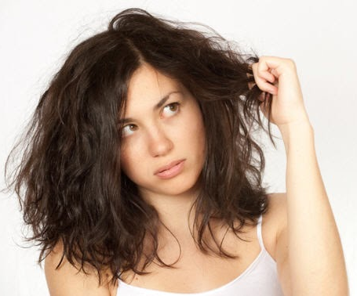
Hair Loss
Other reasons include:
  Stress and bodily weakness
  Dietary imbalance or nutritional deficiency
  Using abrasive shampoos, hair lacquers, dyes, harsh chemicals and bleaching

Slide 14
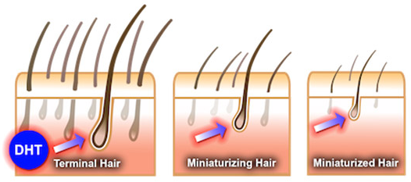
Hair Loss
Patterned hair loss in both men and women is caused due elevated levels of hormone DHT
Di-hydro-testosterone (DHT) is formed from the male hormone testosterone
It shortens the growth phase of the hair (anagen phase) – where the hair follicle shrinks to reduce the thickness of hair
It also makes the hair roots harder which prevents blood circulation and supply of nutrients to the hair

Slide 15

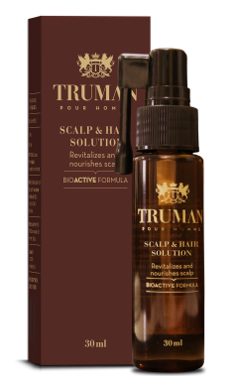
Scalp & Hair Solution
In order to restart the hair cycle and combat Hair loss, it is necessary to activate the anagen, or growth phase of hair
Truman Scalp & Hair Solution acts simultaneously on three principal factors that controls the hair cycle
  Hormonal balance
  Vascular system
  Cell metabolism
It helps to prevent hair loss through carefully selected ingredients that help to nourish scalp and hair
It contains anti-bacterial agents that helps to solve itching and dandruff related problems
Free from alcohol, fragrance, silicones and harsh chemical that can lead to hair loss
Comes with an easy applicator that helps to target specific areas
MRP Rs. 320
DP Rs. 270
Net content: 30 ml

Slide 16
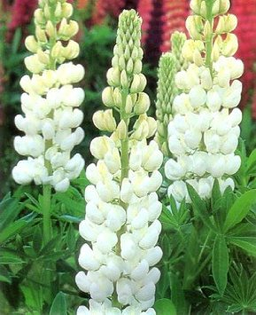
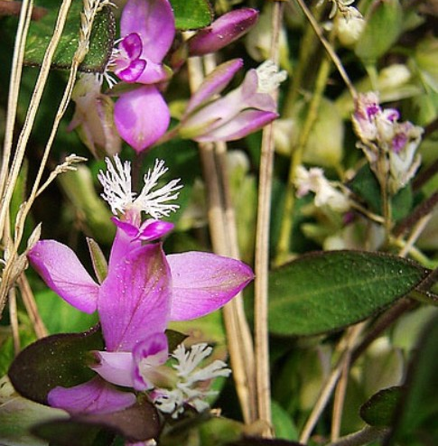
Scalp & Hair Solution
Active ingredients:
Sweet Lupine Protein
  Helps to regulate hormones that cause hair loss
  It is rich in peptides, trace elements and vitamins that helps to improve microcirculation of the scalp and brings hair density to normal
  Helps to stimulate cell metabolism in the scalp
  Improves vascularization around the hair follicles that facilitates the supply of oxygen and nutrients required for hair development
Polygala Extract
  Promotes hair growth and prevents hair loss by increasing hair diameter and weight

Slide 17
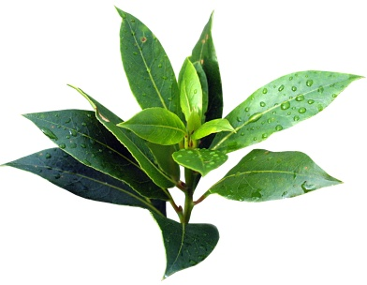
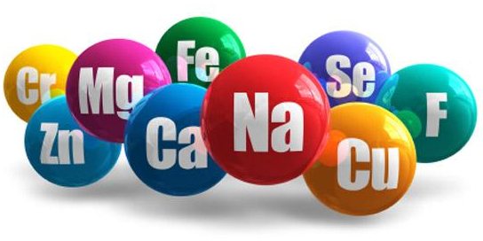
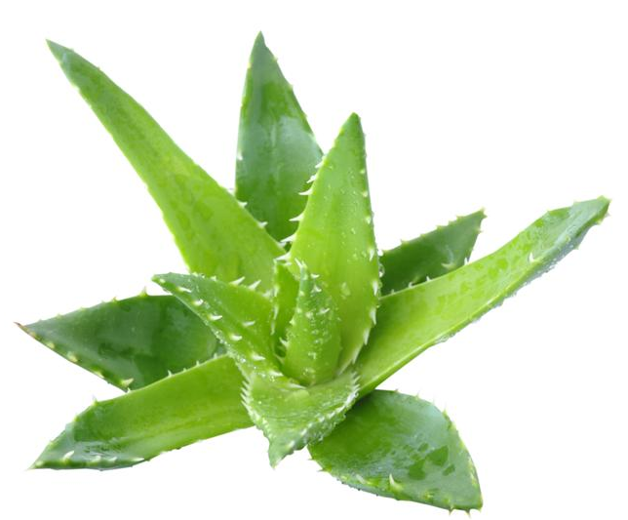
Scalp & Hair Solution
Other ingredients:
Tea Tree Oil and Thyme Extract
  Has anti-bacterial, antifungal and antiseptic properties and helps to tackle dandruff and itching problem which causes hair loss
Multi-Mineral Complex
  Contains zinc, copper and magnesium cocktail that helps to revitalize the scalp
Aloe Vera Leaf Juice
  Provides moisture and acts as anti-inflammatory agent
Pro-vitamin B5
  Helps strengthen the roots

Slide 18
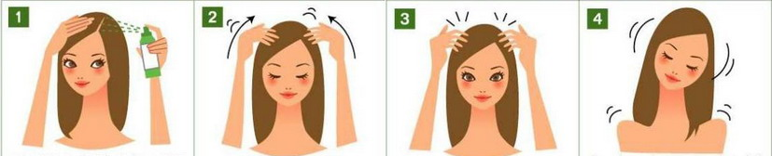
How to apply
Apply the Truman Scalp and Hair Solution in various sections from the crown to the base of neck directly on the scalp
Gently massage for few minutes in a circular motion using your fingertips
For best results apply everyday after washing hair

Slide 19

Other ways to Combat Hair loss
De-stress
Anxiety and stress are one of the main causes for hair fall. Take out some time for yourself, even if it’s in the shower for a few minutes, just to relax and de-stress
Eat Healthy
Drink plenty of water and fill your diet with protein and vitamin rich foods
Cleanse and nourish with Assure Shampoo and Conditioner
Dirt and pollution cause build-up that collects and damages hair at the roots. To make your hair less prone to hair fall, clean with a shampoo that gently nourishes hair roots, follow with conditioner. Pamper yourself with a spa treatment with Assure Hair Spa once a week
Use Truman Scalp and Hair Solution everyday
It gives you extra protection after washing and conditioning

Slide 20
Thank you
QUIZ

