Slide 1


Slide 2

What is Assure?

Slide 3
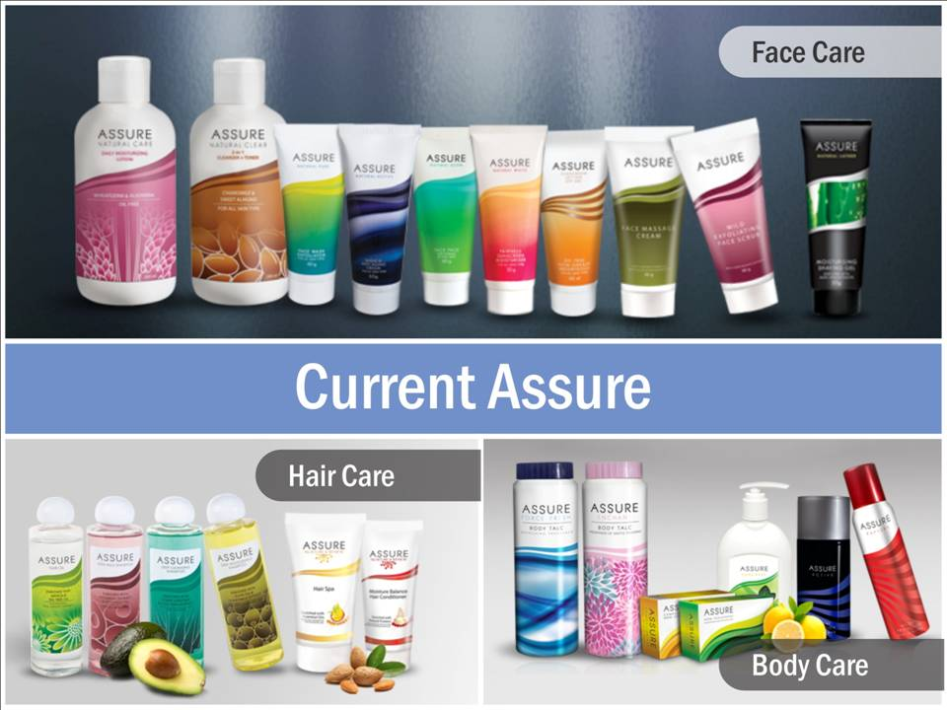

Slide 4

Why to Improve?
Innovation is the most important driver for success
To fulfill the need for enhanced quality and improved overall performance
To stand out in the market against competitors
To attract new customers and retain the old ones
– It’s time to Revolutionize
The New Assure range is developed at our own R&D facility New Edge – equipped with latest technology under supervision of experienced scientists

Slide 5
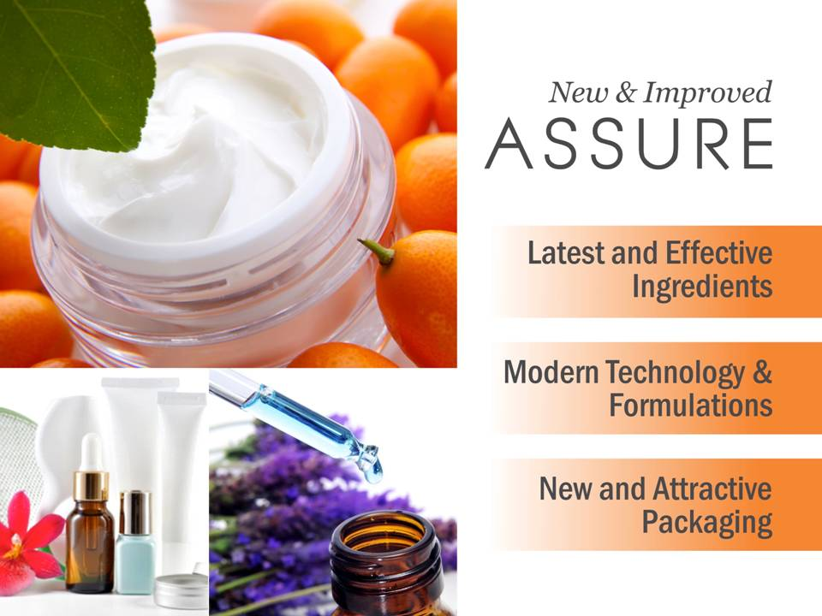

Slide 6

What’s New?
New Advanced Formula
PARABEN-FREE
With new and well-researched actives sourced from world class research laboratories
With new and attractive packaging
With a promise to offer superior performance and best results

Slide 7


Slide 8
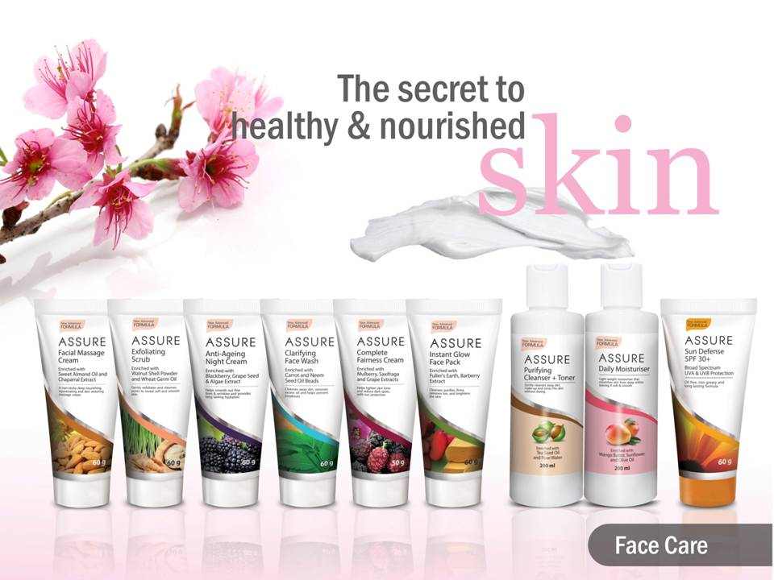

Slide 9
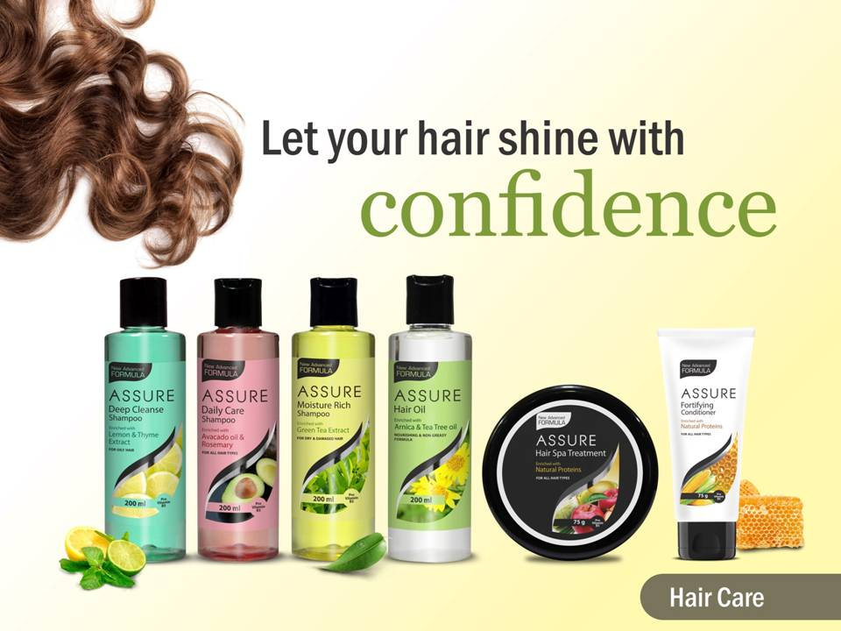

Slide 10
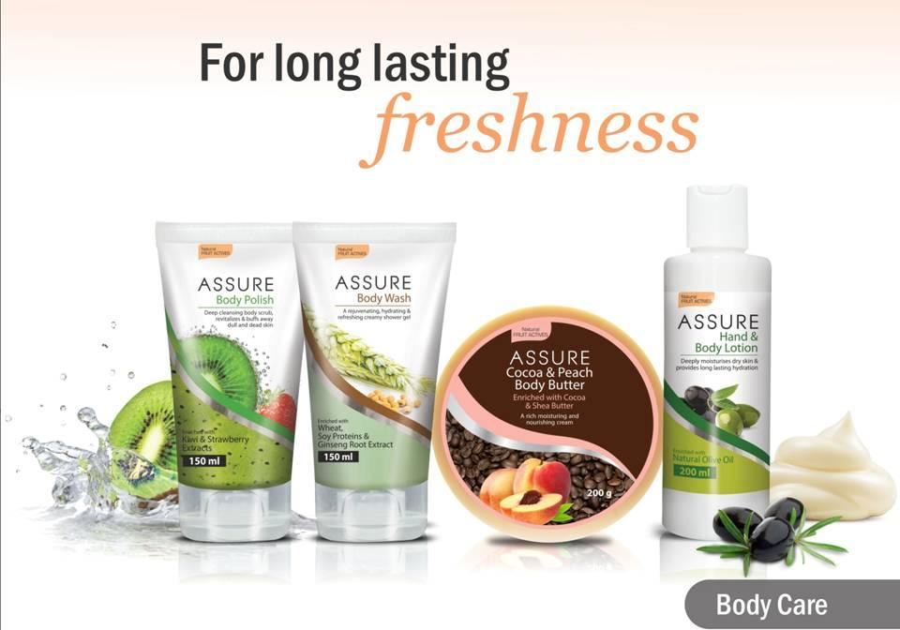

Slide 11


Skin Care Basics

Slide 12
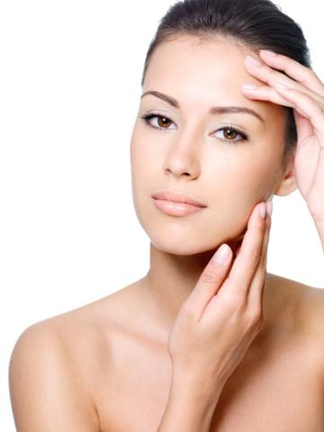
Skin Care Basics
A proper skin care regimen is important to maintain health of your skin
Different skin types have different skin care needs
Every effective regimen must include 3 fundamental elements
  Prevention of accelerated skin ageing
  Protection from sun damage and environmental pollution
  Correction of lines, wrinkles, discoloration, spots and blemishes

Slide 13
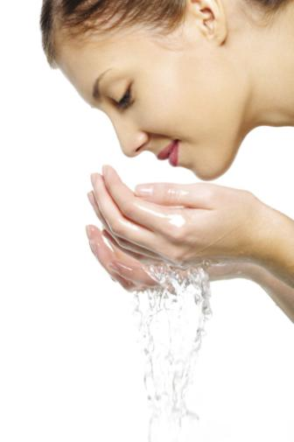
Basic Regimen
Your daily regimen is highly dependent on your skin type, condition and age
A basic regimen must consist of the following:
Regimen | Frequency
Cleanser | Everyday
Toner | Everyday
Exfoliation | Once or Twice a week
Treatment | Everyday on targeted areas
Moisturizer | Everyday (with day or night cream)

Slide 14
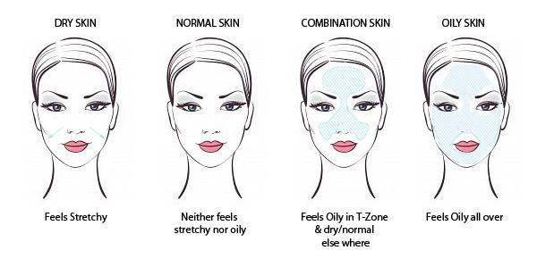
Know your Skin Type

Slide 15
New ASSURE Personal Care Portfolio
Face Care
Complete Fairness cream
Clarifying Face wash
Hair Care
Deep Cleanse Shampoo (For oily hair)
Body Care
Complexion Bar
Anti-ageing night cream
Sun Defense SPF 30+
Instant Glow Face pack
Purifying Cleanser + Toner
Daily Moisturiser
Moisture Rich Shampoo (for dry and Damaged hair)
Daily care shampoo (for all hair types)
Assure Soap
Deodorant for Men
Deodorant for Women
Exfoliating Scrub
Facial massage cream
Fortifying Conditioner
Hair Spa Treatment
Assure Force Fresh Talc
Assure Enchant body talc
Hair Oil
Foot cream
Self Care
Vescare Insta Relief cream
New Additions:
Body Wash
Body Polish
Body Butter
Hand and body lotion
BB Cream

Slide 16
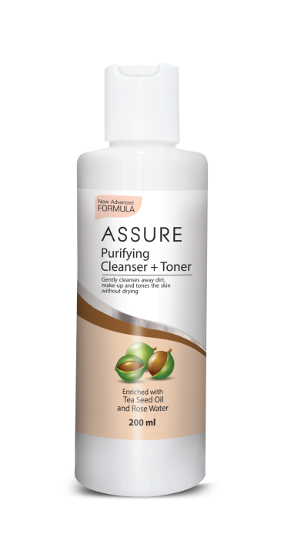
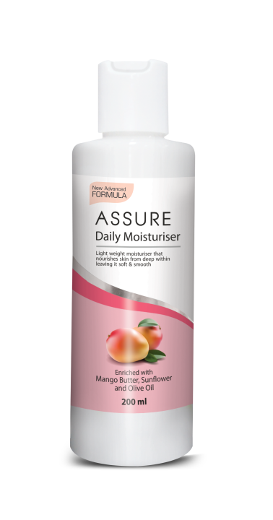
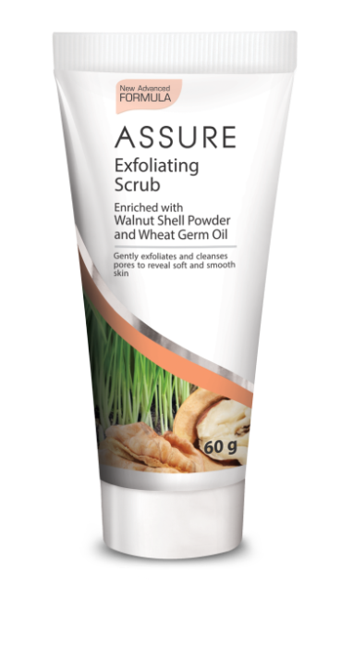
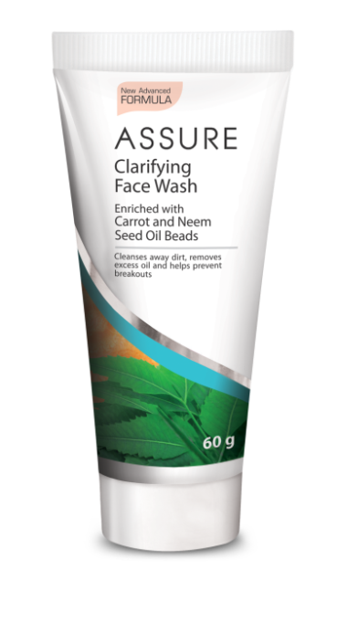
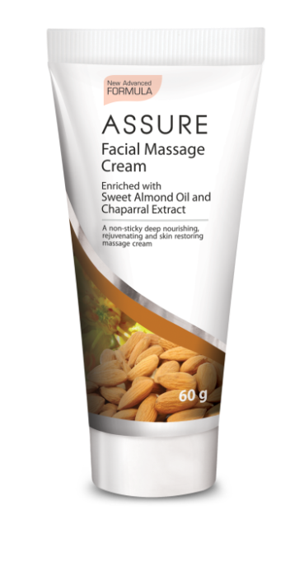
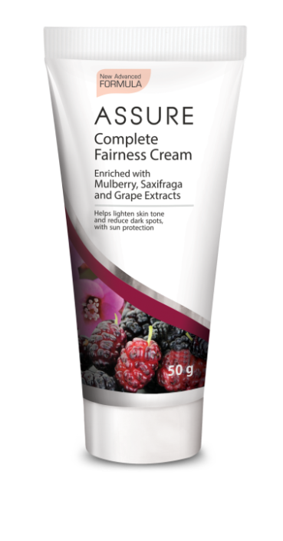
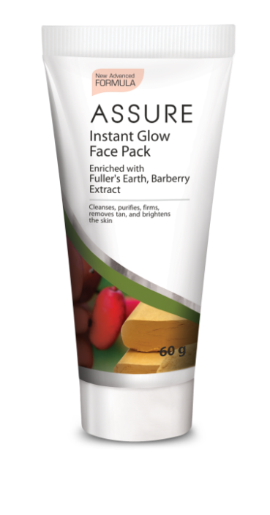
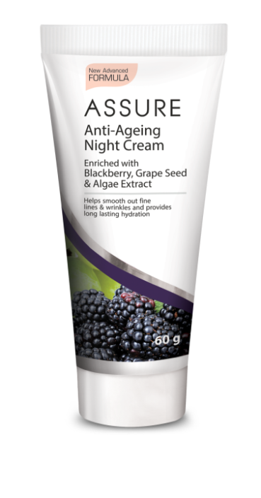
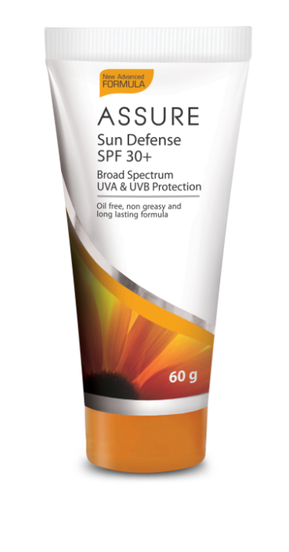
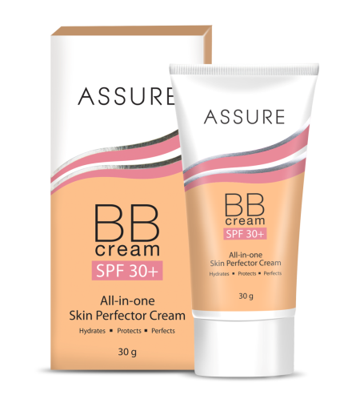
New ASSURE Face Care Range

Slide 17


  New
  ASSURE CLARIFYING FACE WASH
  Enriched with Carrot and
  Neem Seed Oil Beads

Slide 18

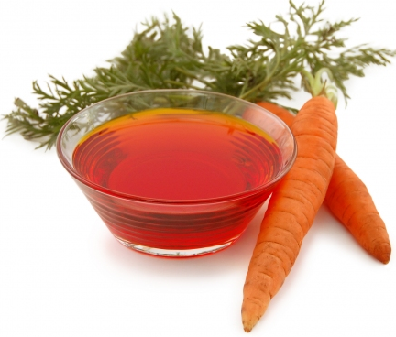
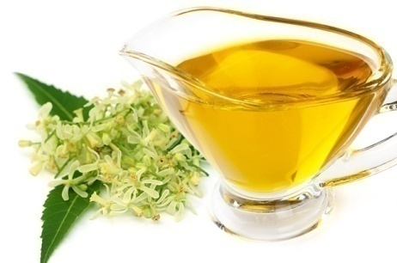
Assure Clarifying Face Wash
Enriched with Carrot and Neem Seed Oil Beads
Product
A gel based formula with innovative ingredient filled beads that releases essential skin nourishment agents on application and helps prevent breakouts. It is soap free and gently removes dirt and excess oil from the skin
Performance (Key Ingredients)
Gentle face cleansing agents
Innovative Neem seed and Carrot seed oil beads – release the oils on application with water
Benefits
The gentle cleansing Face Wash, is a skin hydrating formula that works within and outside the skin's surface for a visibly radiant effect
Removes dirt and extra sebum & helps prevent acne and blemishes without causing dryness, while nourishing the skin

Slide 19
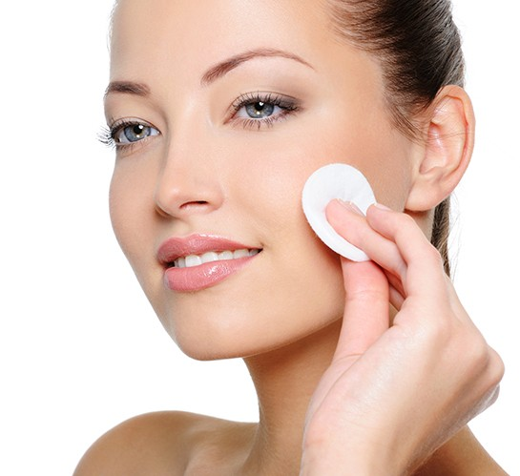
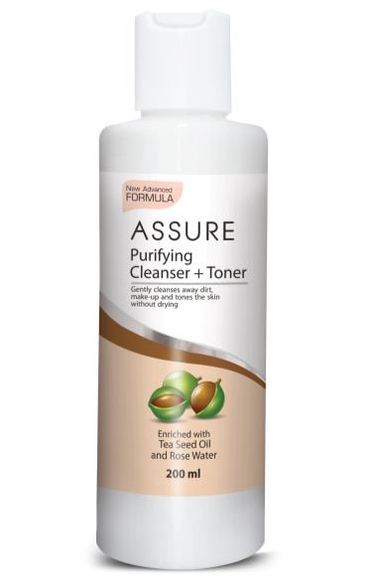
  New
  ASSURE PURIFYING CLEANSER + TONER
  Enriched with Tea seed oil
  and rose water

Slide 20
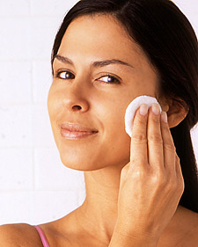
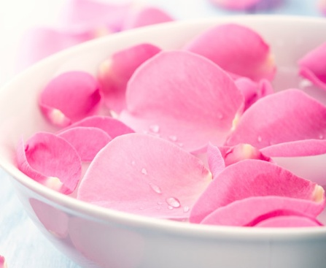
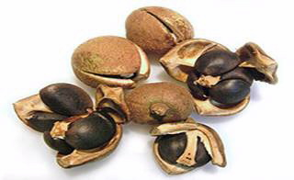
Assure Purifying Cleanse + Toner
Enriched with Tea seed oil and rose water
Product
A refreshing milky white cleansing + toning formula that wipes away dirt and impurities to reveal a fresher, younger looking skin
Performance (Key Ingredients)
Rose water – helps to maintain skin’s pH balance. It helps fight breakouts, hydrate, revitalize, moisturize, and smooth out the skin
Tea seed oil – Rich in antioxidants and vitamins, have restorative and rejuvenating effect on skin, it is an excellent emollient, helps restore pH balance and protect the skin from environmental pollutants
Benefits
Combined benefit of Cleansing + Toning
Unique purifying formula that removes make up, dirt, sebum, excess oil etc to reveal clean, radiant skin
Tightens the skin & improves skin texture and elasticity
Retains moisture and is suitable for all skin types

Slide 21

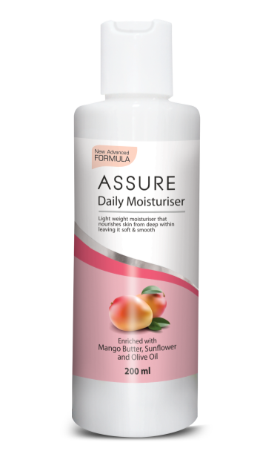
  New
  ASSURE DAILY MOISTURISER
  Enriched with Mango Butter,
  Sunflower and Olive Oil

Slide 22
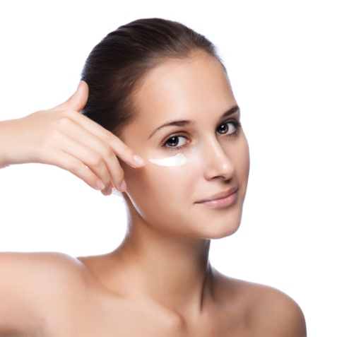
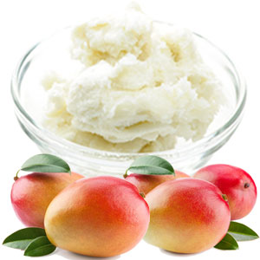
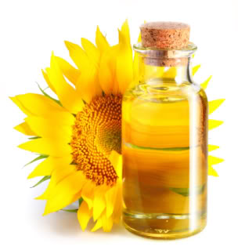
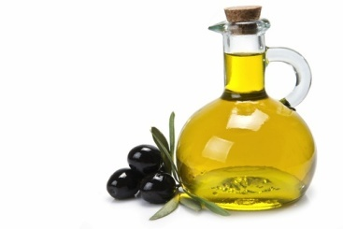
Assure Daily Moisturiser
Enriched with Mango Butter, Sunflower and Olive Oil
The Product
A gentle oil-free moisturizing lotion that easily absorbs into the skin, keeps it supple, gives a radiant glow and provides all-day moisturisation
The Performance (Key ingredients)
Mango Butter: Has skin softening, soothing & moisturizing properties, Helps to combat dry skin, non-greasy and absorbs easily into the skin
Sunflower, olive oil and Vitamin E: These provide the skin with essential hydration and locks it all day, also has antioxidant benefits that protects the skin from damage due to sun and environment
The Benefits
It deeply nourishes and moisturizes the skin and helps restore skin’s natural oils
Hydrates the skin and gives a radiant glow
Its light and oil-free formula absorbs easily into the skin
Suitable for all skin types

Slide 23
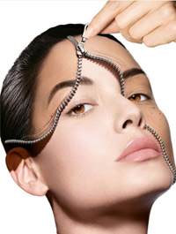
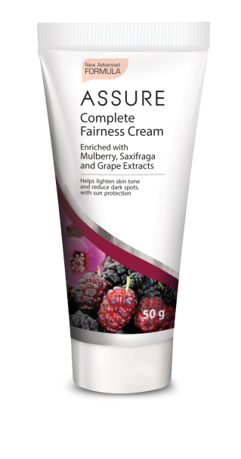
  New
  ASSURE COMPLETE FAIRNESS CREAM
  Enriched with Mulberry,
  Saxifraga and Grape Extracts

Slide 24

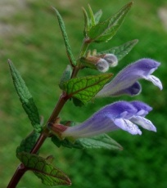
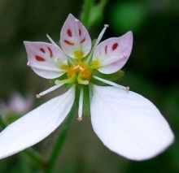
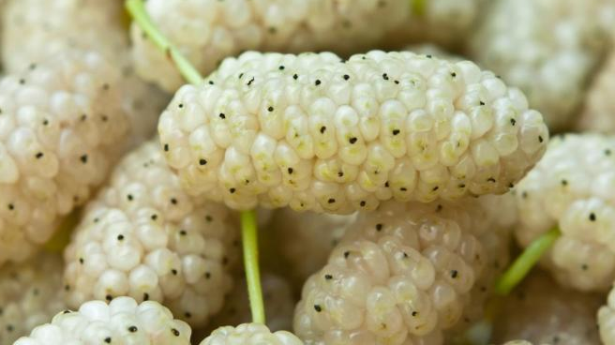
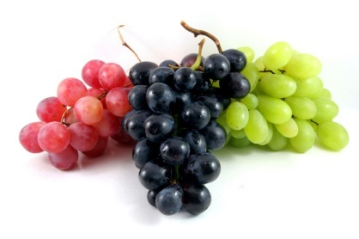
Assure Complete Fairness cream
Enriched with Mulberry, Saxifraga and Grape Extracts
Product
A nourishing skin-lightening cream with a light texture that allows it to absorb quickly into the skin, forming a shield across the skin. Continuous use helps to lighten and brighten complexion from within making it even toned and radiant
Performance (Key Ingredients)
Bio-White Complex: It is a combination of botanical extracts of skullcap, white mulberry, saxifrage, grapes, combined with powerful agents with high skin brightening and whitening efficacy
Benefits
The Bio-White complex helps
  lighten the skin – blocks further melanin production in the skin due to excessive sun exposure
    protect the skin from harsh UV rays
    help reduce the appearance of brown spots, pigmentation
Has anti-aging benefits
It nourishes, moisturizes and revives the skin giving a natural and brighter look

Slide 25


  New
  ASSURE ANTI-AGING NIGHT CREAM
  Enriched with Blackberry,
  Grape Seed and Algae Extracts

Slide 26
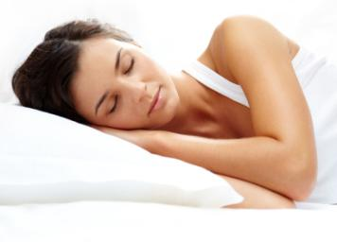
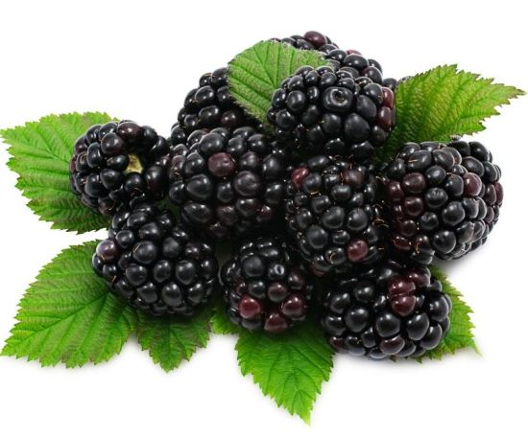
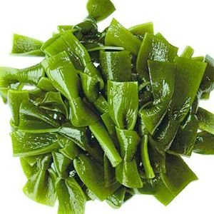
Assure Anti-Ageing Night Cream
Enriched with Blackberry, Grape Seed and Algae Extracts
Product
A replenishing serum-like cream, is a wrinkle-fighting formula that works deep within the skin's surface to significantly reduce the appearance of fine lines and wrinkles making the skin look younger and firmer
Performance (Key Ingredients)
Anti-aging extracts: Consisting of Blackberry fruit extract, Vitamin B3 and Kelp extract, that helps to effectively fill fine lines and wrinkles, tightens and firms sagging skin
Grape stem cells: Has anti-ageing, antioxidant and anti-inflammatory properties
Benefits
Assure Anti-ageing Night Cream renews skin's appearance at night, when the cell renewal process is at its peak
It visibly reduces the appearance of fine lines and wrinkles and tightens the skin
It improves skin hydration and prevent moisture loss, making the skin look younger and radiant
It prevents premature skin aging by inhibiting harmful free radicals

Slide 27
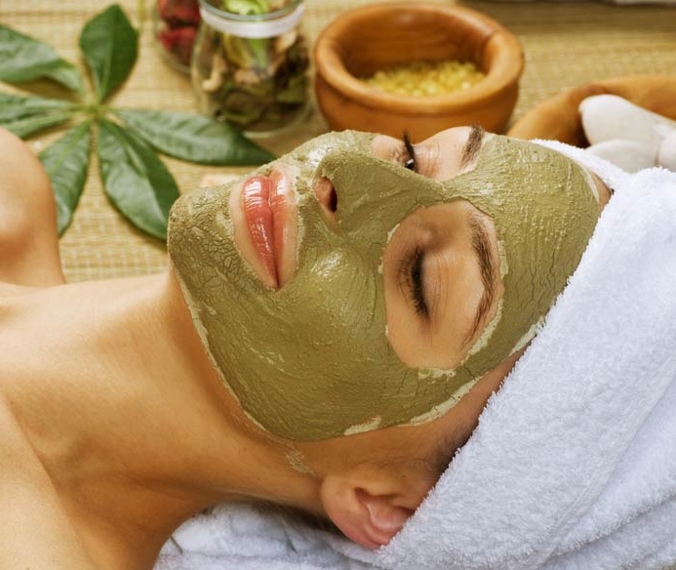
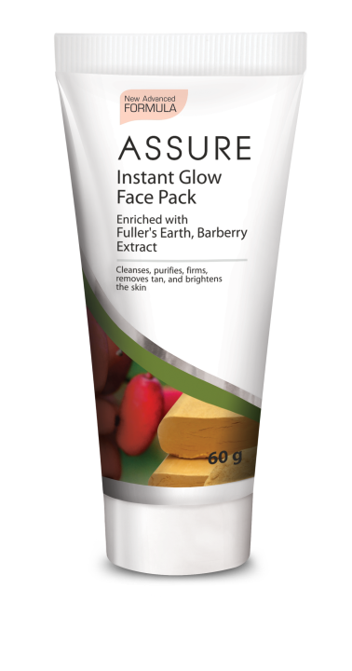
  New
  ASSURE INSTANT GLOW FACE PACK
  Enriched with Fuller’s earth, Barberry Extract

Slide 28
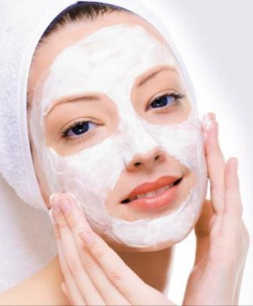
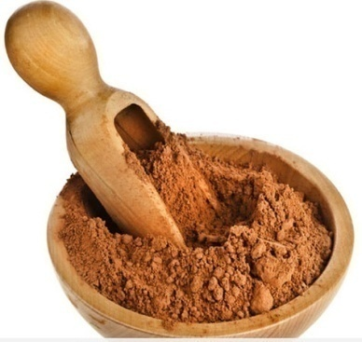
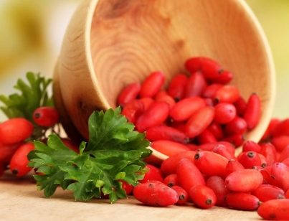
Assure Instant Glow Pack
Enriched with Fuller’s earth, Barberry Extract
Product
Rejuvenating herbal face pack that spreads easily over the skin and quenches excess oil and dirt from its surface, prevents acne, blemishes and provides a matt effect on surface shine and instantly gives a radiant glow
Performance (Key Ingredients)
Kaolin & Fuller’s earth (Multani Mitti): These oil controlling agents prevents excess oil secretion that leads to acne, pimples and breakouts. It deeply cleanses the skin and reveals a natural glow
Barberry extract: helps to calm, heal and rejuvenate the skin leaving it healthy and luminous
Kombuchka extract: regulates oil secretion, help clean, firm and tighten pores
Benefits
Deeply Cleanses, removes tan, clears pores, firms and brightens the skin
Natural clays prevent acne, pimples, blemishes and unwanted breakouts
Clears clogged pores and removes blackheads and white-heads
Helps to tighten, refresh and rejuvenate skin in 5 minutes giving it a natural and healthy glow

Slide 29


  New
  ASSURE SUN DEFENSE SPF 30+
  Broad Spectrum UVA & UVB Protection

Slide 30
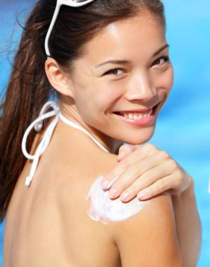
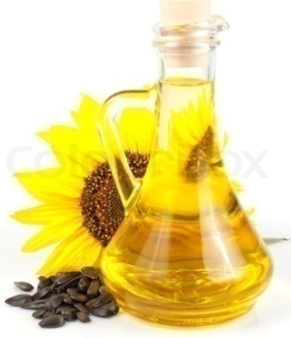
Assure Sun Defense SPF 30+
Broad Spectrum UVA & UVB Protection
The Product
Assure Sun Defense SPF 30+ is a special oil-free formula that absorbs easily into the skin and provides broad spectrum protection against UVA and UVB rays, protecting the skin against sunburns and premature ageing
The Performance (Key ingredients)
Advanced Sun Protection agents: Effectively protects the skin from harmful UVA and UVB rays
Sunflower seed oil: It nourishes and moisturizes the skin as it easily gets absorbs into the skin, providing essential hydration
    The Benefits
Helps to reduces sunburns & skin tanning caused by UVB rays of the sun
    Advanced Sun Protection Factor (SPF) 30+ provides longer protection and is ideally suited for Indian conditions and skin, that is exposed to extreme sun rays most part of the year
It also has PA++ protection, meaning it shields the skin against penetrating UVA rays of the sun that penetrates deep into the skin causing dark spots and premature ageing of the skin

Slide 31
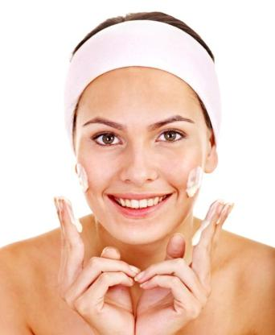

  New
  ASSURE EXFOLIATING SCRUB
  Enriched with Walnut Shell Powder
  and Wheat Germ Oil

Slide 32
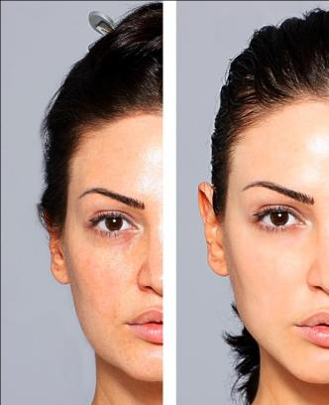
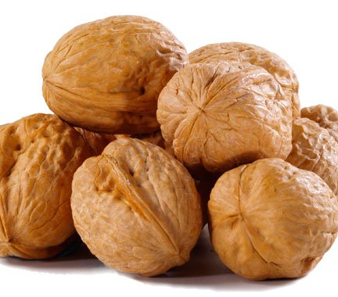
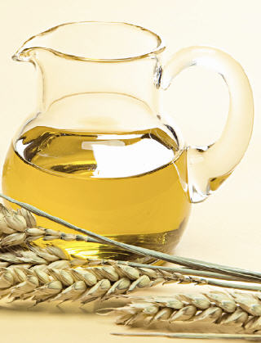
Assure Exfoliating Scrub
  Enriched with Walnut Shell Powder and Wheat Germ Oil
Product
Rich and creamy scrub with blend of coarse and fine exfoliating particles that effectively removes dead skin cells
Performance (Key ingredients)
Walnut Shell powder: Exfoliates dead skin cells to reveal a brighter, clearer and smoother complexion.
Wheat Germ Oil: Rich in Vitamin E that helps improve dry skin and maintain the moisture balance of skin
Benefits
Gentle facial scrub cream contains natural scrub that gently exfoliates dead skin cells
Helps to clear away dead skin cells without tearing the delicate skin underneath, making way for new skin cells
Its creamy texture does not leaves the skin dry and does not rip the skin off essential moisture
Effectively clears clogged pores without excessively drying out the skin or disturbing the natural moisture balance

Slide 33


  New
  ASSURE FACIAL MASSAGE CREAM
  Enriched with Sweet Almond Oil
  and Chaparral Extract

Slide 34


Assure Facial Massage Cream
  Enriched with Sweet Almond Oil and Chaparral Extract
Product
Concentrated formula with deep moisturizing benefits that protects the skin from dryness and wrinkles
Performance (Key ingredients)
Olive Oil: A natural oil that helps to give smoothness and suppleness to the skin, helps to reduce dryness and fine lines
Sweet almond oil: An excellent emollient with skin conditioning benefits
Sunflower oil: It provides long-lasting firming action and visibly smoother skin, and relaxed wrinkles and fine lines
Benefits
Provides deep moisturizing benefits that protects the skin from dryness and wrinkles
Provides skin softness, smoothness, fairness and youthfulness
Excellent anti-aging formula with benefits of chaparral extract works deep within the skin's surface to uplift it and reduce the appearance of fine lines and wrinkles
Natural oil blend hydrate and give the skin smooth and youthful resilience

Slide 35
Quick facial at home using Assure
Step 1
Assure Clarifying Face Wash –Apply a small amount and massage gently for few minutes, splash cold water and pat dry
Step 2
Assure Purifying Cleanser + Toner – Take a small amount onto your palm and add 2-3 drops of cold water. Massage on face and neck in upward circular motions for about 5 minutes. Wipe with wet towel and pat dry.
Step 3
Assure Exfoliating Scrub – Exfoliate away dead skin cells by massaging in upward and circular motions for 3-5 minutes especially around the nose, avoiding eye area. Clean with water or wet towel and pat dry.
Step 4
Assure Facial Massage Cream - Massage a small amount over face and neck in upward circular motion for 10 minutes. Top up with small amount of cold water to continue massage. Wipe with wet towel and pat dry.
Step 5
Assure Instant Glow Face Pack Take a generous amount and apply a thick layer on the face and neck leaving the area around the eyes. Leave for 15 min. and wipe with wet towel and pat dry.
Step 6
Assure Anti-Ageing Night Cream / Assure Sun Defence SPF 30+ or Assure Complete Fairness Cream – End the facial with a suitable day or night protection for the facial to stay longer

Slide 36


  New
  ASSURE BB CREAM SPF 30+
  All-in-one skin perfector

Slide 37

Assure BB Cream SPF 30+
  All-in-one skin perfector
What is BB cream?
BB stands for Beauty Balm or Beauty Benefit cream
An all-in-one moisturizer that does the job of 6 other products
  Moisturizer
  Sunscreen
  Primer
  Concealer
  Foundation
  Skin treatment
It combines skincare with minerals to even skin tone, illuminate, cover imperfections, with hydration and SPF protection, giving a natural look in just one step
Product
A tainted moisturizer with anti-ageing, fairness and sunscreen benefits. Blends perfectly with all skin types and tones giving it a natural and flawless look

Slide 38



Assure BB Cream SPF 30+
  All-in-one skin perfector
Performance (Key ingredients)
Niacinamide or Vitamin B3: Provides long lasting hydration, anti-ageing and skin lightening benefits
Potent Sunblock: With broad spectrum sunscreens protects the skin from both UVA and UVB rays of the sun
Treated Pigments: Provides long lasting effect that makes it waterproof, sweat proof and long lasting
Benefits
6 results in just one swipe
    Brightens complexion
    Evens skin tone
    SPF 30+ and PA ++ protection
    Instantly covers dark spots
    Reduces appearance of fine lines
    Luminous make-up finish

Slide 39







ASSURE Body Care Range

Slide 40

  ASSURE FOOT CREAM
  Enriched with Witch Hazel Extract

Slide 41


Assure Foot Cream
  Enriched with Witch Hazel Extract
The Product
Thick and rich cream with effective moisturizers and healing agents to sooth and nourish dried and cracked skin of the feet
The Performance (Key ingredients)
Witch hazel extract: Witch hazel possesses anti-inflammatory and astringent properties that sooths tired feet and gives anti-oxidant protection
The Benefits
Nourishes and softens dry and rough feet preventing cracks and skin irritations
Offers fast and effective relief from dry and rough heels
Witch hazel extract and effective skin emollients hydrates the skin and locks moisture for longer time

Slide 42










Quick pedicure at home
Soak
Scrub
File
Moisturise
Trim, clip and file nails & cuticles
Massage
Polish

Slide 43


  New
  ASSURE HAND & BODY LOTION
  Enriched with Natural Olive Oil

Slide 44

Assure Hand & Body Lotion
  Enriched with Natural Olive Oil
The Product
Enriched with rich moisturisers yet light weight formula deeply nourishes dry and lifeless skin, absorbs easily into the skin, giving it a radiant glow and all day hydration.
Its soft flowery scent invigorates the senses and keeps the skin refreshed all day
The Performance (Key ingredients)
Olive oil: provides deep nourishment to dry skin leaving skin feeling smooth and silky. Rich in Vitamin E and antioxidants helps prevent premature aging of skin
  Petroleum Jelly: It works by creating a sealing barrier between cells, which locks in moisture and speeds up skin’s natural recovery from dryness, helping it heal from within
The Benefits
Locks in moisture to provide all day hydration
It deeply nourishes the skin and helps restore skin’s natural oils
Hydrates the skin and gives a radiant glow
Keeps the skin soft and supple without greasy feel
Its light and oil-free formula absorbs easily into the skin

Slide 45


  New & Improved
  ASSURE HAND WASH
  Enriched with Aloe Vera and Neem Extract

Slide 46



Assure Hand Wash
  Enriched with Aloe Vera and Neem Extract
Give your hands a gentle care with mild yet effective hand wash
Enriched with Neem and Aloe Vera extracts, provide gentle protection and moisturisation without drying out the skin
Refreshing fragrance keeps the hands fresh for long

Slide 47
  ASSURE DEO
  For Long Lasting Freshness

Slide 48

Assure Deo
  For Long Lasting Freshness
Product
Assure Active for men is an invigorating, refreshing fragrance and a unique anti- bacterial formula with natural extracts, that provides powerful odour protection all day long
Assure Rapture for women has a refreshing fragrance that protects against body odour and makes you feel fresh, active and energetic all day long
Application
Shake the bottle well to mix all ingredients
Hold the bottle 15 cm away from your body
Spray for 2 seconds on each side and you are good to go

Slide 49

  ASSURE TALC
  Refresh and revive your senses

Slide 50


Assure Talc
  Refresh and revive your senses
Assure Force Fresh Body Talc has a rejuvenating musky fragrance that refreshes your mind and energizes the body. Its unique formula keeps you fresh and active throughout the day
Assure Enchant Body Talc has the refreshing fragrance of exotic flowers. It keeps body odour away and makes you feel fresh and vibrant all day long
Talc helps to cut down on friction and absorbs moisture, making it useful for keeping skin dry and helps prevent rashes

Slide 51

  ASSURE SOAPS
  Gentle care and protection

Slide 52


Assure Soaps
  Gentle care and protection
Assure soap is a unique blend of Neem, Tulsi and Pudina
  It protects the skin without making it dry
  It also disinfects and refreshes the skin
Assure Complexion bar is a nourishing and moisturizing bathing bar that cleanses the skin leaving it soft and supple
  It is enriched with brightening extracts of Kesar and honey that enhances the complexion
  It makes the skin cleaner, softer and smoother with a refreshing fragrance

Slide 53

Hair Care Basics

Slide 54

Hair Care Basics
Hair is primarily made up of a protein called keratin
  Also contains natural oils (lipids) and water
Hair grows approx. one-half inch per month
Hair is shed on a daily basis and it is normal to shed between 75-150 hairs per day
Hair Care Regimen for Healthy Hair
Oiling: Massaging scalp for 2 to 3 minutes with oil helps stimulate blood circulation and relax the scalp
Shampoo: It cleans the scalp and removes impurities such as dirt, sebum, oil and other toxins from hair and scalp
Conditioning: This keeps your hair healthy, moisturized, stronger and easier to manage
Hair Spa: Hair Spa is a rehydrating therapy that restores vital oils and moisture for smooth and beautiful hair

Slide 55

New Assure Hair Care Range

Slide 56


  New
  ASSURE MOISTURE RICH SHAMPOO
  Enriched with Green Tea Extract
  For Dry and Damaged Hair

Slide 57

Assure Moisture Rich Shampoo
  Enriched with Green Tea Extract
  For Dry and Damaged Hair
Performance (Key ingredients)
Green Tea Extract: Refreshes the hair and scalp, cleanses, soothes, restores dry hair
Milk Protein: Moisturizes and conditions the hair without weighing it down
Benefits
Extreme heat, cold, sun exposure / chemicals / poor diet can leave hair dry, brittle and damaged
New Assure Moisture Rich Shampoo is enriched with green tea extracts, which refreshes the hair and scalp, as it cleanses, soothes, restores dry hair and repairs split-ends
Milk protein moisturizes and conditions the hair without weighing it down
Pro-Vitamin B5
Attracts water giving hair the required moisture & shine and reduces split ends

Slide 58


  New
  ASSURE DEEP CLEANSE SHAMPOO
  Enriched with Lemon and Thyme Extract
  For Oily Hair

Slide 59

Assure Deep Cleanse Shampoo
  Enriched with Lemon and Thyme Extract
  For Oily Hair
Performance (Key ingredients)
Lemon Extract: It helps to extract excess oil from the hair and gives the right amount of shine to hair. It also helps to prevent hair loss caused due to excessive oily scalp
Thyme extracts: It helps promote hair growth and manage excessive oil secretion in scalp preventing flakyness
Benefits
Thinning hair often starts at the scalp when hair follicles become clogged by sebum or fatty acids
New Assure Deep Cleanse Shampoo helps reduce excess oil and control sebum secretion thus encouraging healthy hair growth
A special herbal complex with lemon and thyme extracts nourishes the hair while adding body and sheen
Pro-Vitamin B5
It penetrates deep into to the hair and give it a healthy shine

Slide 60


  New
  ASSURE DAILY CARE SHAMPOO
  Enriched with Avocado oil and Rosemary
  For All hair types

Slide 61

Assure Daily Care Shampoo
  Enriched with Avocado oil and Rosemary
  For All hair types
Performance (Key ingredients)
Avocado oil: Restores hair luster and hydrates hair. Refreshes the hair and scalp, restores dry hair and repairs split-ends
Rosemary Extract: Gently cleanses and stimulates circulation in the scalp, promoting hair growth
Benefits
Shampoo everyday can strip the hair of essential moisture produced by the scalp making it prone to damage and flakes
New Assure Daily Care Shampoo helps maintain the moisture balance in the hair and scalp
It adds extra bounce to the hair leaving it glossy smooth and healthy
Pro-Vitamin B5
Provides long-lasting moisturisation

Slide 62


  ASSURE HAIR OIL
  Enriched with Arnica and Tea Tree Oil
  Nourishing and non-greasy formula

Slide 63



Assure Hair Oil
  Enriched with Arnica and Tea Tree Oil
  Nourishing and non-greasy formula
Performance (Key ingredients)
Arnica: Serves as a hair growing tonic, nourishes the hair, helps to reduces hair loss and increases hair density
Tea Tree Oil: Helps unblock clogged hair follicles, keeps the scalp cool and helps prevent dandruff and itchyness
Benefits
Assure Hair Oil is enriched with a unique blend of Arnica and Tea Tree oil that provides nourishment to the hair from the roots to the tips
Its special non-greasy formula prevents hair loss and helps control dandruff
It also helps in reducing premature graying, improves the hair texture and adds luster

Slide 64



  New
  ASSURE FORTIFYING CONDITIONER
  Enriched with Honey and Corn Proteins
  For All hair types

Slide 65

Assure Fortifying Conditioner
  Enriched with Honey and Corn Proteins
  For All hair types
Performance (Key ingredients)
Honey: It is a natural humectant, attracts moisture. It is full of antioxidants and nutrients to feed hair follicles, encouraging hair growth. It is a natural cure for dull, brittle and dry hair. It is Moisturizing, Penetrating, Conditioning, Thickening
Corn, Wheat and Soy Proteins: It greatly increases the hair’s ability to retain moistures and adds volume to hair. They help to retain moisture on scalp
Benefits
Assure Fortifying Conditioner is a unique formula that transforms the hair from frizzy rebellious to smooth, repaired and shiny hair
It effectively reduce frizz and makes the hair more manageable, soft and tangle free
It gives control and definition to the hair with gives them natural movement
It also gives extra protection to hair from daily stresses like sunlight, pollution and dust and prevents from damage
Pro-Vitamin B5
It penetrates deep into to the hair and give it a healthy shine

Slide 66



  New
  ASSURE HAIR SPA TREATMENT
  Enriched with Sugarcane, Apple and Lemon Extract
  For All hair types

Slide 67

Assure Hair Spa Treatment
  Enriched with Apple Extract
  For All hair types
Performance (Key ingredients)
Fruit extracts of sugar cane, lemon and apple: It offers natural exfoliating action promoting cell renewal on the scalp. This helps clear the follicles of excessive build up of dead cells, allowing more room for thicker hair growth
Corn, Wheat and Soy Proteins: It greatly increases the hair’s ability to retain moistures and adds volume to hair. They help to retain moisture on scalp. These proteins penetrate the hair cuticle and retain its moisture
Benefits
Assure Hair spa Treatment is a unique blend of botanical extracts that transforms the hair from damaged to repaired, bouncy and shiny hair
It helps to restores natural health and beauty of hair
The highly relaxing spa offers deep nourishment that helps the hair from root to tip
This intensive treatment moisturizes and nourishes damage hair and reduce breakage
The luxurious blend also delivers goodness of overnight oiling in just 5 mins.

Slide 68


VESCARE INSTA RELIEF
CREAM
  Fast acting relief formula

Slide 69



Vescare Insta Relief Cream
  Fast acting relief formula
The Product
Vescare Insta relief cream is a unique formulation that helps to alleviate discomfort and gives instant relief. It is a non-greasy cream that absorbs easily into the skin giving an instant cool sensation
The Performance (Key ingredients)
  Menthol and camphor gives an instant cool sensation
  Eucalyptus and wintergreen oil penetrates deep to relieve discomfort
  Chili pepper and nicotine extracts gives warm after feel to the affected area
The Benefits
Non-greasy formula that absorbs easily into the skin
Gives an instant cool sensation
Gives a warm after feel to the affected area giving comfort and relief

Slide 70
Thank You

