Slide 1


Slide 2

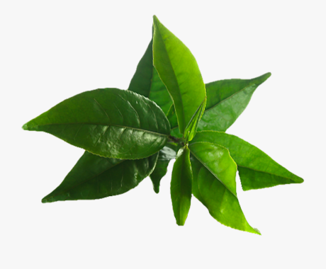
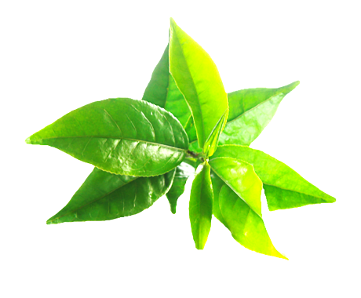
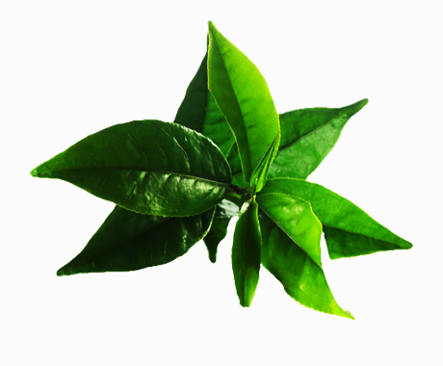
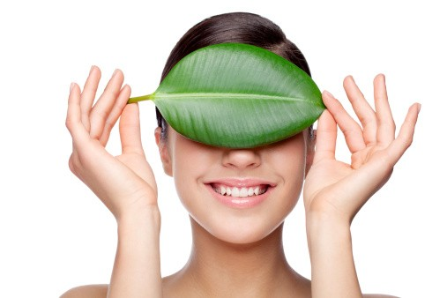
What is Assure Natural …
Assure Natural is an advanced formulation natural personal care range. The products of this range are made with ethically-sourced natural ingredients keeping your body and the environment in mind.

Slide 3

Why do we need Assure Natural
We have realised that we humans are connected with nature and to live a holistically healthy life we have to care for:
The planet
All beautiful creatures
Our “SELF”

Slide 4

So,
Personal care enthusiasts are rooting for products which are good for them and the environment as well

Slide 5

Key pillars of Assure Natural
Noble purpose
Exotic ingredients
Evolving category trends
Ethically right products :
Vegan
Sulphate- free
Paraben-free
PETA certified
World class ingredients
Honest to skin
Environment-friendly
Advanced formulations
International trends
Evolving global consumer trends

Slide 6
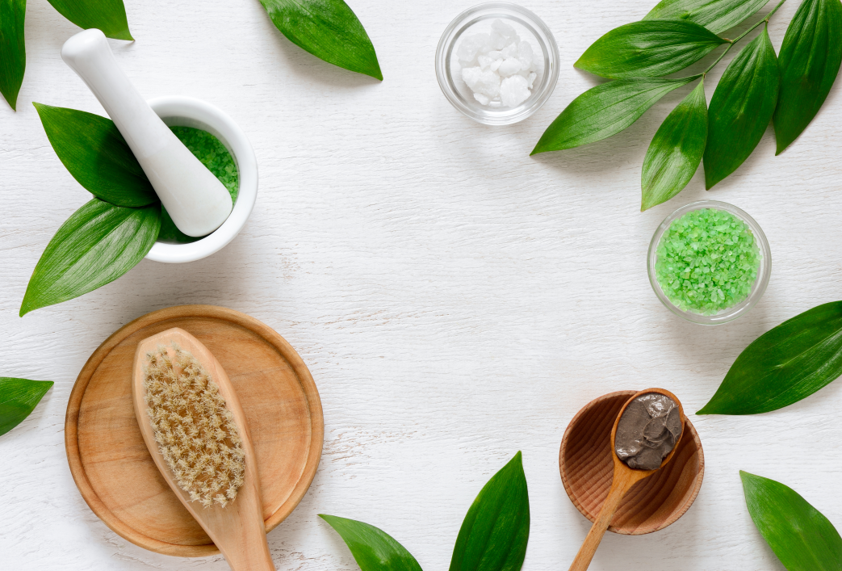
The Assure products are:
Caring
Gentle
Effective

Slide 7
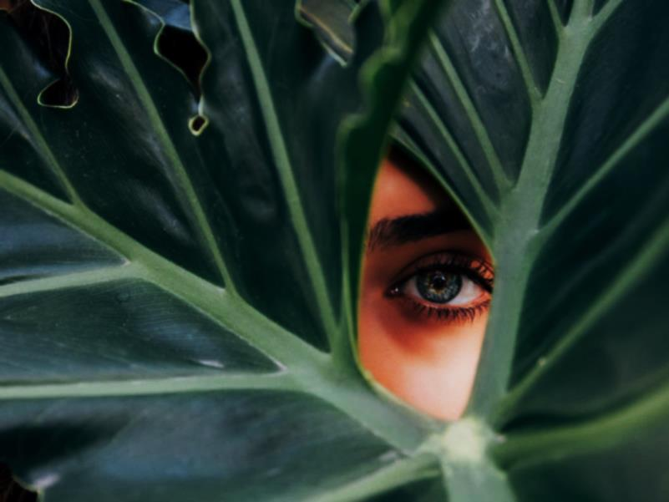
Vegan products
Vegan products are a rich source of nourishment and natural goodness as they are made from plants, and some safe synthetic ingredients.
No animal products or byproducts are used in making these products.
This means that traditional ingredients like beeswax, honey, collagen and keratin are not used in Vegan products.

Slide 8
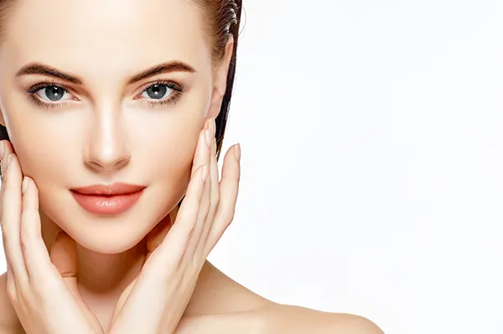
Products that your skin would love to have !
Assure Natural products reduce the chances of skin problems such as rashes, allergies, eczemas, acne, skin inflammation and skin diseases as harmful chemicals are not used in them.

Slide 9

Towards ethical and sustainable world!
Assure Natural products or their ingredients have not been tested on animals.
This range has an accreditation from PETA

Slide 10
No doubt you’ve heard about those sneaky little preservatives called parabens and Sulphate.
Assure Natural range is free of such chemicals

Slide 11
What is sulphate and how they harm us?
Sulphate refers to a family of cheap detergents used in soaps and other personal products as a grease cutting or lathering agent.
They can cause varying levels of skin and eye irritation.
Sulphate can often dry out the skin, which may lead to more acne

Slide 12
What is paraben and why it’s harmful?
Parabens are the most widely used preservatives in personal care products.
They can cause a variety of reactions and allergies and cause skin irritation. Other issues like skin inflammation characterised by rashes, blisters, and burning skins are caused by parabens.

Slide 13

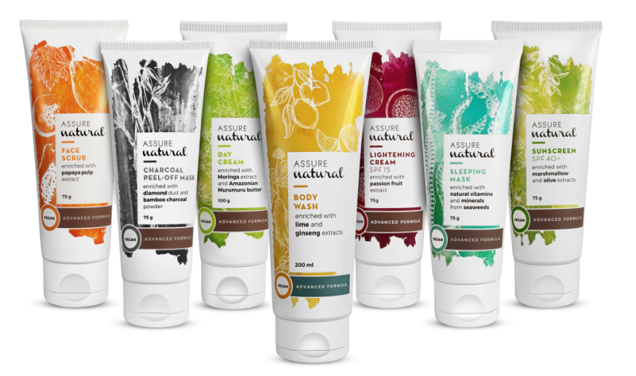
Introducing…

Slide 14
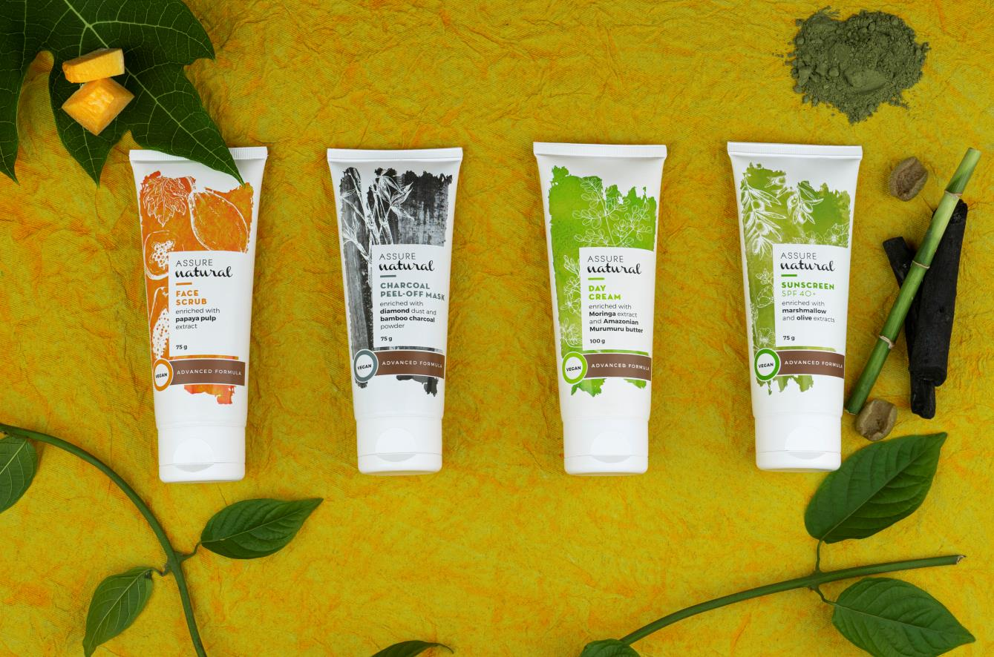

Slide 15
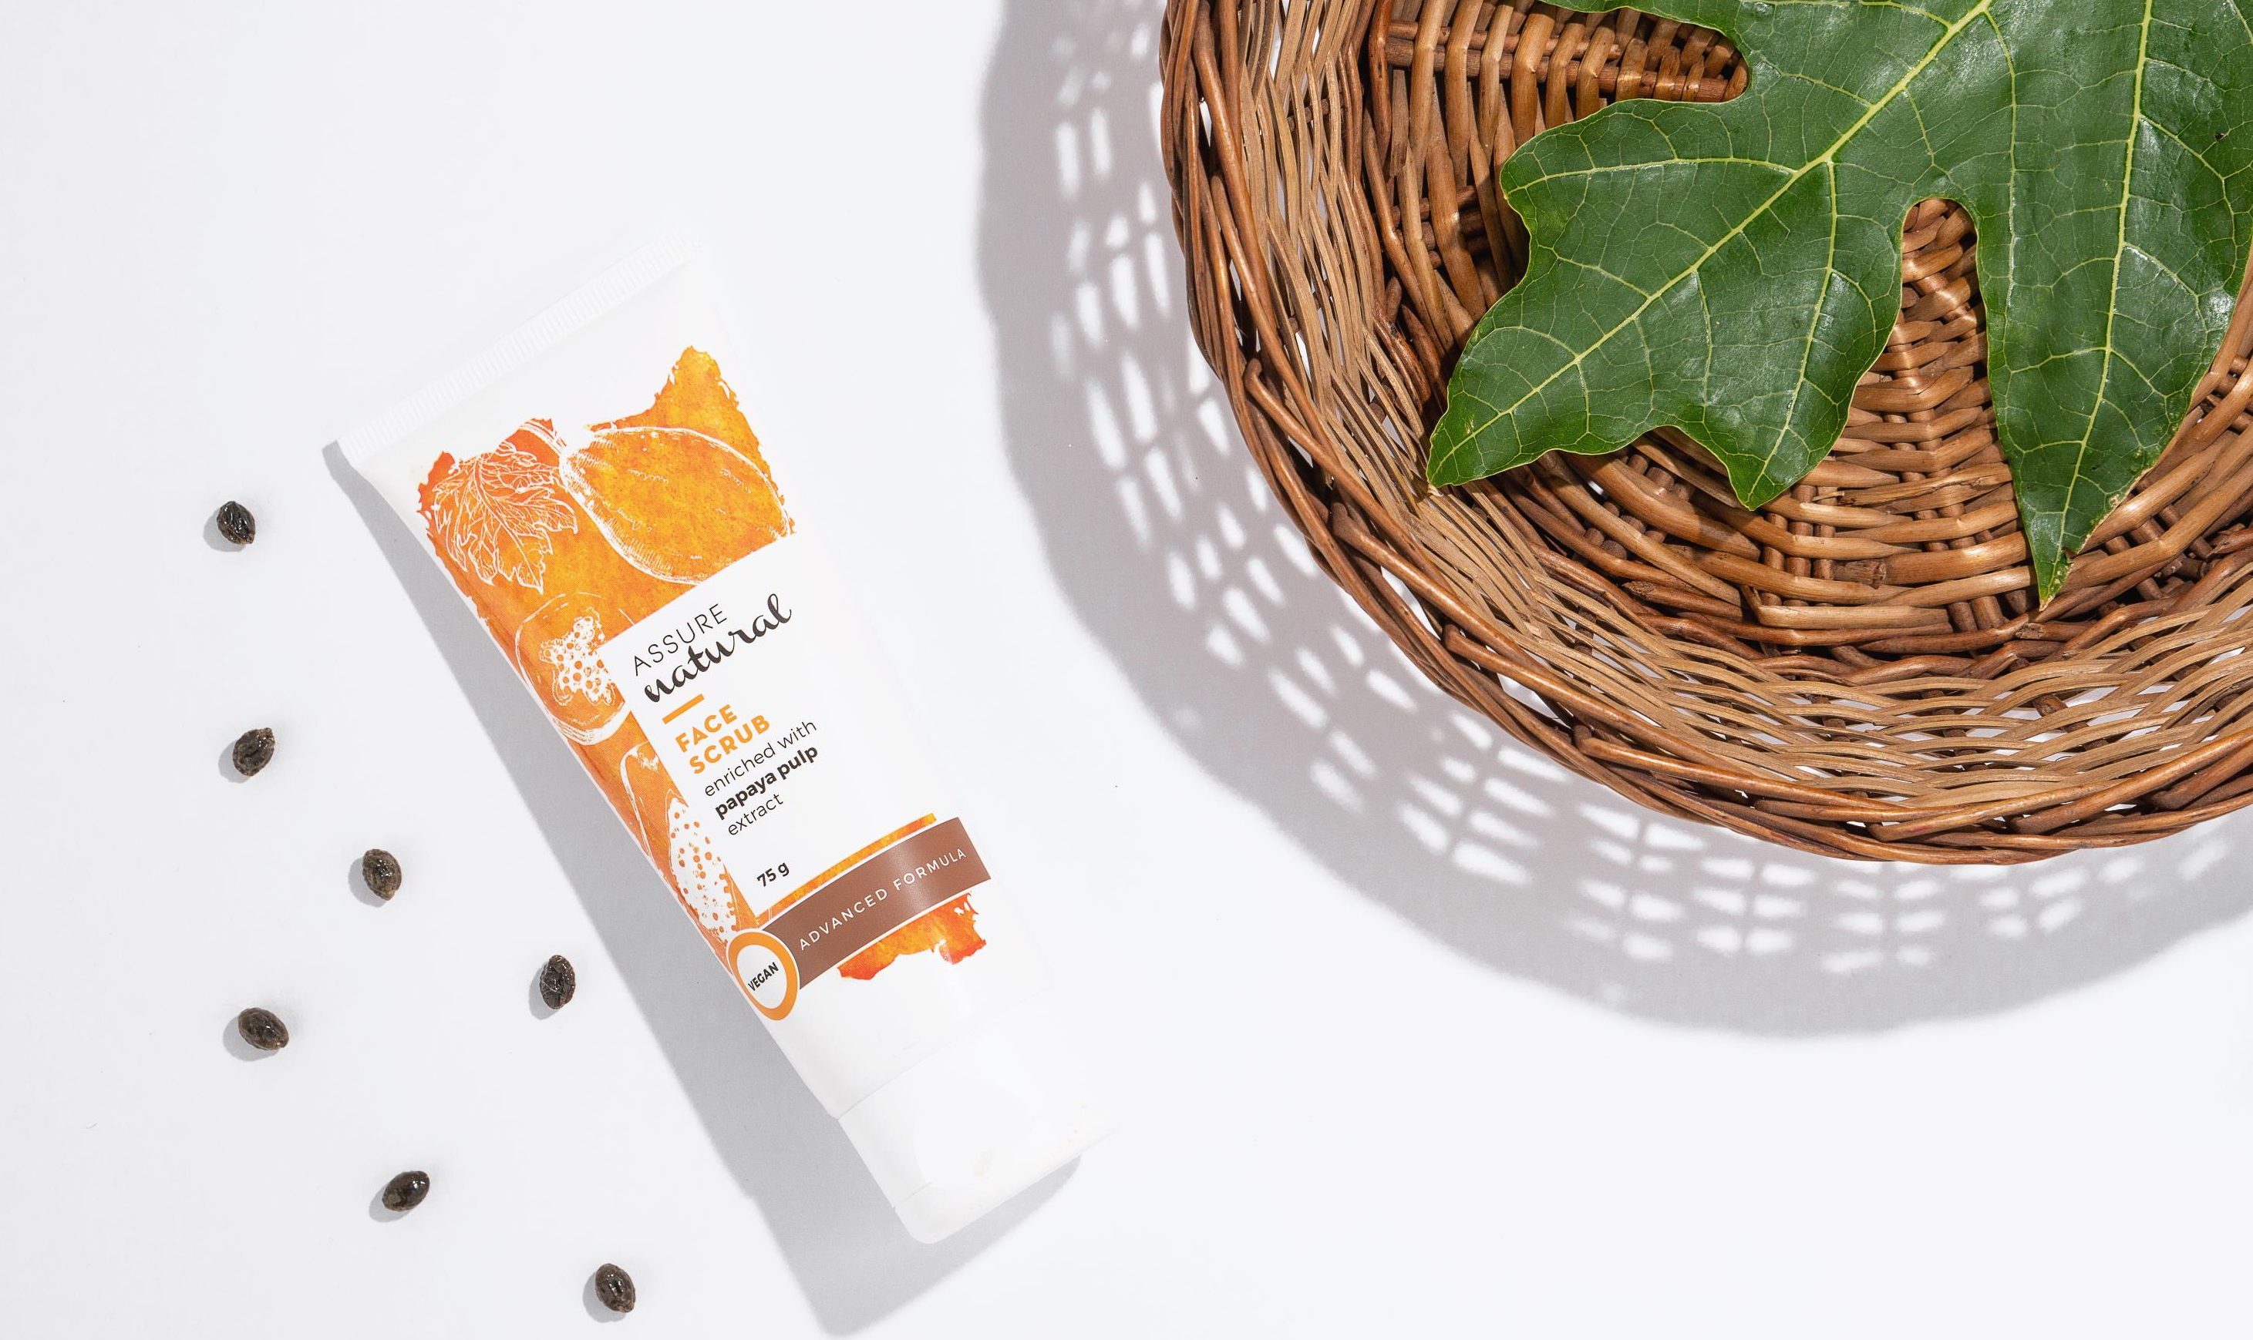

Slide 16

Ever wondered about the secret recipe for a glowing and beautiful skin?

Slide 17
Skin is the outer most layer of protection and most exposed part of the human body.
You may have a very rigorous regime of cleansing, moisturising, using night/day creams and sunscreens
But
Issues like dull skin, blackheads and lack of natural glow of the skin still remain and you keep on seeking the best solution for them…

Slide 18
Make way for new skin, everyday
Unclog pores from dirt, blackheads, dead skin and other surface impurities so that new, healthy skin may flourish.
Exfoliating helps sluggish skin turn over its top dermal layer more often, so you can address a multitude of problems such as flakiness or excess sebum.

Slide 19
What is a Face Scrub
A facial scrub uses small particles, beads, or substances to get rid of the old skin cells and make way for new ones in a process known as exfoliation.

Slide 20
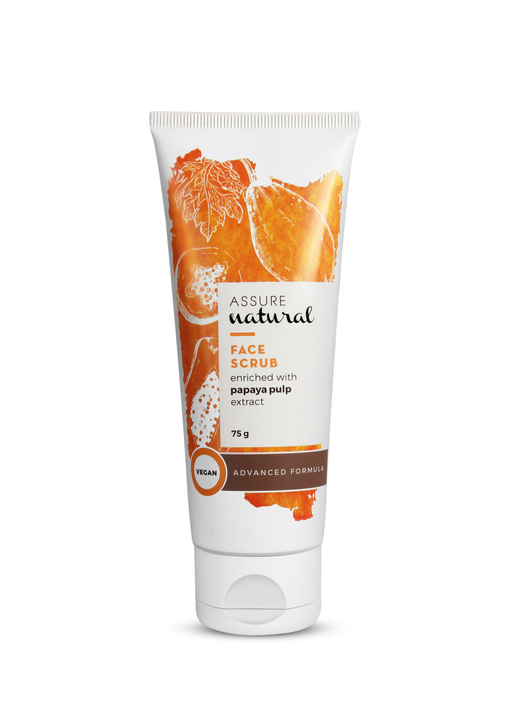
Assure Natural Charcoal Peel-Off Mask
MRP- Rs.310
DP- 265
BV- 159
PV- 8.33
Assure Natural Face Scrub
MRP- Rs.310
DP- 265
BV- 159
PV- 8.33

Slide 21
Assure Natural Face Scrub
Assure Natural Face Scrub is enriched with the goodness of real papaya extract, that gently removes dead skin cells and leaves the skin soft, supple and radiant.
It is rich in anti-oxidants, clears skin pigmentation and reduces dark spots.
It slows down the ageing process by retaining the required moisture of the skin.

Slide 22
Exfoliation of the skin can prevent many skin problems!
Removes dirt, dead skin and other impurities from the surface of the skin.
Promotes better absorption of other skincare products.
Reduces acne and breakouts.
Provides glow and improves texture of the skin.
Prevents premature ageing of the skin.
Prevents ingrown hair.

Slide 23
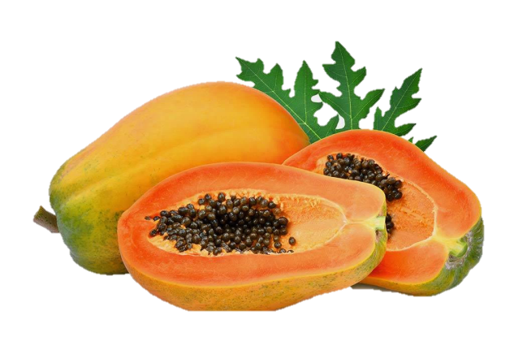
Assure Natural Face Scrub is enriched with Papaya extract and Agar
Papaya fruit extract helps to:
Remove dead cells and other impurities present in the skin.
Unclog pores and remove excess sebum.
Promote healing of sunburn.
Soothe irritated skin.
Agar : Softens and promotes moisture retention of the skin

Slide 24
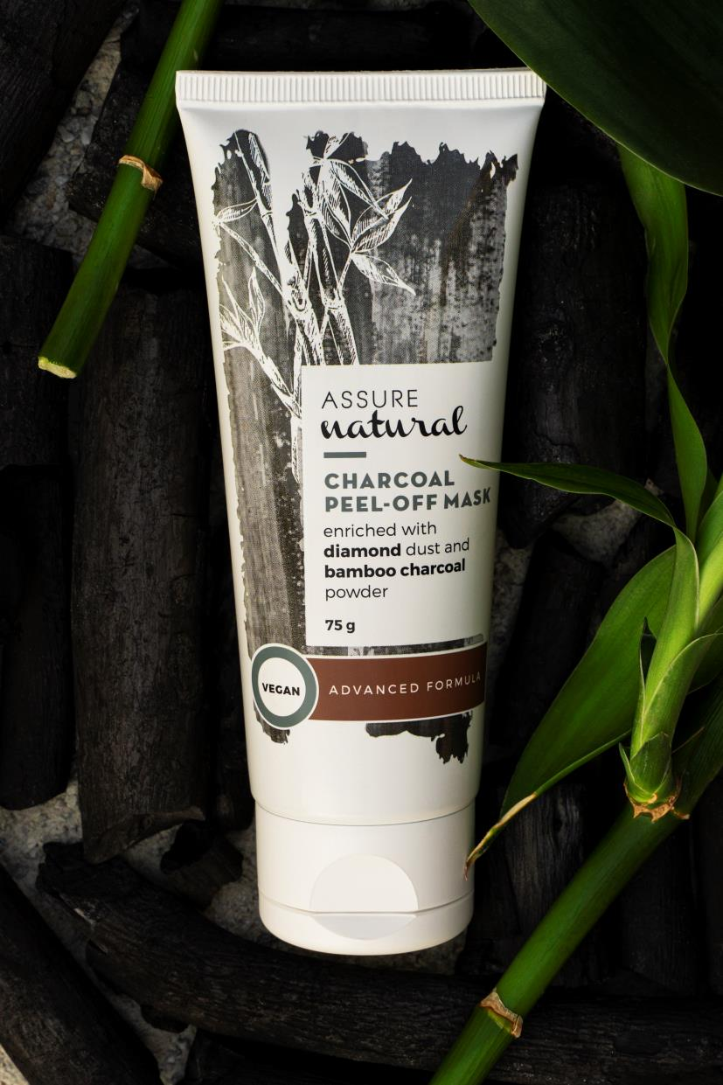

Slide 25
Beauty trends come and go, but face masks are here to stay. Peel-off face masks have multiple benefits.

Slide 26

A proper face mask routine
Get ready for a glowing skin – A proper face mask routine will take you there

Slide 27

Why Are Face Masks so Apeeling?
Banish the “bad.”
They are type of physical exfoliate, which means they remove the top layer of skin to slough away dead skin cells.
Look younger, feel better.
By visibly reducing pore size and revealing firmer skin.
Hydration:
Peel-off masks lock the cleansing components while they penetrate the deeper layers of the skin

Slide 28
Shoo away the shine.
Peel-off masks can alleviate the issue by helping to absorb excess oil from your skin, by unclogging and purifying your pores.
Cooling and soothing:
They may help reduce inflammation from particles in the air.

Slide 29
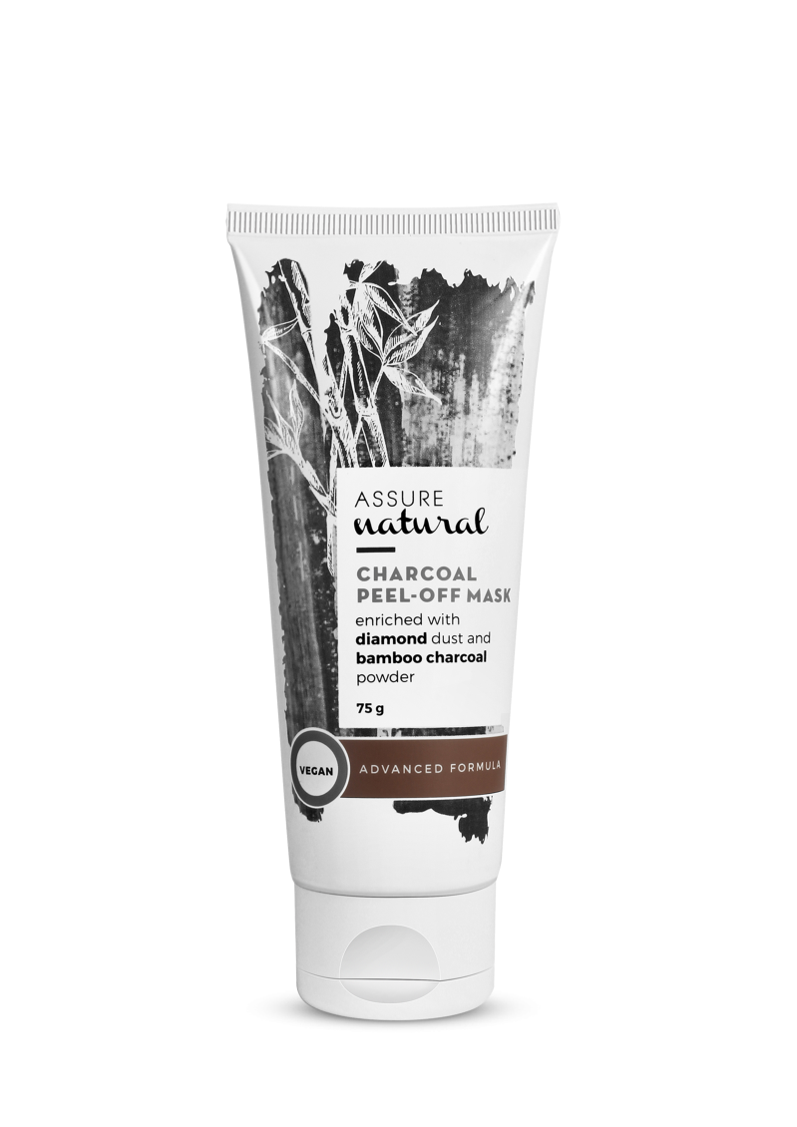
Assure Natural Charcoal Peel-Off Mask
MRP- Rs. 285
DP- 245
BV- 147.06
PV- 8.17

Slide 30
Assure Natural Charcoal Peel-Off Mask
Assure Natural Charcoal Peel-Off Mask is a detoxifying and skin-brightening formula.
It helps to pull out blackheads, dead skin, excess oil and improves the skin’s tone while adding youthful radiance.
It also repairs skin damage and increases hydration.

Slide 31
Assure Natural Charcoal Peel-Off Mask
is enriched with Bamboo Charcoal Powder and Diamond Powder

Slide 32
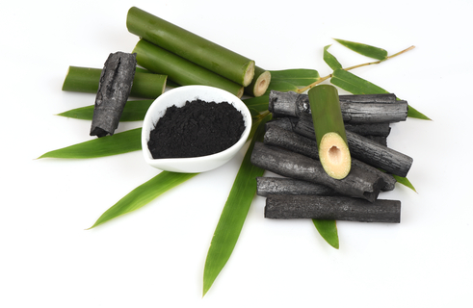
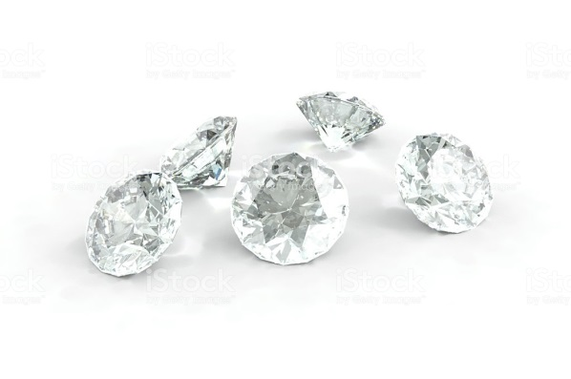
Benefits of key ingredients
Bamboo Charcoal Powder:
Removes impurities from the skin and reduces acne
Improves and increases skin hydration and repairs skin damage
Enhances overall skin complexion
Diamond Powder:
Evens out skin tone and improves complexion
Exfoliates dead skin cells and hydrates the skin
Prevents skin ageing

Slide 33
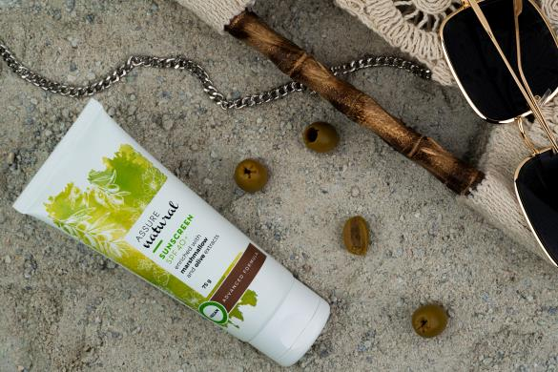

Slide 34
Sun, skin, and sunscreen
We all enjoy spending time in the sun.
Few consequences, besides sunburns, of overexposure to the sun are early skin ageing, skin cancer, and other skin problems.

Slide 35
How to detect sun damage?
Wrinkles: Associated with natural ageing. However, UV rays from the sun can actually cause up to 90% of skin ageing.
Age spots: They’re actually areas of extra pigmentation that result from overexposure to the sun
Red-brown patches: Include red-brown patches of scaly skin.

Slide 36
What else are the signs?
Sagging neck: Besides the face, sun exposure can also damage the skin around the neck and make the neck skin appear saggy and loose.
Chapped lips: UV rays can lead to chapped, dry, and scaly lips, affecting mainly the lower lip.

Slide 37
Two types of ultraviolet radiation, namely UVA and UVB, cause damage to the skin.
And these rays come in contact with your skin throughout the year, even when it’s cloudy or when you’re indoors.
Hence,
A broad-spectrum sunscreen with SPF is required!

Slide 38

So what is SPF
SPF or Sun Protection Factor is a measure of how much UV radiation is required to burn your protected skin as compared to the amount required by UV rays to burn your unprotected skin.

Slide 39
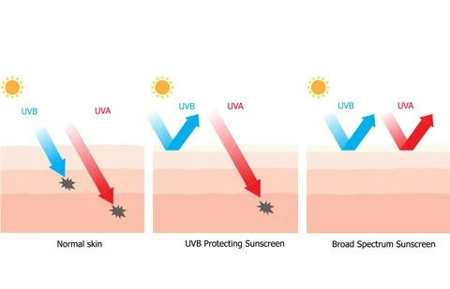
How SPF works?
UVA rays seep into the skin and reach its dermal layers. SPF in sunscreen absorbs or reflects these rays to protect the skin.

Slide 40
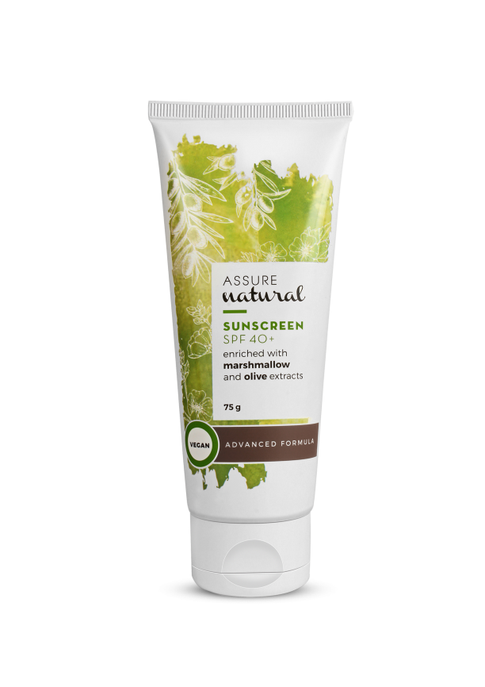
Assure Natural Sunscreen SPF-40+
MRP- Rs 510.00
DP- 435
BV- 261
PV- 14.50

Slide 41
Assure Natural Sunscreen SPF-40+
It is a hydrating, softening, and non-greasy daily sun-care cream with SPF 40+.
It protects against harmful UVA and UVB rays that causes tanning and sunburns
Prevents premature ageing or skin ageing and protects the skin proteins from damages
It is enriched with marshmallow and olive extracts that balance the skin and gives it a shine-free finish.

Slide 42
Assure Natural Sunscreen SPF-40+ is enriched with
Marshmallow &
Olive extracts

Slide 43
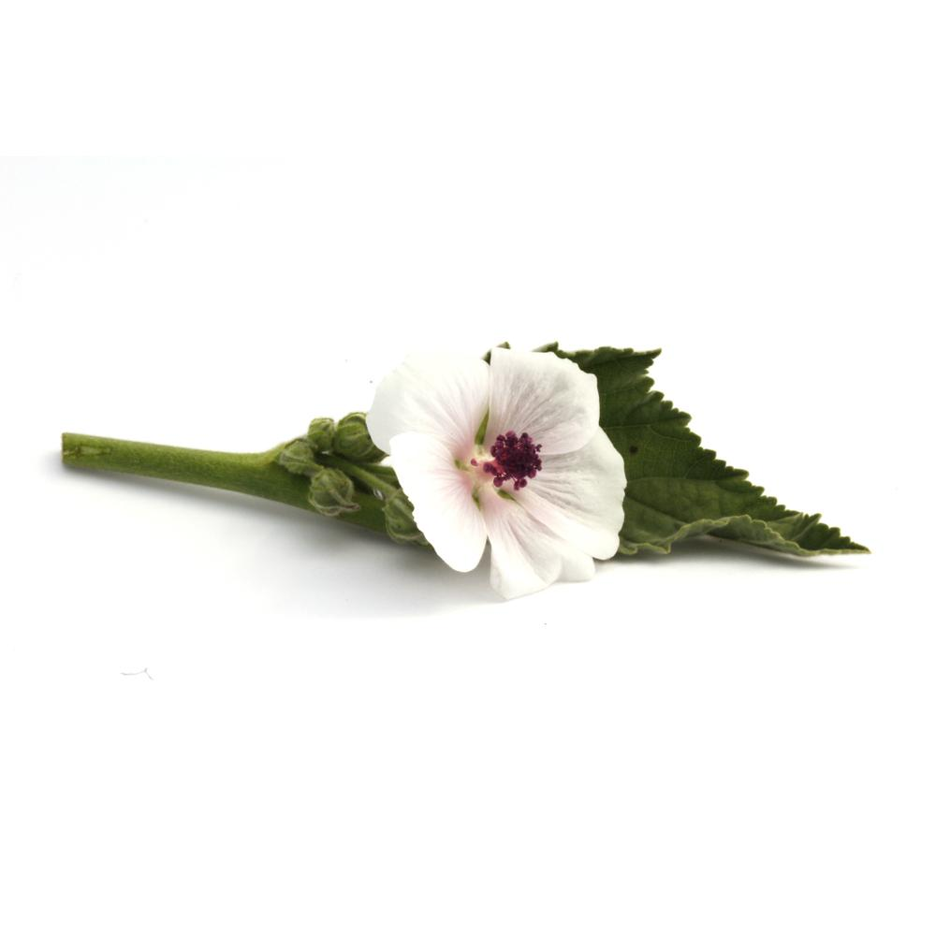
Marshmallow root extracts
Provide relief from itching, swelling, redness, and chaffing due to its emollient and soothing properties.
The roots of the marshmallow plant secrete mucilage, which helps to soften the skin, reduces swelling, and kills bacteria.

Slide 44
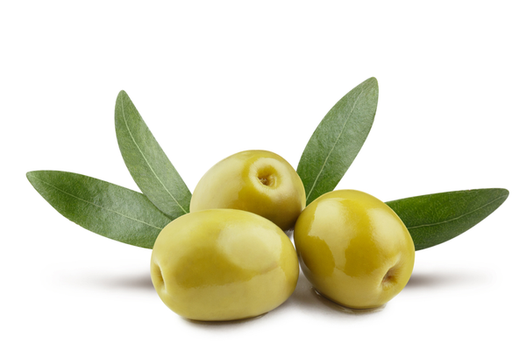
Benefits of Olive
Prevents the oxidative damage involved in the formation of wrinkles and in skin hyper-proliferation and dryness.

Slide 45
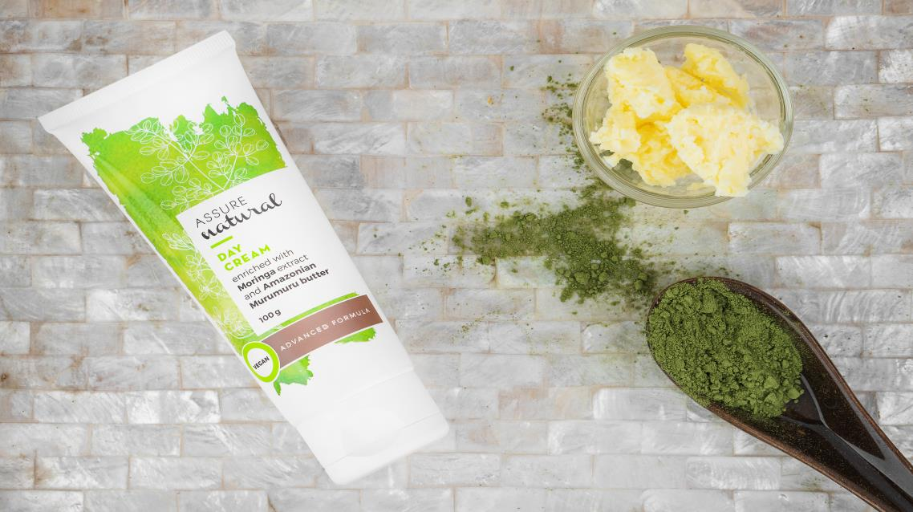

Slide 46
Every day in a woman’s life is different and has its own rhythm and that’s why you need regular skin care.
During the day, your skin needs protection from environmental influences.

Slide 47
During the day, your facial skin needs moisture and protection:
Day cream hydrates the skin and works like a protective shield against environmental influences.
Day creams with antioxidants neutralise free radicals and protect the skin’s cells from oxidative stress.
They add a fresh and smooth glow to the skin.

Slide 48
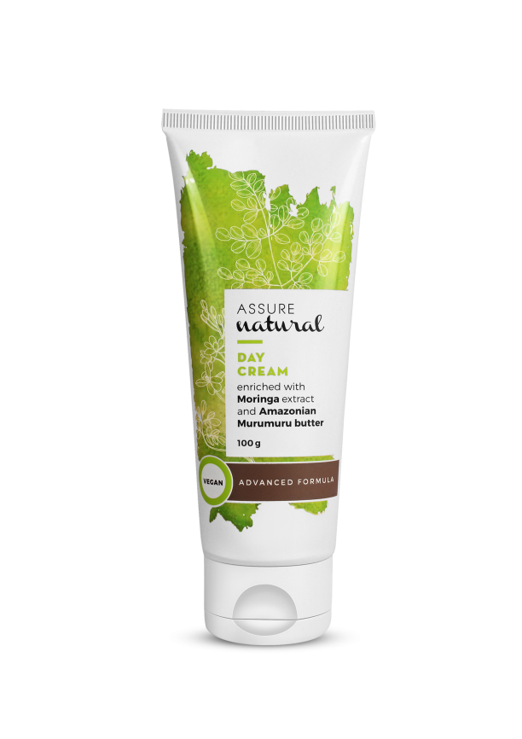
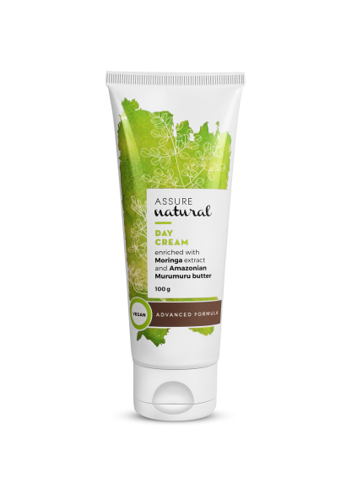
Assure Natural Day Cream
MRP Rs. 360
DP- 310
BV- 185.94
PV-10.33

Slide 49
Assure Natural Day Cream
Assure Natural Day Cream is a lightweight and fast-absorbing moisturising cream with Moringa and Amazonian Murumuru butter extracts.
It regenerate cells and provide long lasting hydration, making the skin smooth, soft and radiant.

Slide 50
Assure Natural Day Cream enriched with
Moringa extract &
Amazonian Murumuru butter

Slide 51
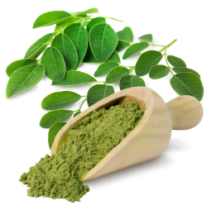
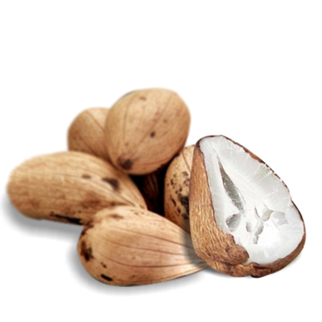
How Moringa and Amazonian Murumuru seed butter are beneficial for the skin?
Moringa leaf extract:
Rich in antioxidants , it helps in reducing wrinkles and blemishes. It also rejuvenates dull and dryb skin.
Amazonian Murumuru seed butter :
Provides hydration and nourishment
Less likely to clog pores
Reduces signs of ageing, such as wrinkles and fine lines

Slide 52
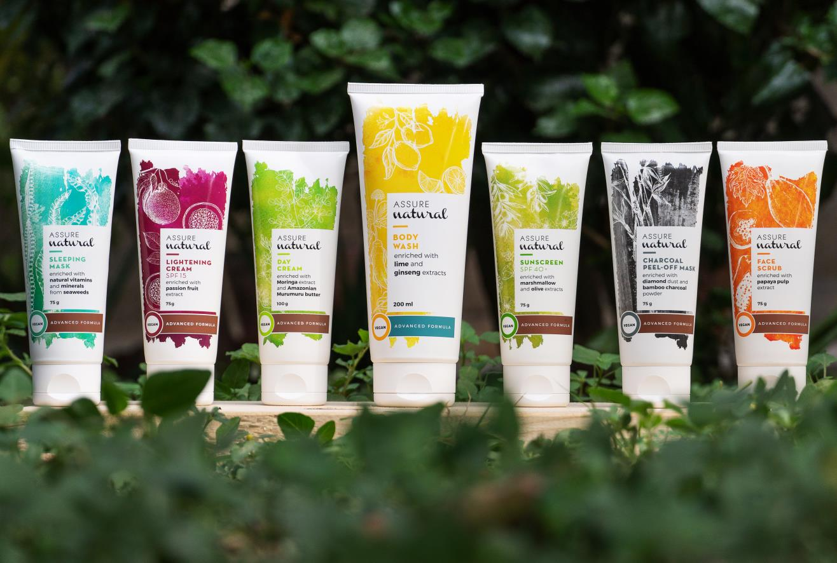

Slide 53
Everyone wants a flawless, younger-looking and radiant skin
Unfortunately, the increased exposure of our skin to pollution, harsh weather conditions and sun rays can lead to dull, dry and blemished skin.

Slide 54
Hence,
There is a need for a solution that will reduce the pigmentation and treat skin problems such as age spots, acne scars, or discolouration related to hormones, etc.

Slide 55
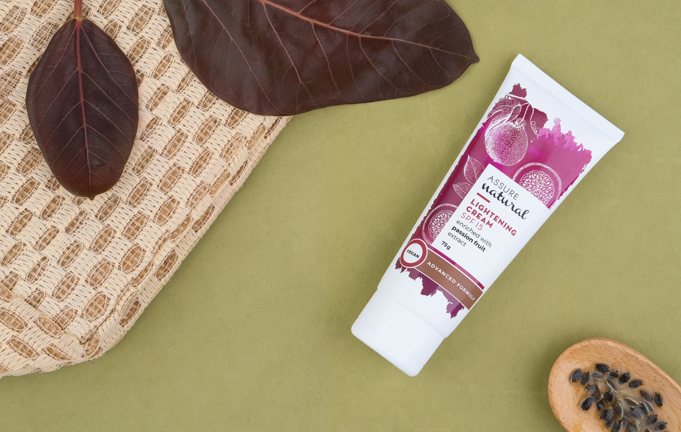

Slide 56
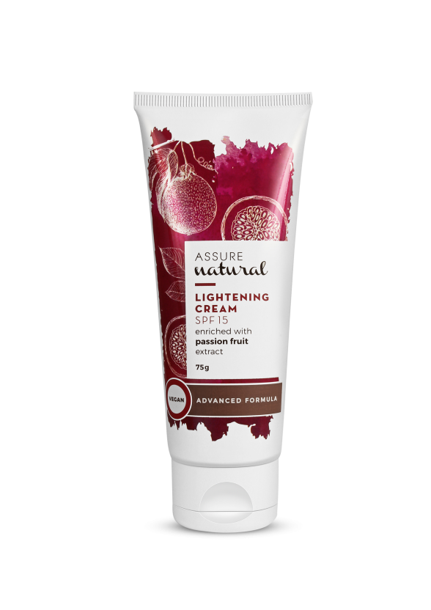
Assure Natural Lightening Cream SPF 15
MRP Rs. 425
DP- 360
BV- 216
PV-12

Slide 57
Assure Natural Lightening Cream SPF 15
Assure Natural Lightening Cream SPF 15 increases hydration, restoring the skin's structure and combats oxidative stress that causes premature ageing and dark spots.
Enriched with passion fruit extract, which is high in Vitamin C and antioxidants, it keeps the skin firm and youthful.
It is a great source of Vitamin A in the form of carotenoids, which helps reduce the appearance of fine lines and wrinkles.

Slide 58
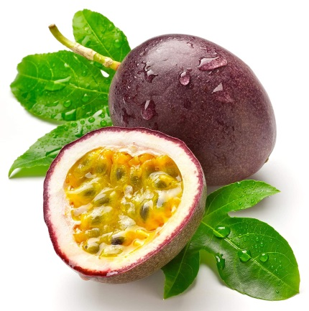
Assure Natural Lightening Cream SPF 15 is enriched with Passion Fruit extract & Seed oil
Rich in antioxidants it provides protection from free radicals
It helps to minimise dark spots and acne scars leaving a radiant skin
Evens out the skin tone by reducing the melanin pigmentation in the skin
Gives glowing, soft skin with less blemishes
Provides nourishment to skin and helps in keeping skin firm & youthful

Slide 59
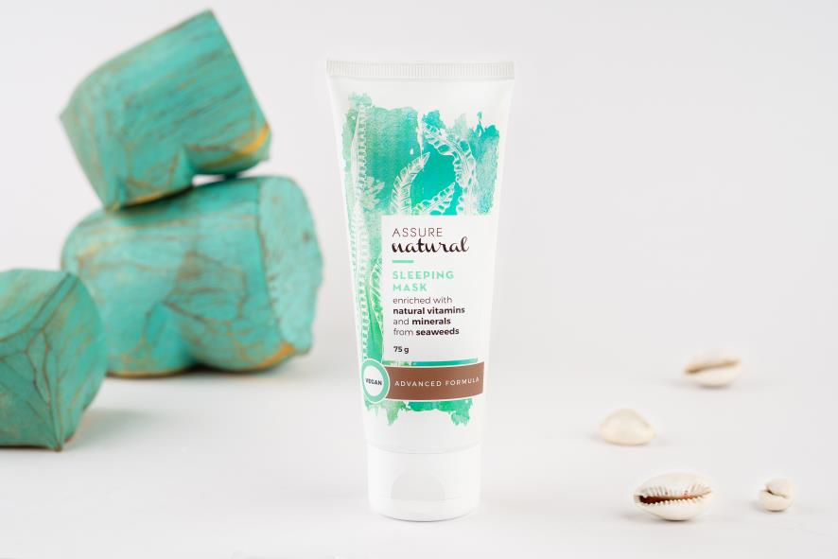

Slide 60
Going to bed is arguably the best part of the day, but won’t it be even better if your skin can recharge at the same time?
The skin does a lot of repairing and regeneration when we sleep.

Slide 61
Therefore, there is a magical product called sleeping mask.
Sleep masks work overnight to repair and replenish skin when it needs it the most, without any effort on your part.

Slide 62
Cover your face in a mystic mask before you go to bed
&
As the mask is absorbed, the active ingredients are slowly released throughout the night to give your skin the ultimate pampering.

Slide 63
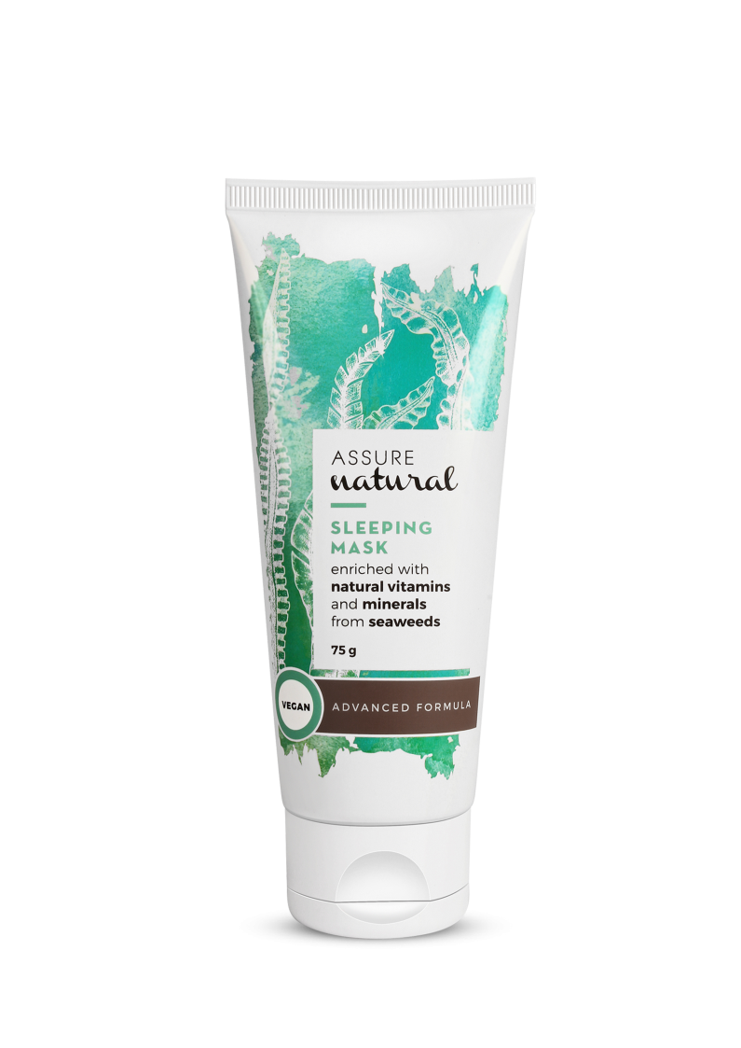
Assure Natural Sleeping Mask
MRP- Rs. 540
DP- 460
BV- 275.94
PV- 15.33

Slide 64
Assure Natural Sleeping Mask
Assure Natural Sleeping Mask is an overnight rejuvenating face mask.
Enriched with seaweed extracts, that naturally detoxify and replenish the lost moisture content of the skin.
Helps to make the skin radiant, hydrated and youthful. It helps to soothe and soften the skin, and reduce skin sensitivity.

Slide 65

How are seaweeds beneficial for the skin?
Seaweed is full of humectants that draw in moisture from the environment and also full of vitamins and minerals
Provides ultra hydration
Naturally cleanses and purifies the skin
Provides Nourishment
Has anti-ageing properties
Helps in reproducing new healthy skin cells
Has skin healing properties

Slide 66
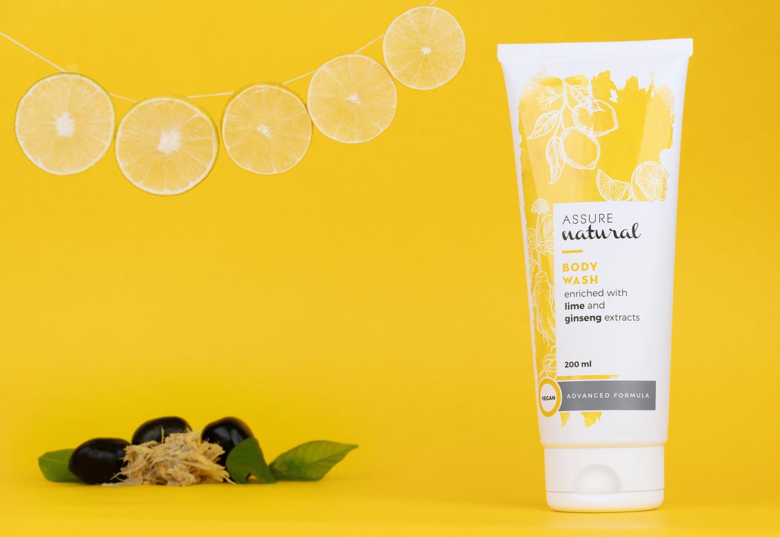

Slide 67
A hot and aromatic bath can do more than just get you clean — it helps wash away stress, relax tensed nerves and makes you happier!
It helps you to reduce stress and makes you feel good about yourself.

Slide 68
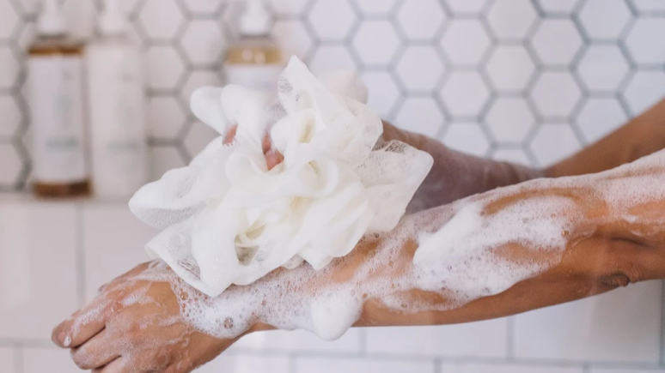
For a rejuvenating bathing experience, use a body wash that gives a relaxing time.
They are rich in emollients that provide moisturisation and softness to the skin.

Slide 69
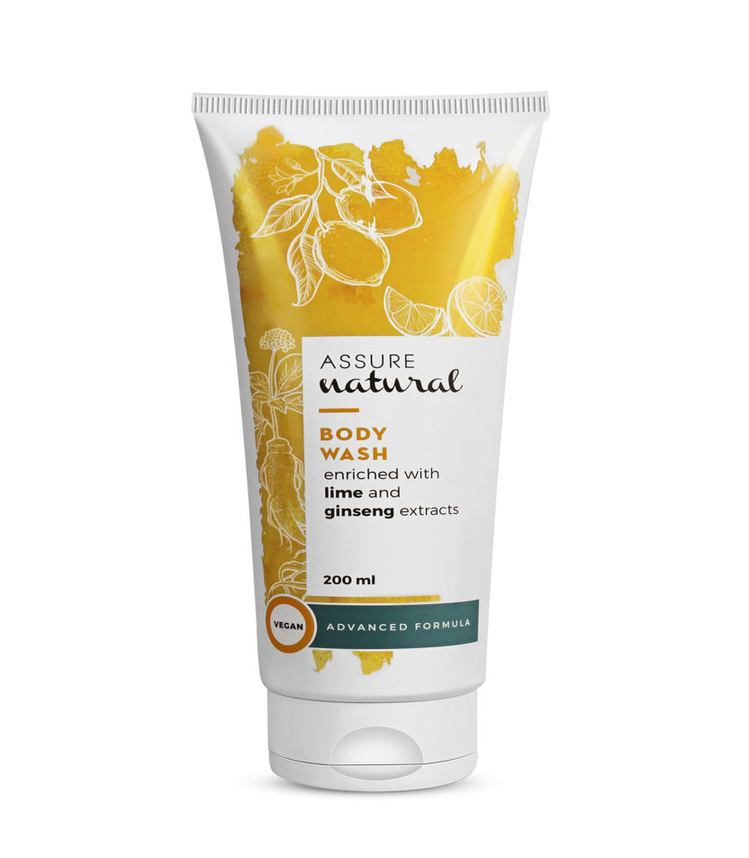
Assure Natural Body Wash
MRP- Rs. 560
DP- 480
BV- 302.4
PV- 16.8

Slide 70
Assure Natural Body Wash
Assure Natural Body Wash is enriched with Siberian ginseng root and lime extracts, laden with antioxidants and Vitamin C.
It helps in rinsing away daily impurities while keeping your skin smooth, soft, nourished and hydrated.

Slide 71
Assure Natural Body Wash is enriched with Siberian Ginseng root extract and Lime fruit extract

Slide 72
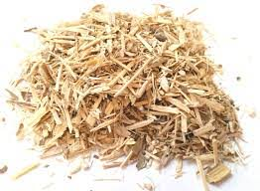
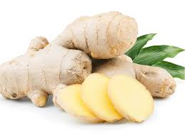

Skin Benefits of key ingredients
Siberian Ginseng root is:
Rich in antioxidants which protect against ageing
Helpful in reducing skin dullness
Known for its soothing properties
Ginger is :
Rich in antioxidants
Known to rejuvenate the skin
Lime fruit extract is:
Rich in antioxidants
Known for its skin lightening and smoothening properties

Slide 73


