Slide 2
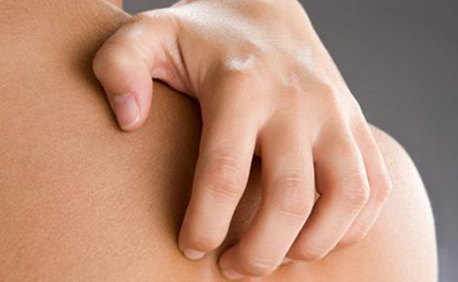
Why do we need a Hand & Body Lotion?
The skin loses moisture during the course of the day, which needs to be replenished
Our body, especially hands are generally exposed to harsh conditions, like washing hands with harsh soap many times a day, making the skin much drier, even cracked, leaving the skin lifeless and dry
Hand and body lotion rebalances and restores the skin of essential moisture and glow
It keeps the skin hydrated
Maintain the elasticity of the skin, making it tight and soft and avoiding sagging

Slide 3
Introducing ASSURE HAND & BODY LOTION
Enriched with Natural Olive Oil

Slide 4
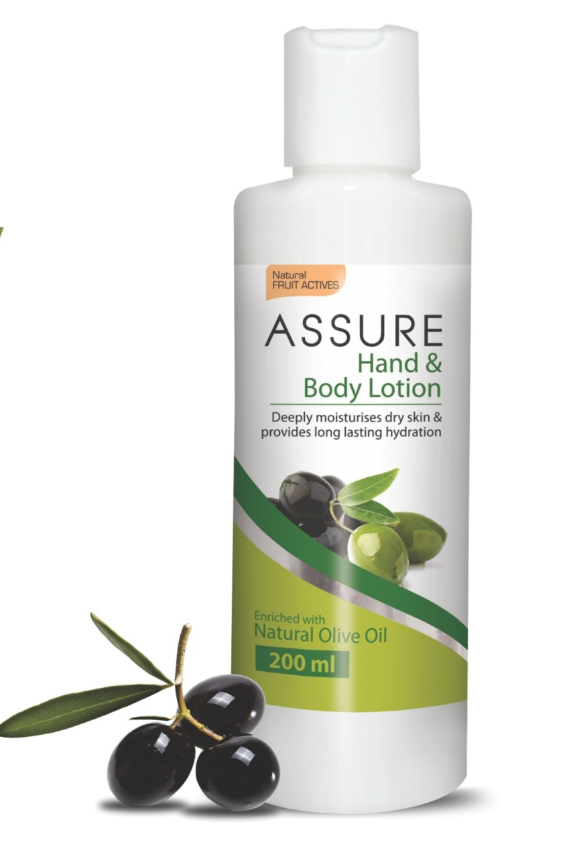
Assure Hand & Body Lotion The Product
Assure Hand and Body Lotion enriched with rich moisturisers yet light weight formula that deeply nourishes dry and lifeless skin, absorbs easily into the skin, giving it a radiant glow and all day hydration
Its soft flowery scent invigorates the senses and keeps the skin refreshed all day

Slide 5
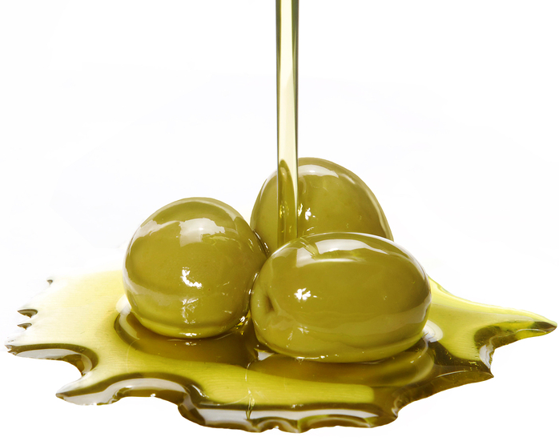
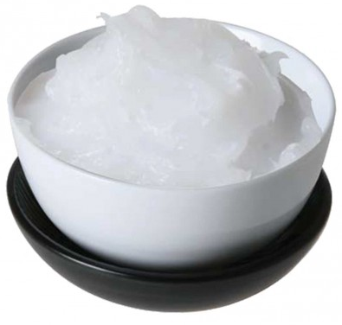
Assure Hand & Body Lotion The Performance
A blend of nourishing moisturisers, this lightweight lotion leaves skin soft and lightly scented all day
It is enriched with natural moisturising agents:
Olive Seed oil - provides deep nourishment to dry skin leaving skin feeling smooth and silky. Rich in Vitamin E and antioxidants helps prevent premature aging of skin
Petroleum Jelly - An oil-based emollient, smooth and protect rough and dry skin
It works by creating a sealing barrier between cells, which locks in moisture and speeds up skin’s natural recovery from dryness, helping it heal from within

Slide 6
Assure Hand & Body Lotion The Benefits
Locks in moisture to provide all day hydration
It deeply nourishes the skin and helps restore skin’s natural oils
Hydrates the skin and gives a radiant glow
Keeps the skin soft and supple without greasy feel
Its light and oil-free formula absorbs easily into the skin
Helps prevent dryness
Suitable for all skin types
Light flowery scent rejuvenates the senses

Slide 7
What is the difference between Daily Moisturiser and Hand & Body Lotion?
Assure Daily Moisturiser | Assure Hand & Body Lotion
It is meant for the face and neck | It is for the rough hands and body
Skin of the face is thin and delicate | Skin of the hands and body is thicker, therefore needs different treatment
We take extra care when applying anything on face, like using a milder face wash to wash the face only once or twice a day | The body skin is exposed to harsher conditions than the face, like washing hands with soaps several times a day. This cumulative effect on the hands can cause them to dry and cracked and therefore need a rich moisturiser
Assure Daily Moisturizer is a light lotion containing light oils such as sunflower and olive that absorbs easily into the skin. They match the skin oils closely and perfect to replenish lost face moisture. | Assure hand & body lotion is a rich moisturizer that provide a barrier around the skin to lock moisture into the skin of hands and body against harsh conditions

Slide 8
Assure Hand and Body Lotion The Application
Use daily on hands, arms, legs, back and front, to help prevent and relieve dry skin
For best results, apply everyday after bathing and hand washing

Slide 9
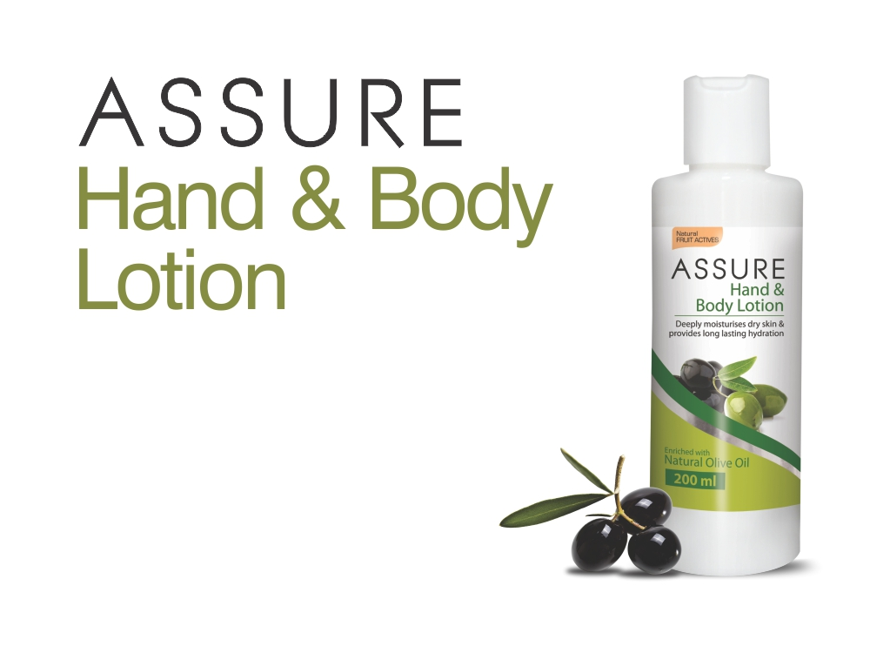
MRP Rs. 210/-
DP Rs. 180/-
BV 108

Slide 10
THANK YOU Team VESTBuy

