Slide 1
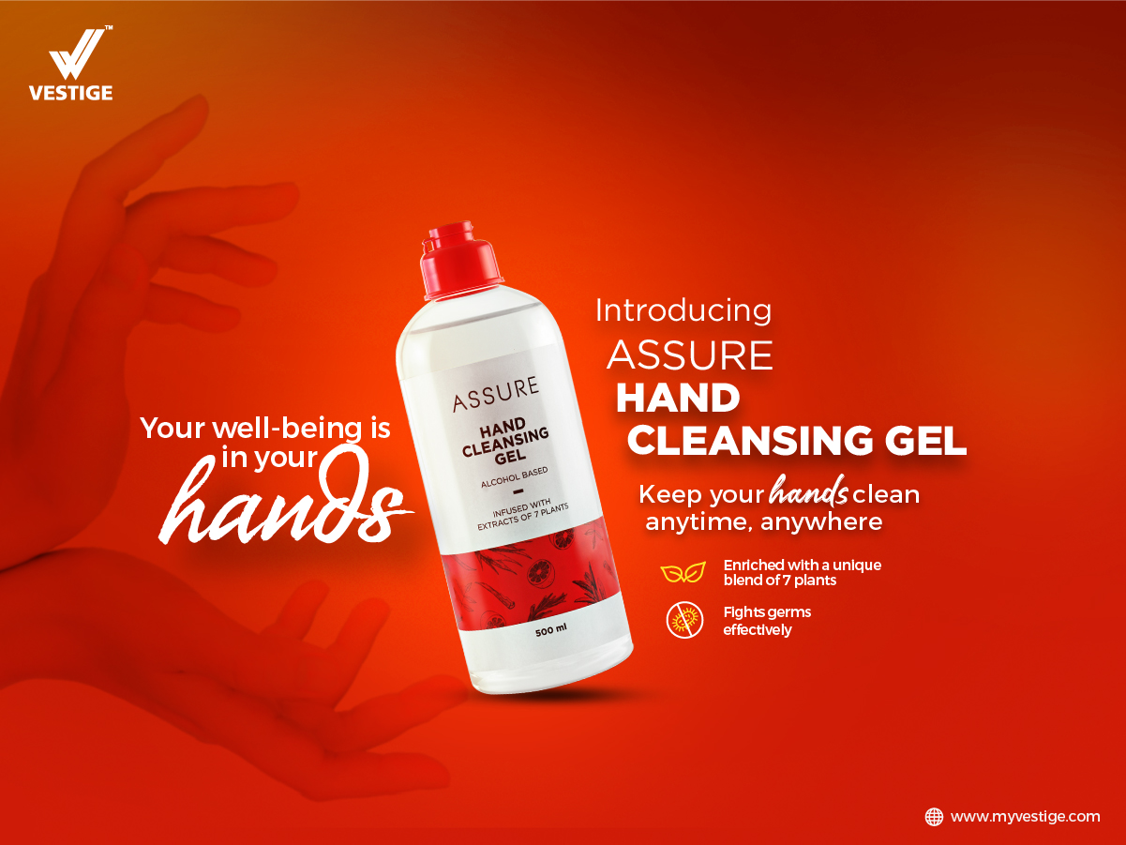

Slide 2


It’s said that your good health is in your hands!
To maintain proper hygiene and safeguard yourself, it’s important that your hands remain germ-free and sanitised.

Slide 3
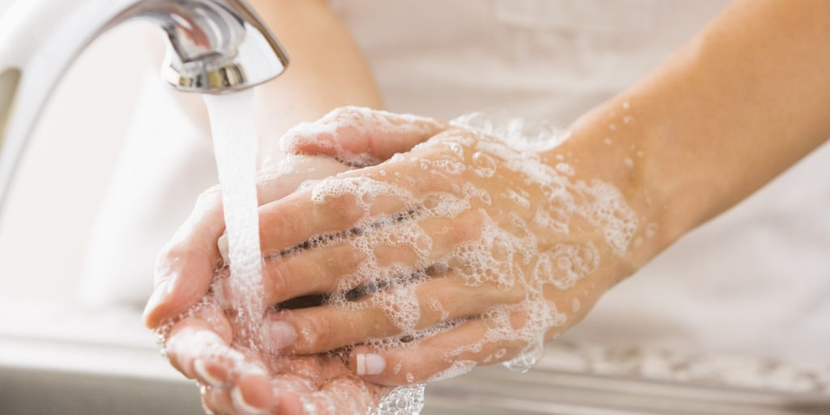

At present, globally people are inculcating new hygiene habits. A part of the new normal is washing and disinfecting our hands very frequently
&
This is a lasting behavioural change in us.

Slide 4
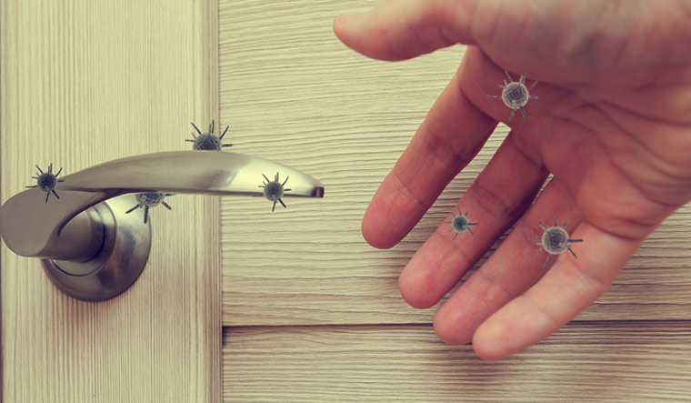
Knowingly and unknowingly, we touch many surfaces at public places which can potentially expose us to germs.
Water and soap are not readily available at public places. Clean hands are important to your health and they prevent the spread of infections from one person to the next.

Slide 5

Introducing Assure Hand Cleansing Gel,
a unique product which helps to keep your hands clean and safe anywhere, anytime!

Slide 6
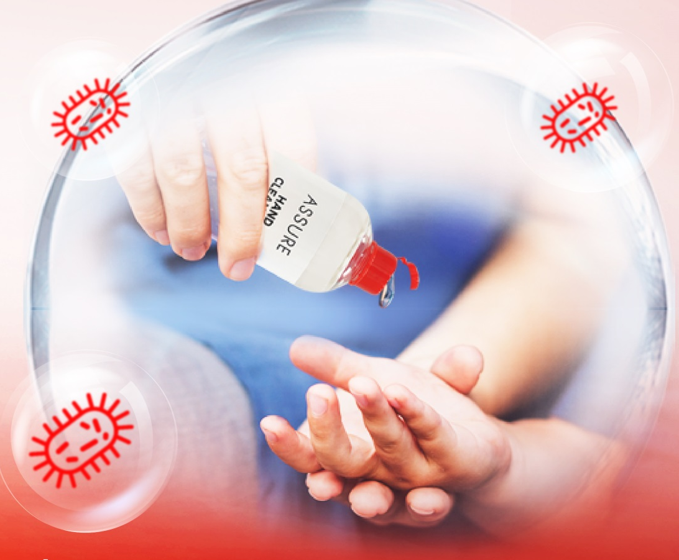
WHAT IS ASSURE HAND CLEANSING GEL?
It is a delicately-perfumed gel for soap-free and water-free cleansing. It conceals odour and leaves your hands soft and clean without washing. It dries fast and does not leave a sticky layer on the skin.

Slide 7
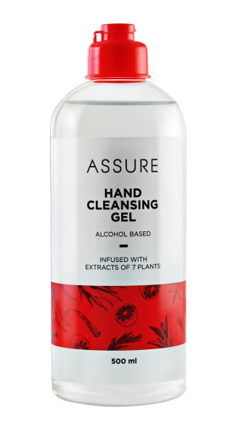
PRESENTING
ASSURE HAND CLEANSING GEL
Assure Hand Cleansing Gel is an alcohol-based gel, which helps in cleansing germs. Enriched with a unique blend of seven plants, it acts fast and helps to prevent infections.
To use, squeeze a thumbnail-size amount in your palm then briskly rub hands together until dry.
It is an on-the-go, rinse-free and non-sticky instant hand protection solution.

Slide 8
ASSURE HAND CLEANSING GEL IS A 70% ALCOHOL-BASED HAND CLEANSING GEL
Alcohol is known to act on germs and viruses by breaking apart proteins.
Alcohol kills a broader variety of bacteria and viruses when the concentration exceeds 60%, and it works faster as the concentration increases. Maximum efficacy is reached at 90-95% concentration.
Germs and viruses don't develop a resistance to it, so alcohol doesn't lose effectiveness with continued use.

Slide 9
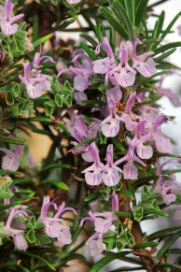
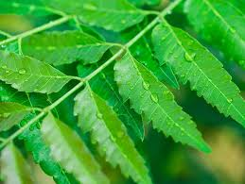
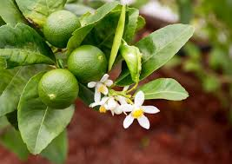
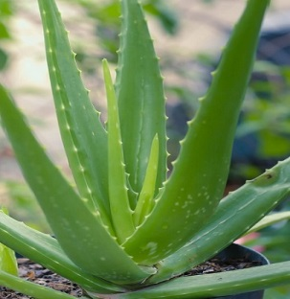

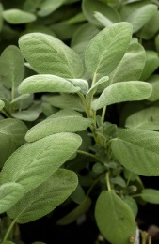
ENRICHED WITH SEVEN HERBS WITH UNIQUE QUALITIES
Lime juice: It has curative properties and acts as a natural antibiotic.
Rosemary leaf oil: It is used as a disinfectant.
Neem leaf extract: It is one of the best healing and disinfectant agents.
Sage oil: It has antiseptic and antibacterial properties
Aloe leaf juice powder: It helps to relieve pain, reduce swelling and quell itching.
Thyme oil: It is used for its antiseptic properties.
Vetiver root oil: It has mostly protective activity as well as soothing benefits.

Slide 10
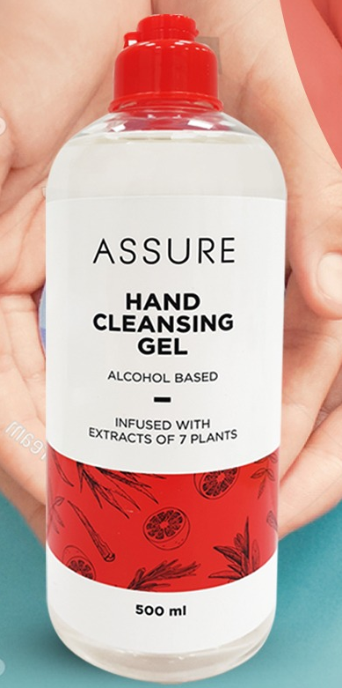
ANYWHERE ANYTIME HAND SANITISATION
Assure Hand Cleansing Gel kills a wide range of germs instantly, without water. Use anytime, anywhere - while in a car, at office, when travelling, after playing, etc.
Leaves your hands clean and germ-free. Use as often as required.

Slide 11

Assure Hand Cleansing Gel is
a convenient, portable and easy to use germ protection solution for hands. It also prevents skin dryness and is irritation free.
Assures healthy, happy hands.

Slide 12
CAUTION
DIRECTIONS FOR USE
Take a little amount, spread and rub on the palms and on the back of hands and fingertips until it dries.
Keep away from heat/sparks/open flames/hot surfaces.
Keep the container tightly closed.
Keep out of reach of children.
For external use only.

Slide 13
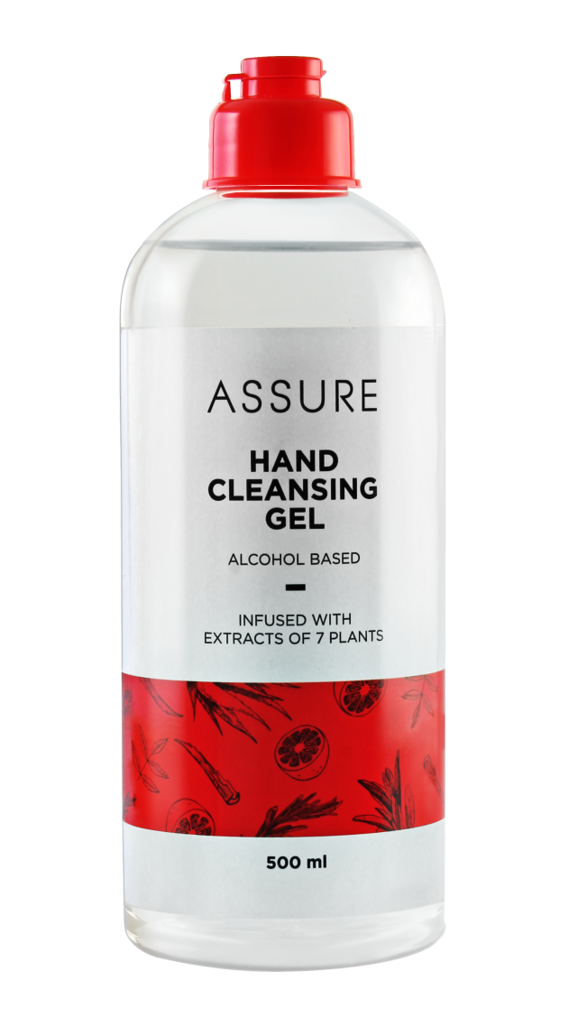
ASSURE HAND CLEANSING GEL
MRP- Rs 340
DP- Rs 290
PV- 8.06

Slide 14


