Slide 2
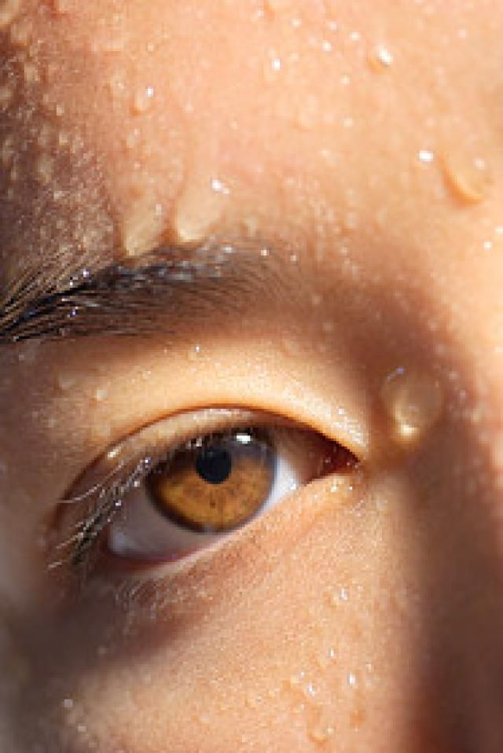
SWEAT
We sweat a lot everyday, but most of it evaporates and we do not realise.
Sweat is odourless.
It is a clear liquid mostly made up of water, salt proteins and oils.
The smell that we call ‘body odour’ is caused by bacteria breaking down protein and oils, releasing the odour.
Body odour can be defined as the unpleasant smell that is created every time we sweat.
Body odour can be prevented with the help of few simple personal hygiene steps.
Perfect Pocket Companion

Slide 3
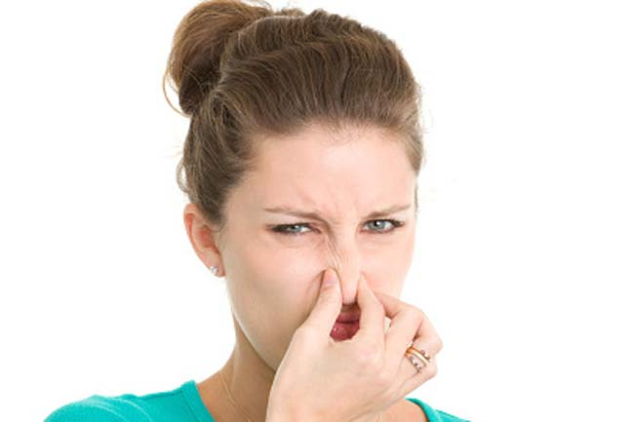
WHAT CAUSES BODY ODOUR?
Body odour does not originate from sweat.
The smell arises because of bacteria that break down the sweat into aromatic fatty acids, which give birth to the unpleasant body odour.
Sweating is body’s natural technique of regulating body temperature.
As sweat evaporates, it takes the heat away from the body helping it cool down.
To help achieve this, the body has more than 4 million sweat glands.
Perfect Pocket Companion

Slide 4
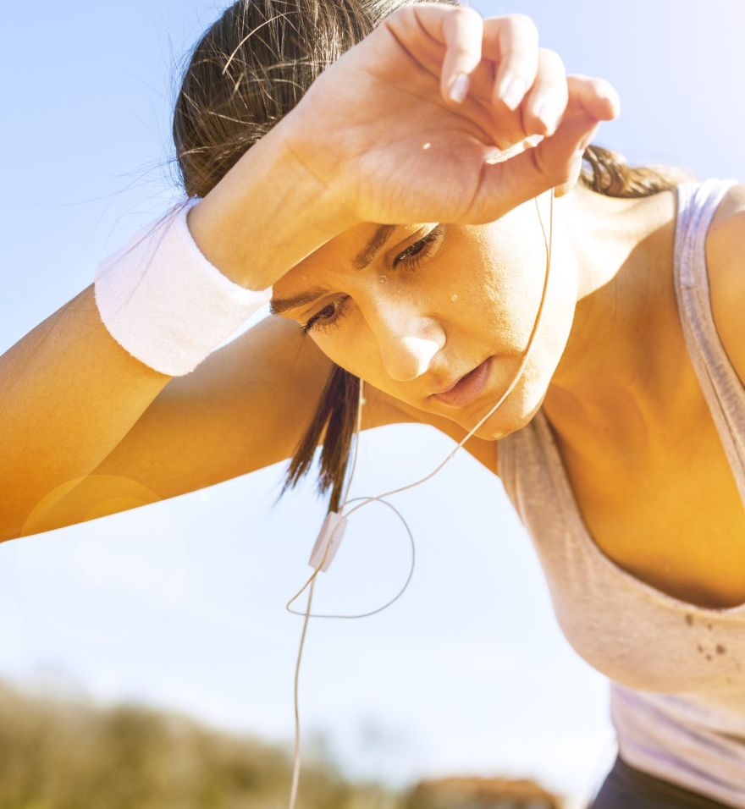
FACTORS AFFECTING BODY ODOUR
Warm environment
General movement and physical activities
Emotional feelings, including stress
Eating hot or spicy food
Side effects from medication or surgery
Illness or fever
Hormonal changes such as menopause, pregnancy, menstruation or puberty
Perfect Pocket Companion

Slide 5
HOW TO PREVENT BODY ODOUR?
Change clothes regularly, wash them regularly and replace them if required.
Mixing disinfectant to wash can help in getting rid of bacteria.
Apply deodorant under your armpits after bathing.
Keeping armpits hair-free allows sweat to evaporate quickly, giving bacteria less time to evolve.
Wear natural and breathable fabrics like wool, silk or cotton.
Take it easy when it comes to garlic and spices in the food.
Perfect Pocket Companion

Slide 6
ASSURE BLOSSOM
It has a floral fragrance which helps to mark your day with confidence.
Its sparkling floral note with a blend of jasmine keeps you natural and refreshed all day long.
Stay ahead of all with this mesmerising floral aura.
Perfect Pocket Companion

Slide 7
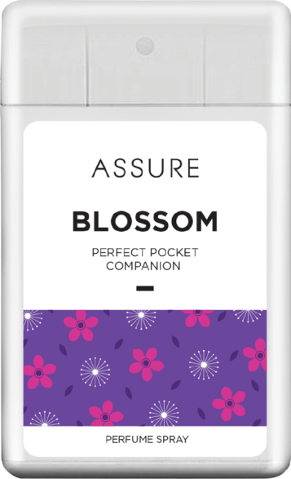
ASSURE BLOSSOM- Benefits
Easy to carry
Anytime available
Anywhere available
Long day freshness
Easy to use
Perfect Pocket Companion

Slide 8
ASSURE BLOSSOM
MRP Rs 100.00
DP Rs 85.00
BV 51
PV 2.83

