Slide 1
Reap The Business of Success

Slide 2
INTRODUCING 4 NEW ADDITIONS IN VESTIGE AGRI

Slide 3
AGRI BIOFUNGICIDE

Slide 4
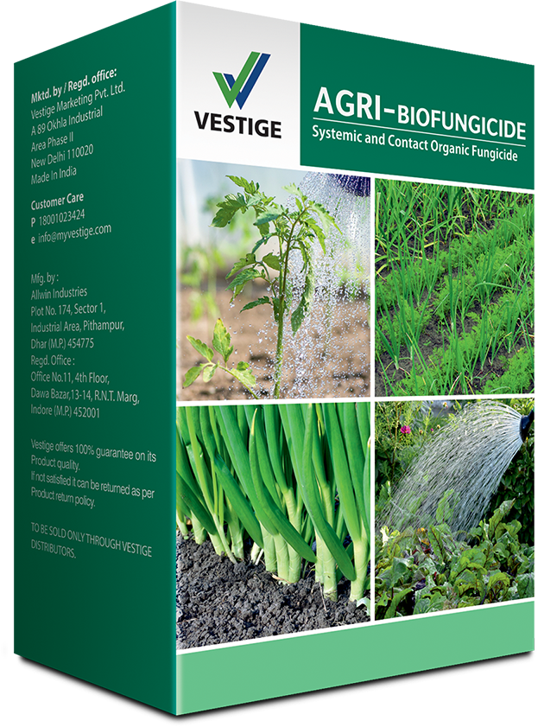
AGRI BIOFUNGICIDE
Agri-Biofungicide is a unique formulation of systemic and contact, organic fungicide
It multiplies fast on root exudates, produces antibiotics and enzymes that kills the pathogens in the rhizosphere and protects the host plant
It contains conidial spores, mycelia fragments and vegetative cells
It controls most fungal diseases of different crops

Slide 5
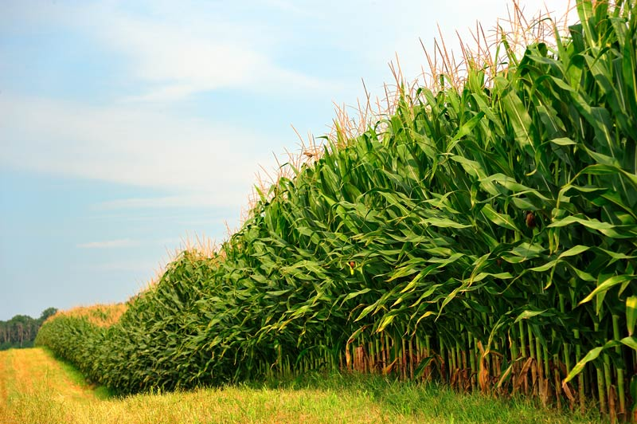
ADVANTAGES OF AGRI BIOFUNGICIDE
It can be used for organic Agriculture
The method used in formulation of Agri- Biofungicide is superior to other products available in market
It improves crop yields and quality of produce by keeping the crops disease free
It is eco-friendly and maintains the ecological balance of the soil
It is harmless to the environment, does not create resistance and residue problem

Slide 6
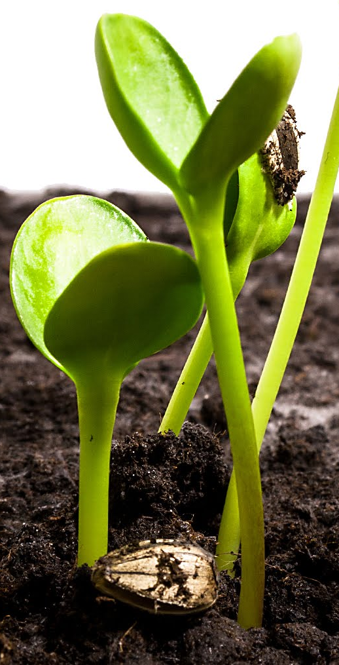
MODE OF ACTION
Agri-Biofungicide acts as biological control agent, the antagonistic properties of which are based on the activation of multiple mechanisms
It controls pathogens by creating competition for substrates and nutrients
It colonizes maximum space and absorbs maximum nutrients available at the target site and thereby controls the pathogens by making them starve for space and food
Agri-Biofungicide is a preventive biological fungicide that attacks disease-causing pathogen before they reach the root system
It grows fast and coils around the pathogen, penetrates through it and takes nutrients from the pathogen
The pathogen eventually dies and finally eliminated from the field

Slide 7
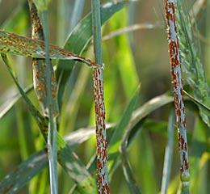
MODE OF ACTION
It offers a long-lasting control against the pathogen by secreting secondary metabolites which exhibit antibiotic effect on the pathogen
It also induces plant growth by secreting various acids that help in the solubilization of insoluble phosphorus and hence, to some extent, it makes phosphorus available to crops
It is both preventive and curative in nature
It also helps in improving plant defense mechanism against diseases

Slide 8
BENEFITS
It effectively controls many diseases in plants and suitable for all kinds of crops
It improves germination rates
Improves yield and income /ha
Increases crop production

Slide 9
DOSES AND APPLICATION
Agri-Biofungicide can be applied either alone or in combination with other chemical fertilizers if found convenient
It is also compatible with most of biopesticides/ bio-fertilizers
  Seed Treatment: 5-10 gm/Kg of Seeds
    Treated Seed must be sown the same day after drying
  Root Dipping: 10-15 gm/L of water
  Foliar Spray: 10-40 gm/15 L of water
  Soil Treatment: 2 kg per acre with 100 kg of FYM (Farm yard manure, completely matured) culture

Slide 10
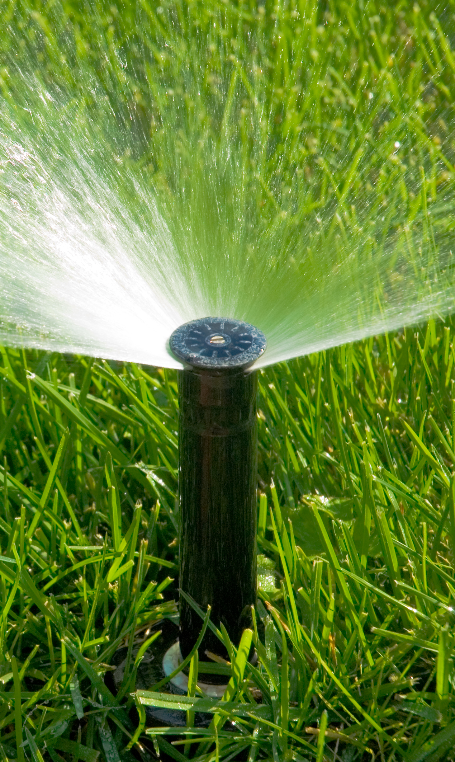
RECOMMENDATIONS
On vegetables: 15 gm to 20 gm / 15 L of water
On fruits crops: 10 gm to 15 gm / 15 L of water
On flowers: 10 gm to 15 gm /15 L of water
On other crops: 30 gm to 40 gm /15 L of water
PRECAUTIONS
Spray early morning or evening
After seed treatment, dried seeds should be sown on same day

Slide 11
AGRI MOSS

Slide 12
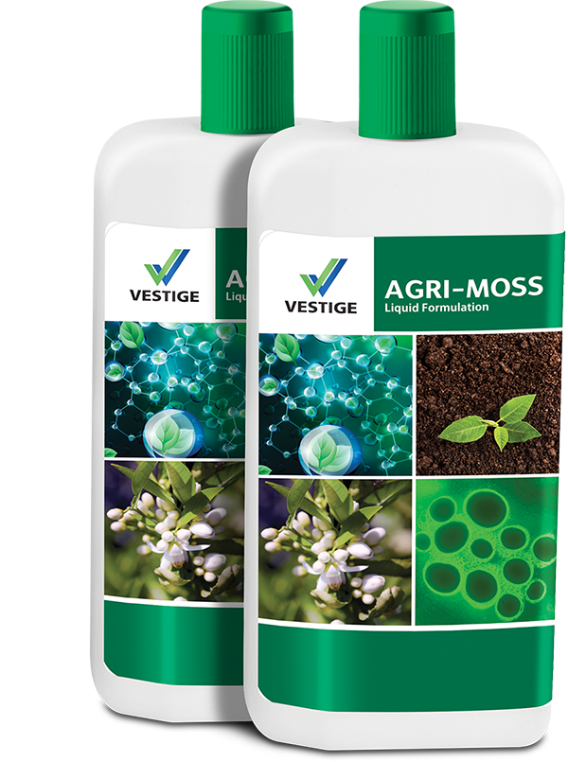
AGRI MOSS
AGRI-MOSS enhances crop performance growth, vigor, yield, quality
It is very useful in plant’s fertility and reproduction process
It improves anti-stress effect

Slide 13
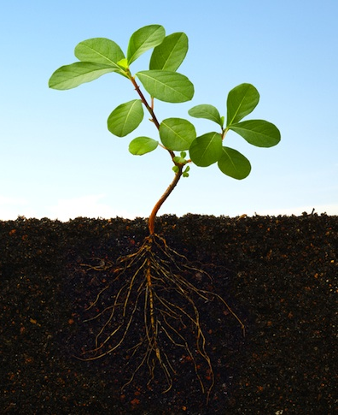
ADVANTAGES OF AGRI MOSS
Agri-moss is a product of natural origin for the balanced nutrition of plants, which can be used as foliar spray
Agri-moss is water soluble and non-toxic to plants, animals and human beings
It detoxifies certain toxic chemicals like pesticides/ herbicides and prevents from toxic residual effect

Slide 14
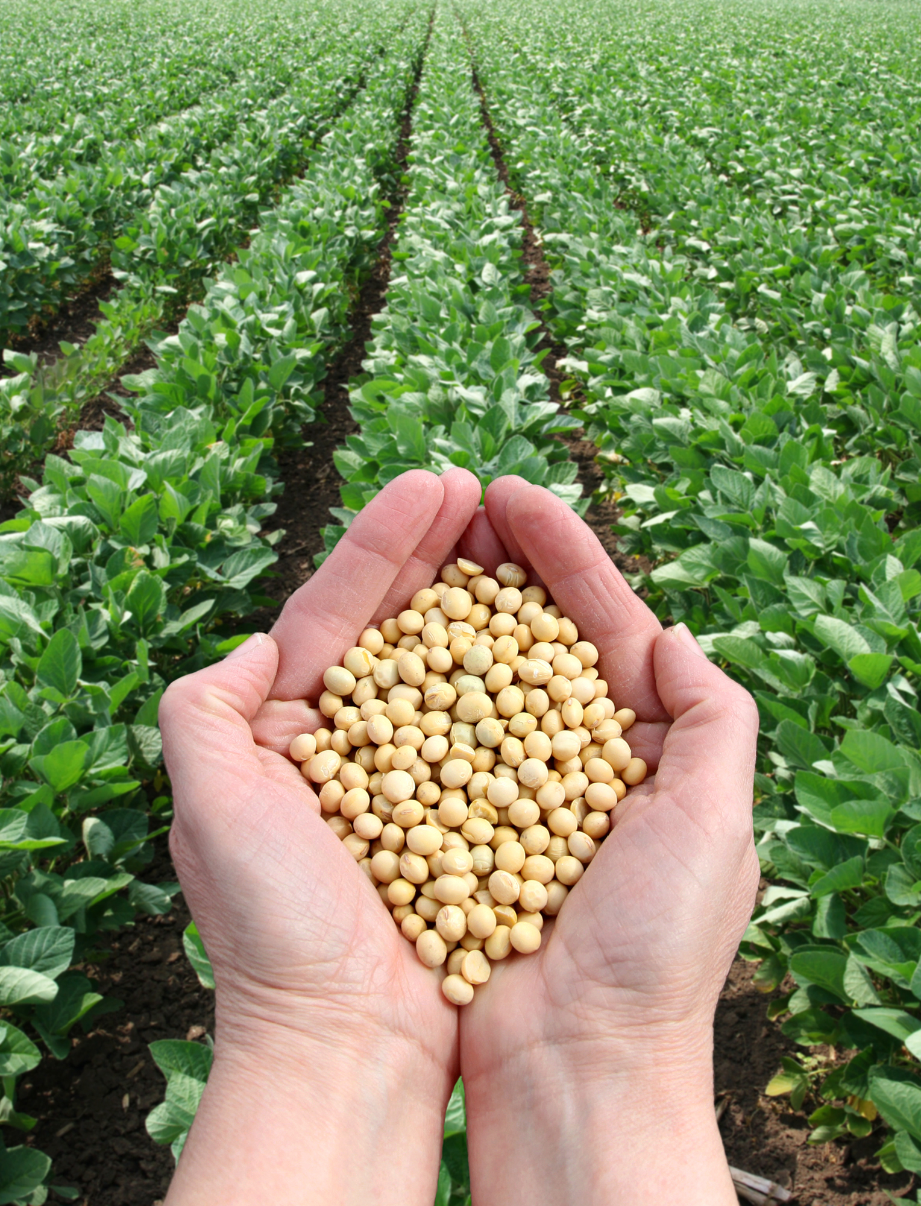
MODE OF ACTION
Agri moss enhances the metabolic activities of plant
It penetrates the plant body rapidly and promotes circulation of cytoplasm
It stimulates cell division
It improves transport of plant hormones and alters the response of plants to these hormones
It helps in vigorous development of buds, induces greater flowering, promotes pollination and setting of fruits
It improves the quantity and quality of the harvest

Slide 15
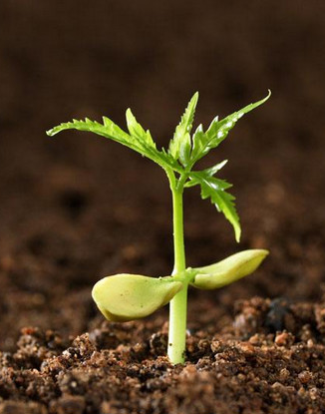
BENEFITS
Agri-Moss improves crop quality and increase yield significantly
It reduces dropping of flowers and fruits
It improves nutrient uptake and promoted uniform shape and color of the fruits
It helps in increasing root hair production, facilitating better absorption of nutrients
It increases lateral branching and give a better plant frame

Slide 16
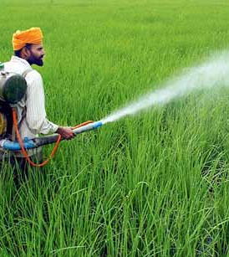
RECOMMENDATIONS
It can be used on various crops:
  On vegetables: 20ml /15 L of water
  On fruits crops: 20ml /15 L of water
  On flowers: 20ml /15 L of water
  On grains crops: 20ml /15 L of water
  Oil seed crops: 20ml /15 L of water
Note: Use Agri-Moss 15 to 20 days before flowering starts and after 20 days of flowering or at the time of fruit setting

Slide 17
AGRI NANOTEK

Slide 18
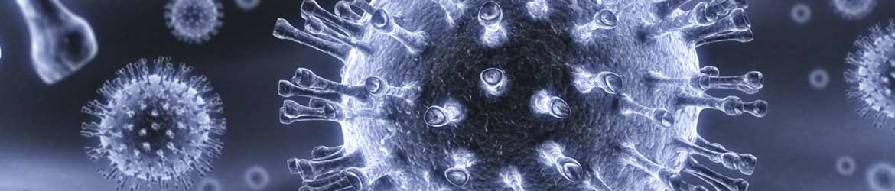
AGRI NANOTEK
Development of agriculture sector is only possible by increasing the resources and using them efficiently with minimum damage to agro ecology through effective use of modern technologies
Nanotechnology has the potential to revolutionize agricultural systems, biomedicine, environmental engineering, safety and security, water resources, energy conversion, and numerous other areas
Nanotechnology is working with the smallest possible particles which raise hopes for improving agricultural productivity through encountering problems unsolved conventionally
Agri-Nenotek is a unique product developed by using nanotechnology

Slide 19
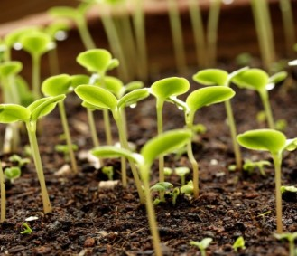
ADVANTAGES OF AGRI NANOTEK
Agri-Nanotek helps to improve soil fertility by releasing fixed nutrients
It enhances soli fertility, plant growth, and helps in photosynthesis process
It increases the nutrient usage efficiency of plant and provides stress tolerance ability

Slide 20
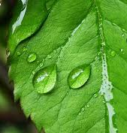
MODE OF ACTION
Agri-Nanotek is a chelated nano-fertilizer produced by nano-chelating technology
It has flexible structures, which are resistant and stable in both alkaline and acidic soils
It demonstrates its distinctive nano-scale traits on the crops, such as simulative effect on photosynthesis function and chlorophyll formation rate
It also helps in expansion of the leaf surface

Slide 21
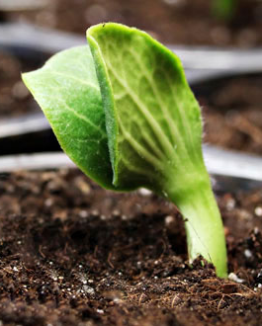
MODE OF ACTION
Agri-Nanotek when applied to plant surfaces or soil, colonizes the rhizosphere or the interior of the plant and promotes growth by increasing the supply or availability of primary nutrients to the host plant
It increases pollination process and flowering
It helps in release of inorganic nutrients in soil and their absorption through root to some extent
It helps to direct absorption of minerals from the soil over a large area and handing over the same to the root
This helps the plant absorbs 2-3 times more of nitrogen, phosphorus, potassium and calcium

Slide 22
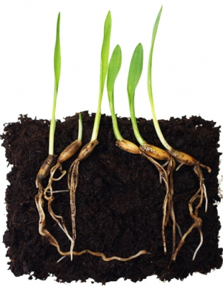
BENEFITS
Agri-Nanotek is pollution free
It improves physical properties of soil and soil health in general
It improves soil fertility and productivity
It increases the crop yield
It is effective even under semi-arid conditions
It produces vitamins and growth promoting hormones
It increase foliage of plants and increases flowers and fruits setting, resulting in increasing overall yield of the crop
It improves stress tolerance in plant and improves shelf life of produce

Slide 23
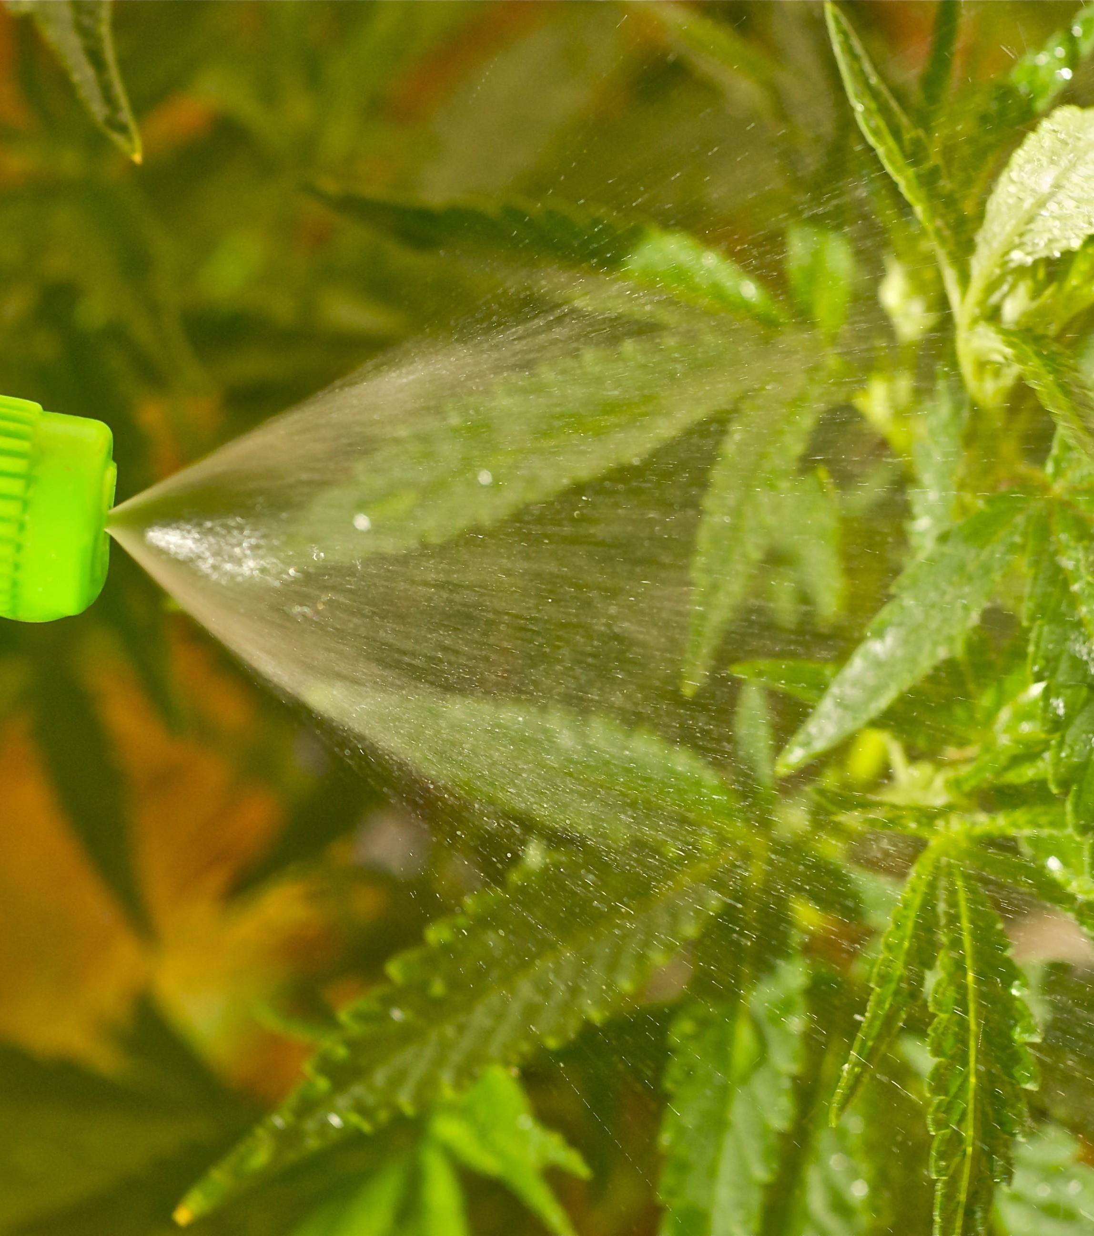
RECOMMENDATIONS
It can be used on various crops
  On vegetables: 15 to 20 gm /15 L of water
  On fruits crops: 10 to 15 gm/15 L of water
  On flowers: 10 to 15 gm/15 L of water
  On grains crops: 30 to 40 gm/15 L of water
Use as a soil application with FYM culture
  1-2 kg Agri-Nanotek by mixing with 100 kg FYM culture per acre
As foliar spray, use 20 days before flowering stage followed by 20 days after flowering (depend on standing crop morphology)

Slide 24
AGRI GOLD

Slide 25

AGRI GOLD
A plant growth regulator that can infiltrate to the body of plant rapidly and deliver magical results
It helps to promote the cytoplasm circulation inside the plant cell
It is a magical combination of bio-ingredients that help the crop to increase its metabolic activities, growth and secondary root formation
This enhances both quality and the quantity of crops
Agri gold directly and indirectly influences the composition and productivity of natural plant communities

Slide 26
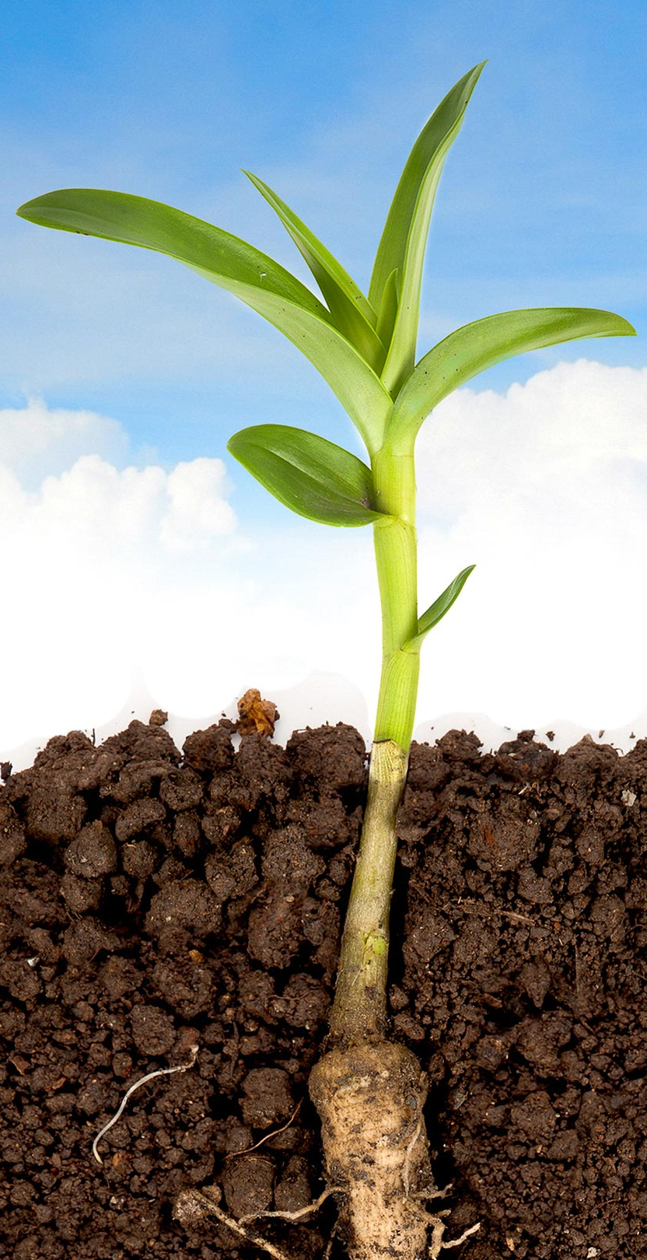
ADVANTAGES OF AGRI GOLD
Agri-gold dose not leave any toxic residue and there is no fear of environment pollution
It stimulates the closure of stomata which controls water loss during respiration process
It promotes root and shoot growth
It enhances the process of seed germination
It brakes the dormancy at various developmental stages of plant
It enhance the immunity of the crops and reduce the occurrences of plant diseases
It enhance the quality and quantity of crops
It enhances the survival rate of seedlings after transplantation
It inhibits dropping of flowers and enhances the rate of fruit setting
It enhances fruit class and commodity
It reduces damages on crops due to adverse climatic conditions
It promotes the quality of the crops to improve the yield, appearance
and the characteristics of the fruits

Slide 27
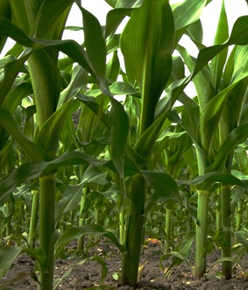
MODE OF ACTION
It regulates cellular process in targeted cells
It helps in determining formation of stems, leaves, and flowers
It also helps in determining development and ripening of fruits
It helps in controlling the rate of metabolic reaction
It also acts as catalyst which speedup reactions
It plays role in process of photosynthesis and respiration
AGRI GOLD acts by stimulating plant cell division, producing more chlorophyll and proteins which promote vigorous growth of auxiliary buds, formation and pollination of flower, thus increasing fruit weight

Slide 28
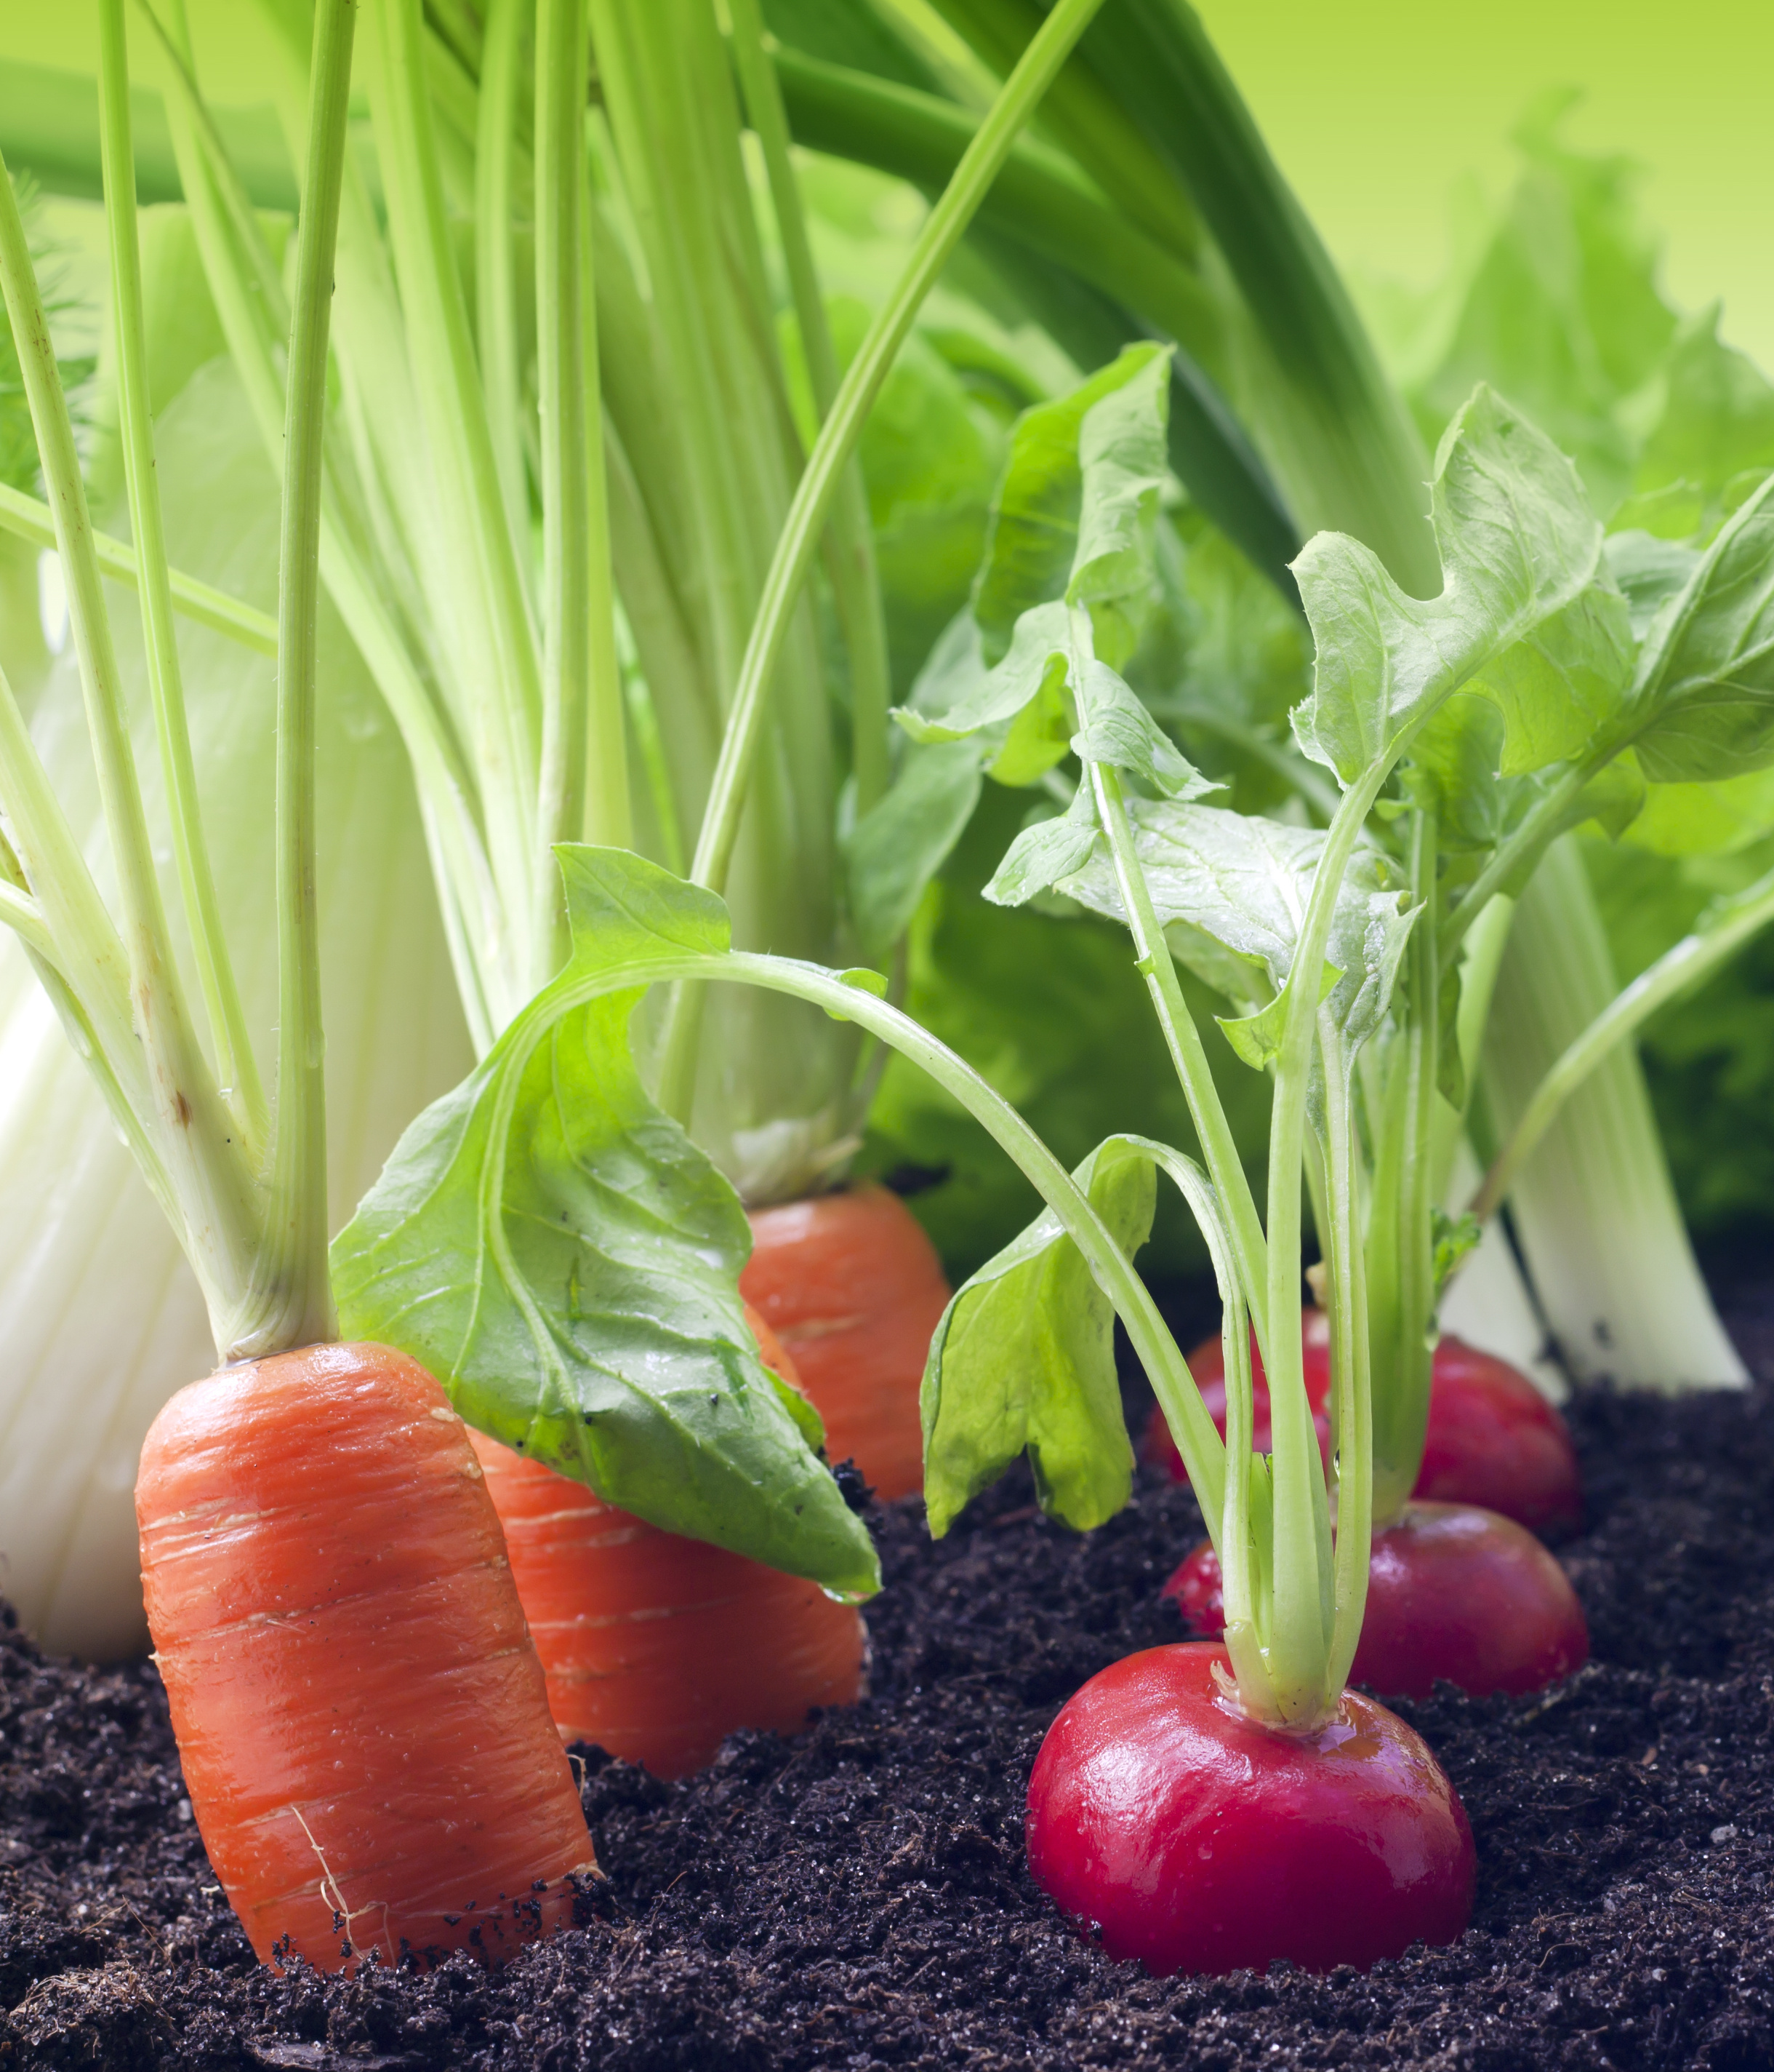
BENEFITS
It gives a healthy vegetative growth to the plant
It balances properly the vegetative phase and reproductive phase of plant
It improves the physical characteristic of produce
It is improves the nutrients uptake capacity of roots
If mixed with the insecticide, it can strengthen the capacity of the plant against the damages caused by the pests and reduce the sequels of the damages remarkably
AGRI-GOLD is different from other plant growth hormones as it can be applied to plant at any growth stage

Slide 29
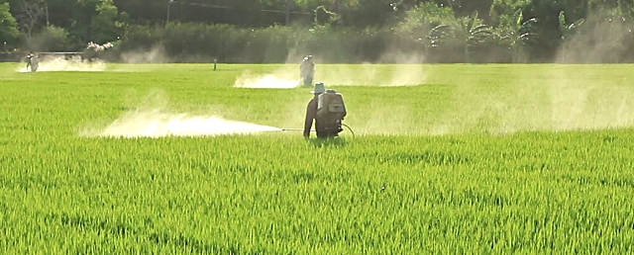
RECOMMENDATIONS
For Foliar spray: 1-2gm per L of water
For use in drip irrigation: 100-200 gm per Acre

Slide 30
SUMMARY

Slide 31
VESTIGE AGRI PRODUCTS
AGRI 82
AGRI Humic
AGRI Moss
Nonionic spray
A plant bio-stimulant containing humic substance
Combination of organic compounds for crops
Spreader, activator and wetter
It reduces the spray droplet tendency to bounce off from the leaf
allows rapid coverage and penetration of the spray droplets
Contents: Non-Ionic surfactants
Derived from the decomposed organic matter
Enhance plant nutrition, health, growth and productivity
Contents: Concentrated Liquid with Humic Substances (Humic acid, fulvic acid and humin)
Enhances reproductive growth of the crop
Improves cell division and flowering
Contents: Organic fraction from amino acids, peptide mixture , Inorganic fraction
Improves flowering and conversion of flower to fruits

Slide 32
VESTIGE AGRI PRODUCTS
AGRI 82
AGRI Humic
AGRI Moss
Can be used with all sprays – inorganic and organic
Makes the spray in the mist form that makes any product available to the plant more efficiently
Seed treatment, can be used with Agri-Biofungicide
20 days before flowering
Soil treatment can be done
Foliar spray can be done.
Can be used in combination with other products also
It is a versatile and multidimensional product
Increases the efficacy of the product used upto 80%
Soil Treatment can be done, that will improve the water holding capacity of the soil
20 days after flowering or at the time of fruit setting

Slide 33
VESTIGE AGRI PRODUCTS
AGRI Nanotek
AGRI Gold
Agri Biofungicide
Nanotechnology based chelated fertilizer with Multi-micronutrients
It is a growth regulator
Systemic and contact fungicide
Enhance the rate of photosynthesis and chlorophyll formation
Helps to deliver the microelements to desired tissues
Increases flowering and thereby increases yield
Contents: Ca, Si, Mg, Fe, Zn, Cu, Mo and Co
Works against the causal organism and spreads very fast to destroy the disease causing organism
Harmless to the crop
Contents: Microbial Consortia (spores, mycelia and vegetative cells) with Organic mineral powder
Preventive and curative
It enhances vegetative growth, fruiting, maturity, root development and quality of produce
It is a magical combination of bio-ingredients that help the crop to increase its metabolic activities, Contents: Microbial consortia (nanotech based) Plant extracts, enzymes and hormones , Natural vitamins and amino acids

Slide 34
VESTIGE AGRI PRODUCTS
AGRI Nanotek
AGRI Gold
Agri Biofungicide
Soil treatment with Agri-Biofungicide
2-3 sprays in the entire life of the plant can give maximum benefit
1st spray on 1 month old crops with Agri Gold
2nd Spray – 20 days before flowering (can be used with Agri-Moss)
1st Spray spray 20 days before flowering
Sprays must at different stage of the crop
Frist spray – 10-20 days of plant life (3-4 leaf stage), can be used with Agri-Biofungicide
3rd spray – 15-20 days after flowering (optional )
2nd Spray – 20 days before flowering
2nd spray – 20 days after flowering
Can be used at the root zone at 35 days of plant’s life
One spray can be done before maturity also
One optional spray 10-15 before fruit maturity
Soil and Seed treatment
For Diseased conditions 2-3 sprays must be done in 15 days interval

Slide 35

VESTIGE AGRI PRODUCTS
500 ml
500 g
500 g
100 g
MRP: Rs. 2100
DP Rs. 1800
BV 1080
MRP: Rs. 1750
DP Rs. 1500
BV 900
MRP: Rs. 1750
DP Rs. 1510
BV 906
MRP: Rs. 650
DP Rs. 550
BV 330

